Slide 1
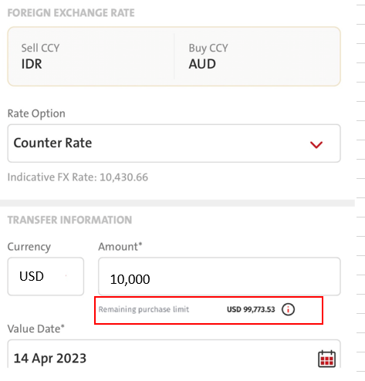
QC1357 – Accumulation Limit Information for Purchase of FCY against IDR
Applicable only for Purchase of FCY transaction against IDR. (example: IDR to USD, IDR to SGD, IDR to AUD, etc)
Please refer to Slide #2 for entries and scenarios for display [Remaining Purchase Limit];
FE needs to display Remaining Purchase Limit when
Sell CCY = IDR
Buy CCY = Foreign currency.
COPYWRITING
Please position Remaining Purchase Limit below Amount field will automatically display information:
  ENG: Remaining Purchase Limit USD XX,XXX.XX
  IND: Sisa Limit Pembelian USD XX,XXX.XX

Slide 2
A. Own Fund Transfer / Internal Transfer
1. [ Transaction – Fund Transfer – OCBC NISP Fund Transfer – Own Fund Transfer / Internal Transfer – Select Source = IDR – Select Saved Destination = Any currency other than IDR ]
Before comes to the screen, FE will RetrieveIndividualExchangeRate Request
BE calls fxrate/inquiry request
FE gets RetrieveIndividualExchangeRate Response
FE will continue to call WS – Pending BE Spec 10.33
1.1 [ Transaction – Fund Transfer – OCBC NISP Fund Transfer – Internal Transfer – Select Source = IDR – Create New Destination = Any currency other than IDR ] –– this is only applicable to Internal transfer
FE gets RetrieveIndividualExchangeRate Response
FE will continue to call WS – Pending BE Spec 10.33
2. [ Transaction – Fund Transfer – Manage Saved beneficiary – Select OCBC NISP Fund Transfer - Select Destination = Any currency other than IDR – click FUND TRANSFER button – Select Source = IDR ]
FE gets RetrieveIndividualExchangeRate Response
FE will continue to call WS – Pending BE Spec 10.33
3. Administration – Beneficiary Management – Select OCBC NISP Fund Transfer – Select Saved Destination = Any currency other than IDR click FUND TRANSFER button - Select Source = IDR ]
FE gets RetrieveIndividualExchangeRate Response
FE will continue to call WS – Pending BE Spec 10.33
4. Dashboard – tap on favorite acct – Select Fund Transfer – OCBC NISP Fund Transfer - Continue with point #1, #1.1
B. Telegraphic Transfer
1. [Transaction – Fund Transfer – Telegraphic Transfer – Select Source = IDR – Select Saved Destination = Any currency other than IDR - On Destination Screen ]
FE gets RetrieveIndividualExchangeRate Response
FE will continue to call WS – Pending BE Spec 10.33
2. [Transaction – Fund Transfer – Telegraphic Transfer – select source IDR – create new – select Any Currency other than IDR – Destination Screen ]
FE gets RetrieveIndividualExchangeRate Response
FE will continue to call WS – Pending BE Spec 10.33
3. [ Transaction – Fund Transfer – Manage Saved beneficiary – Select Telegraphic Transfer - Select Saved Destination = Any currency other than IDR – click FUND TRANSFER button – Select Source = IDR ]
FE gets RetrieveIndividualExchangeRate Response
FE will continue to call WS – Pending BE Spec 10.33
3. Administration – Beneficiary Management – Select Telegraphic Transfer – Select Saved Destination = Any currency other than IDR click FUND TRANSFER button - Select Source = IDR ]
FE gets RetrieveIndividualExchangeRate Response
FE will continue to call WS – Pending BE Spec 10.33
4. Dashboard – tap on favorite acct – Fund Transfer – Telegraphic Transfer – Applicable to continue with point #1, #2

Slide 3
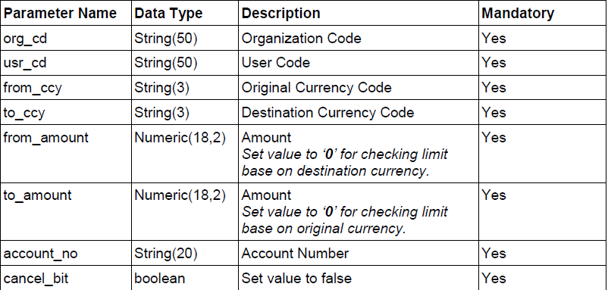
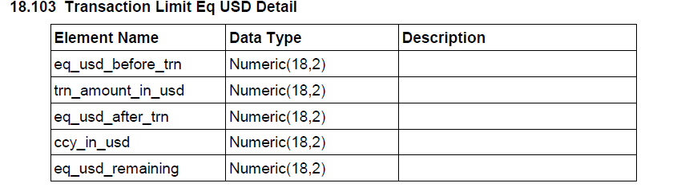
QC1357 – Accumulation Limit Information for Purchase of FCY against IDR
FE will continue to call WS – Pending BE Spec 10.33
BE - 10.33 Transaction Limit Equal USD – New WS
FE – Account Currency from transactionSourceofFund Response
FE – Account Currency from TransactionBeneficiaries Response
FE passes – empty value – BE send “0”
FE passes – empty value - BE send “0”
FE passes SOURCE account number from tranactionSourceofFund
FE passes empty – BE send False
FE map with eq_usd_remaining
With the icon on the right side and can be clicked to display Pop Up Dialog Info:
ENG
REMAINING PURCHASE LIMIT
The remaining limit of foreign currency purchase against IDR is based on the accumulation in 1 (one) month from all transaction channels at the Bank.
IND:
SISA LIMIT PEMBELIAN
Sisa limit pembelian valuta asing terhadap Rupiah adalah berdasarkan akumulasi dalam 1 (satu) bulan dari seluruh media transaksi di Bank.
BE – 1 day
iOS – 4
Android -

