Slide 1
TRANSFER OWN
Figures show logs of Mobile BE catch multiple requests from a single Transfer within BIBD (Transfer Own) transaction, the first request is approved, and the second request will be rejected and throw ‘Service Unavailable’ error.

Slide 2
TRANSFER 3RD PARTY
Figures show logs of Mobile BE catch multiple requests from a single Transfer within BIBD (3rd Party), the first request is approved, and the second request will be rejected and throw ‘Service Unavailable’ error.

Slide 3
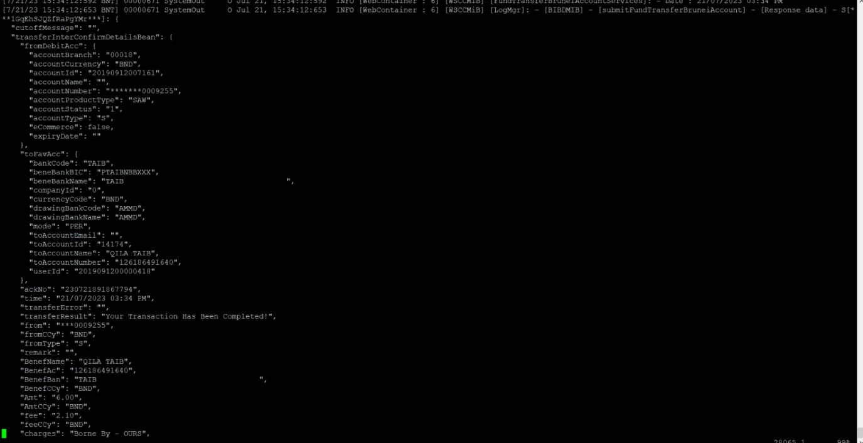
TRANSFER TO BANKS IN BRUNEI
Figures show logs of Mobile BE catch multiple requests from a single Transfer within BIBD (Transfer Own) transaction, the first request is approved, and the second request will be rejected and throw ‘Service Unavailable’ error.

Slide 4
TRANSFER OUTSIDE BRUNEI (T/T)
Figures show logs of Mobile BE catch multiple requests from a single Transfer within BIBD (3rd Party), the first request is approved, and the second request will be rejected and throw ‘Service Unavailable’ error.

