Slide 1
Credit Card New/ Activate Credit Card

Slide 2
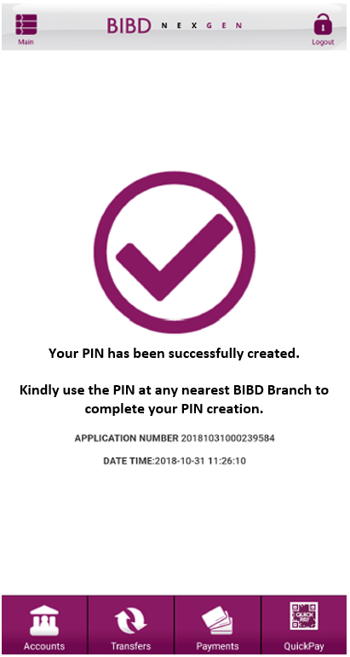
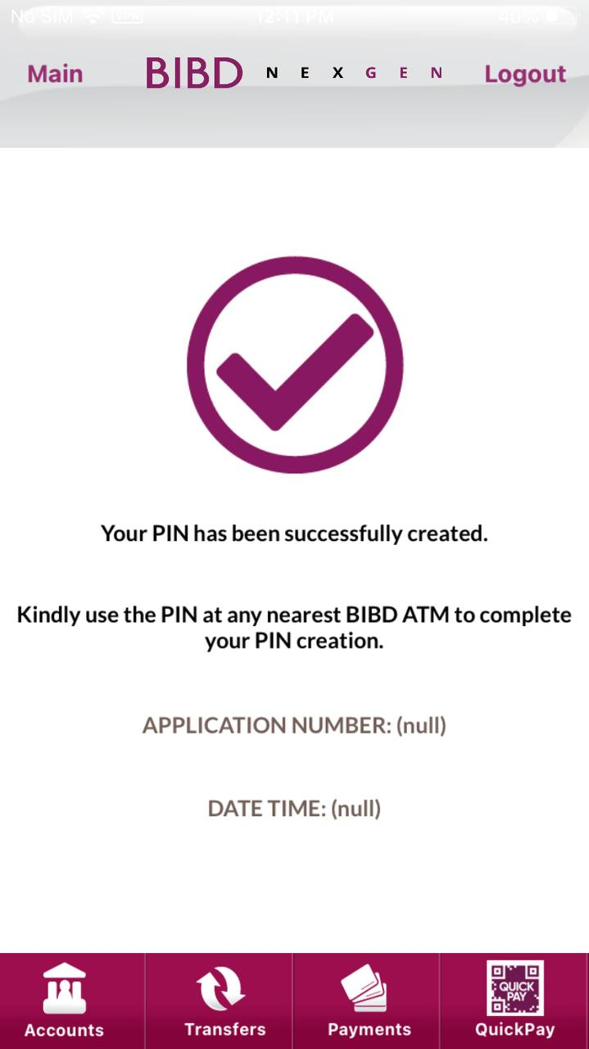
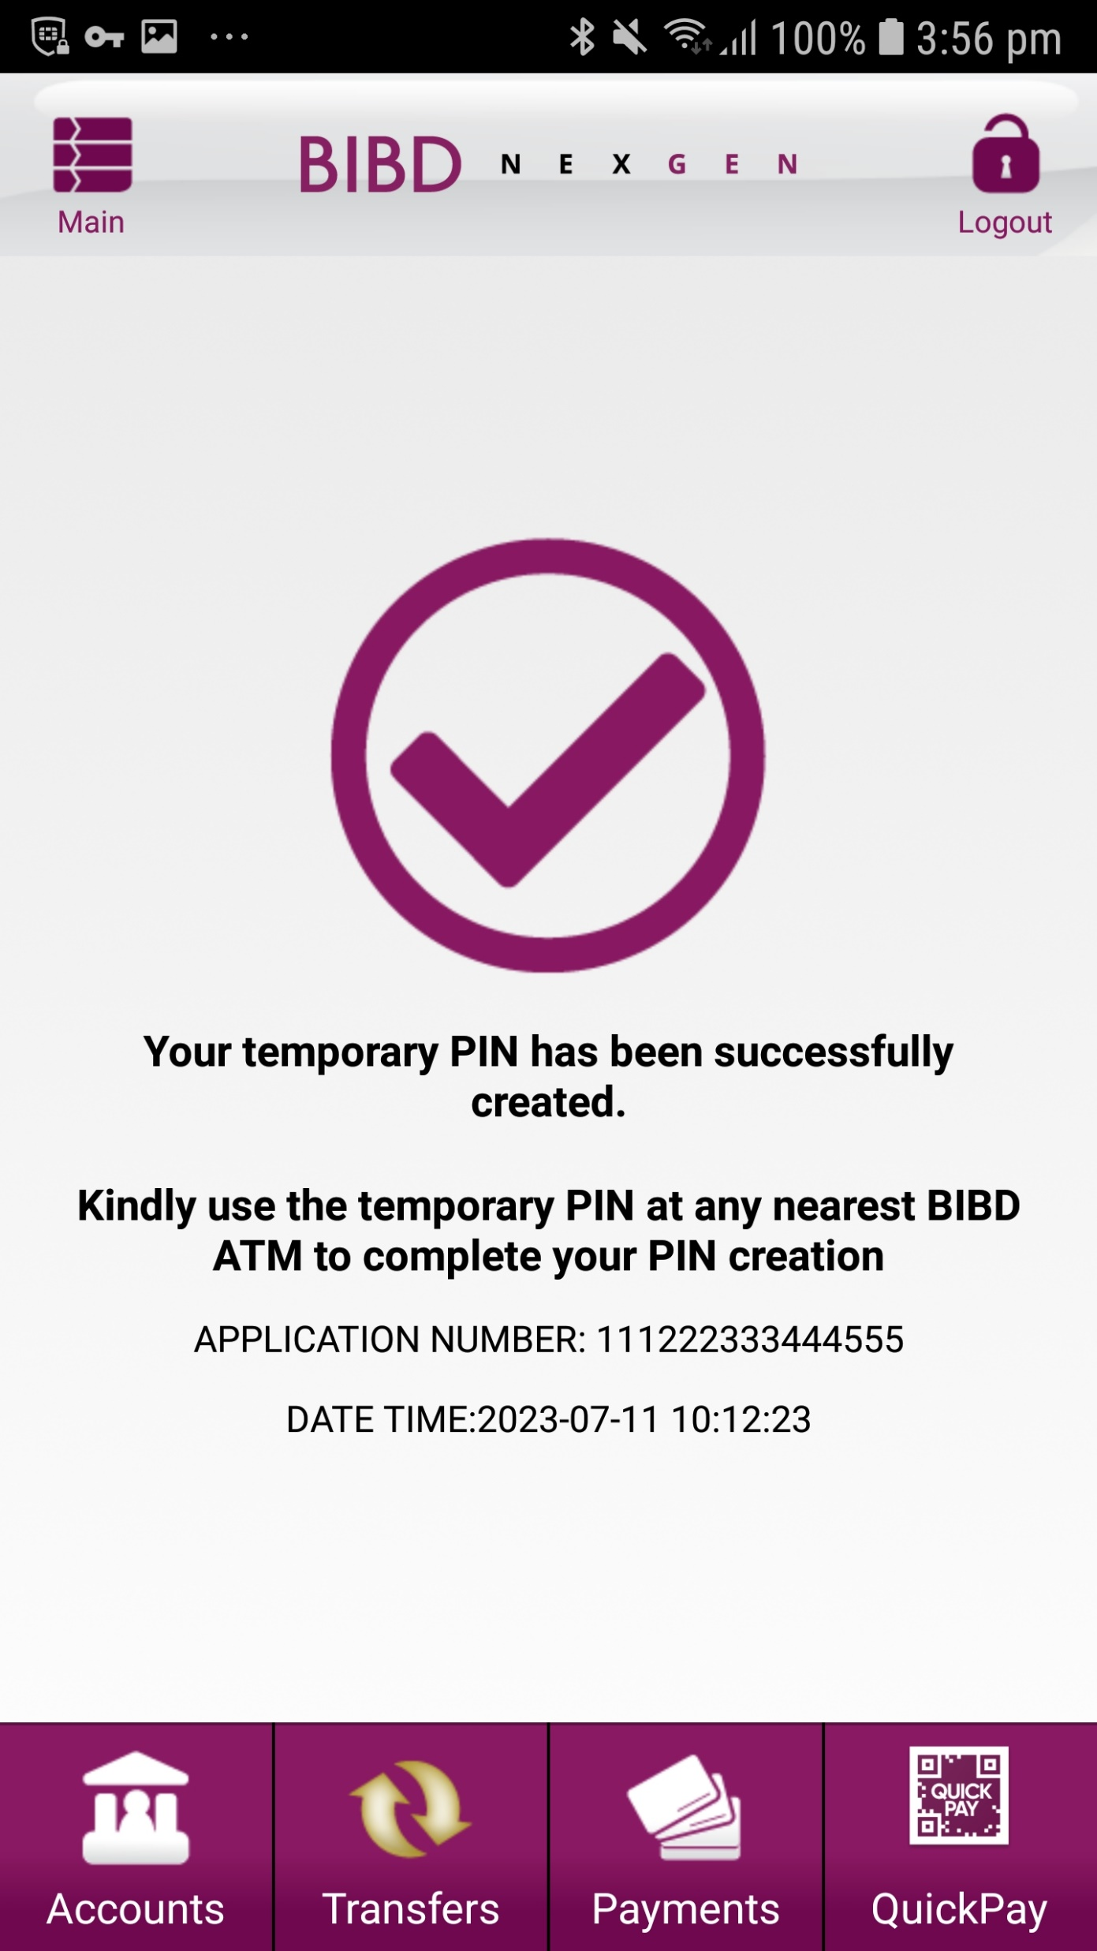
EXPECTED
IOS
ANDROID

Slide 3
Credit Card Change Pin

Slide 4
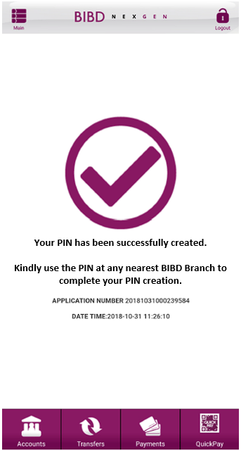
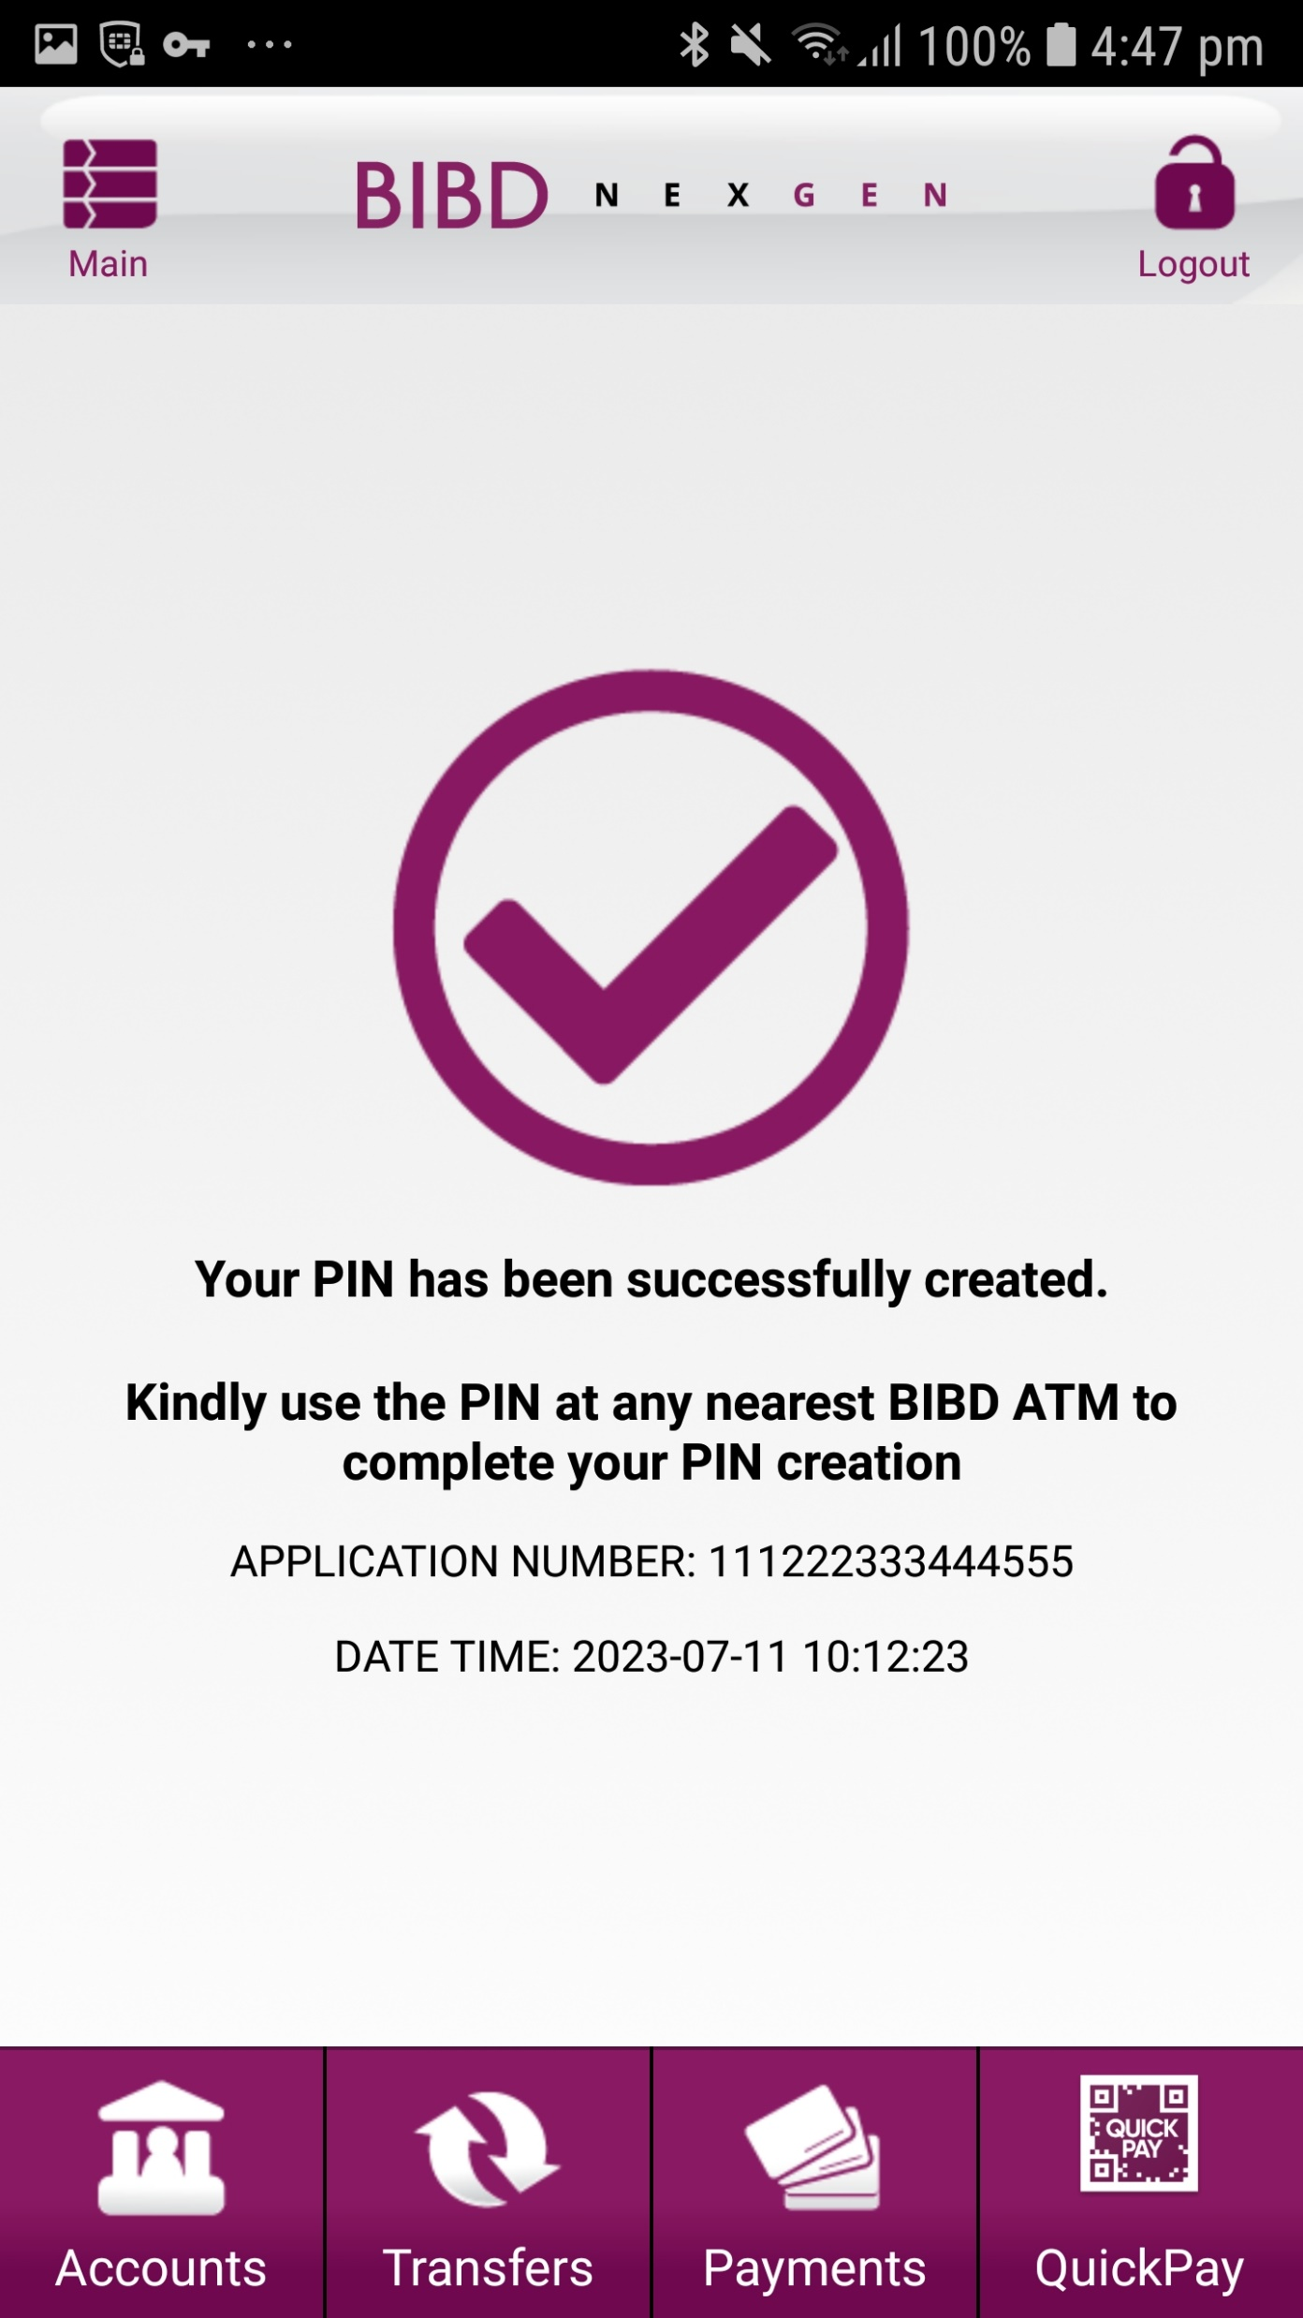
EXPECTED
IOS
ANDROID

