Slide 1
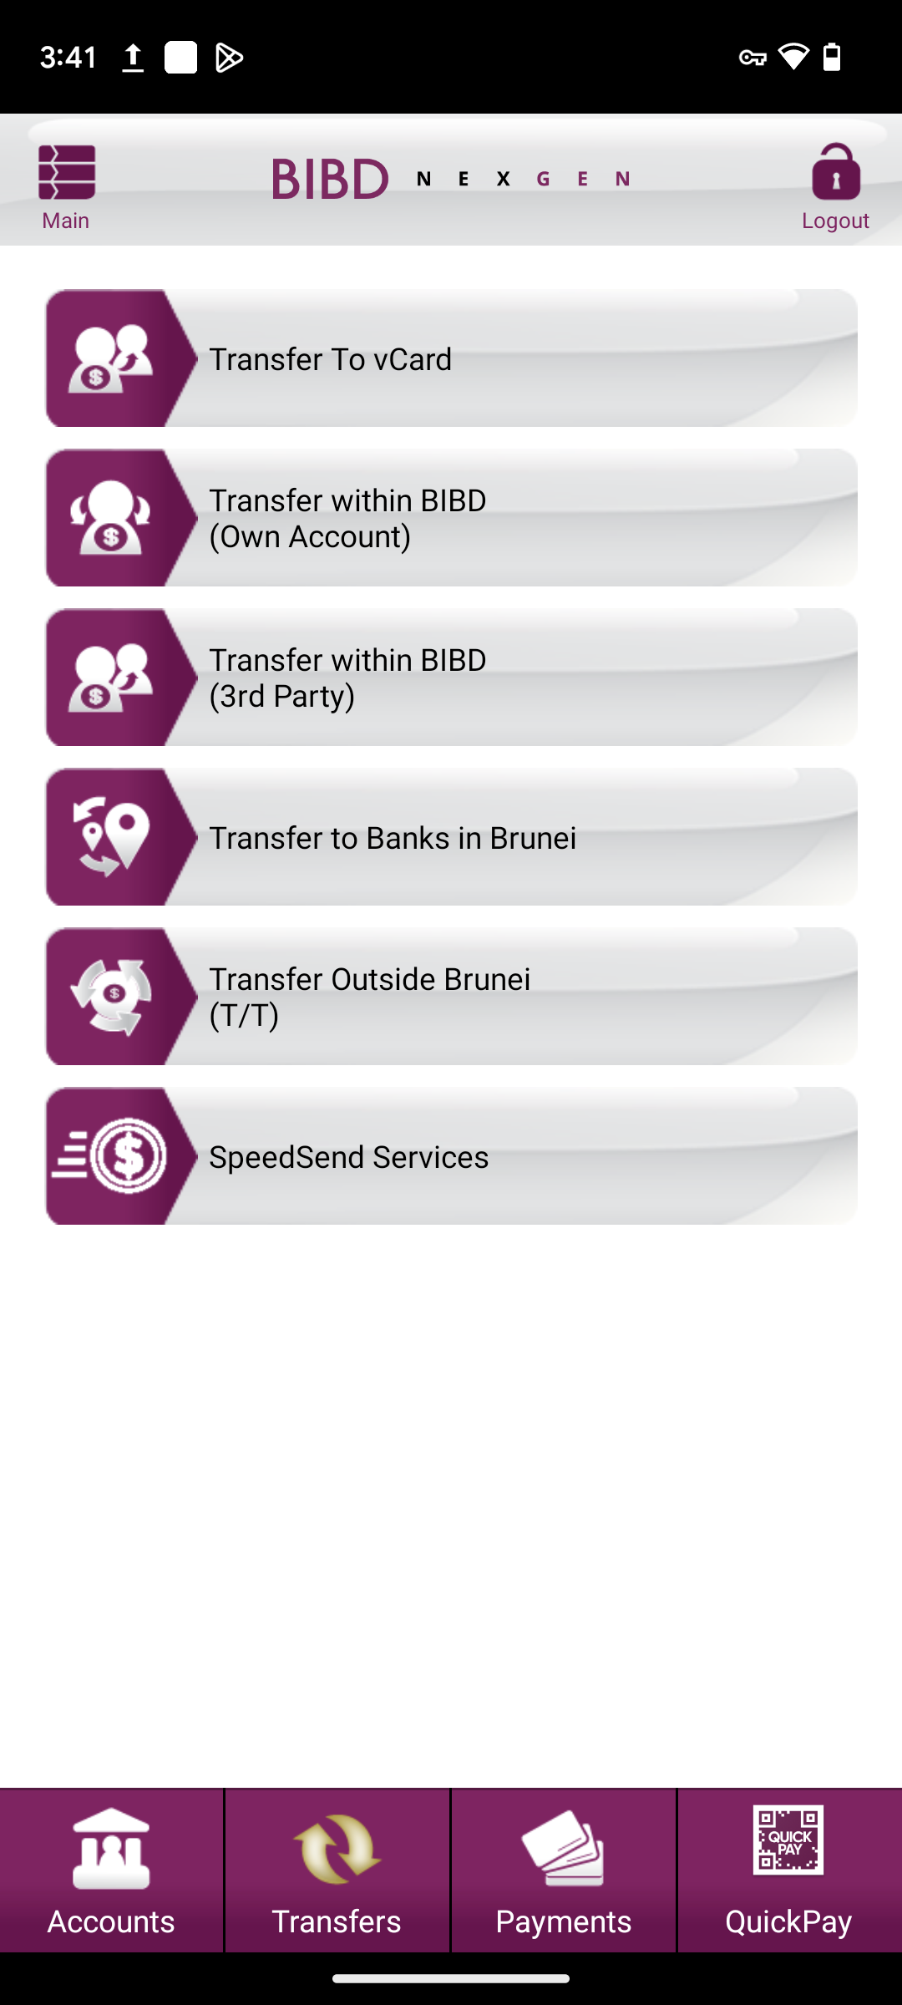
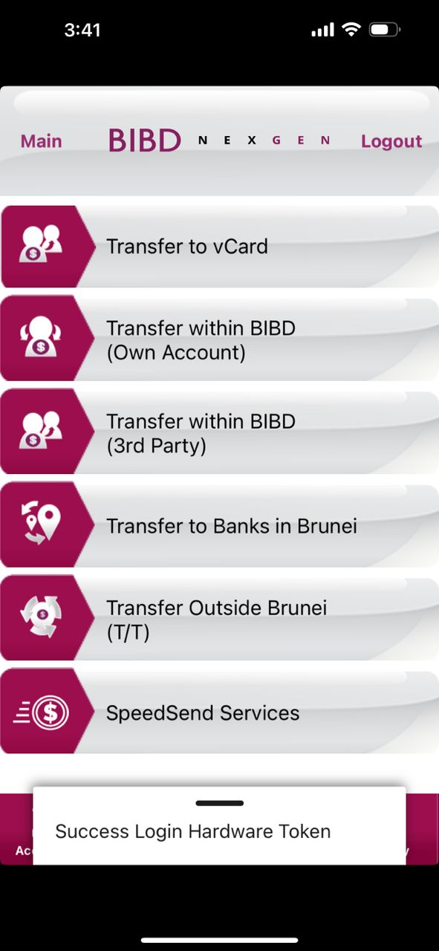
Android
MENU TRANSFER
(BAU)
iOS

Slide 2
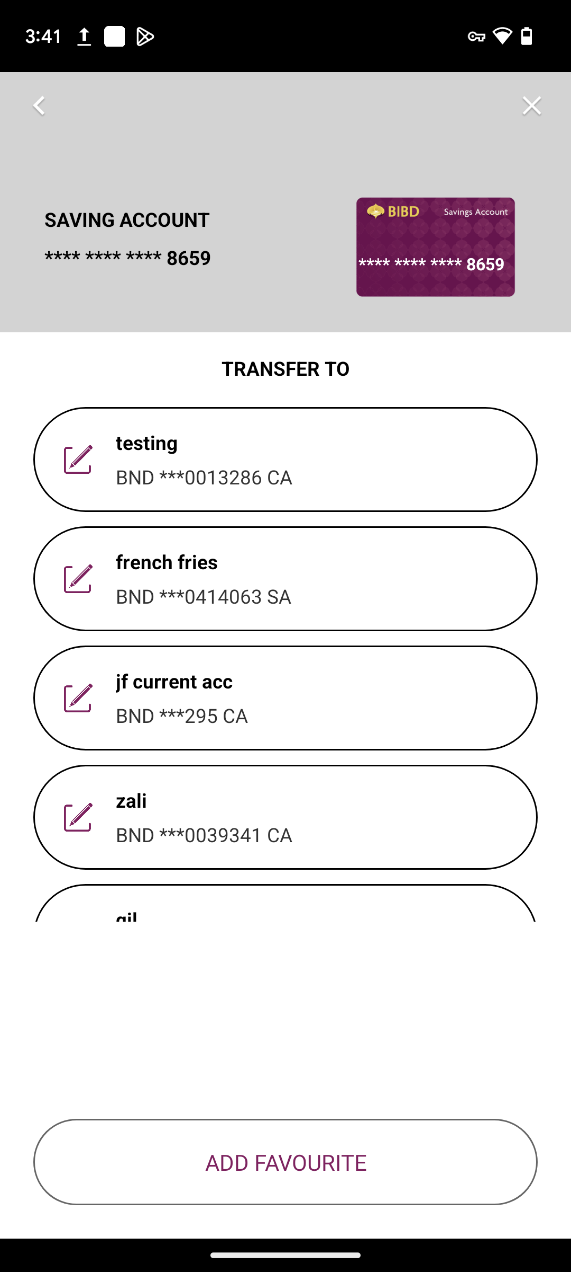
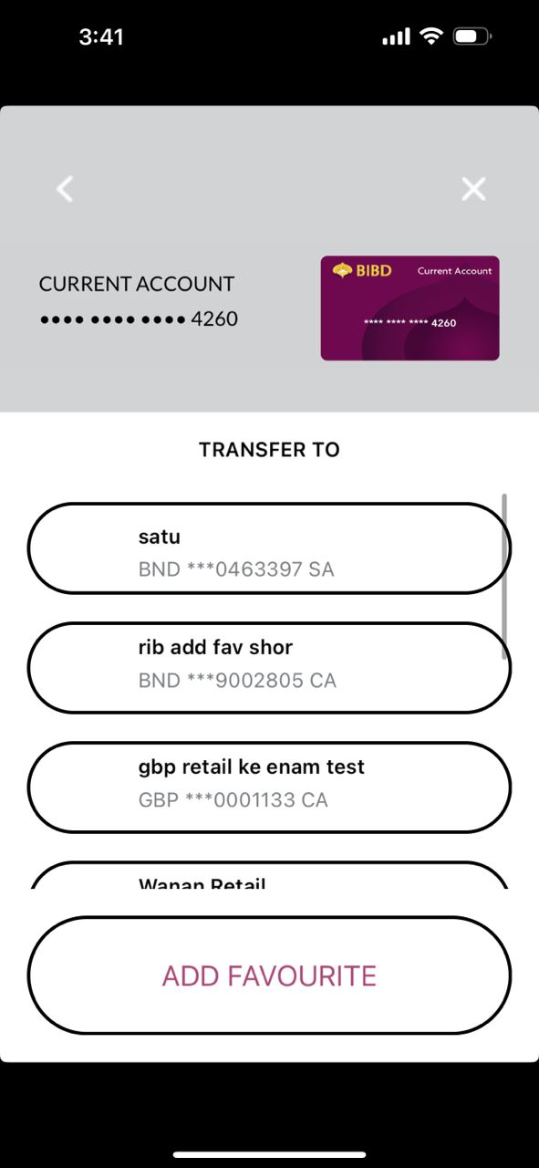
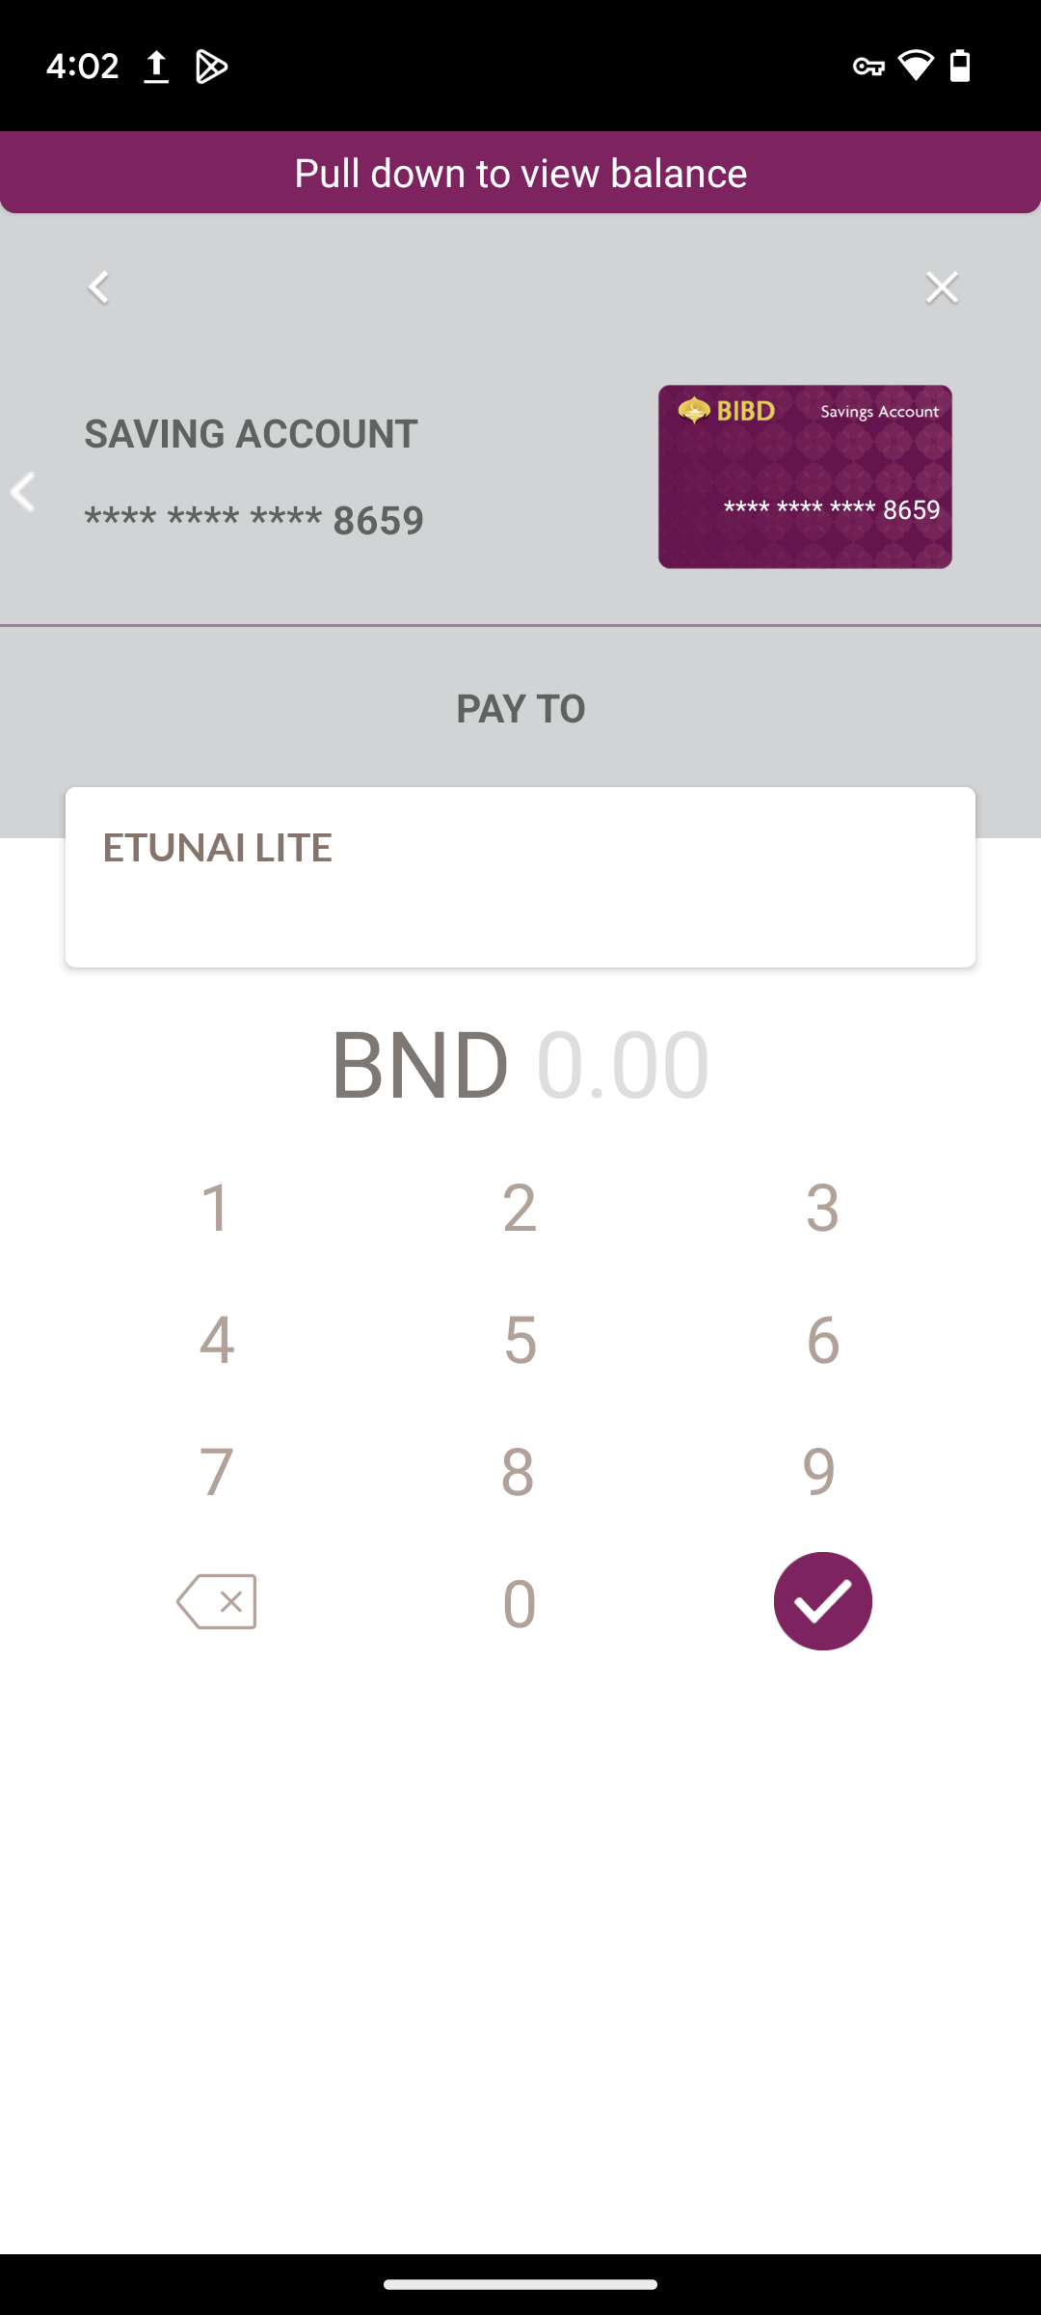
Android
FAV LIST TRANSFER
iOS
Card art small and not center between SAVING ACCOUNT word and card number (refer quickpay module sample)
Text bold?
Expected: unbold
Expected: No Edit icon if from Transfer menu
The button size too big. Make same size as the favourite button
Expected: No big space leave between fav list and button ADD FAVOURITE

Slide 3
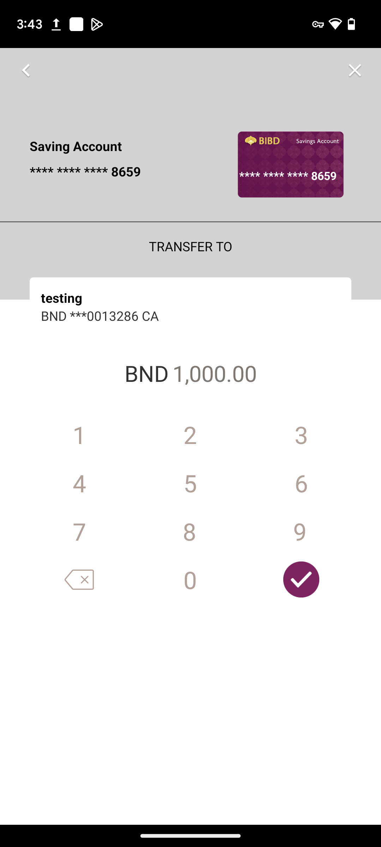
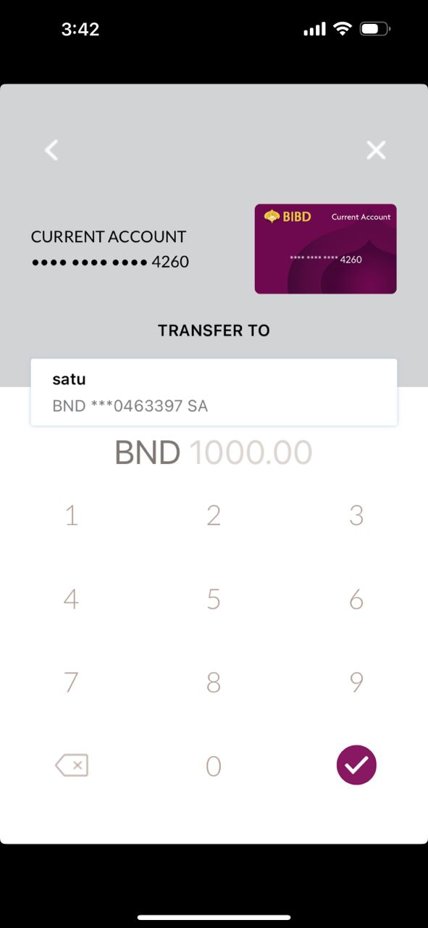
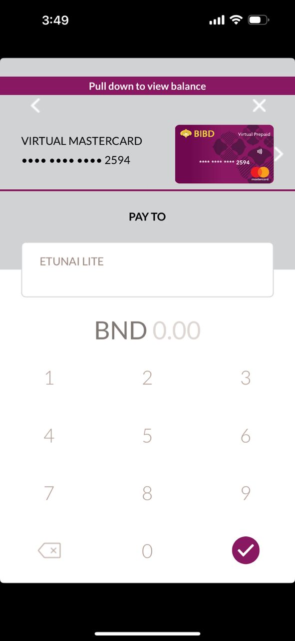
Android
INPUT AMOUNT TRANSFER
iOS
Text bold?
Expected: unbold
Saving Account
Expected: SAVING ACCOUNT
Same comment as slide 2
Line should be purple color
Expected: Black and bold
Missing purple line
(refer quickpay module sample)
Limit input up to 5 digit amount (example 10000.00)
BIBD to decide limit
Box size, box border, font size follow as per quickpay module
Limit input up to 5 digit amount (example 10000.00)
BIBD to decide limit
Font size, font color, font position follow as per quickpay module

Slide 4
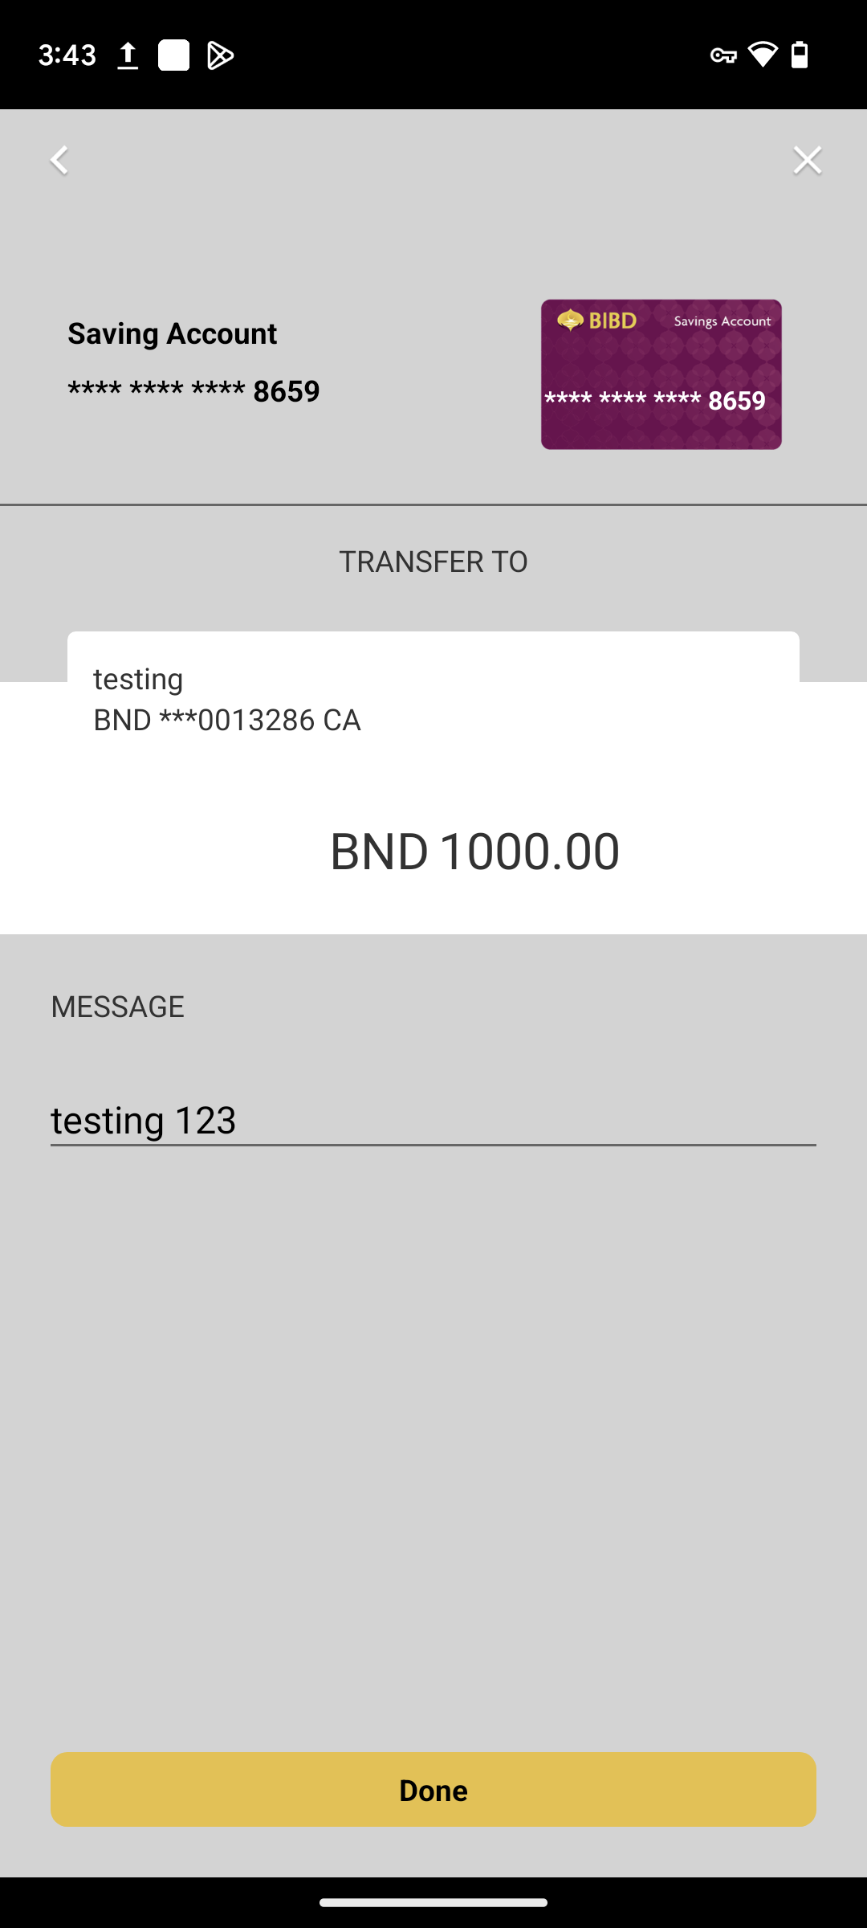
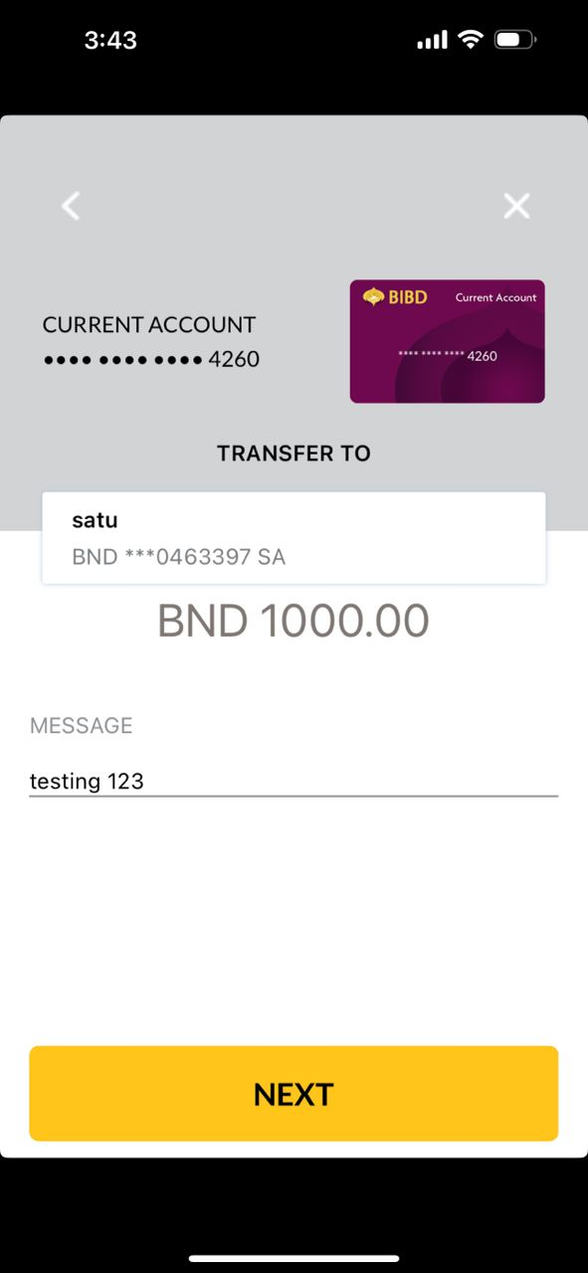
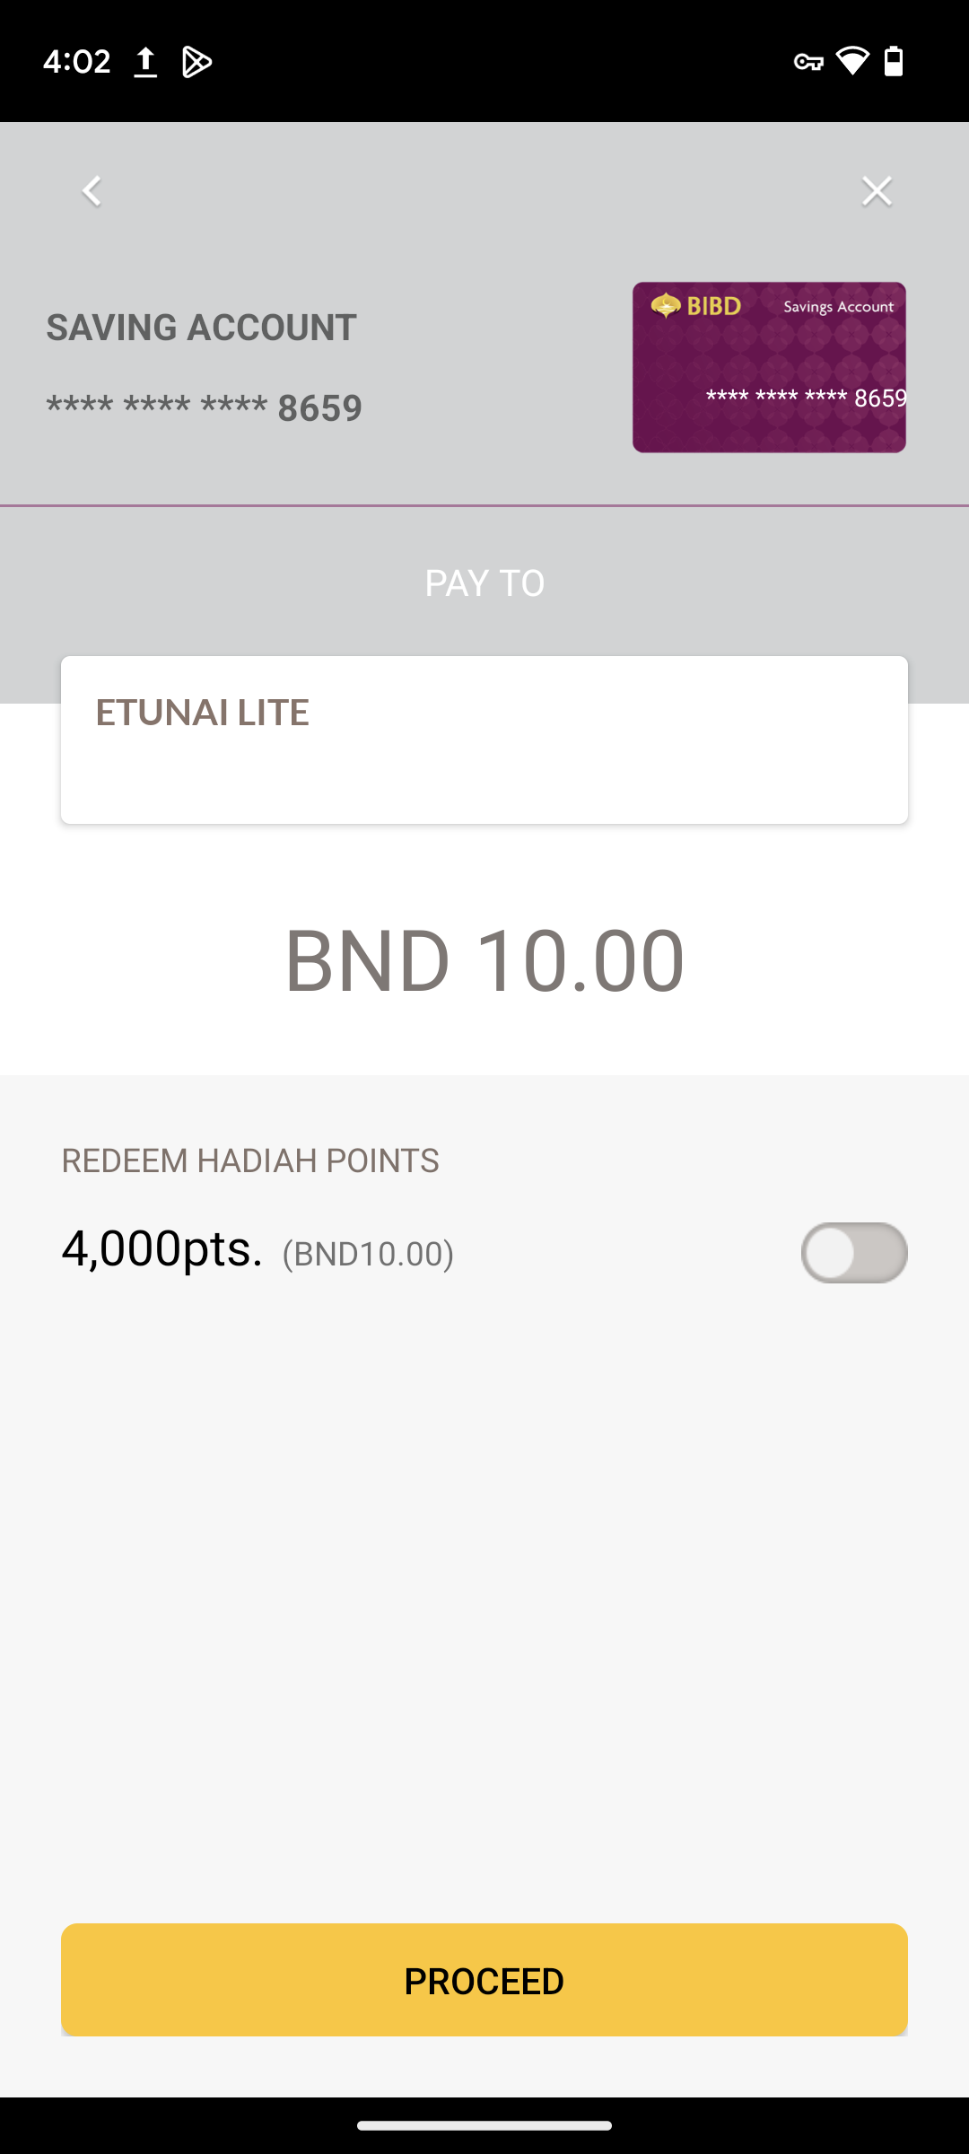
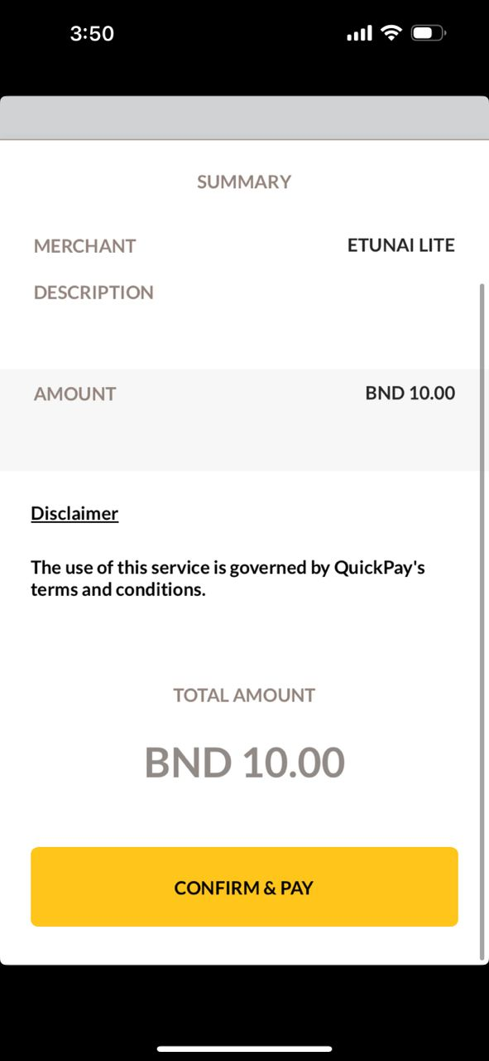
Android
INPUT MESSAGE TRANSFER
iOS
Missing purple line
(refer quickpay module sample)
Same comment as slide 3
Font size, font color and font position follow as per quickpay module
Grey color follow as per quickpay module
Box size, font size, box color follow as per quickpay module and word should be ‘Next’

Slide 5
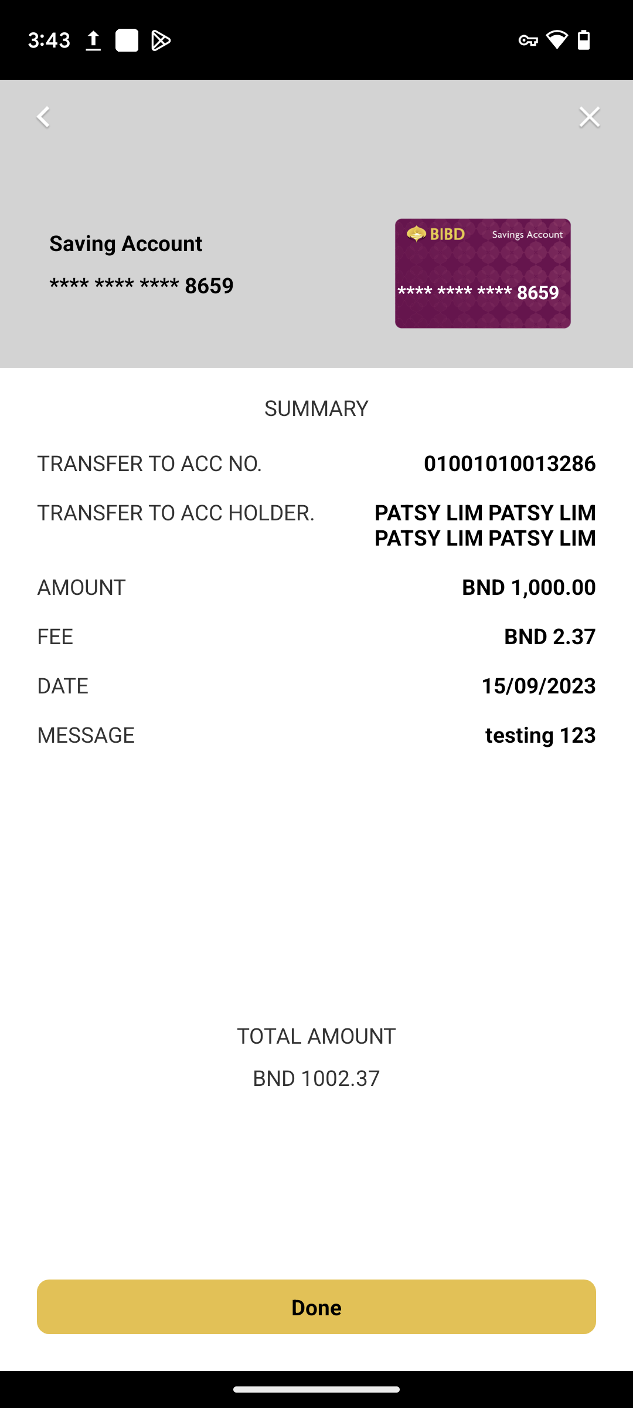
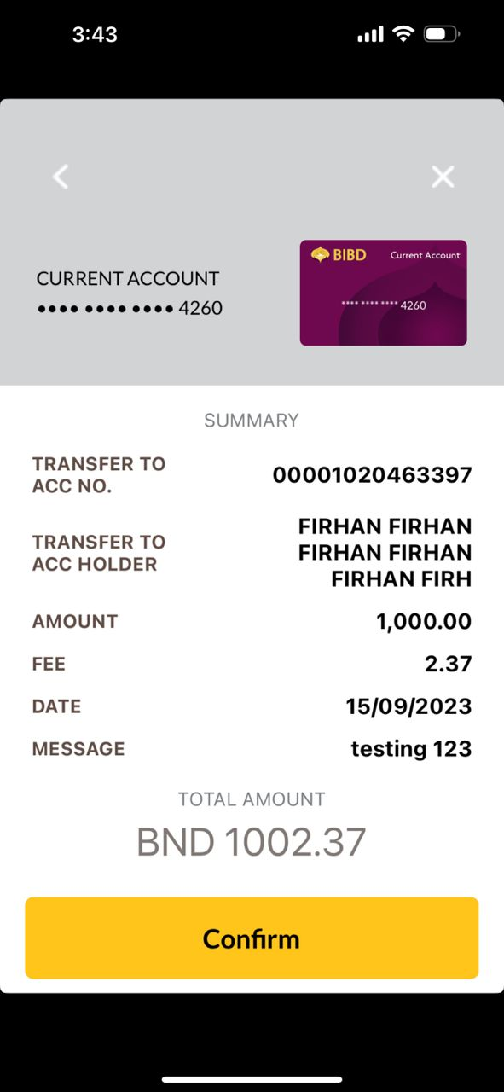
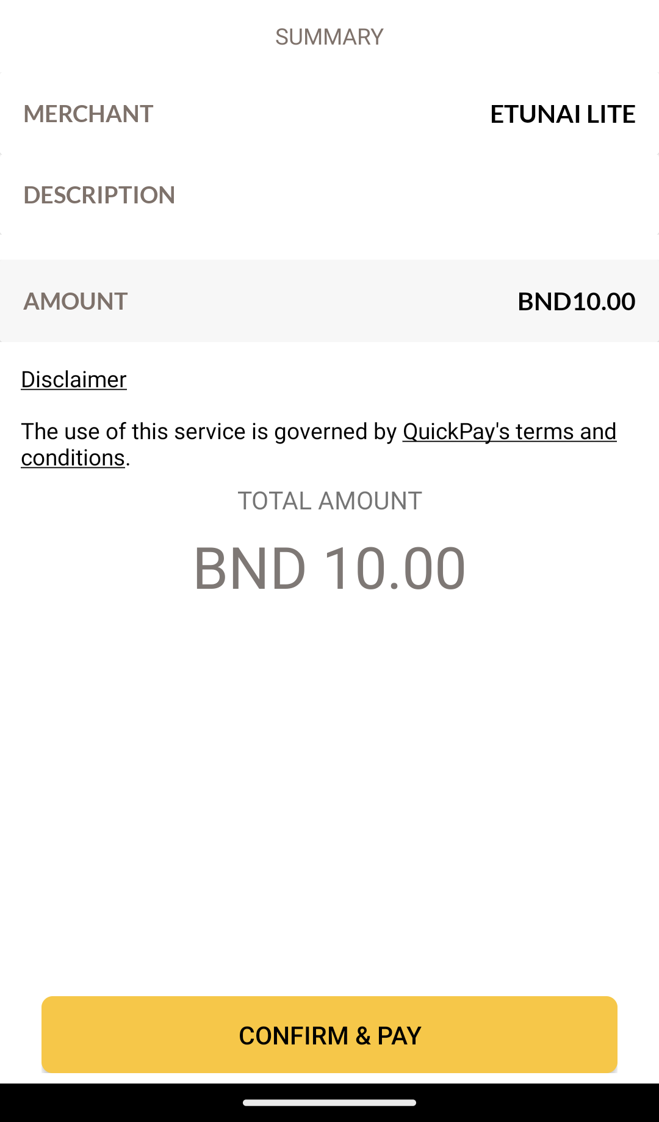
Android
CONFIRM TRANSFER
iOS
Same comment as slide 3
Font size, font color, font position, button color, button size, fee and amount have grey color background follow as per quickpay module
And button text expected – ‘Confirm’

Slide 6
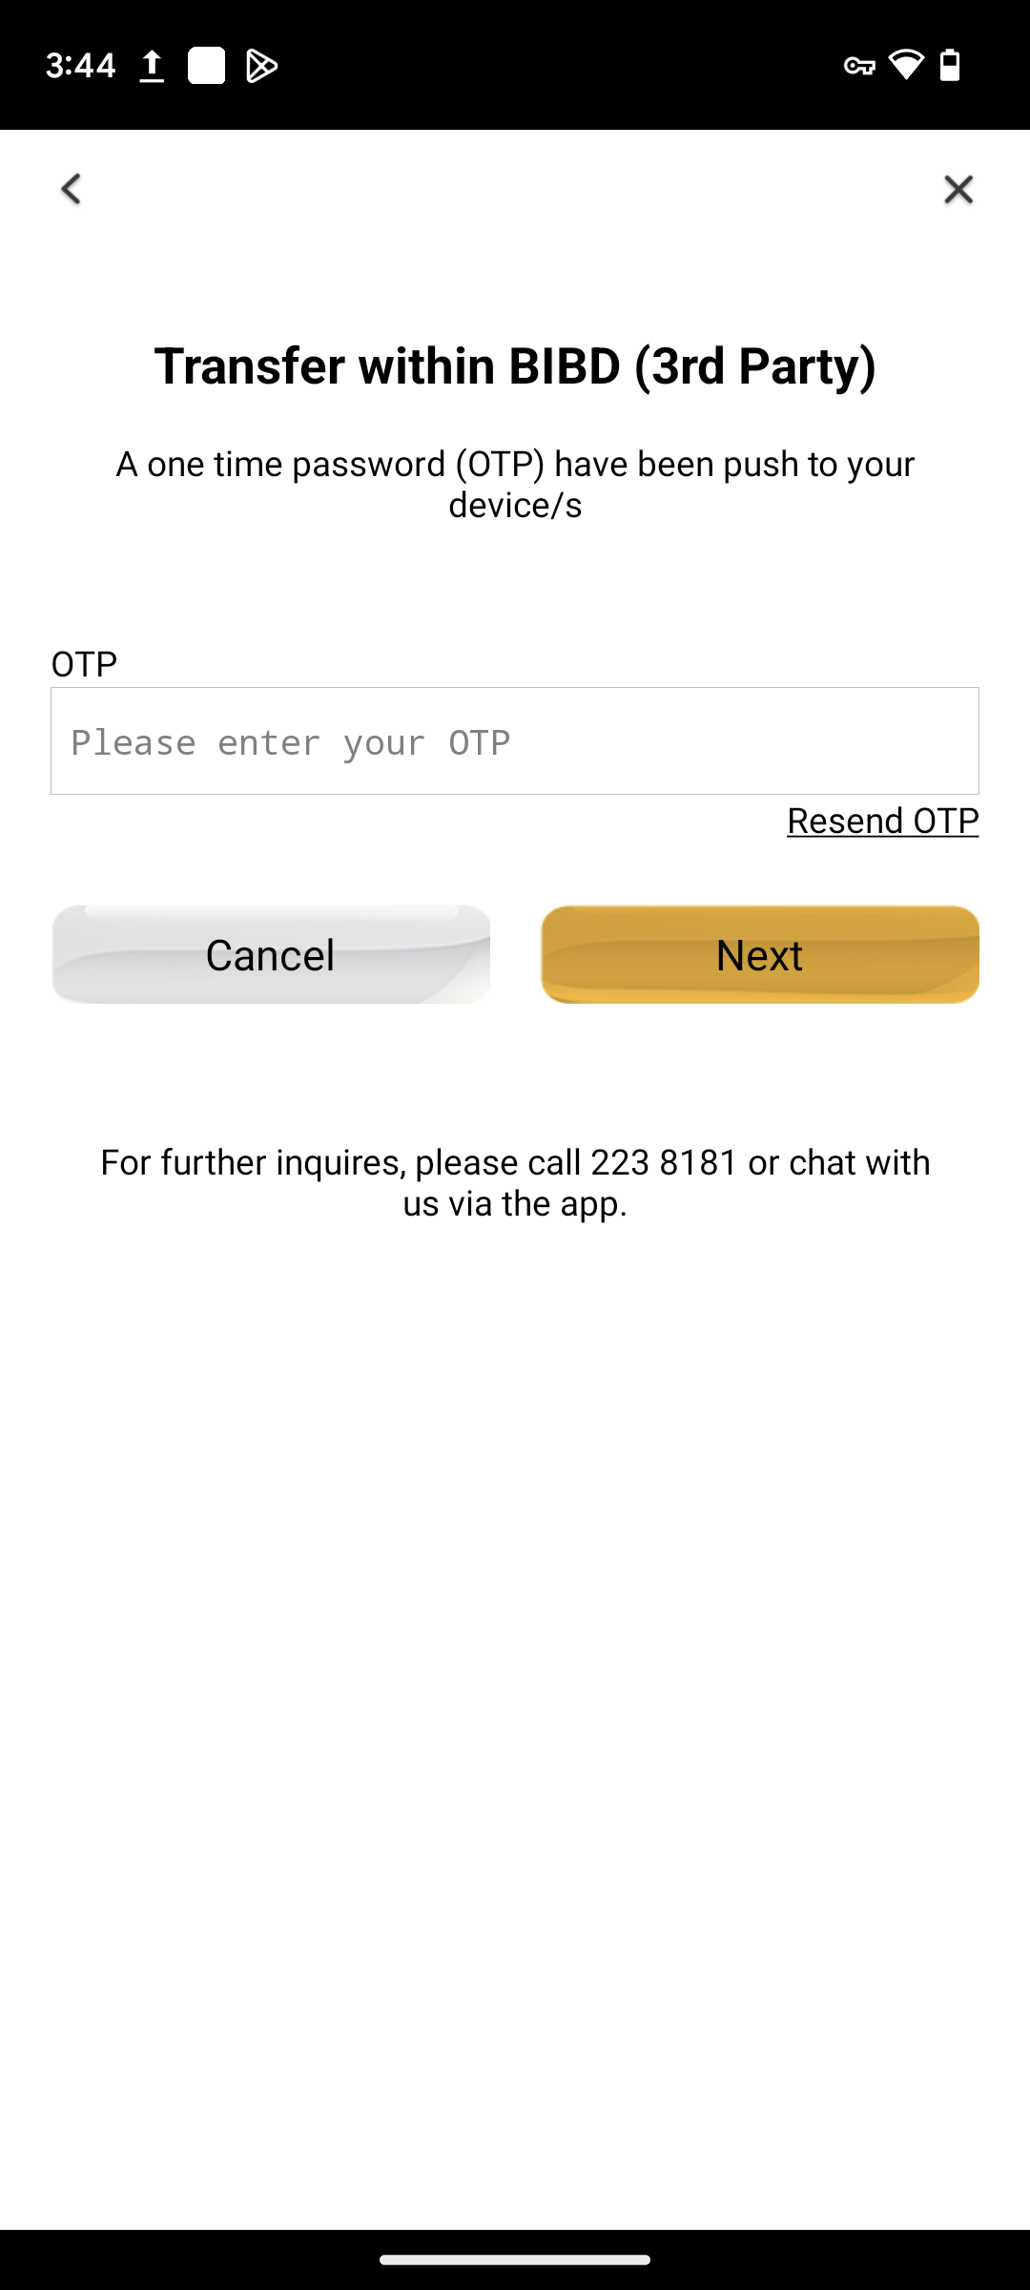
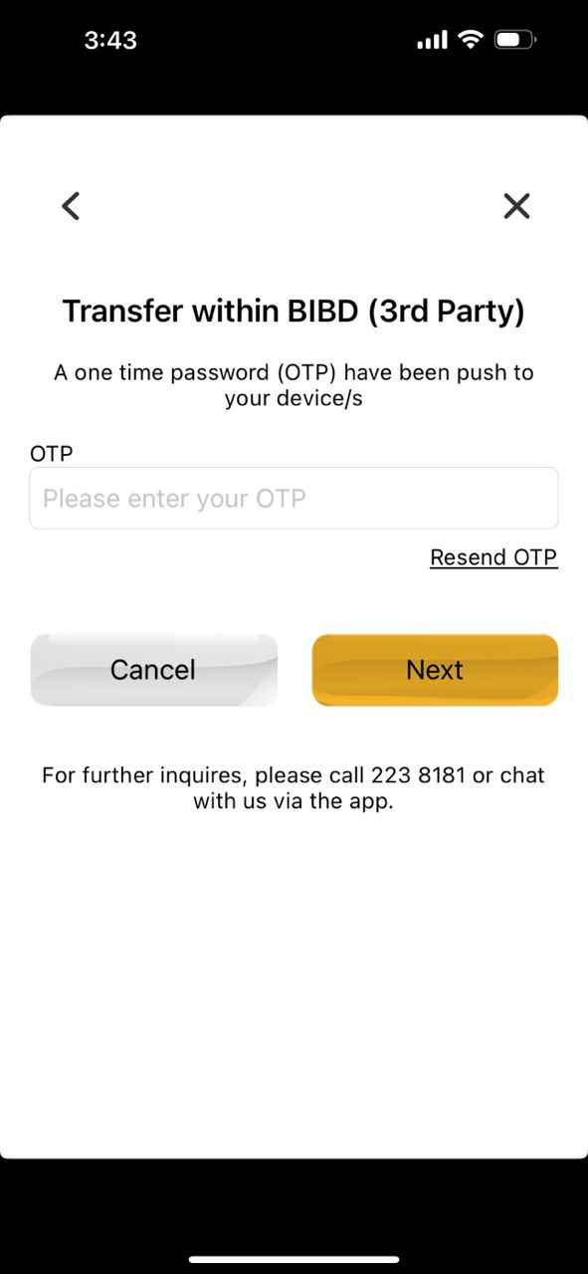
Android
OTP
iOS

Slide 7
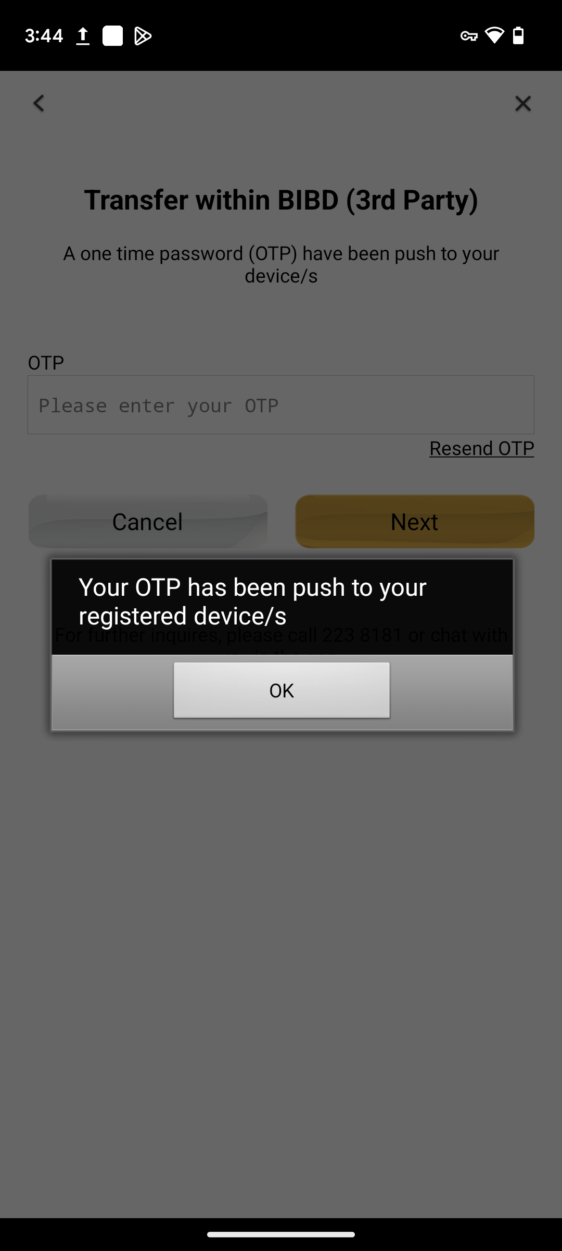
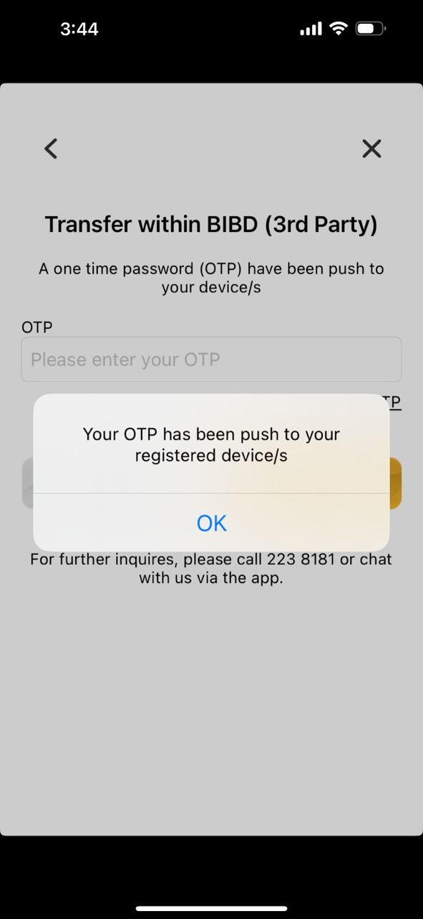
Android
RESEND OTP
iOS

Slide 8
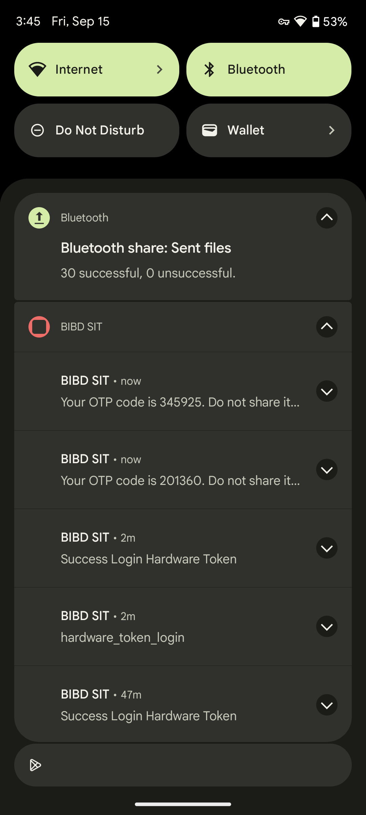
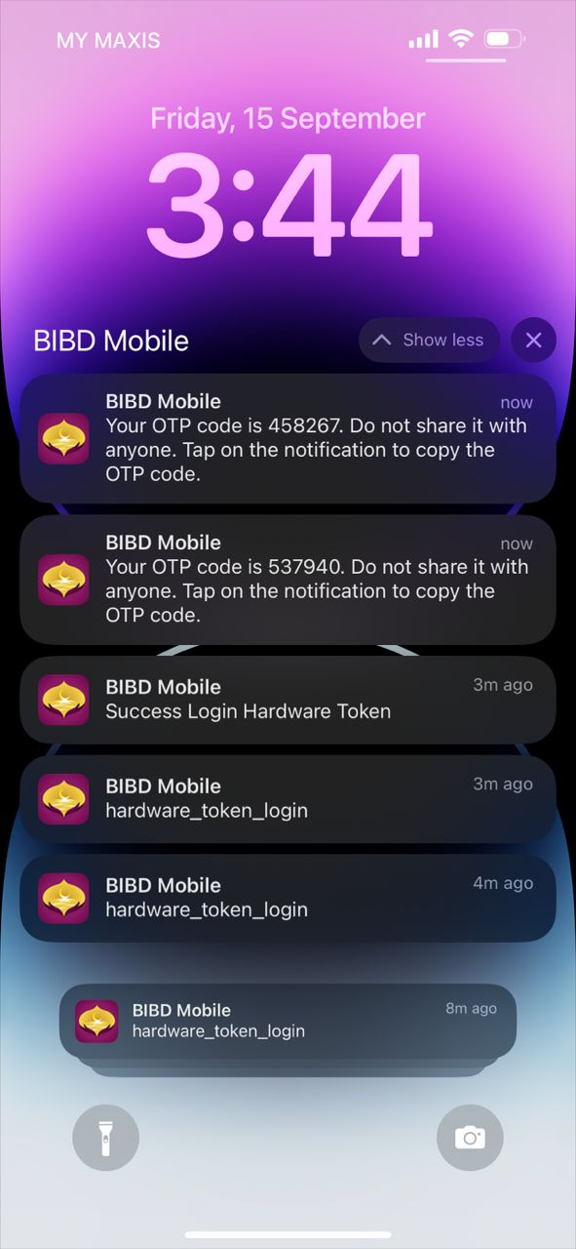
Android
OTP PUSH
iOS

Slide 9
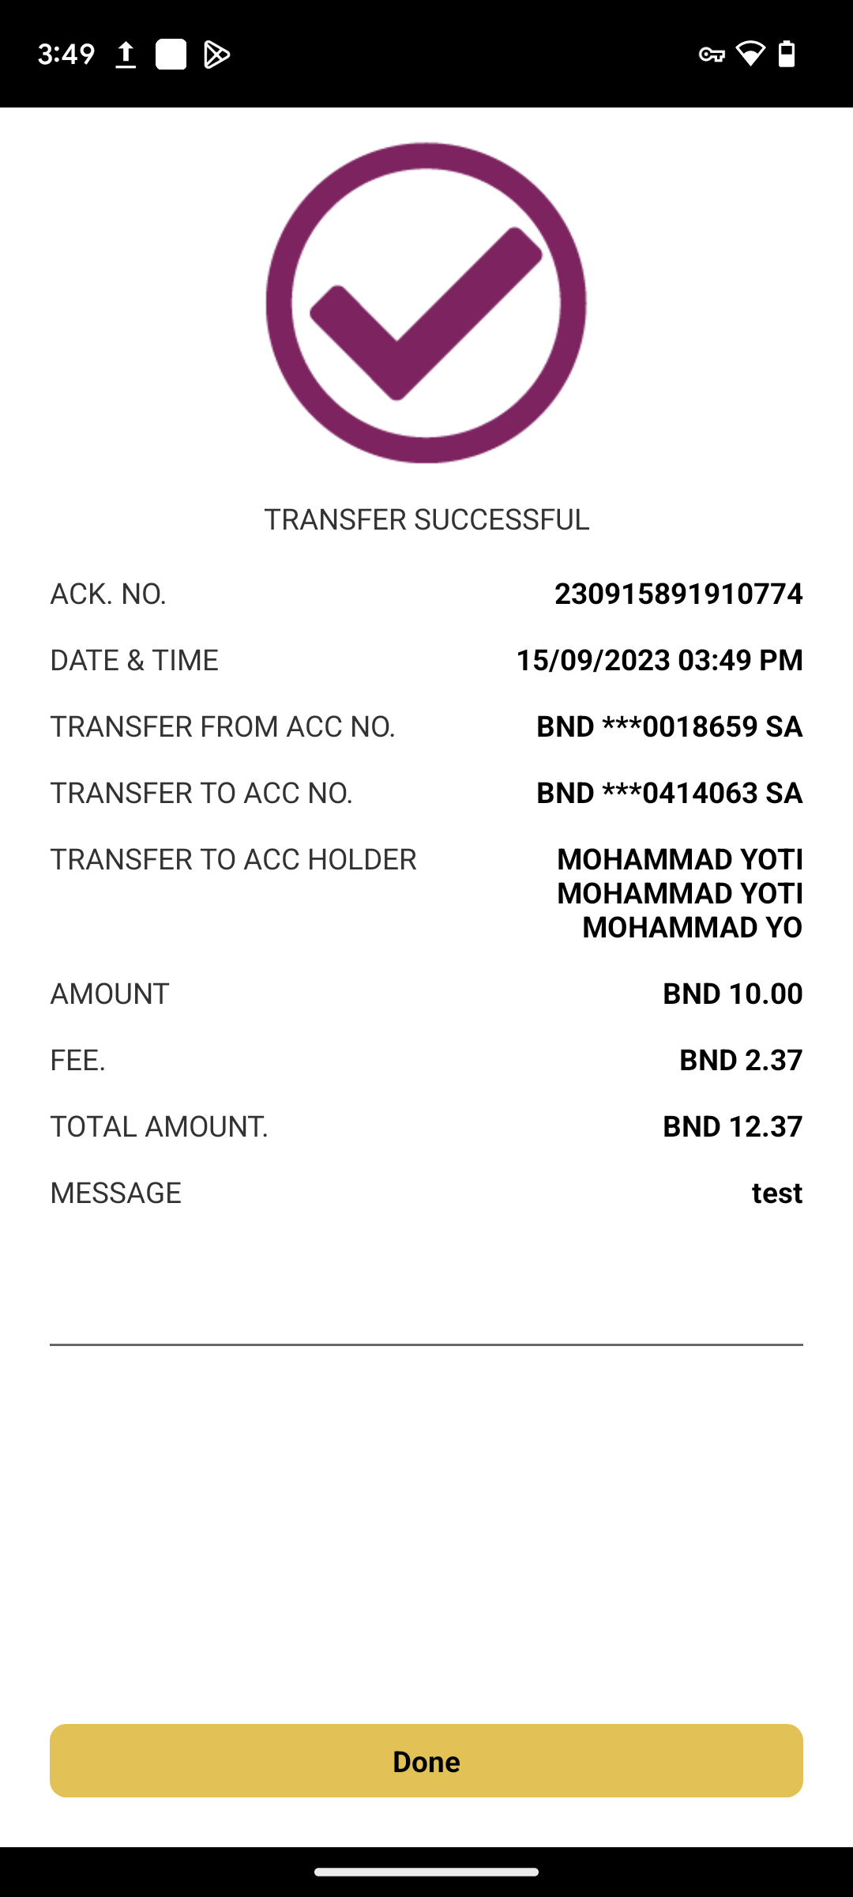
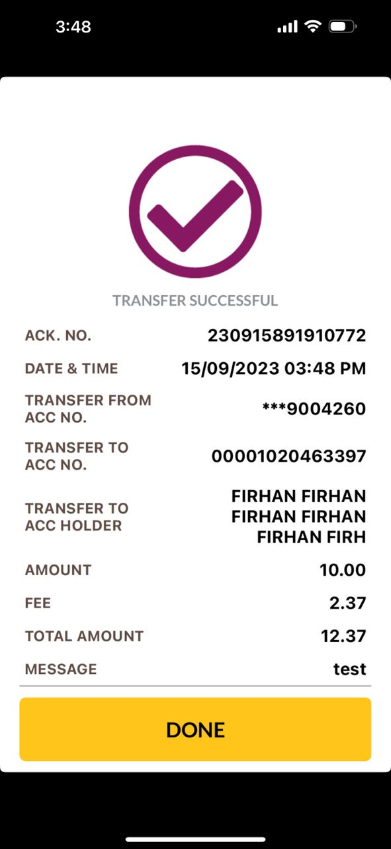
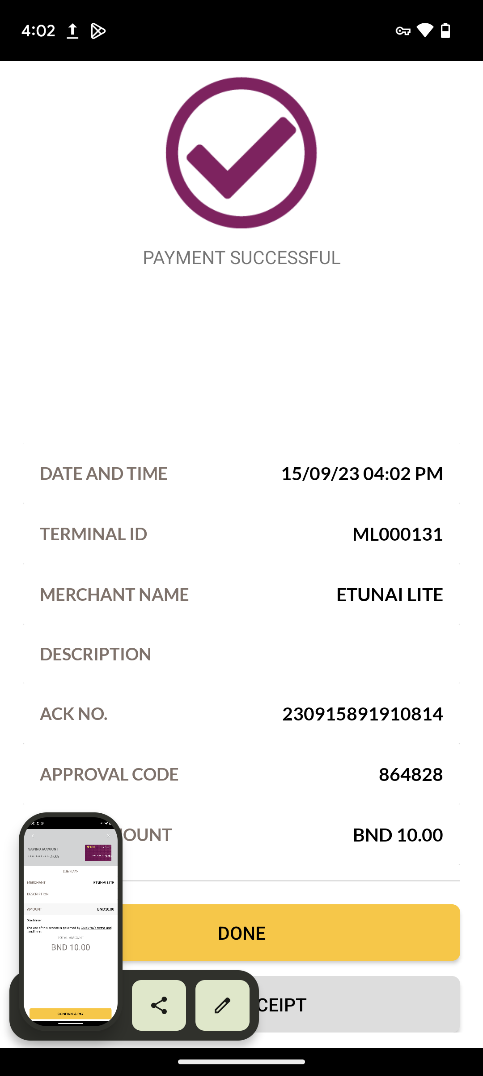
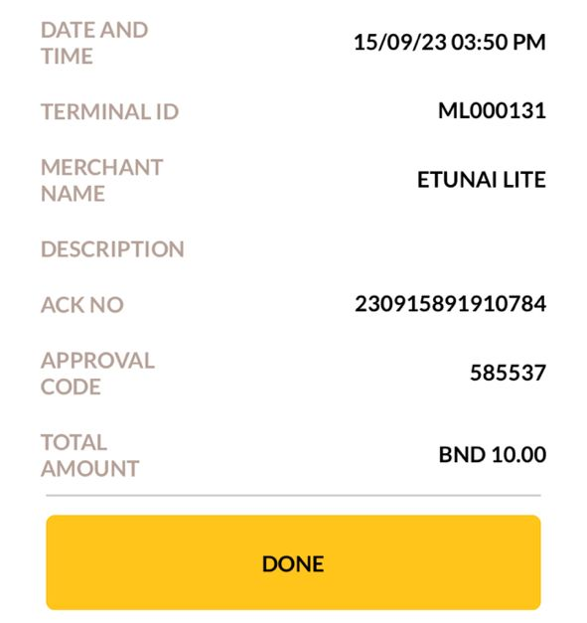
Android
SUCCESS TRANSFER
iOS
Font size and font color follow as per quickpay module
Font size, font color, font position and grey line follow as per quickpay module
Box size, font size, box color follow as per quickpay module and word should be ‘Done’

Slide 10
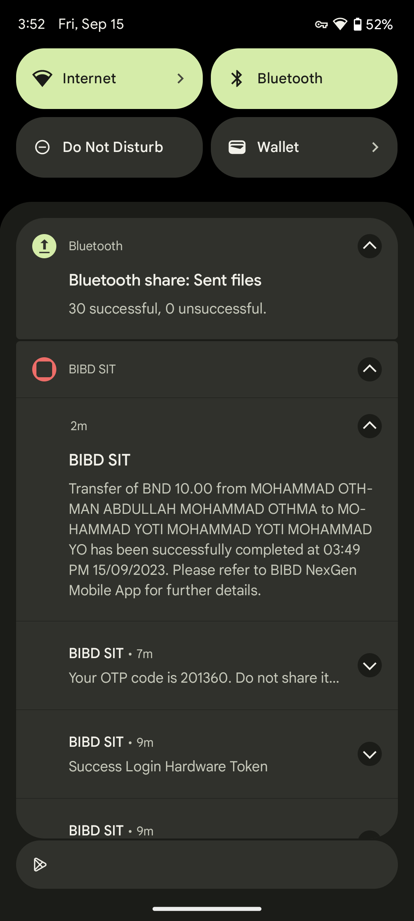
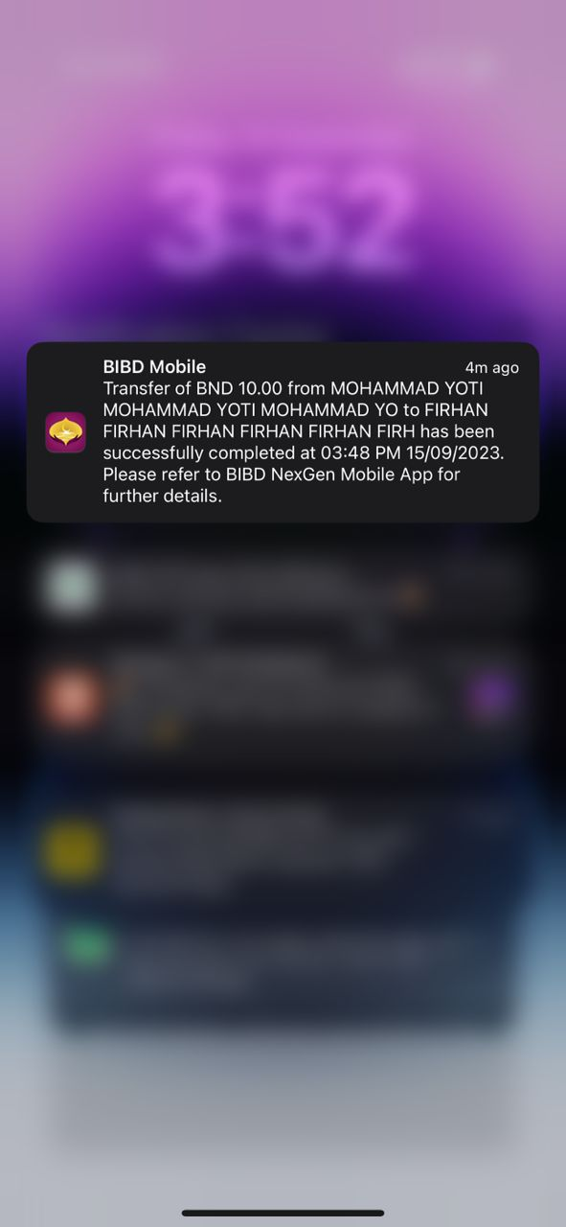
Android
TRANSFER PUSH NOTIFICATION
iOS

