Slide 1
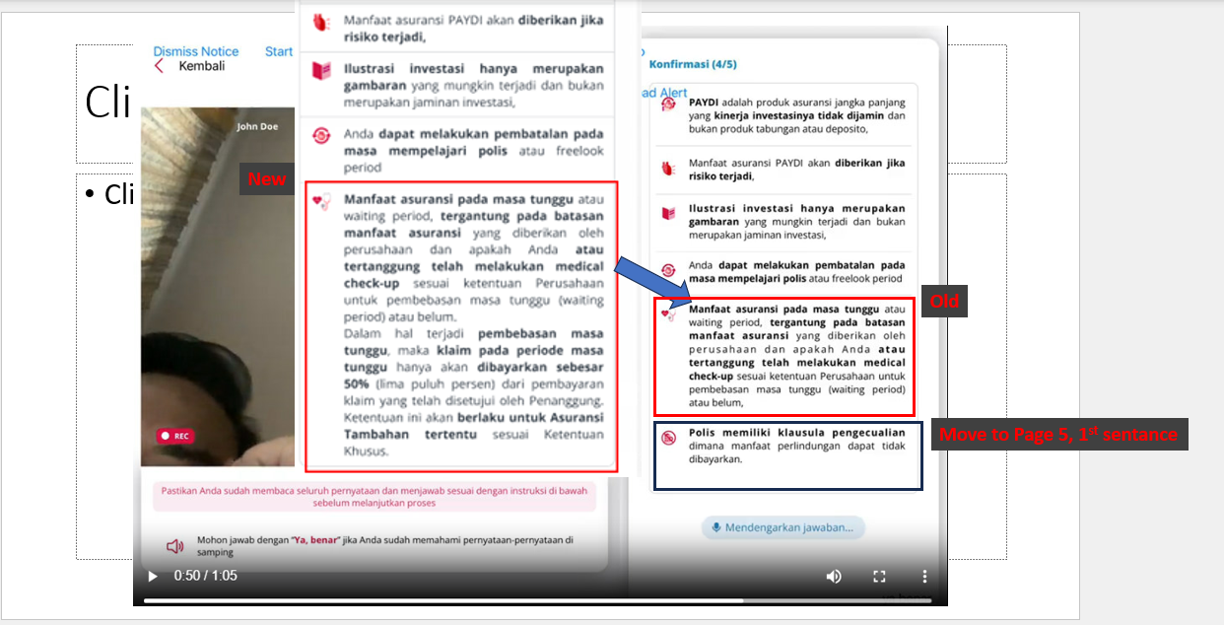
Kindly assist to apply this changes into SDK,
Change the Page 4 - Manfaat asuransi pada masa tunggu (old) to the new contains showing in the Left red box.
Move the Page 4 – 6th items into the page 5 1st items.
*note: if the page 4 items become too long, make the right panel scrollable, but when it listen to the ‘Ya Benar’ auto scroll to the bottom, so it can display the “menunggu jawaban” display.

