Slide 1
ADD FAVOURITE FROM TRANSFER MENU

Slide 2
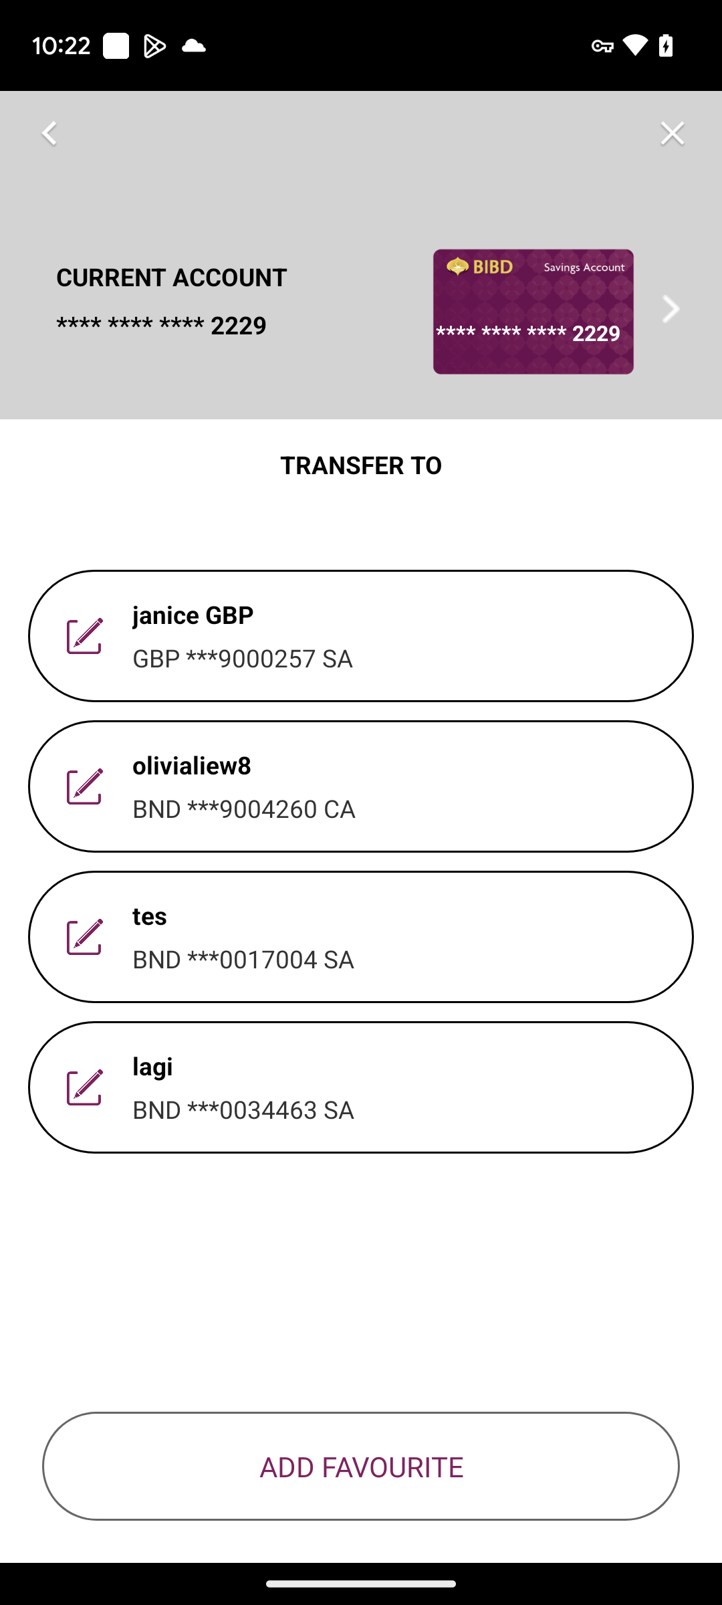
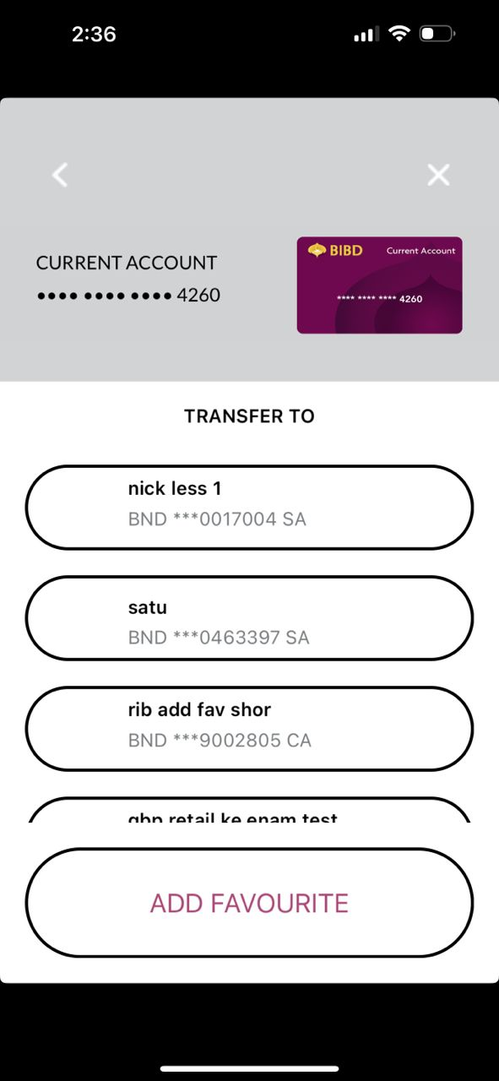
Android
TRANSFER MENU
FAV LIST AND TRANSFER
iOS

Slide 3
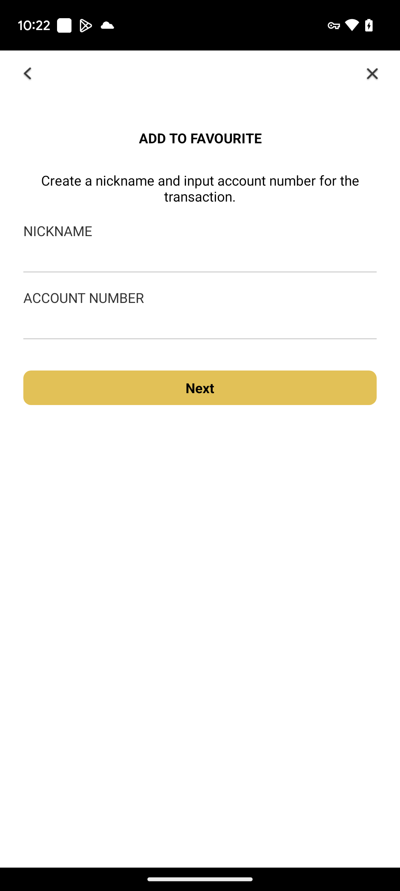
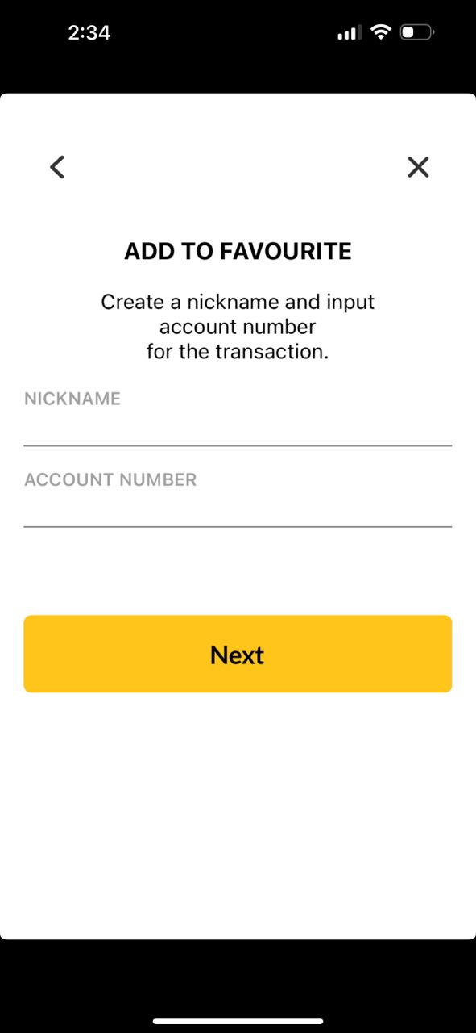
Android
TRANSFER MENU
INPUT ADD
iOS
Can make text in 2 lines only?
Box size, font size, box color follow as per quickpay module and word should be ‘Next’

Slide 4
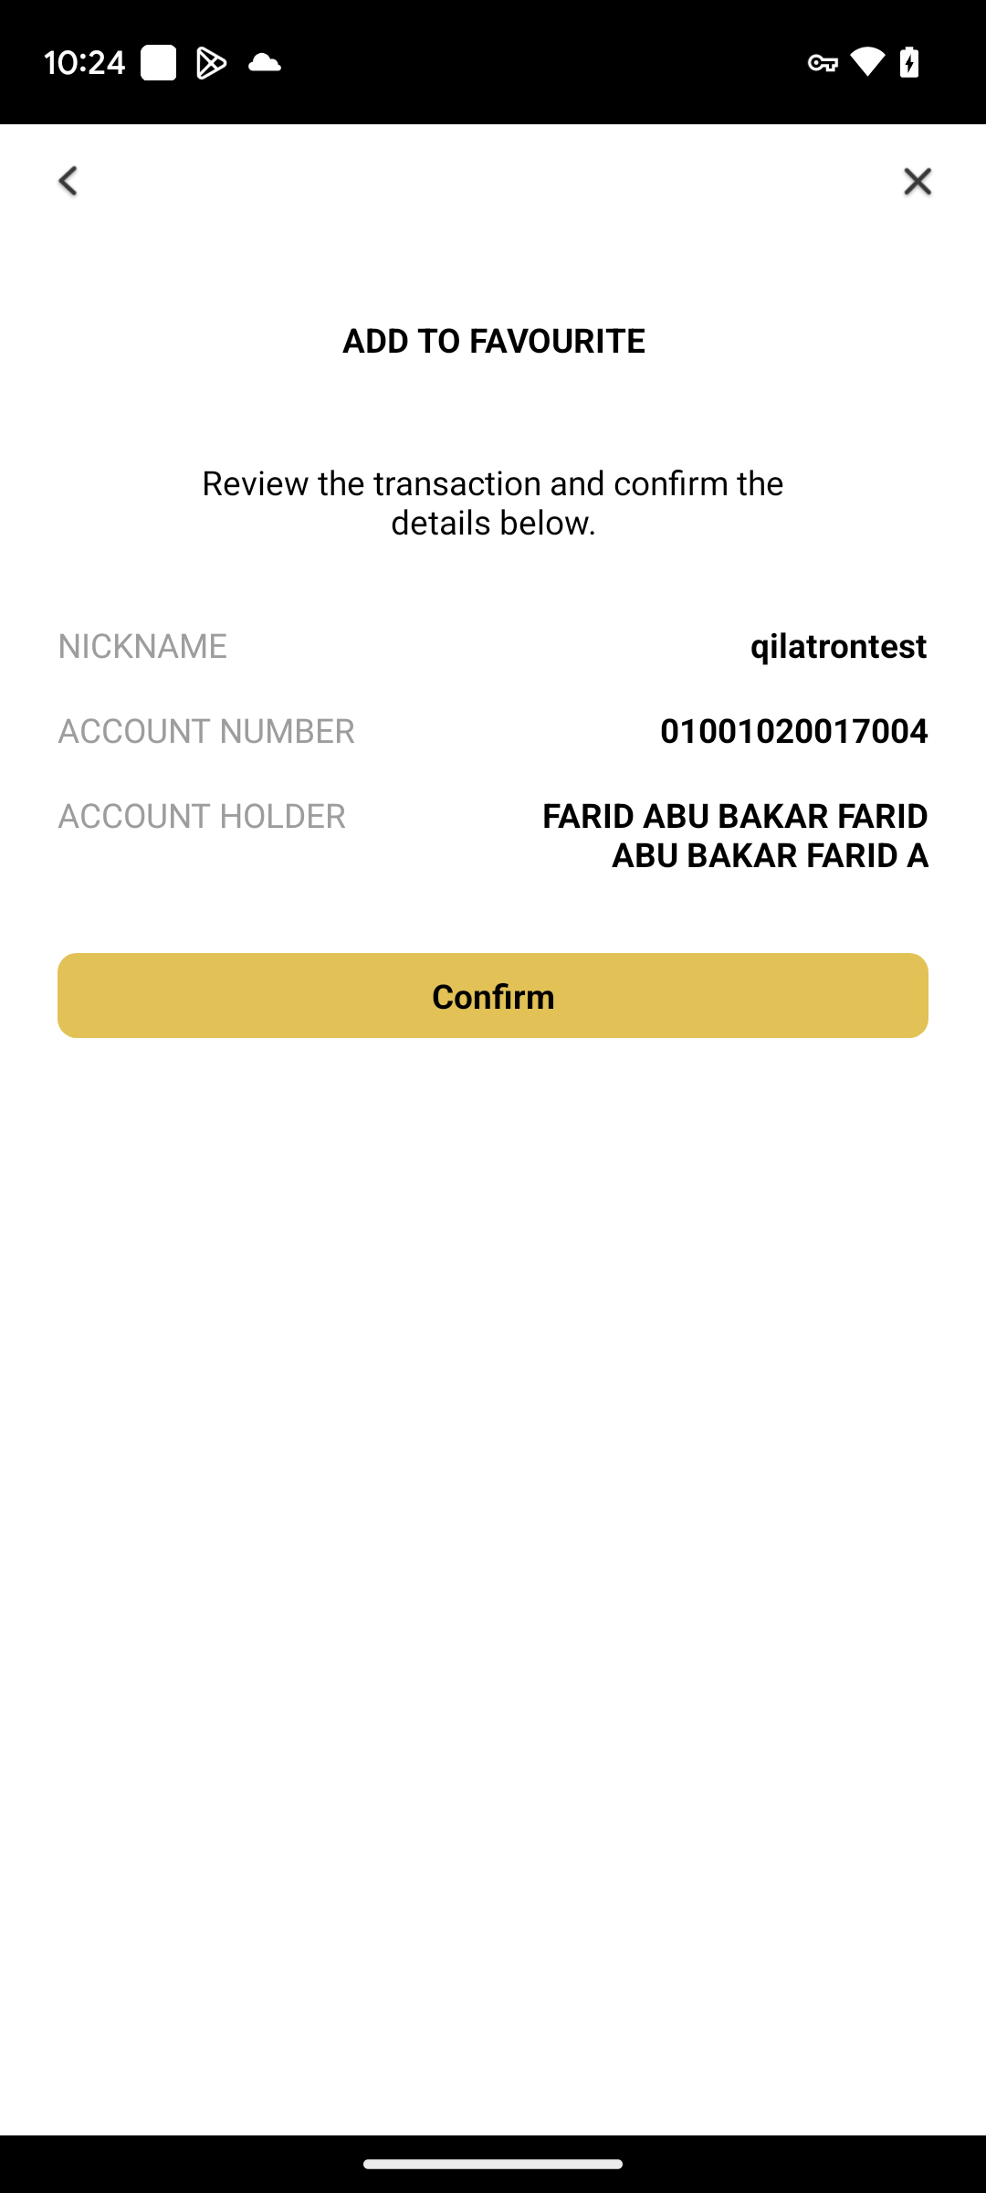
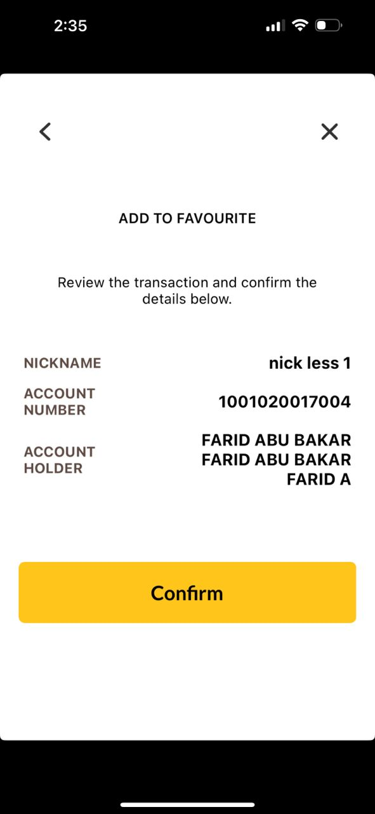
Android
TRANSFER MENU
CONFIRM ADD
iOS
Box size, font size, box color follow as per quickpay module and word should be ‘Confirm’

Slide 5
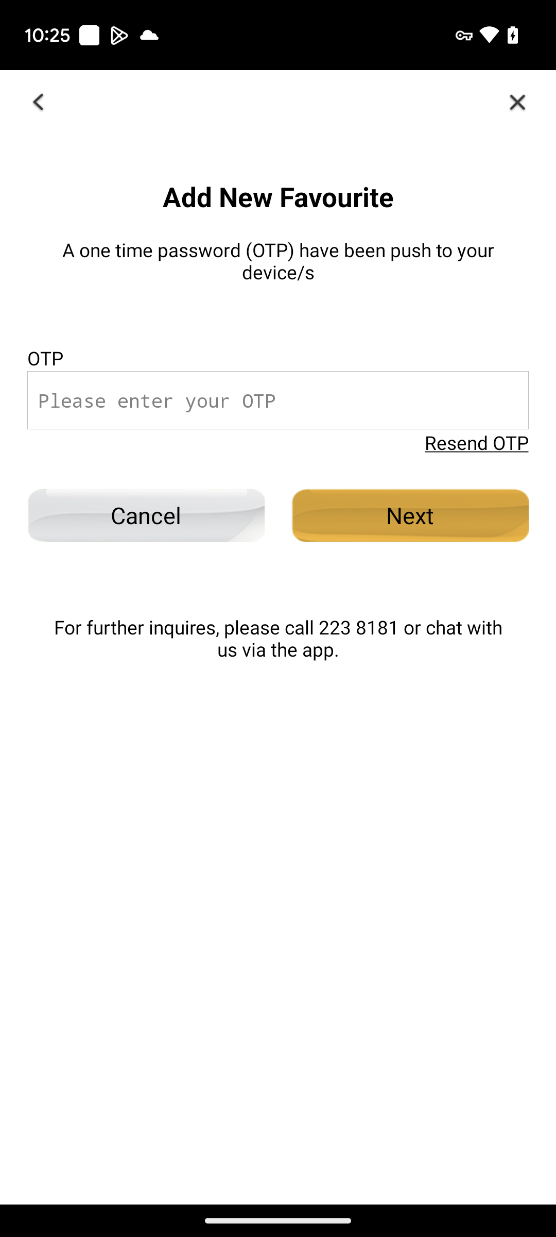
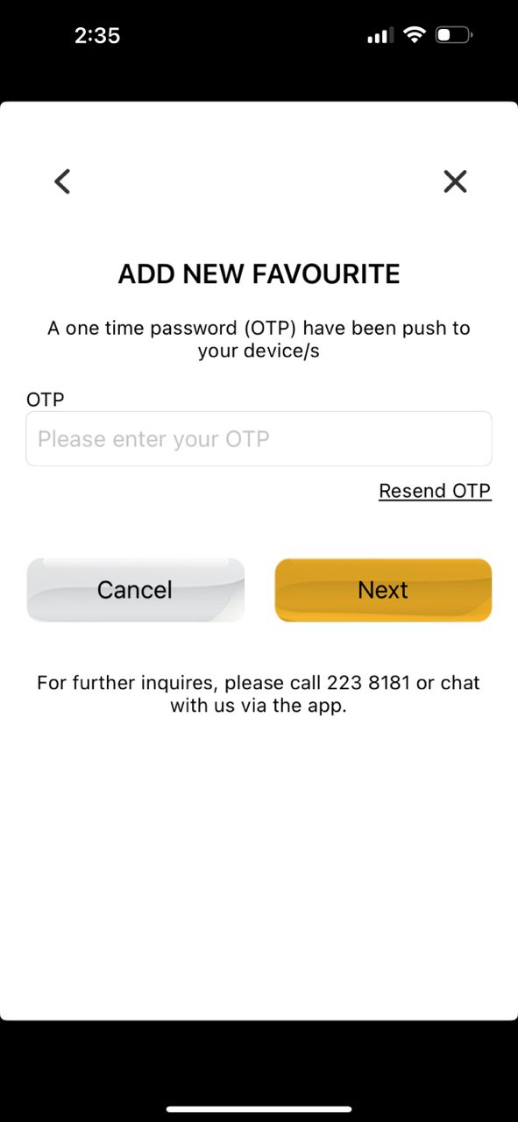
Android
TRANSFER MENU
OTP ADD
iOS
Change to ‘Add New Favourite’

Slide 6
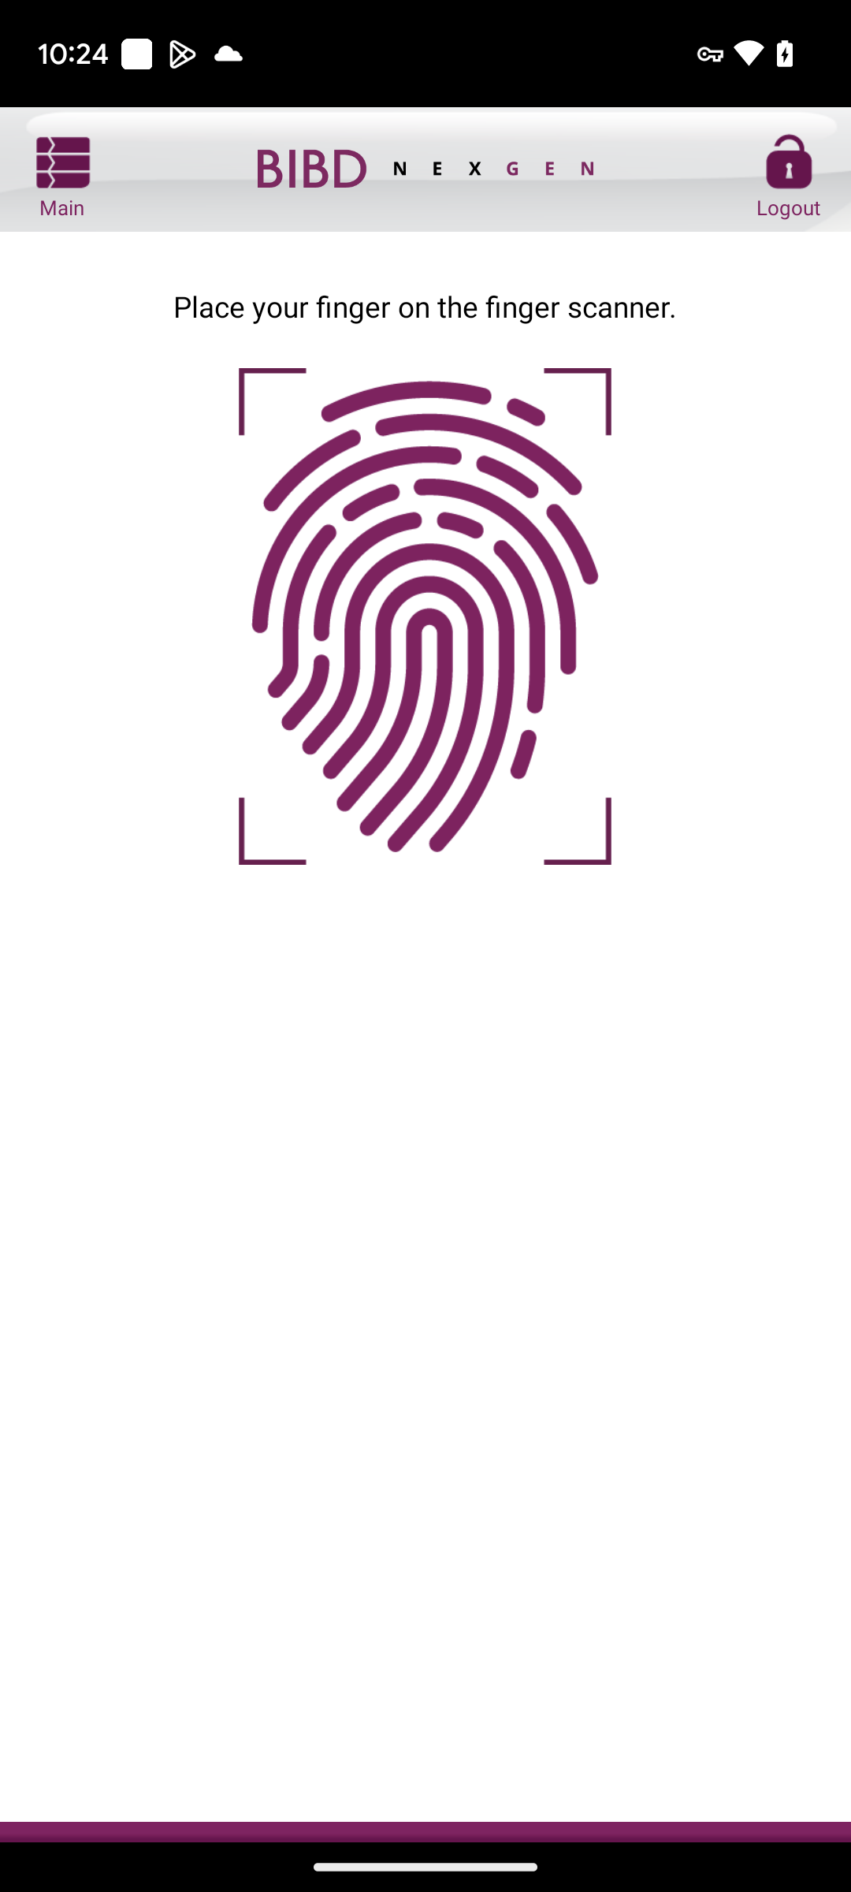
Android
TRANSFER MENU
BIO ADD
iOS

Slide 7
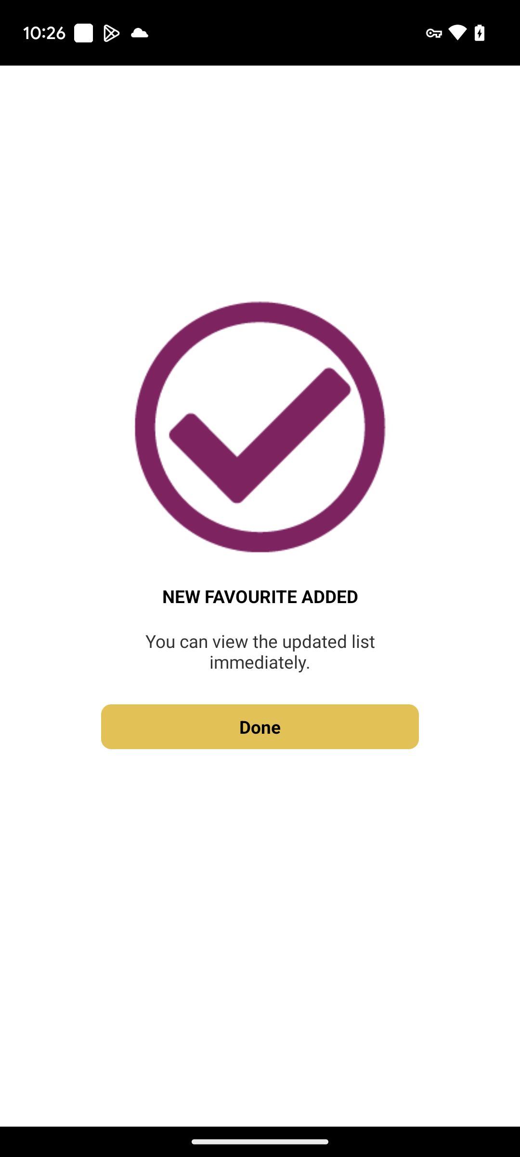
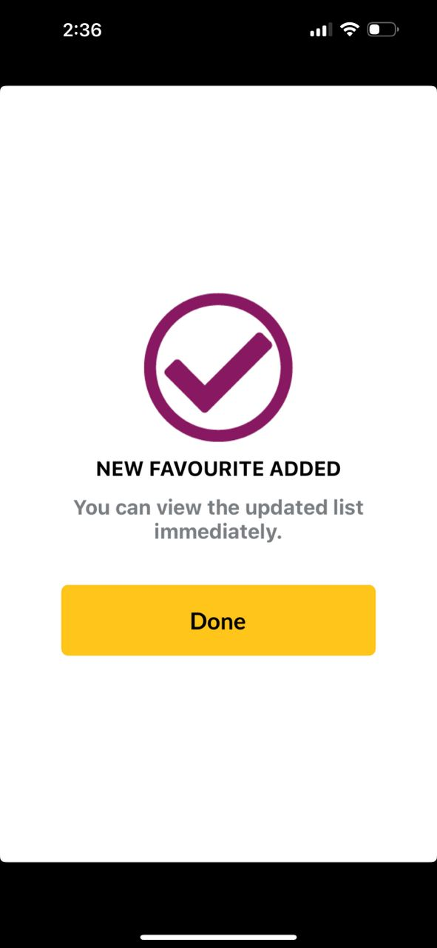
Android
TRANSFER MENU
SUCCESS ADD
iOS
Box size, font size, box color follow as per quickpay module and word should be ‘Done’

Slide 8
ADD/EDIT/DELETE FAVOURITE FROM MANAGE FAVOURITE MENU

Slide 9
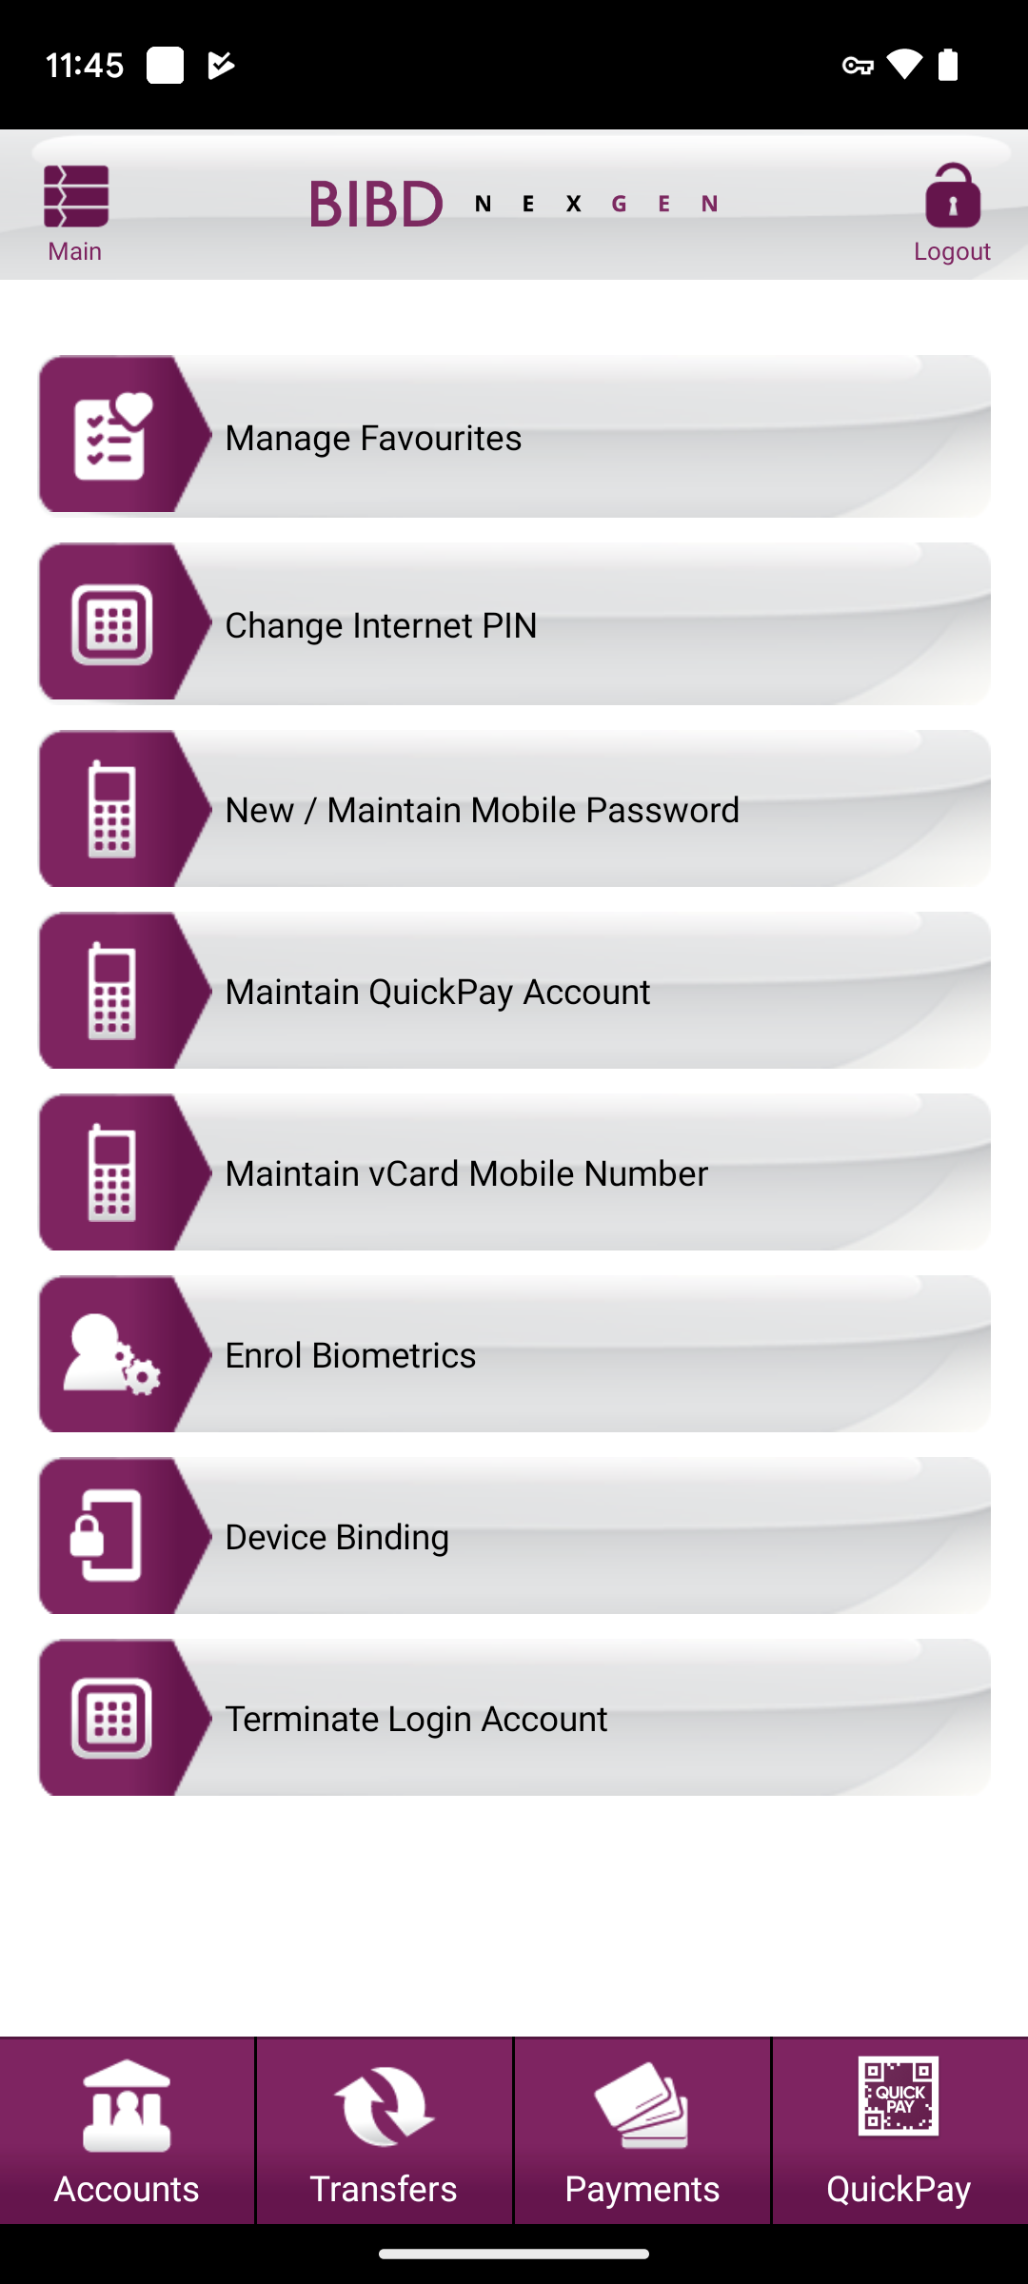
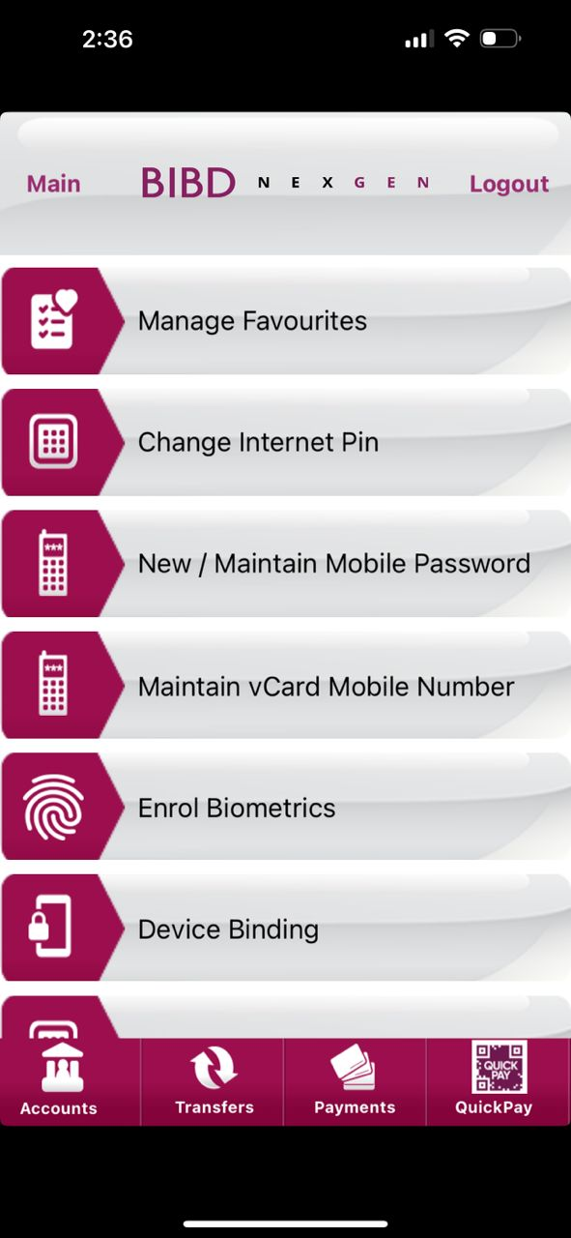
Android
SETTINGS
iOS

Slide 10
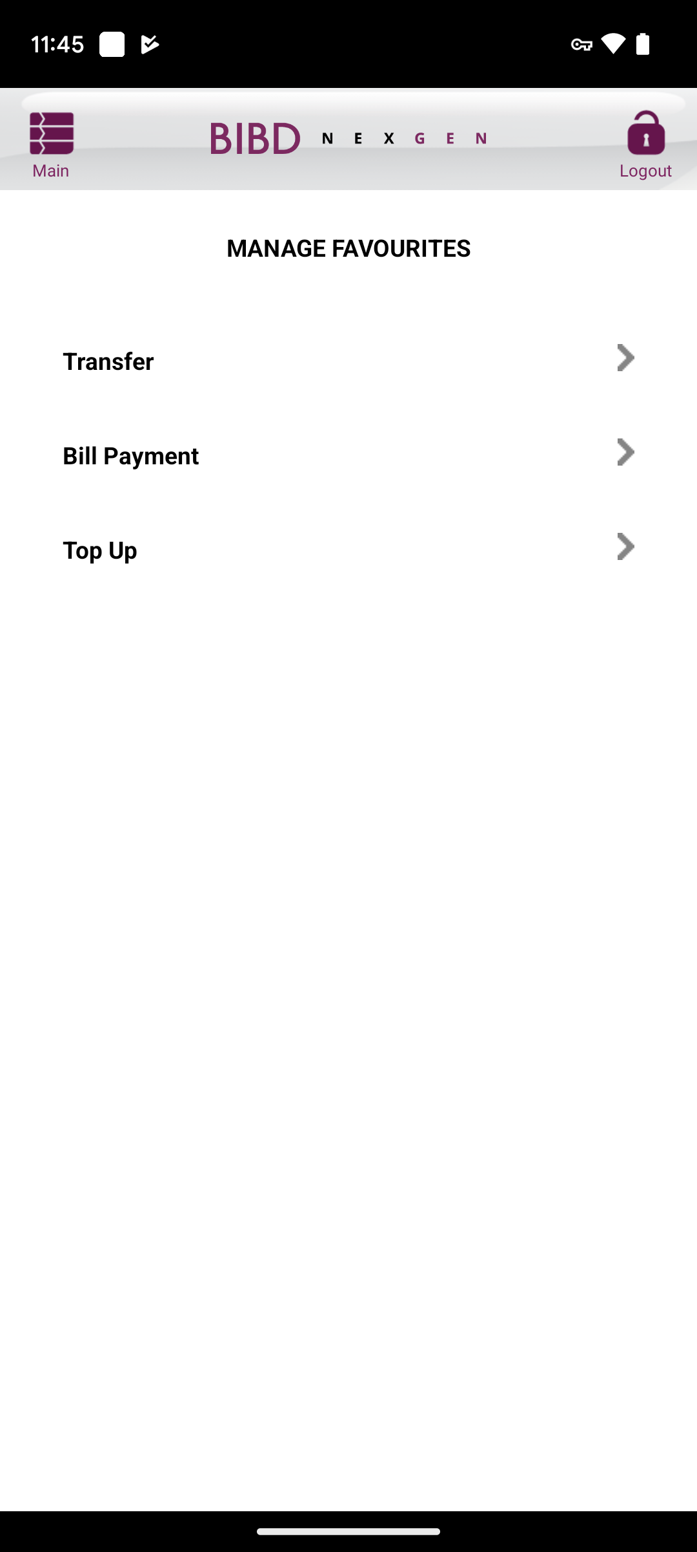
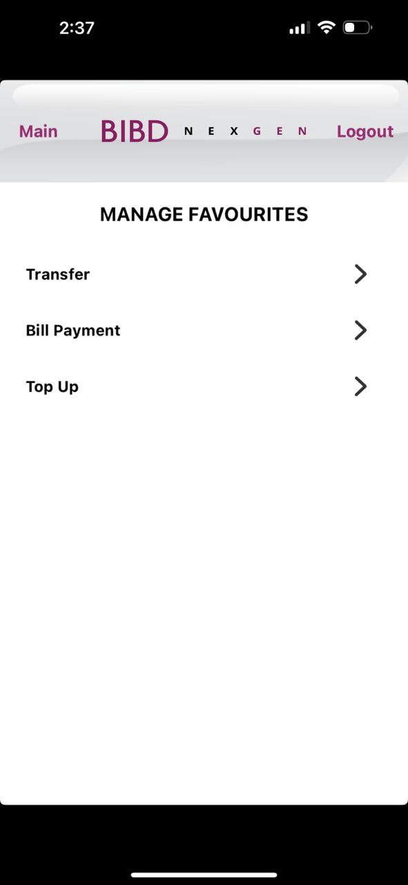
Android
MANAGE FAVOURITES
iOS

Slide 11
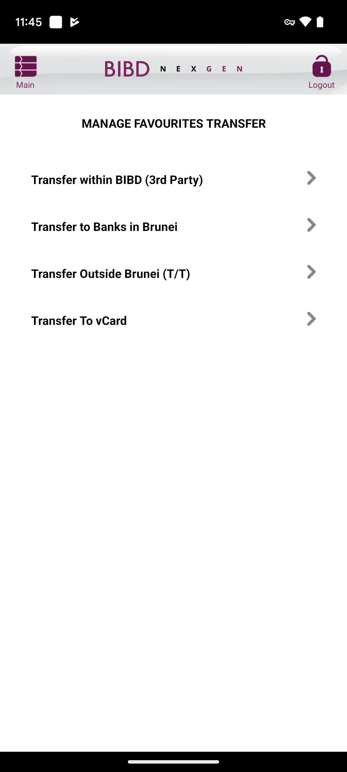
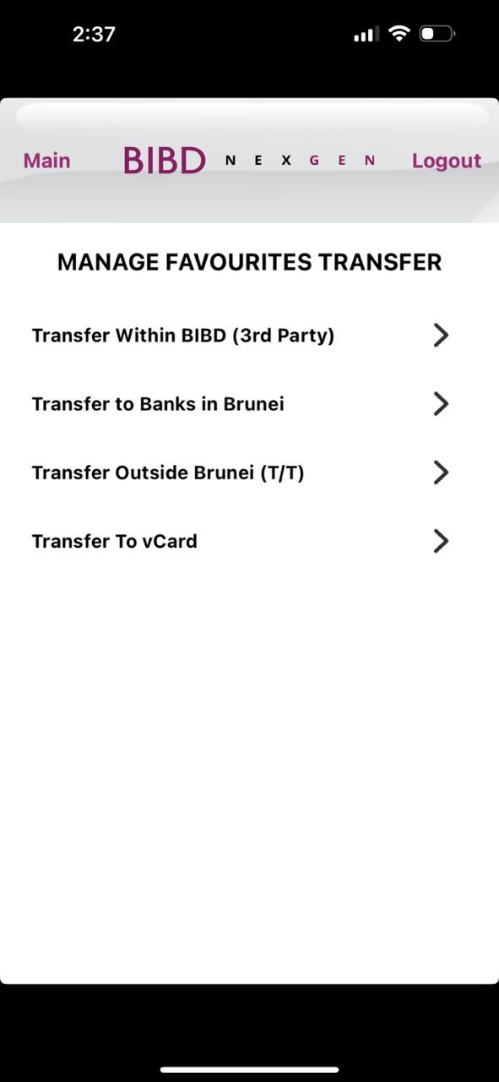
Android
MANAGE FAV TRANSFER
iOS
Change to ‘Transfer within BIBD (3rd Party)’

Slide 12
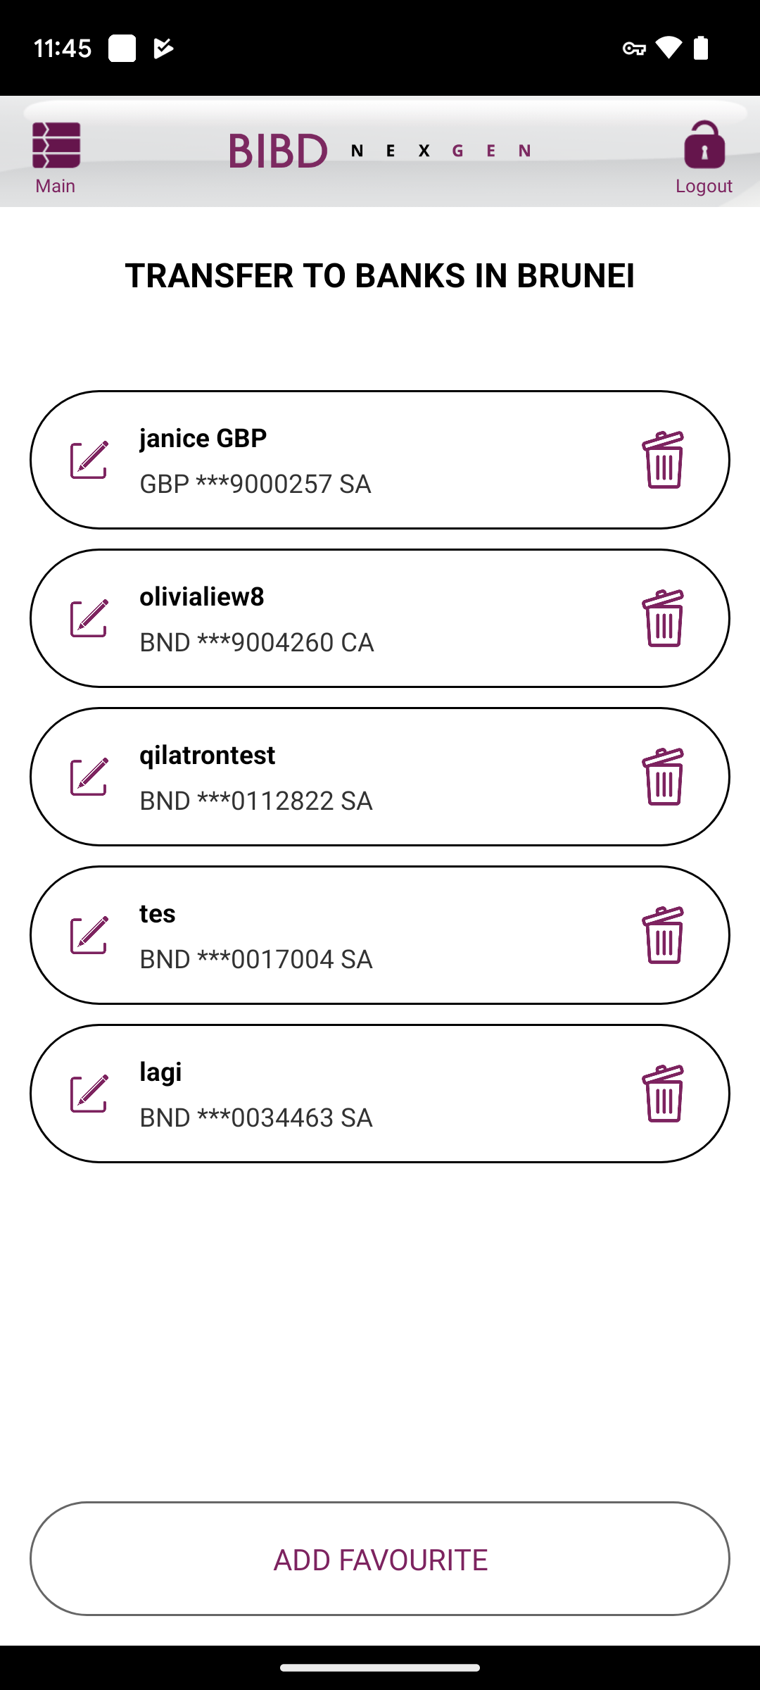
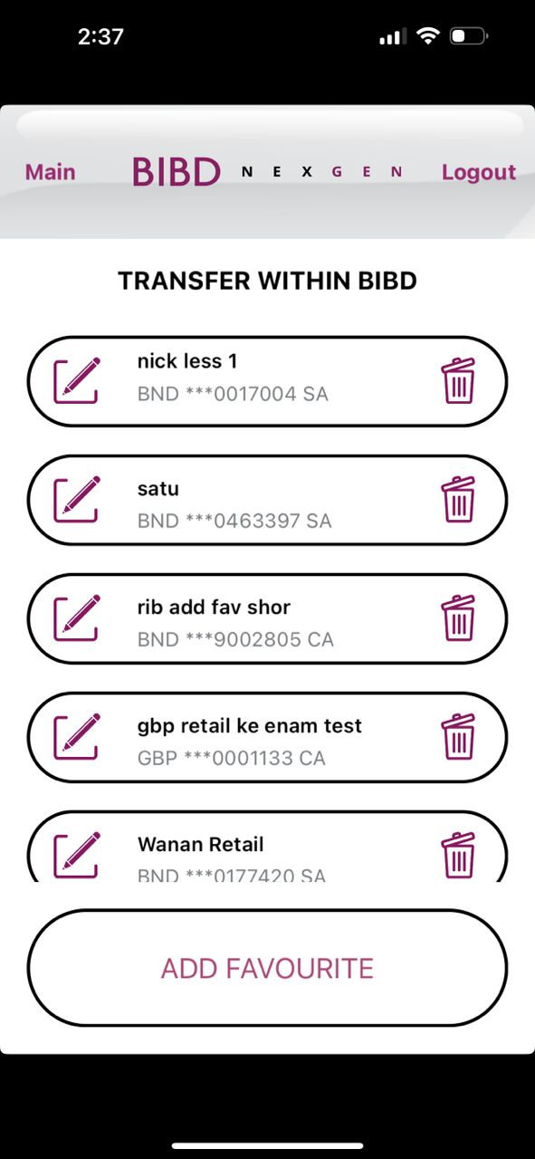
Android
TRANSFER WITHIN BIBD
FAV LIST
iOS
Change to ‘TRANSFER WITHIN BIBD’ since this 3rd party fav list

Slide 13
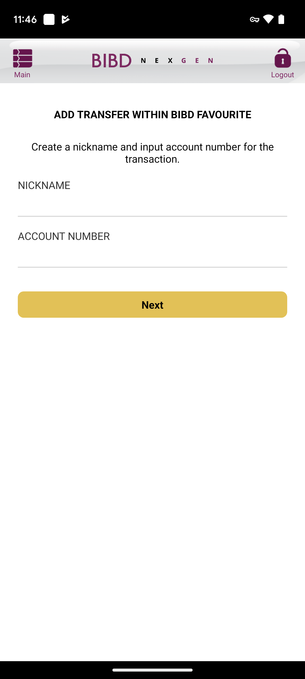
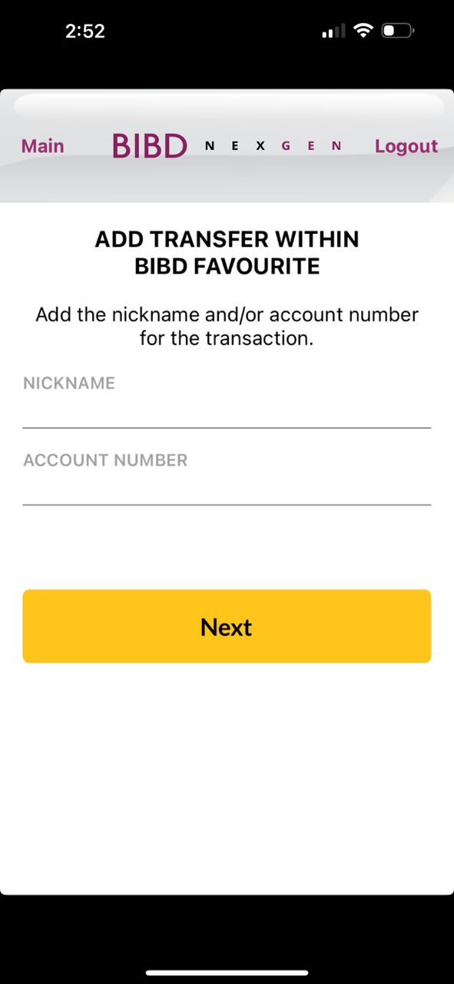
Android
INPUT ADD
iOS
Follow like Android
Box size, font size, box color follow as per quickpay module and word should be ‘Next’

Slide 14
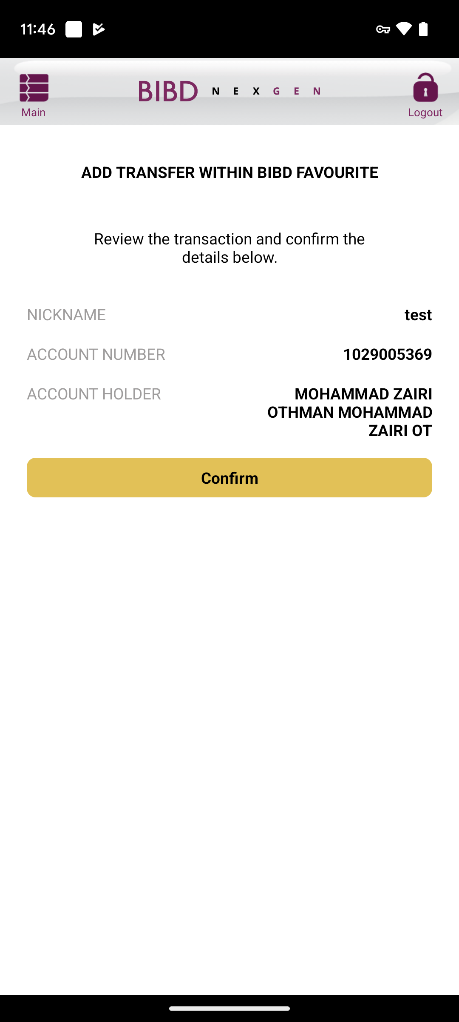
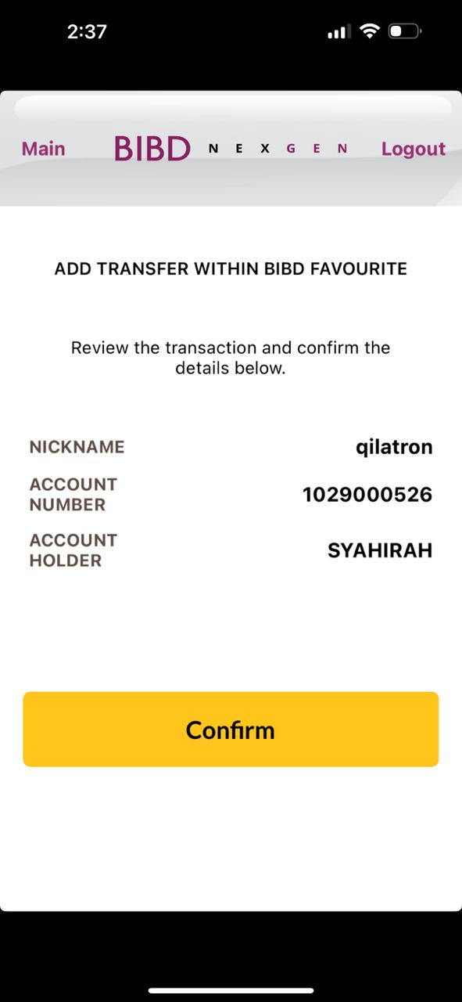
Android
CONFIRM ADD
iOS
Box size, font size, box color follow as per quickpay module and word should be ‘Confirm’

Slide 15
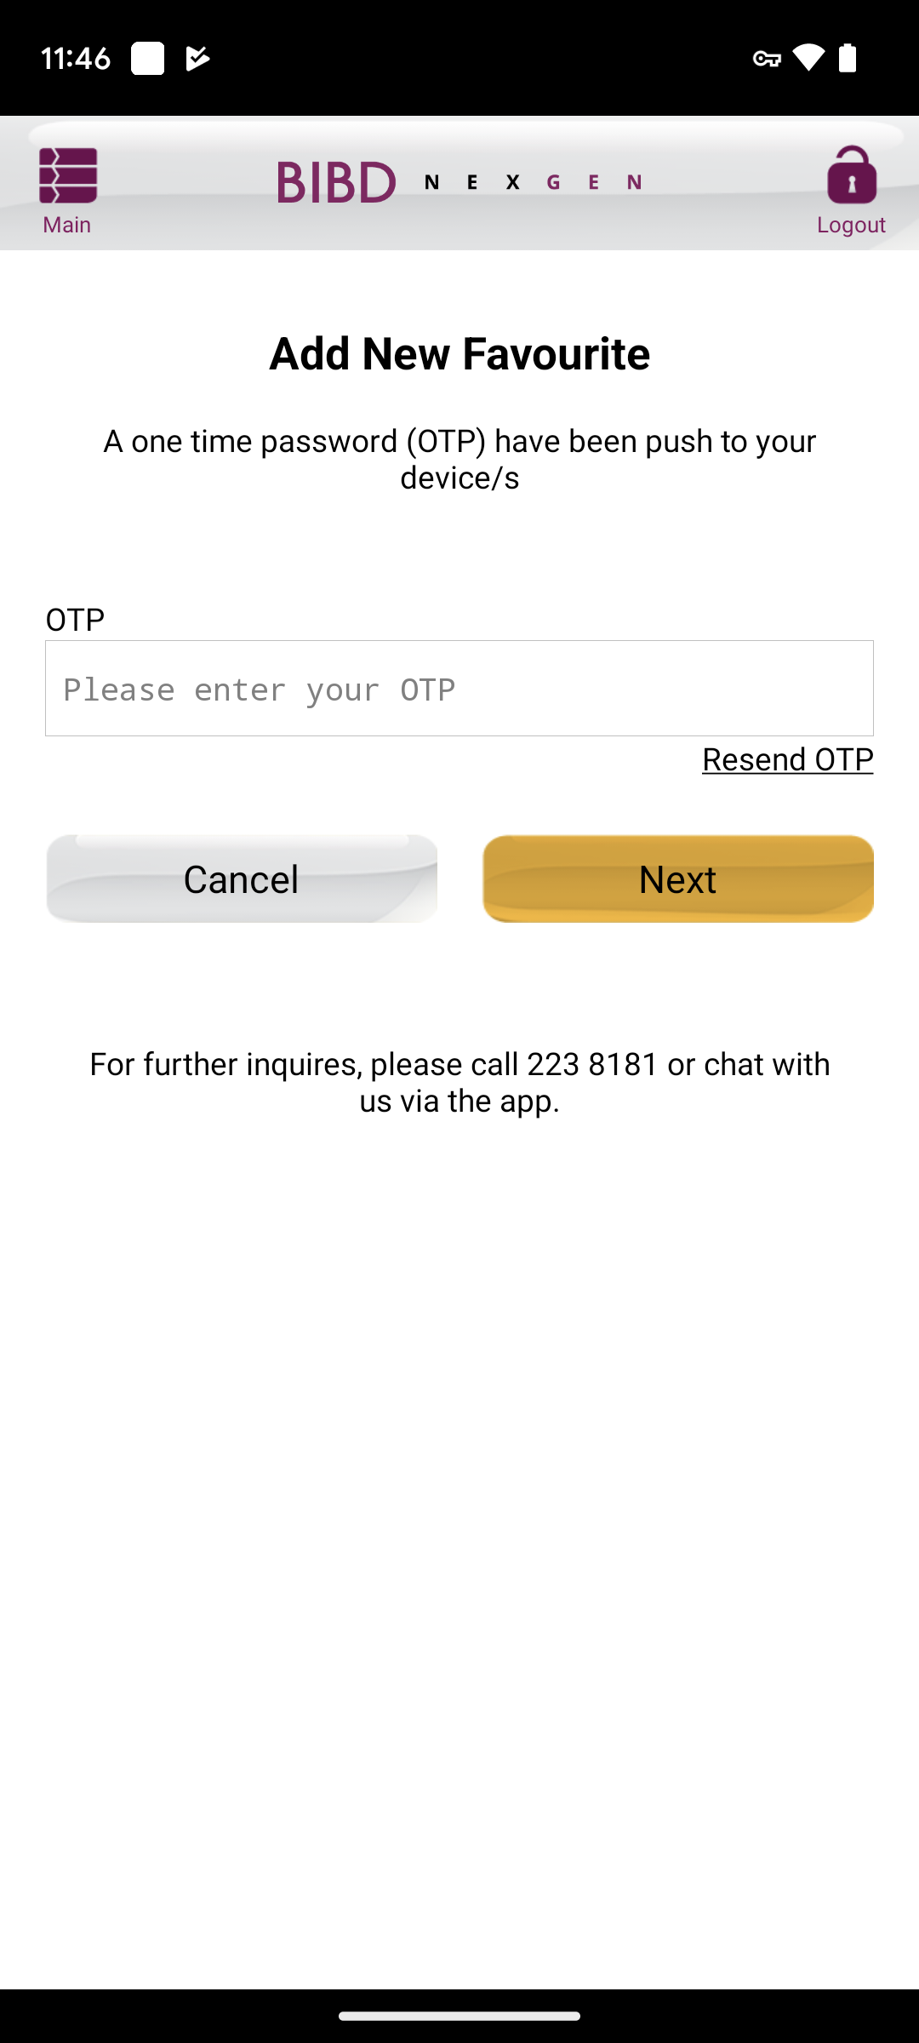
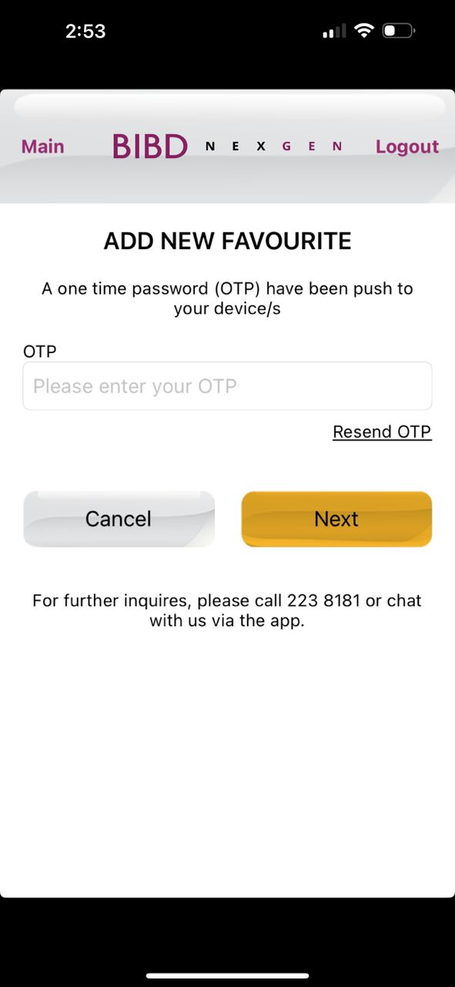
Android
OTP ADD
iOS
Change to ‘Add New Favourite’

Slide 16
Android
BIO ADD
iOS

Slide 17
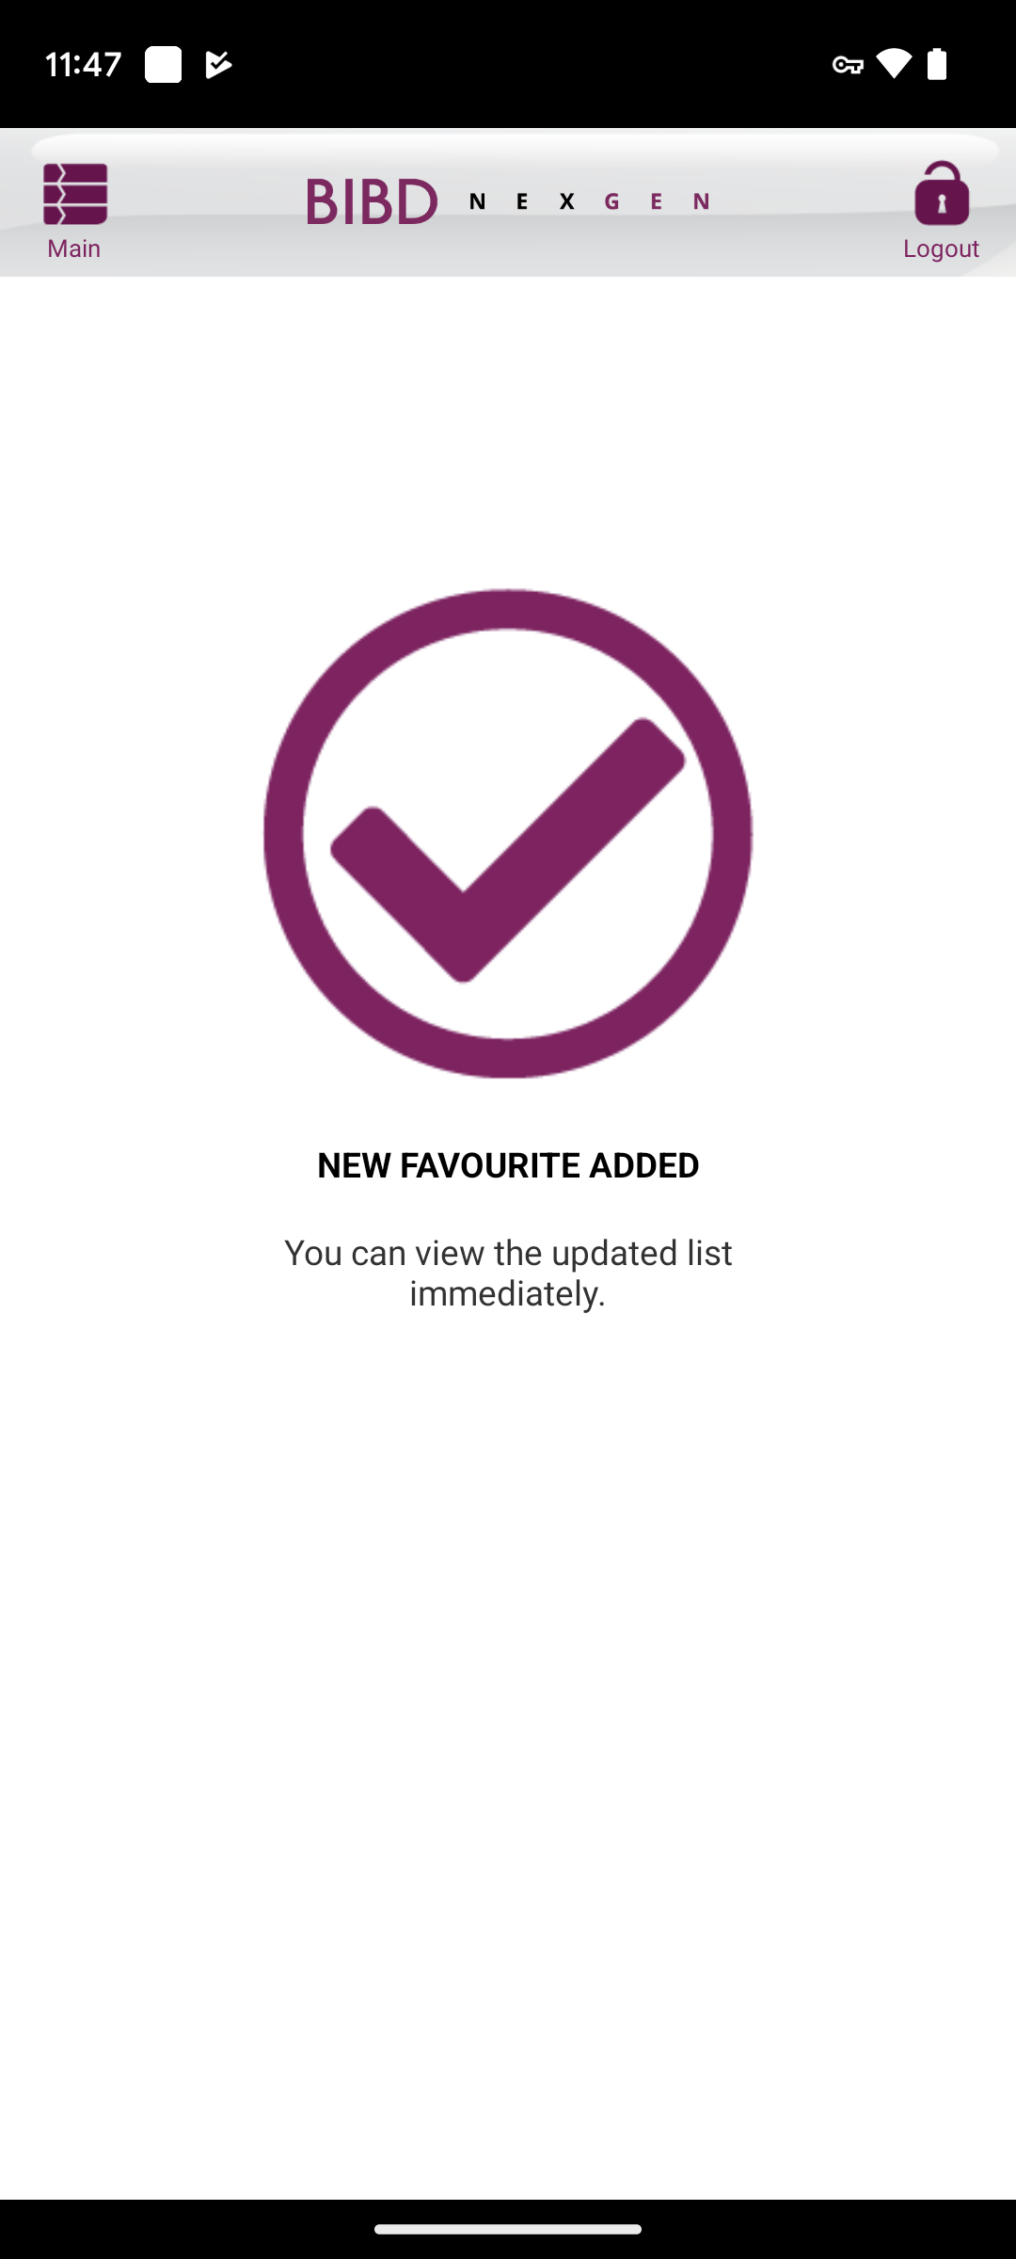
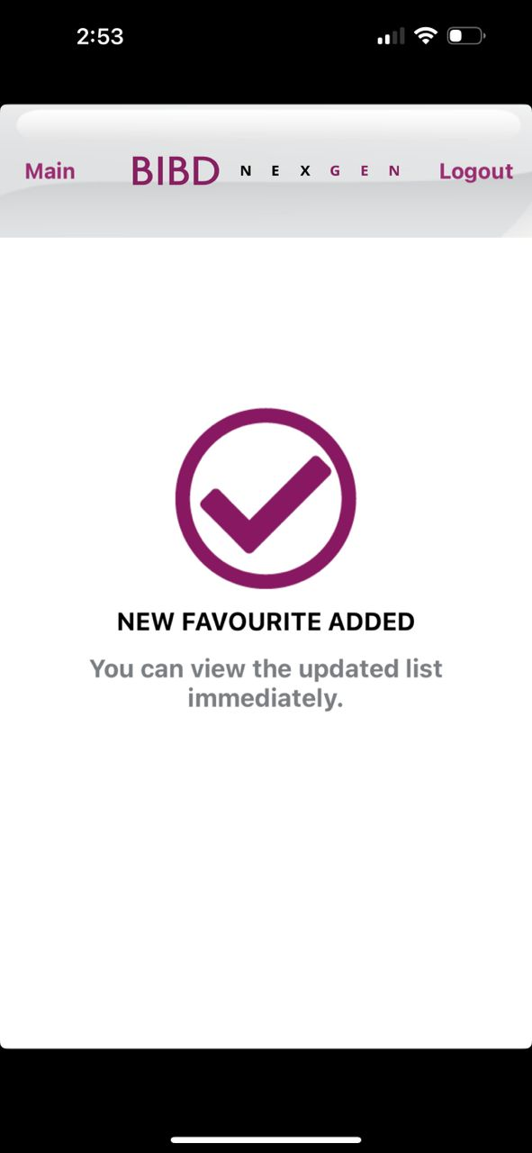
Android
SUCCESS ADD
iOS
Done
Done

Slide 18
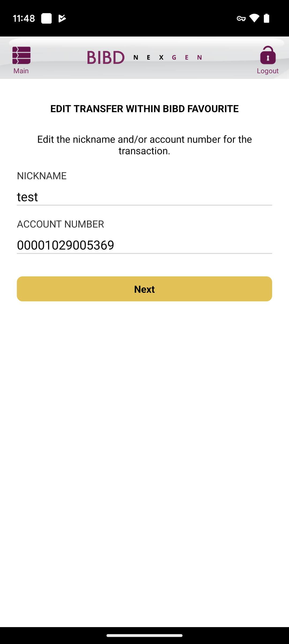
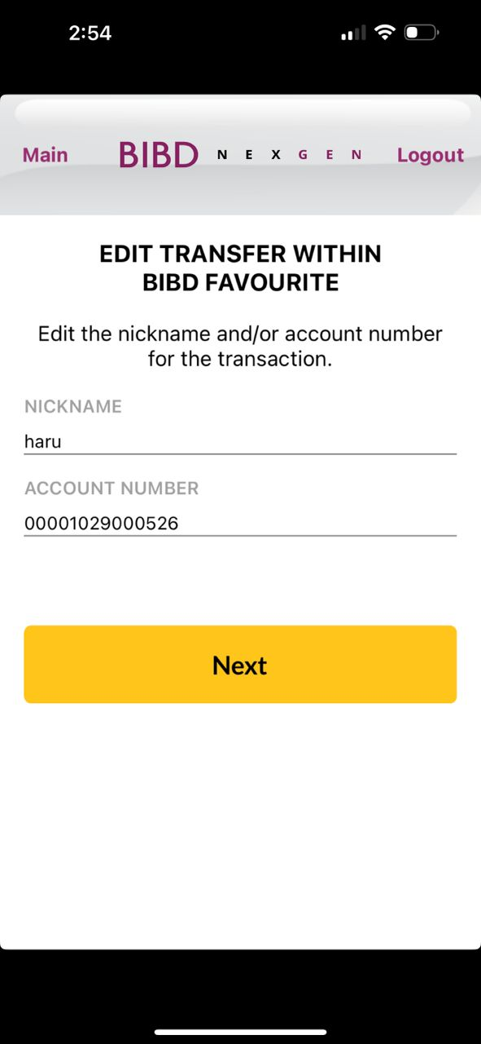
Android
INPUT EDIT
iOS
Box size, font size, box color follow as per quickpay module and word should be ‘Next’

Slide 19
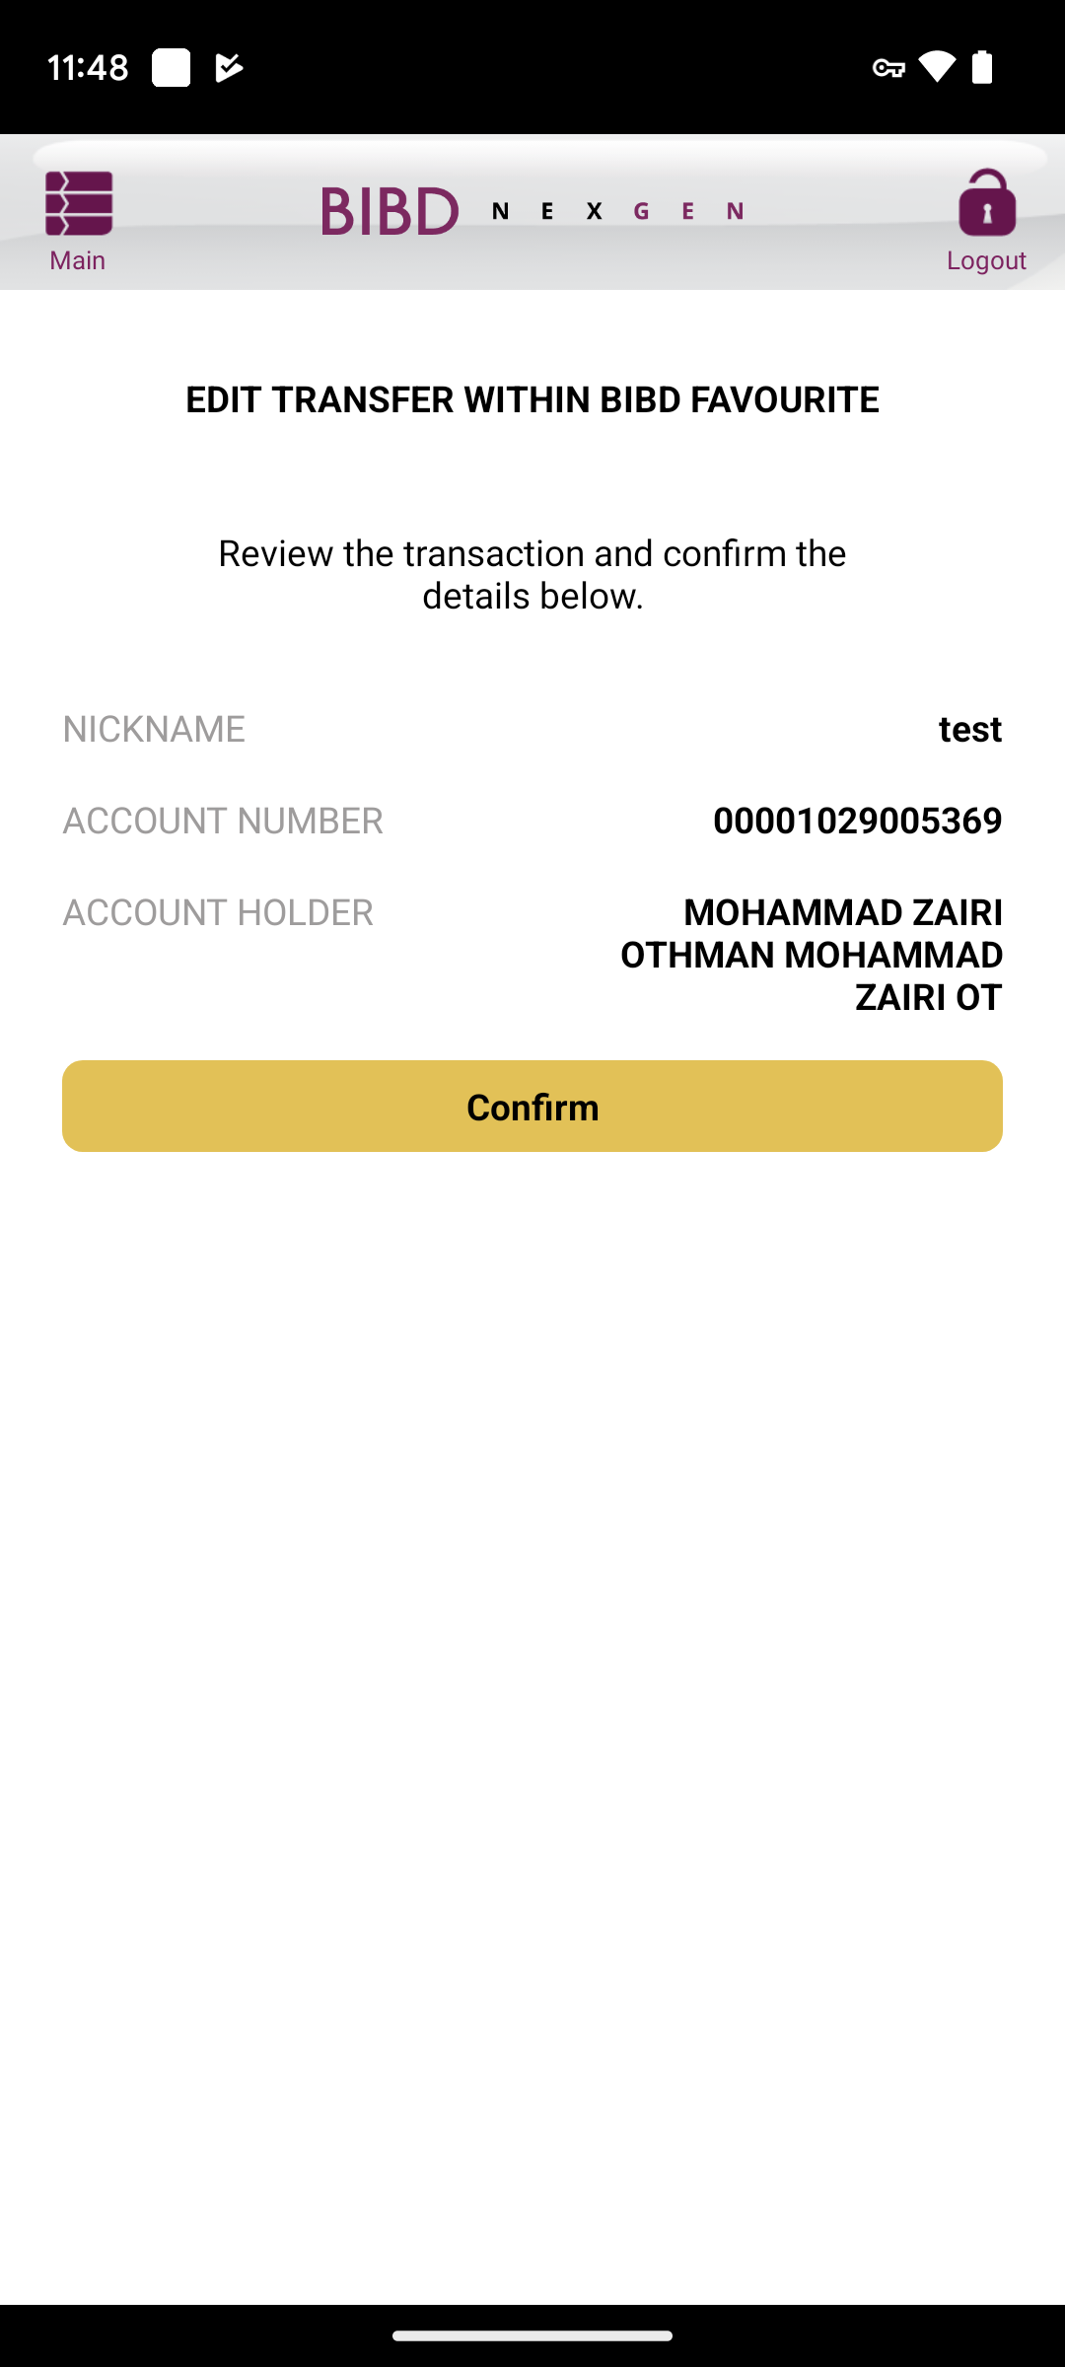
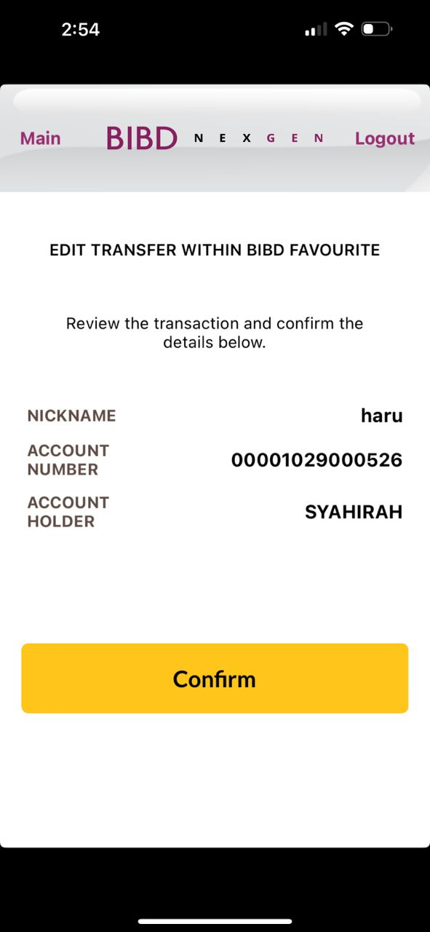
Android
CONFIRM EDIT
iOS
Box size, font size, box color follow as per quickpay module and word should be ‘Confirm’

Slide 20
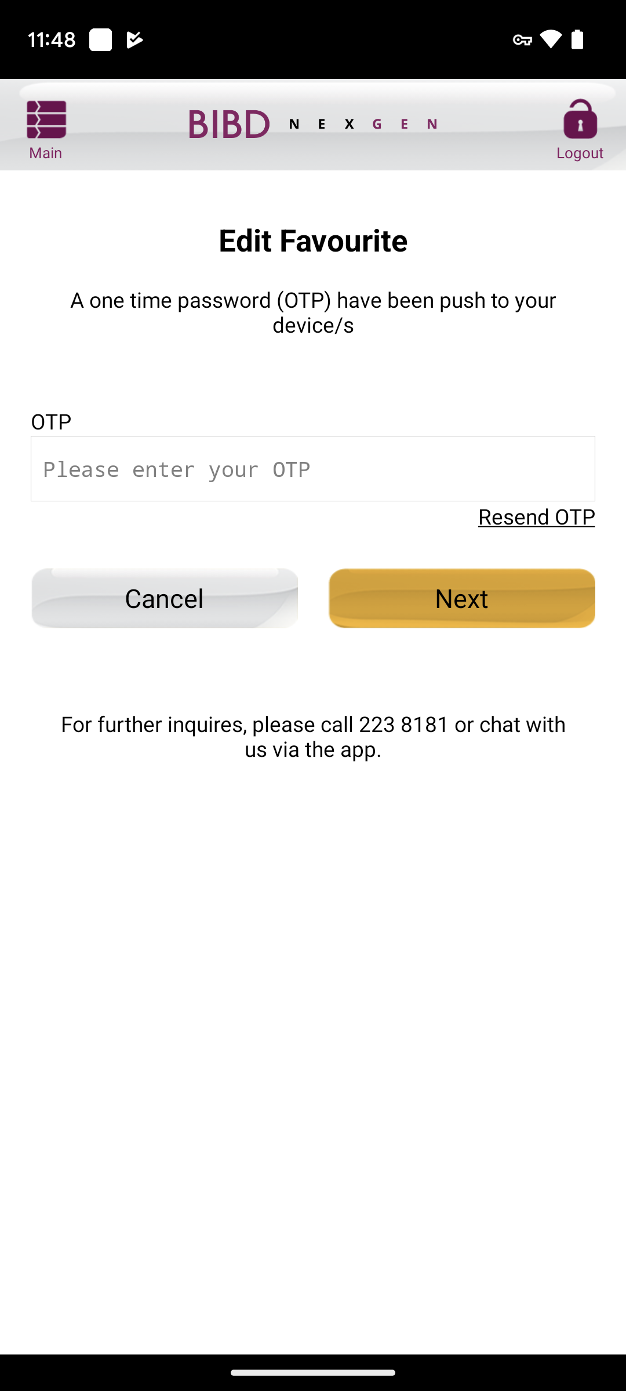
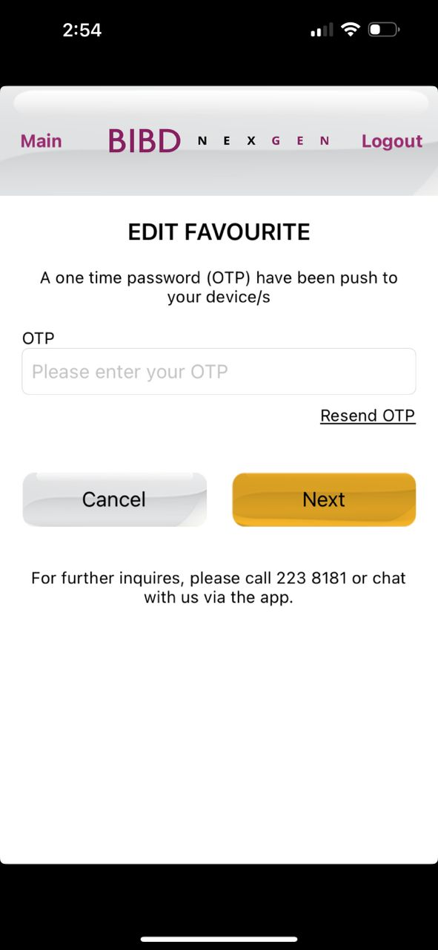
Android
OTP EDIT
iOS
Change to ‘Edit Favourite’

Slide 21
Android
BIO EDIT
iOS

Slide 22
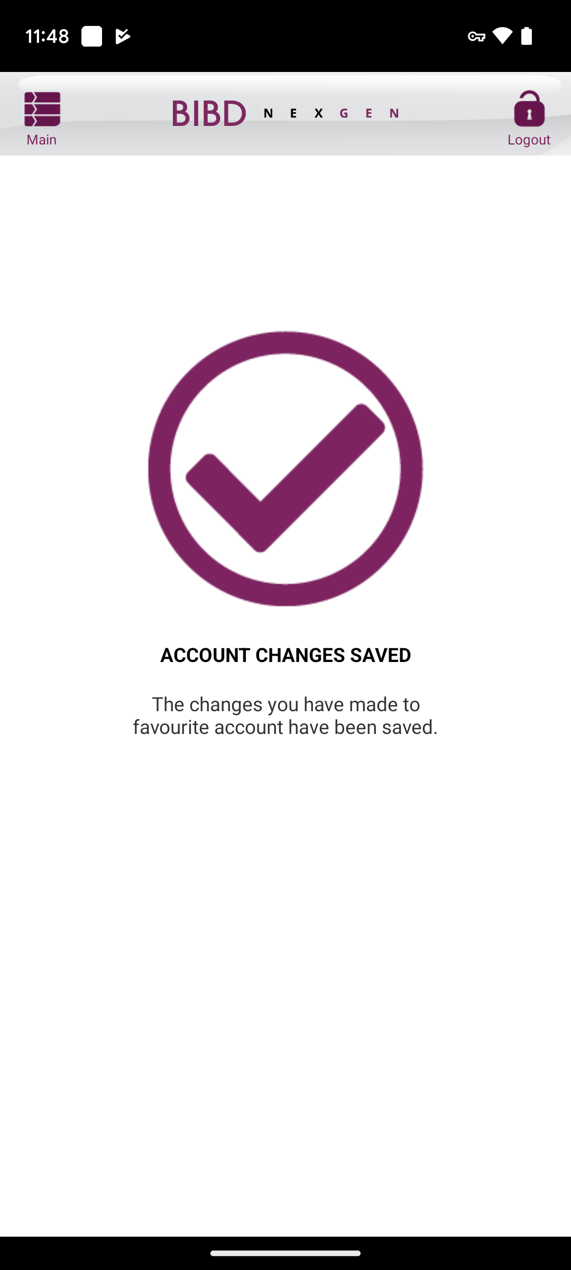
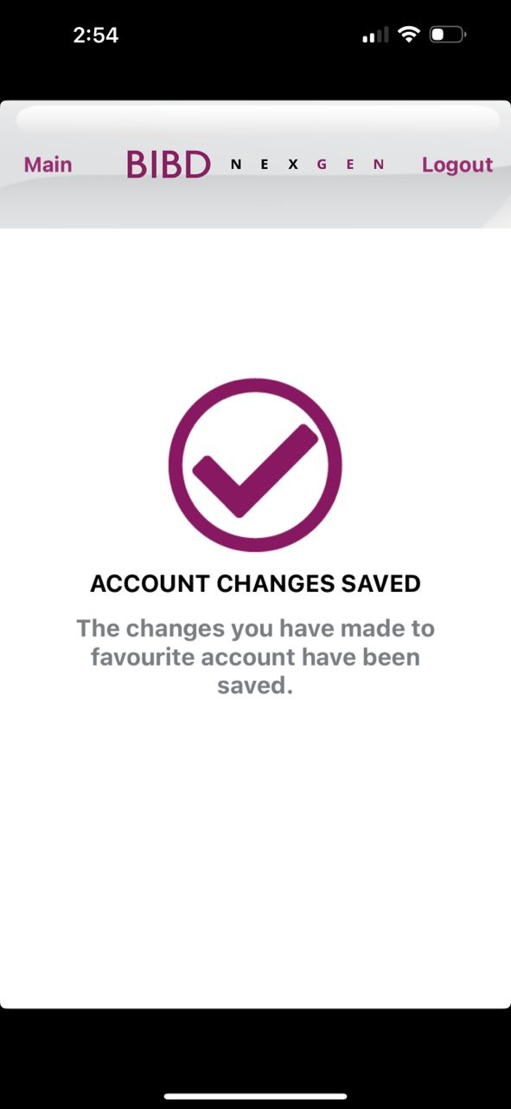
Android
SUCCESS EDIT
iOS
Done
Done

Slide 23
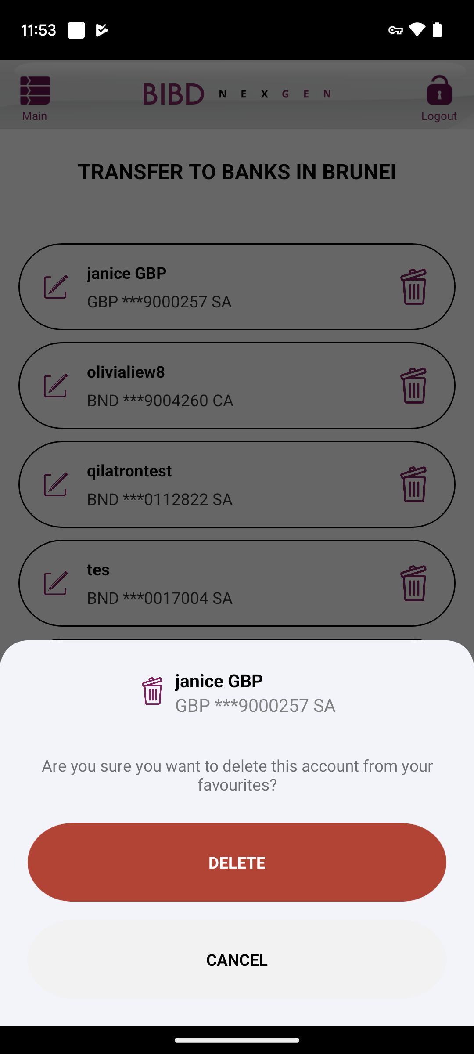
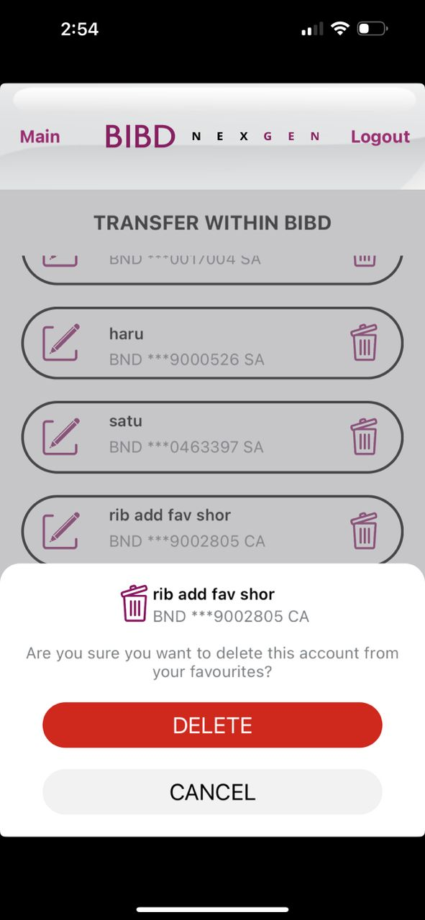
Android
CONFIRM DELETE
iOS
Transparent should be until header. Customer cannot click < or X. only can click DELETE or CANCEL or DONE
Make the icon bigger
Make box Delete and Cancel bigger a bit
Box color white

Slide 24
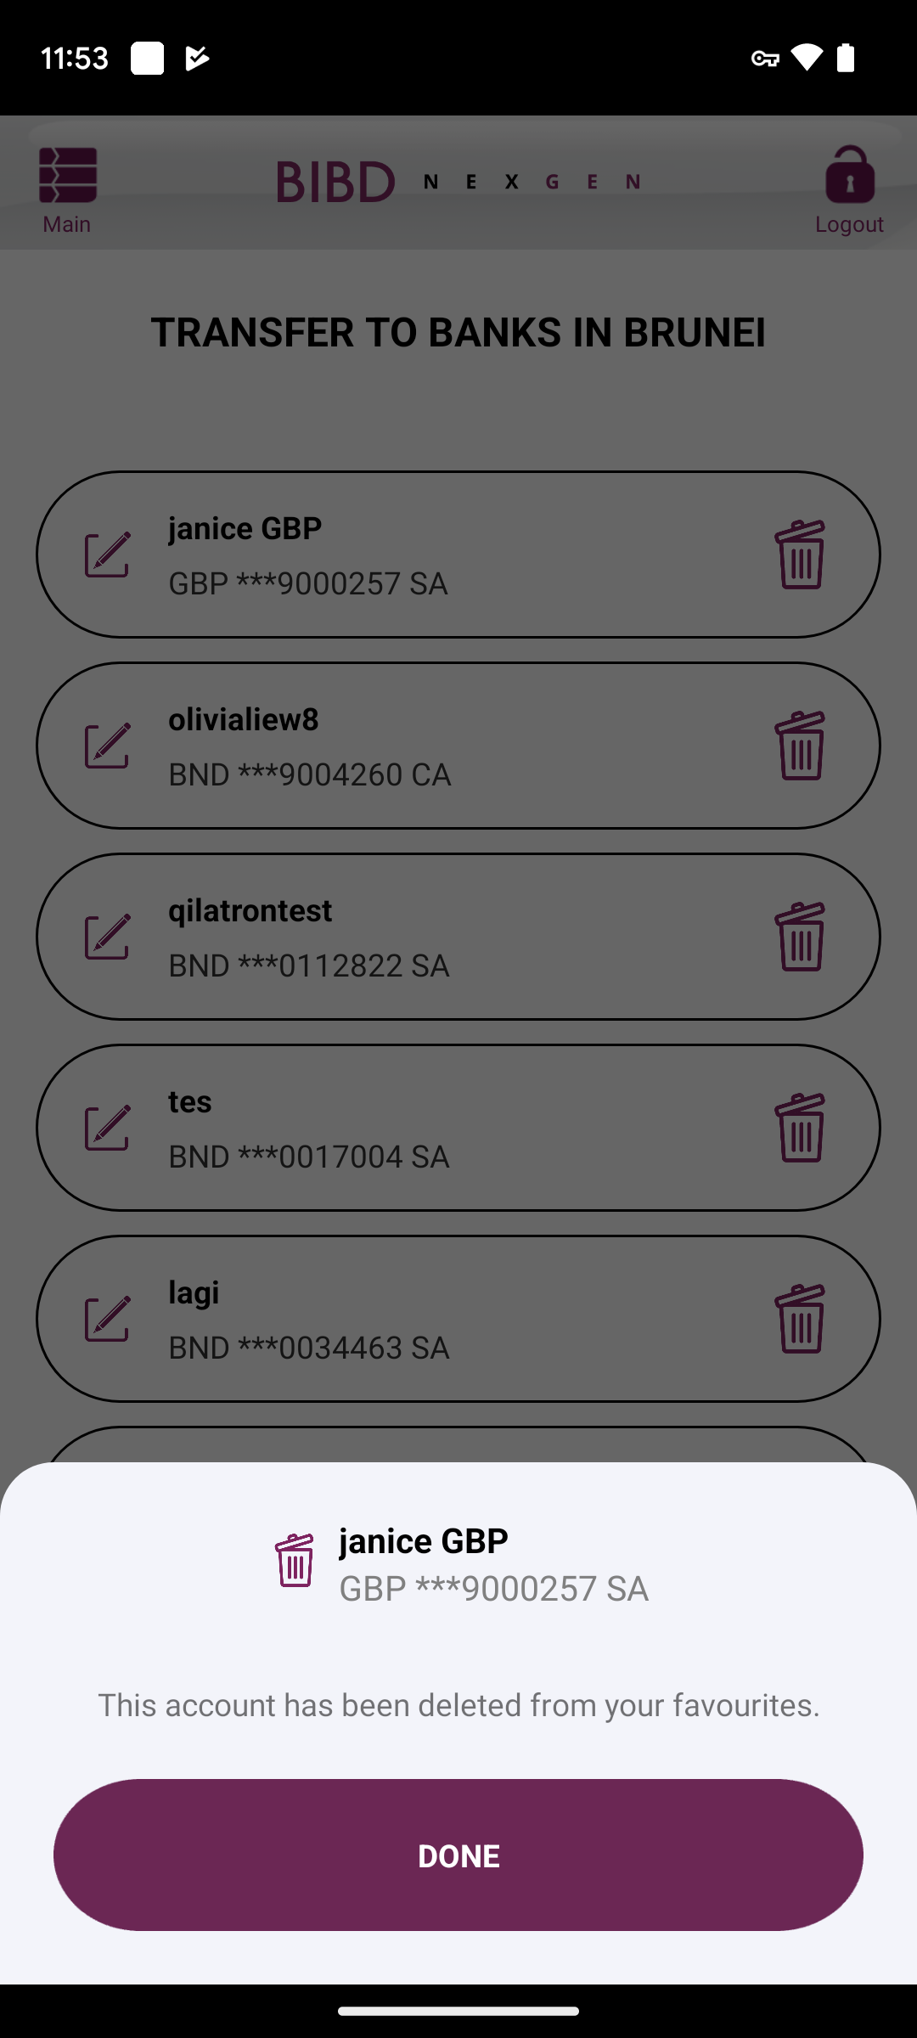
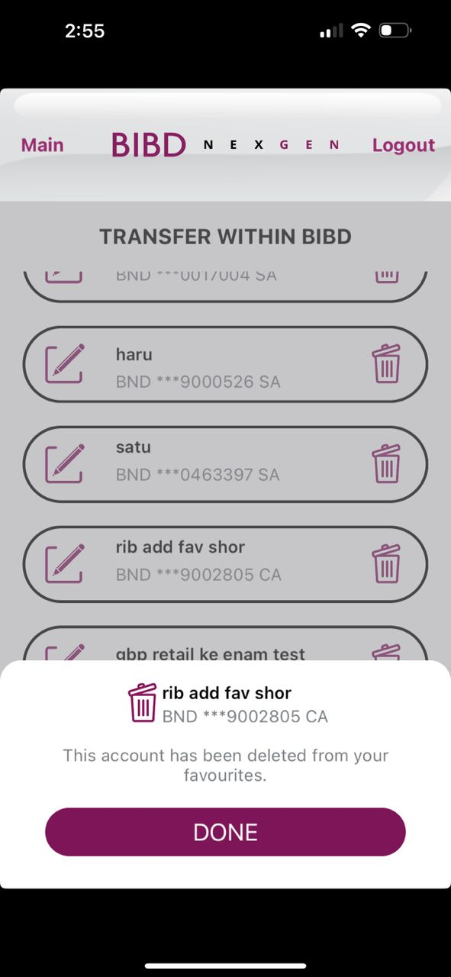
Android
SUCCESS DELETE
iOS
Transparent should be until header. Customer cannot click < or X. only can click DELETE or CANCEL or DONE
Make box Delete and Cancel bigger a bit
Box color white

Slide 25
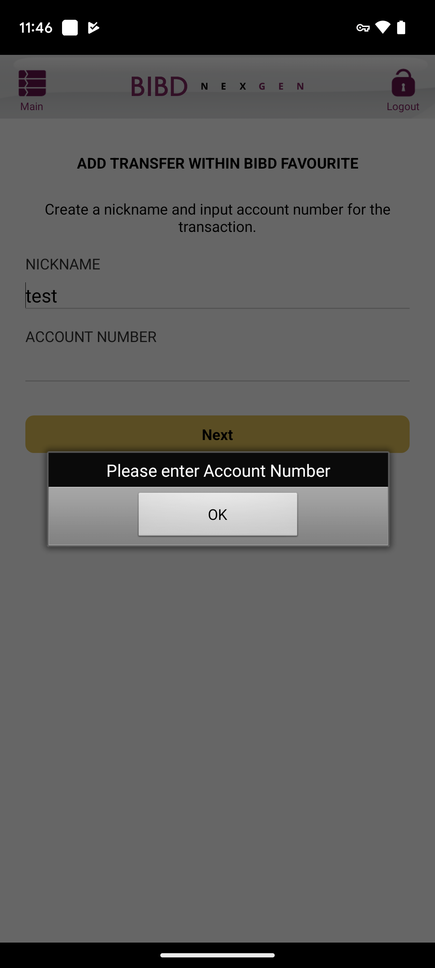
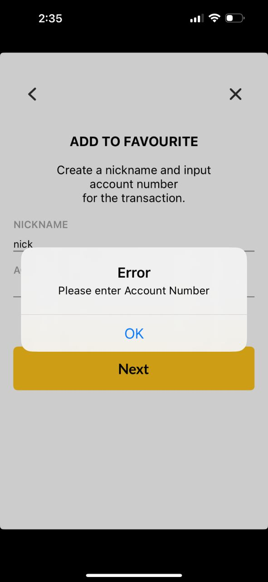
Android
ERROR EMPTY ACC NUM
iOS

Slide 26
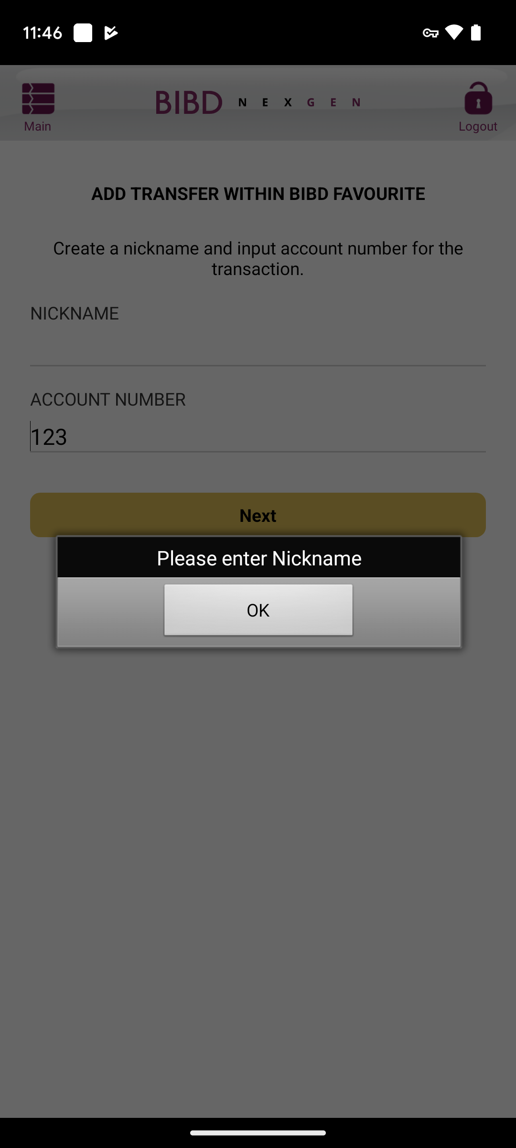
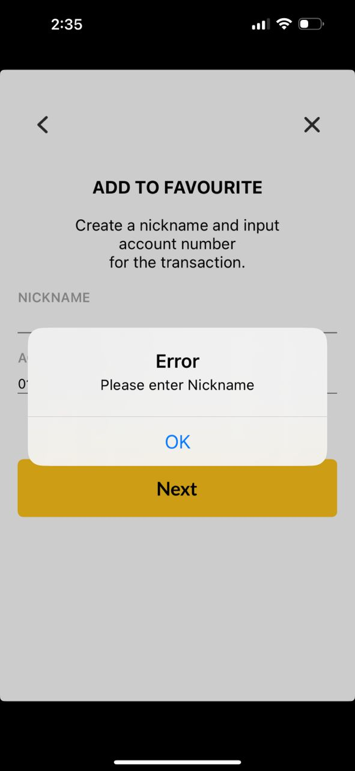
Android
ERROR EMPTY NICKNAME
iOS

Slide 27
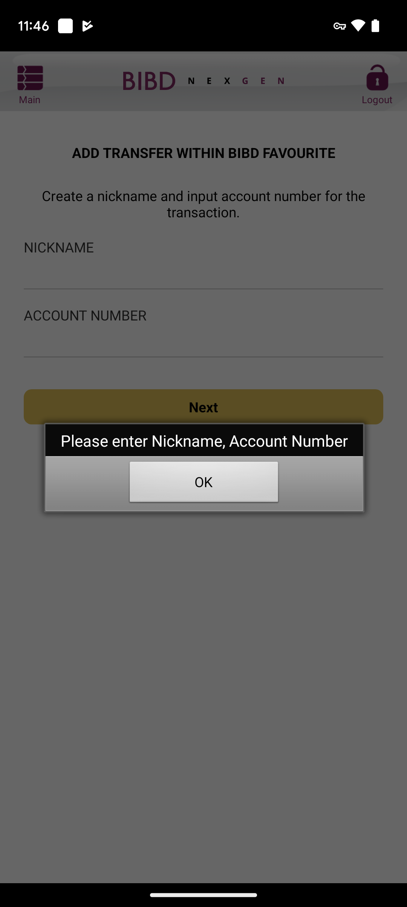
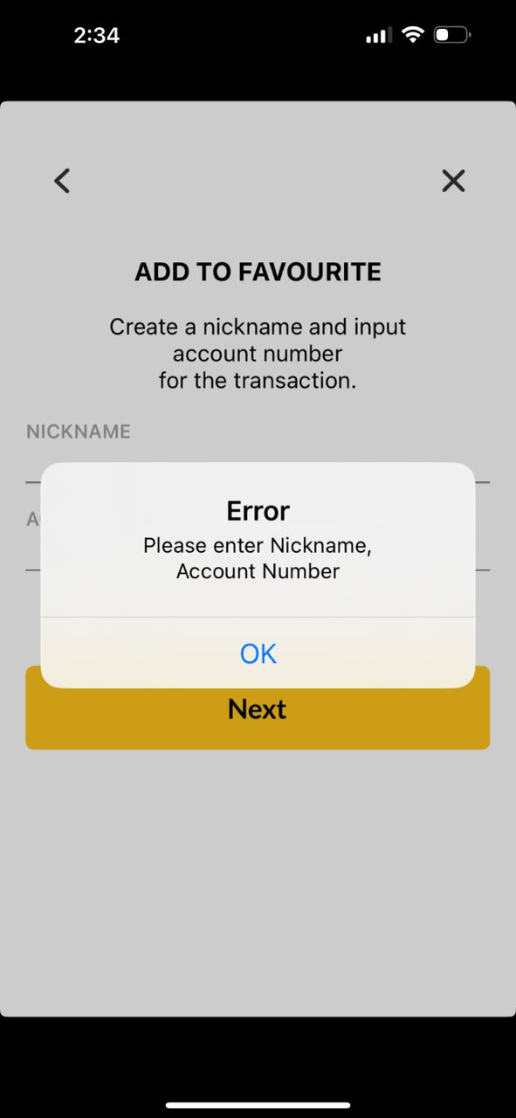
Android
ERROR EMPTY NICKNAME
AND ACC NUM
iOS

