Slide 1
ADD/EDIT/DELETE FAVOURITE FROM MANAGE FAVOURITE MENU

Slide 2
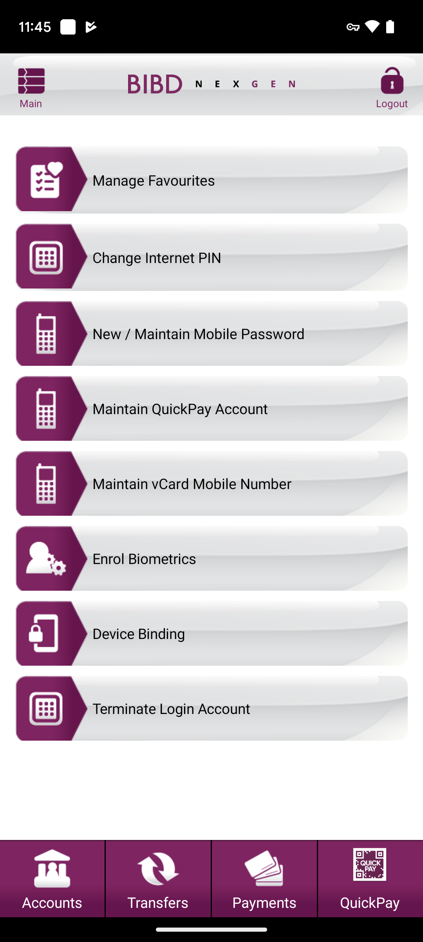
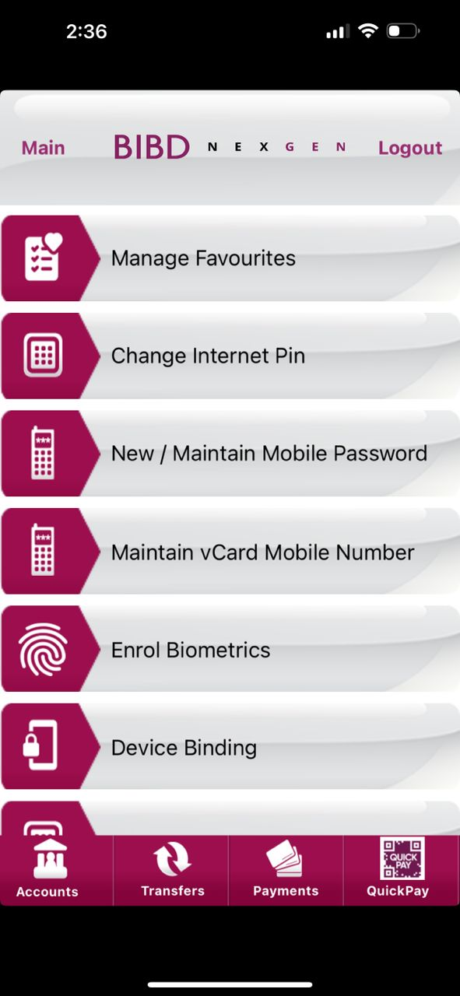
Android
SETTINGS
iOS

Slide 3
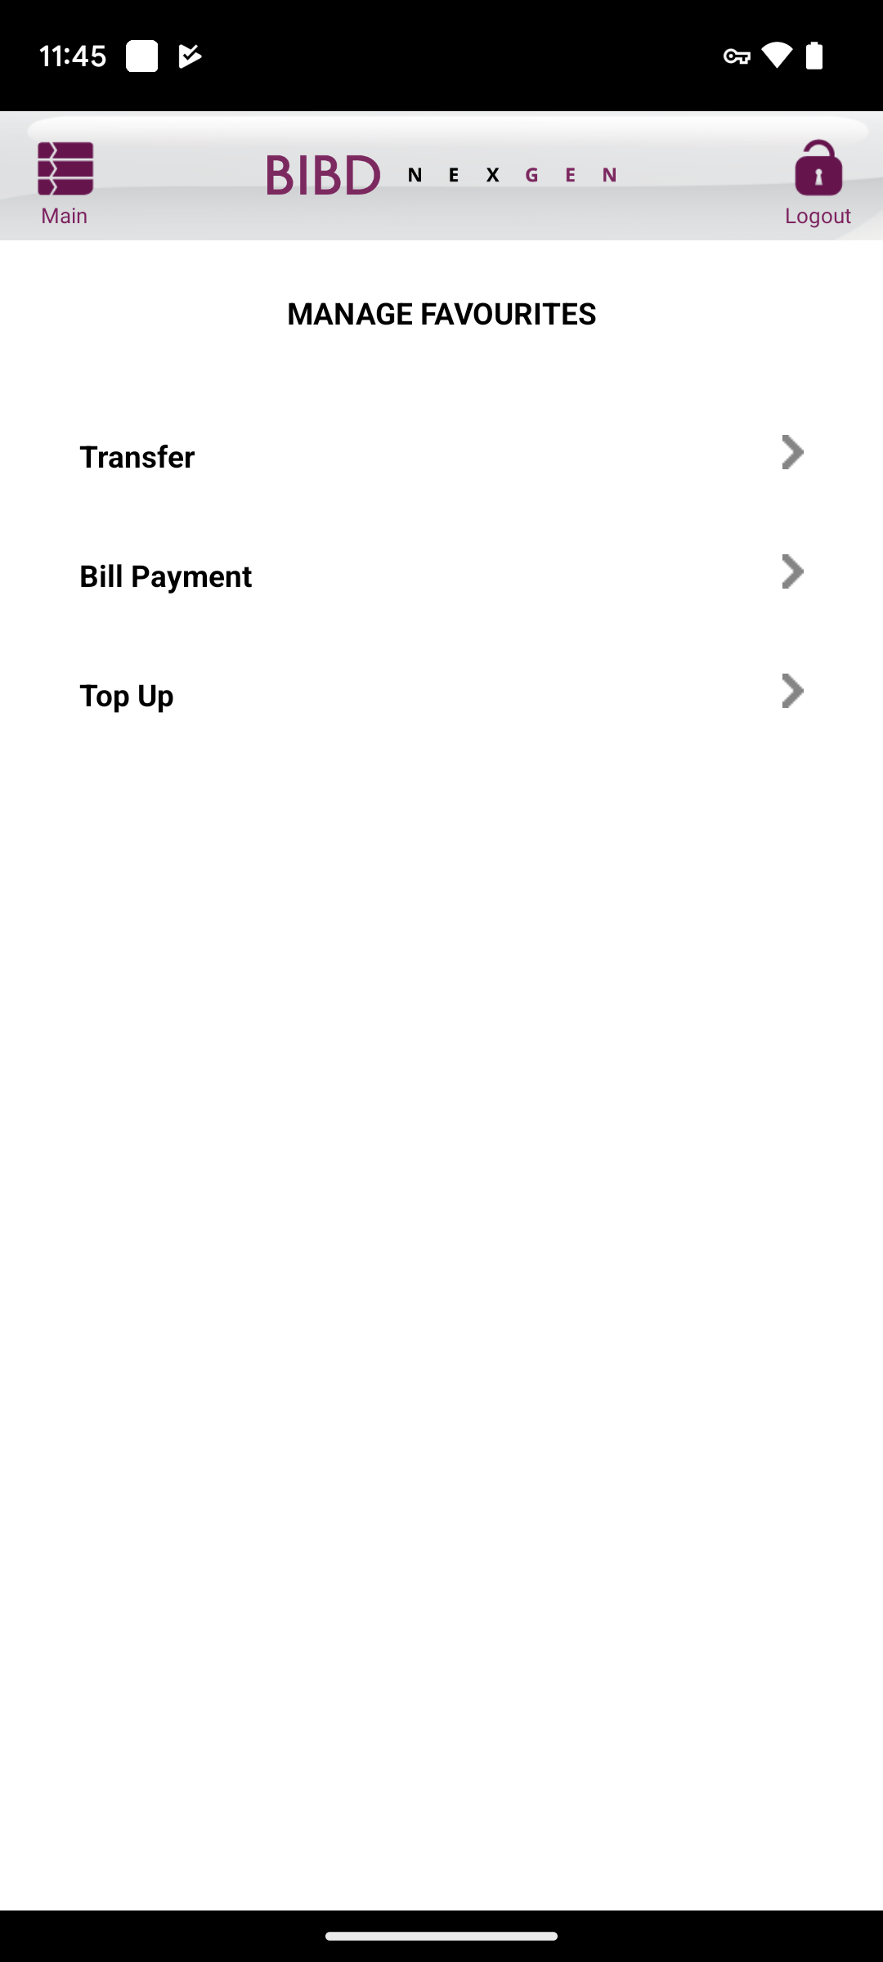
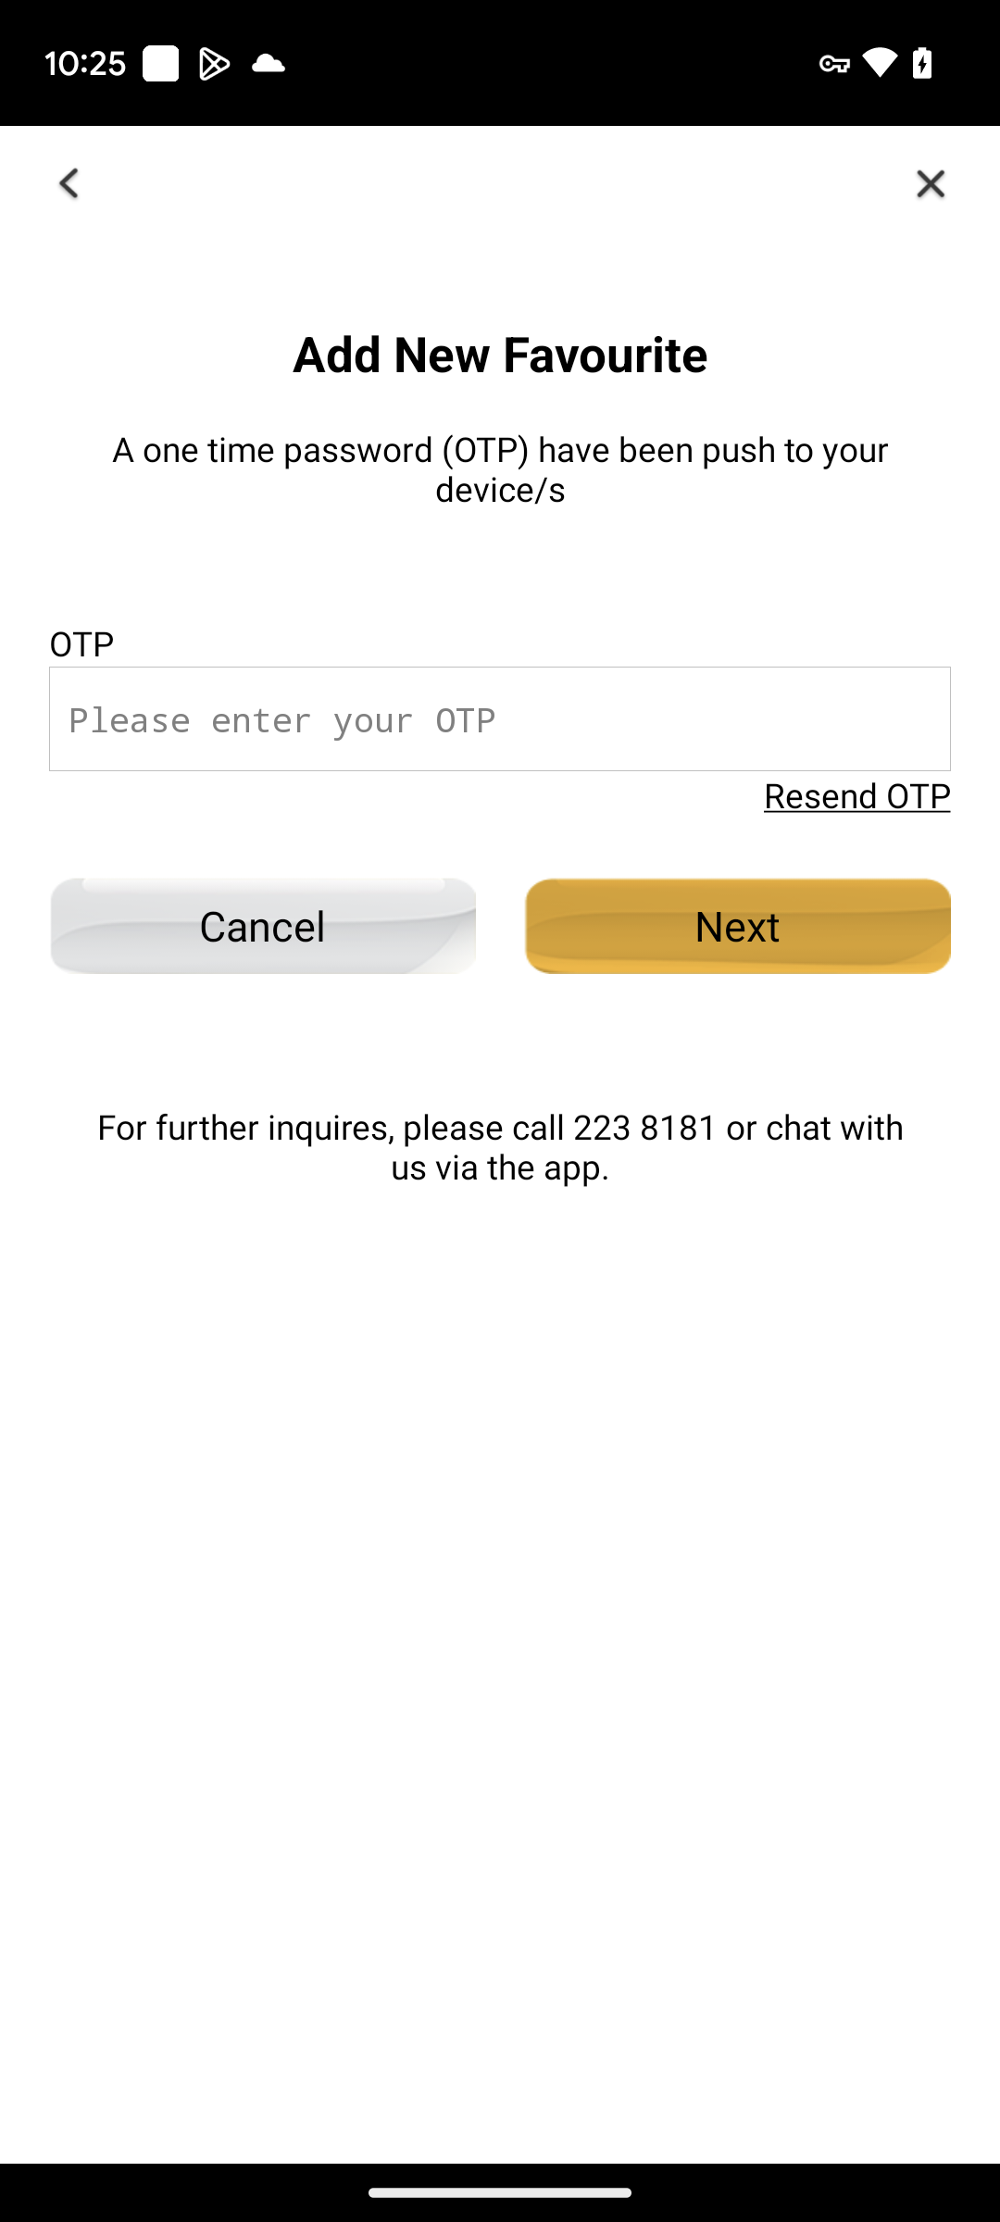
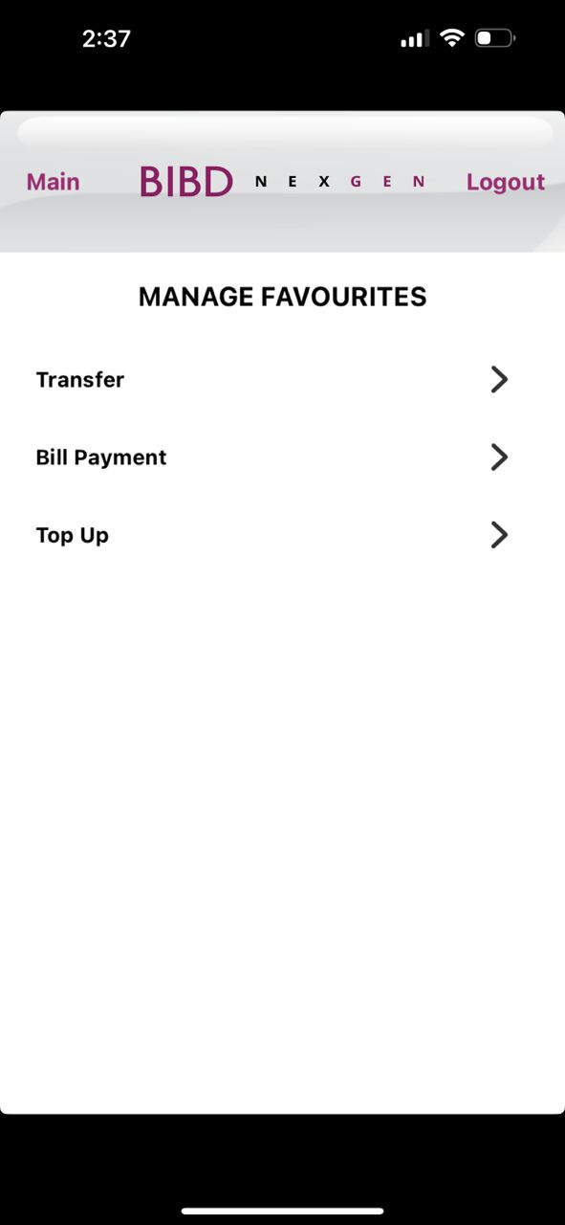
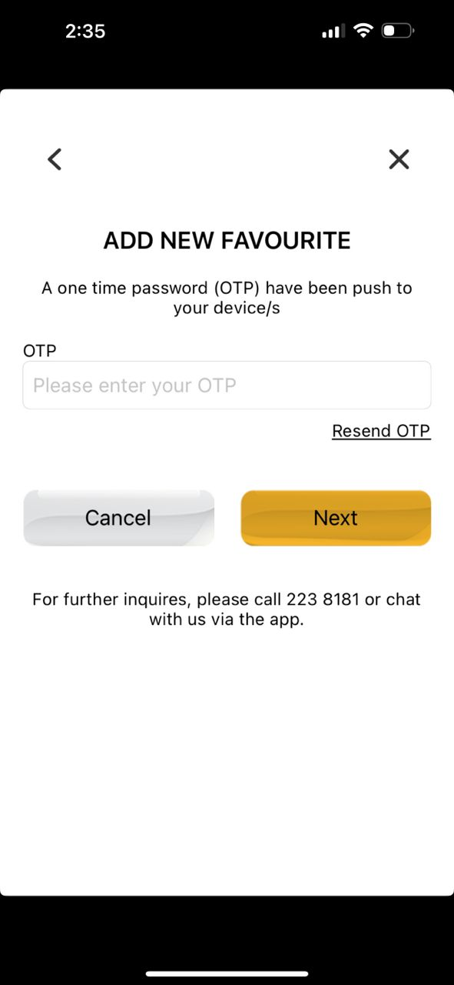
Android
MANAGE FAVOURITES
iOS

Slide 4
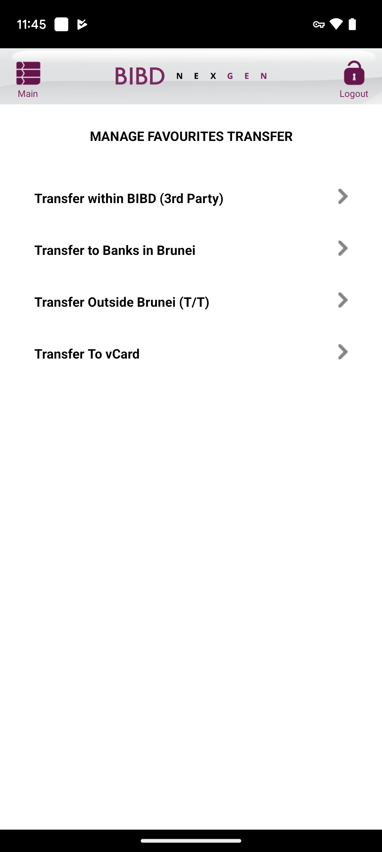
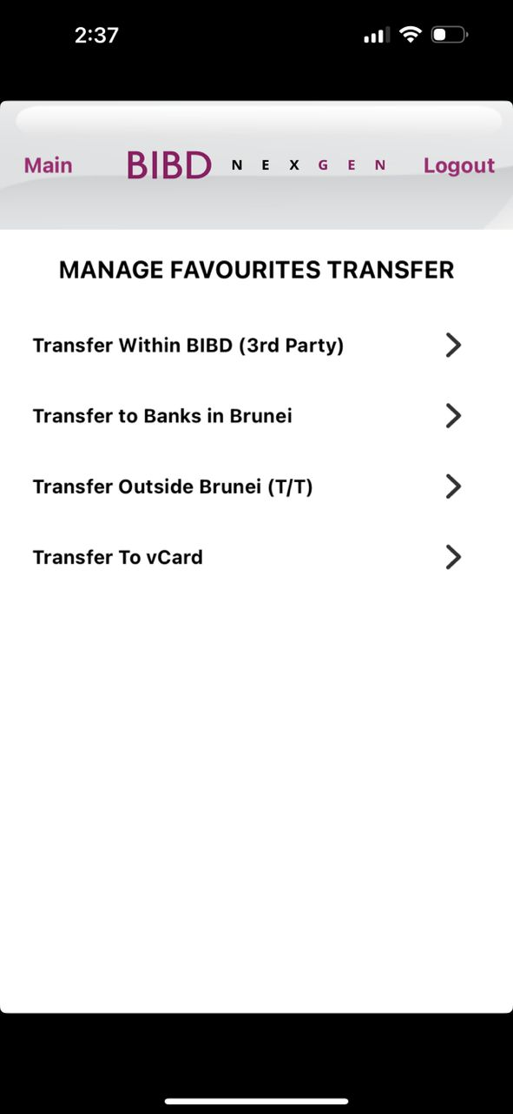
Android
MANAGE FAV TRANSFER
iOS

Slide 5
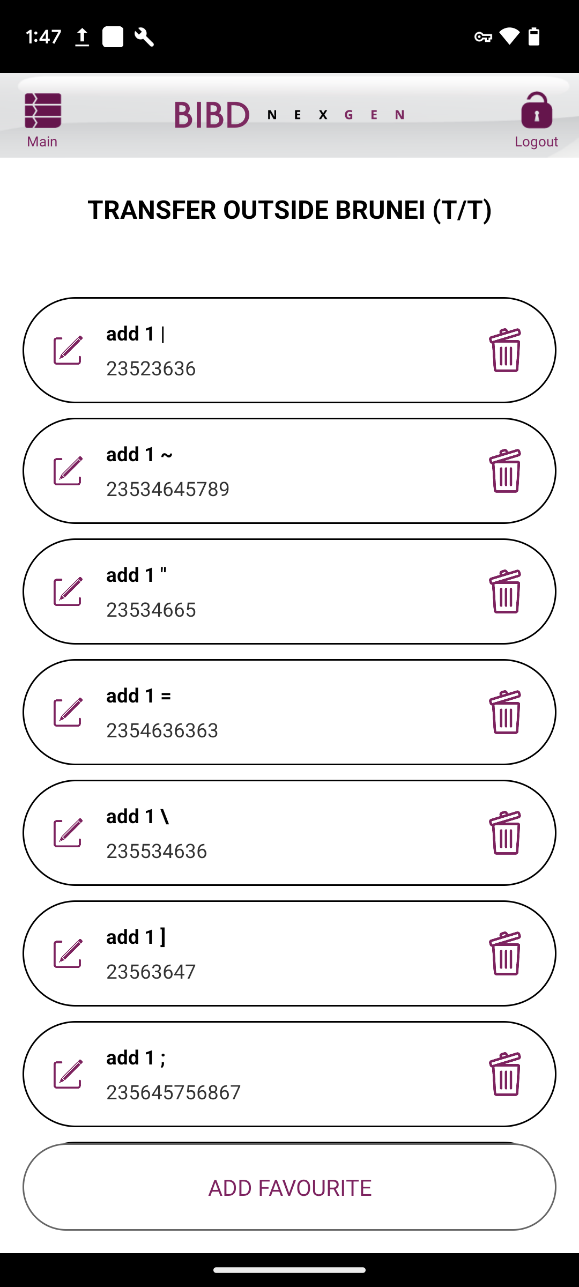
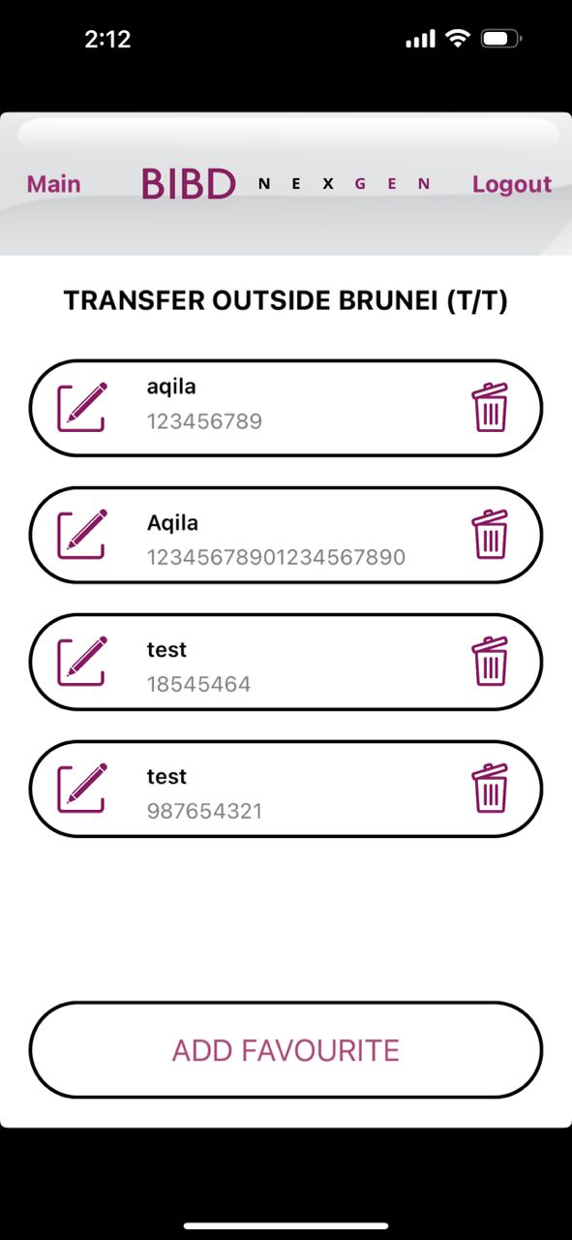
Android
TRANSFER TO BANKS IN BRUNEI
FAV LIST
iOS

Slide 6
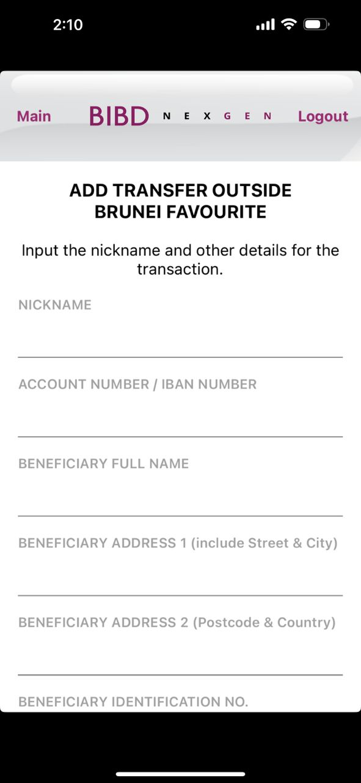
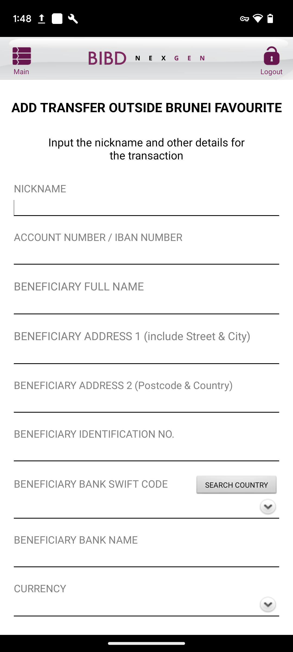
Android
INPUT ADD (1 OF 2)
iOS
Change to
‘Create a nickname and input other details for the transaction’

Slide 7
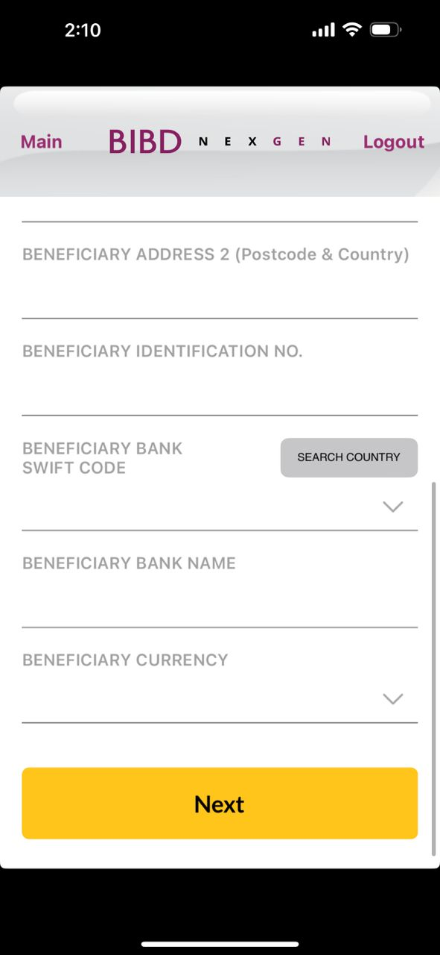
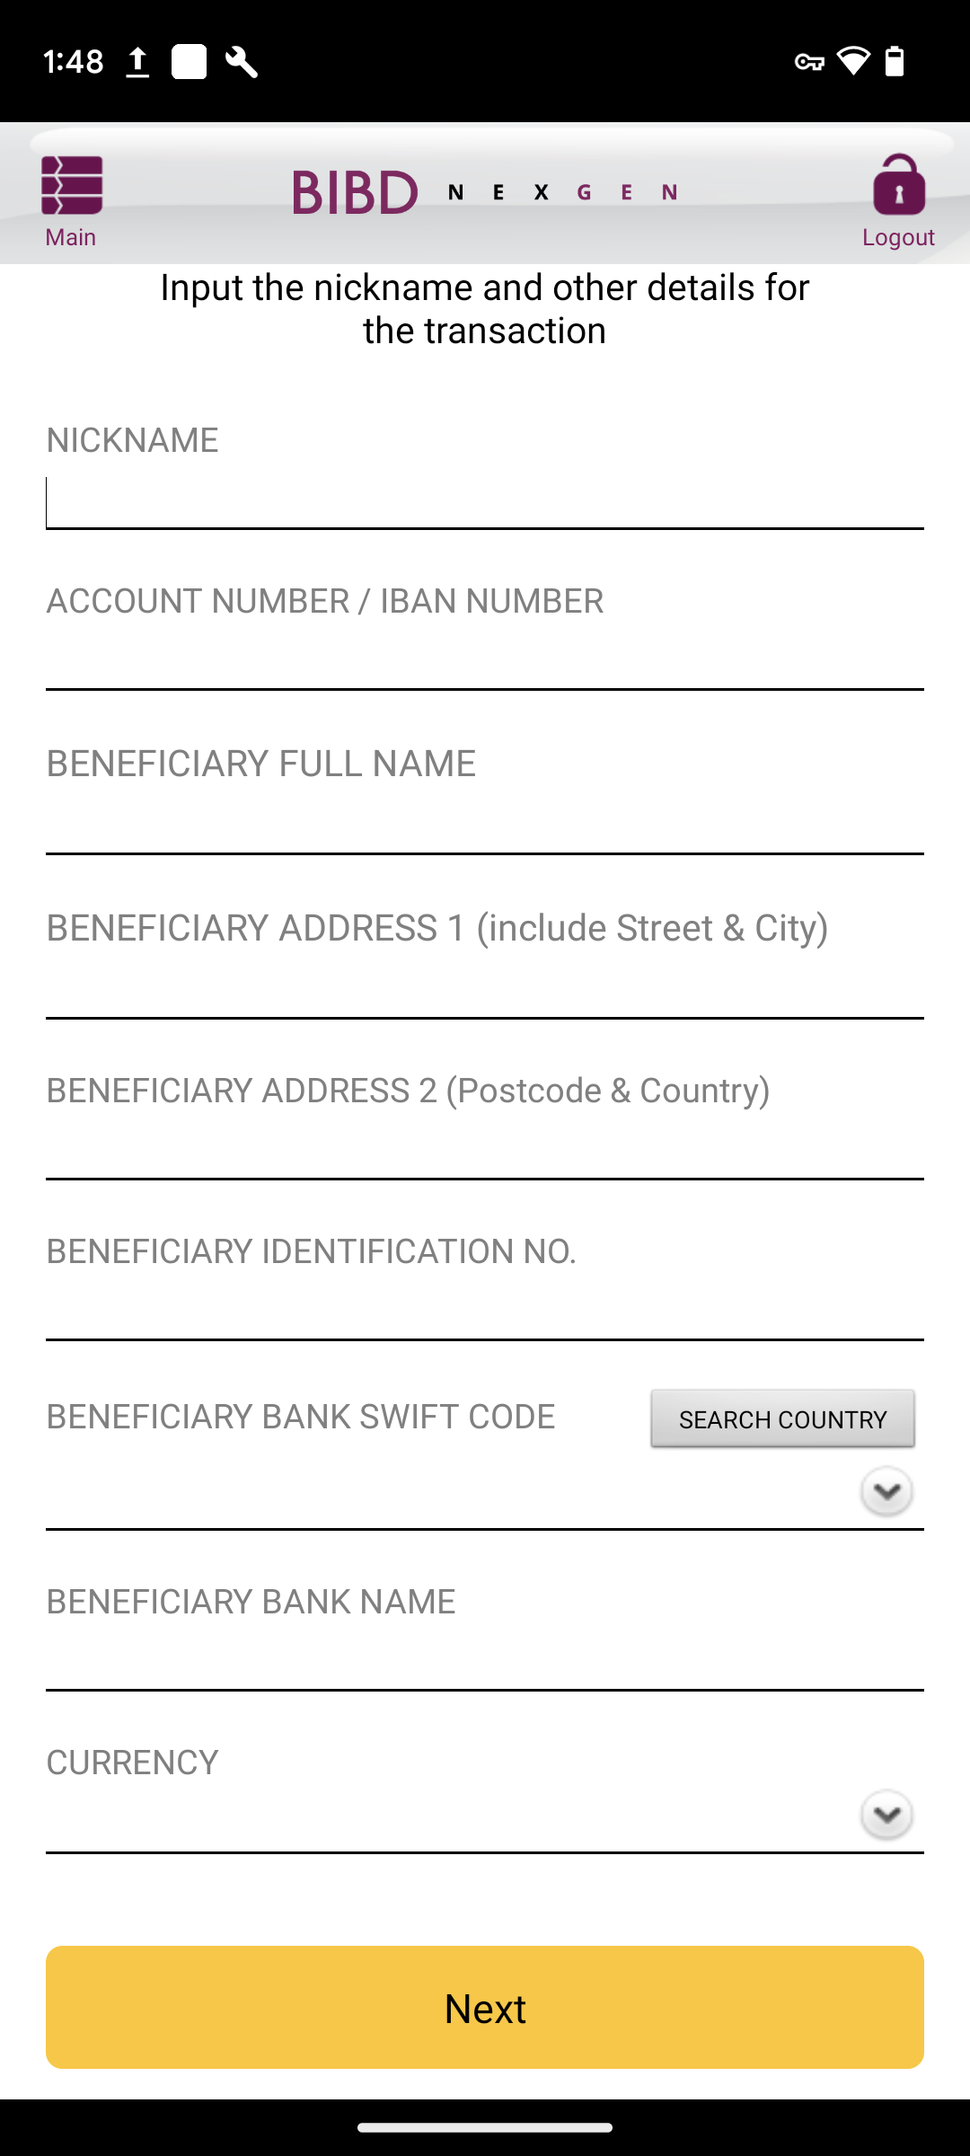
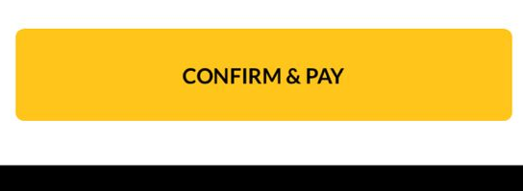
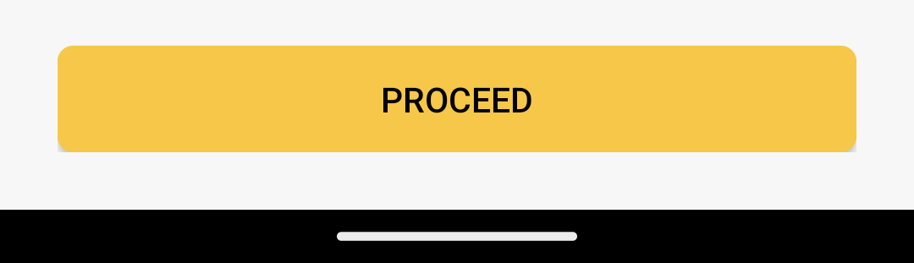
Android
INPUT ADD (2 OF 2)
iOS
Change to ‘BENEFICIARY CURRENCY’
Box size, font size, box color follow as per quickpay module and word should be ‘Next’

Slide 8
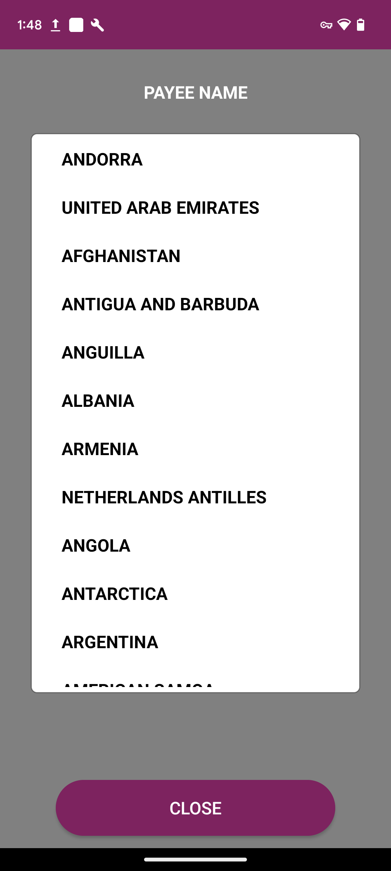
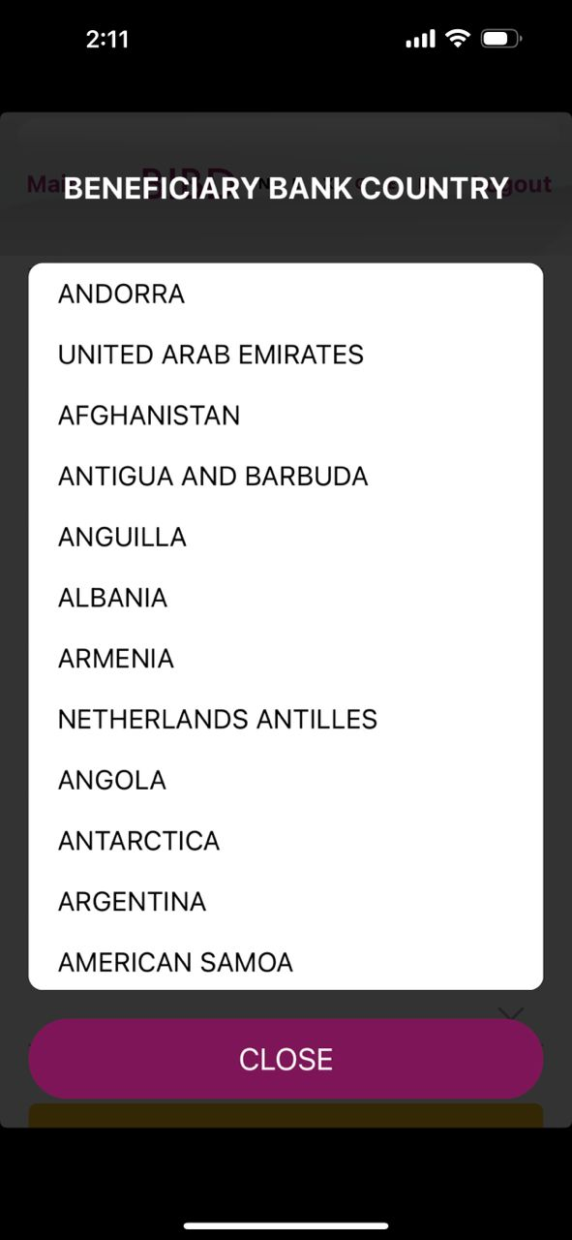
Android
LIST COUNTRY
iOS
Change to ‘BENEFICIARY BANK COUNTRY’
Un-bold the wording

Slide 9
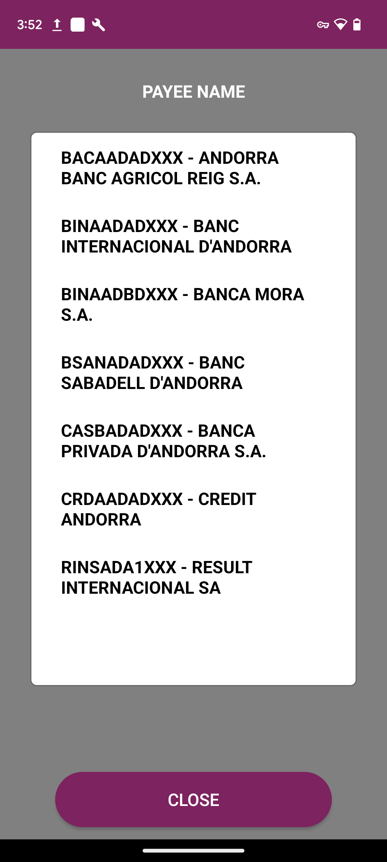
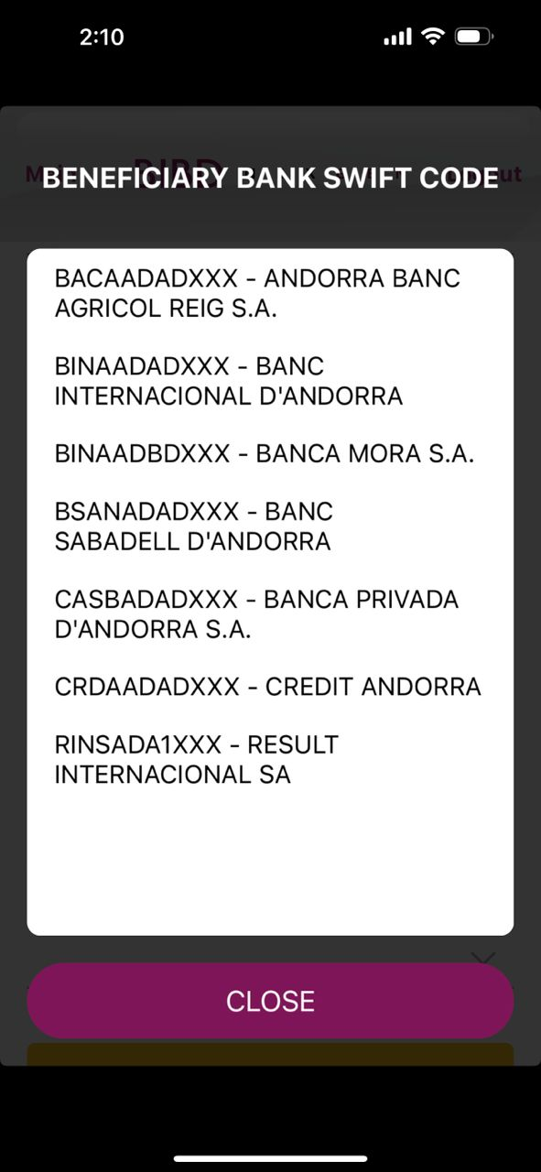
Android
LIST BIC CODE
iOS
Change to ‘BENEFICIARY BANK SWIFT CODE’
Un-bold the wording
The box to be responsive and not show white space

Slide 10
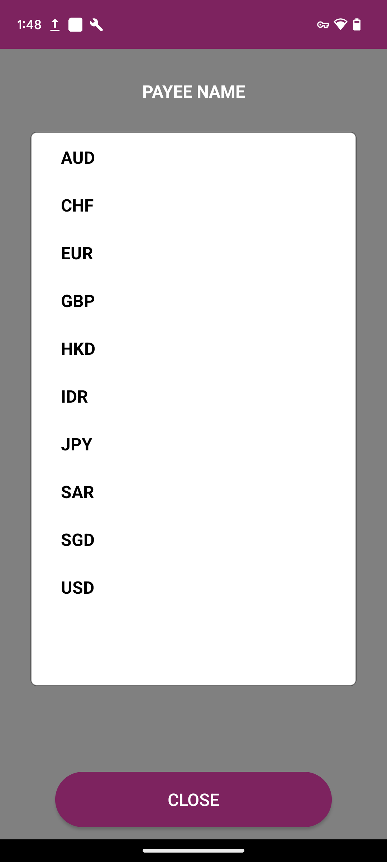
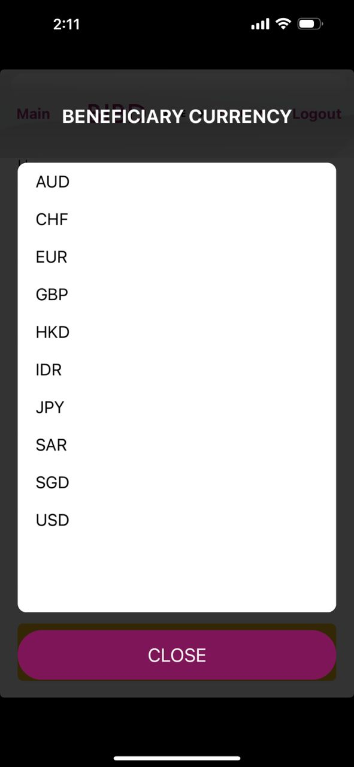
Android
LIST CURRENCY
iOS
Change to ‘BENEFICIARY CURRENCY’
Un-bold the wording
The box to be responsive and not show white space

Slide 11
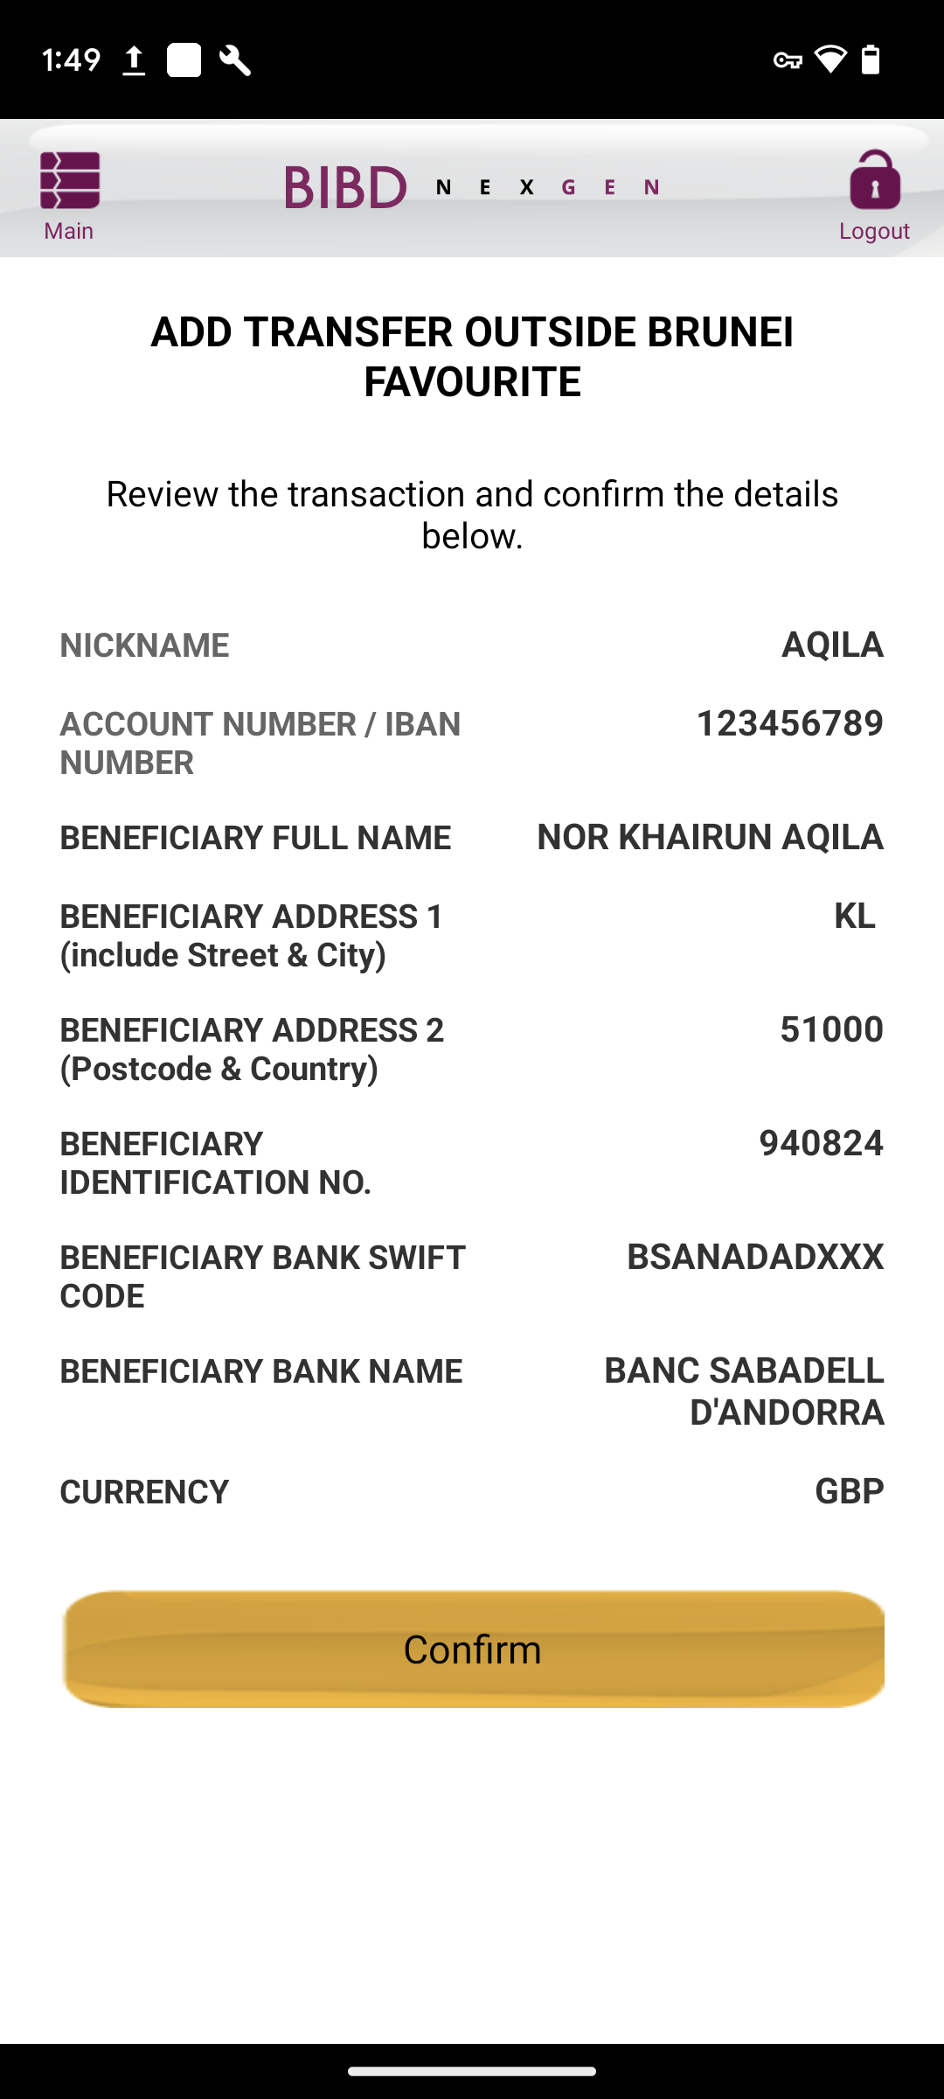
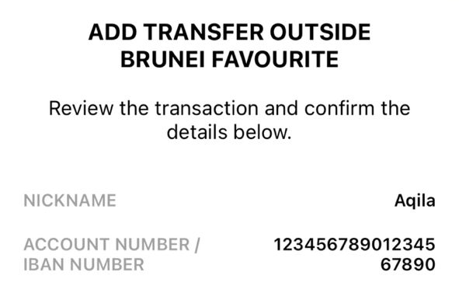
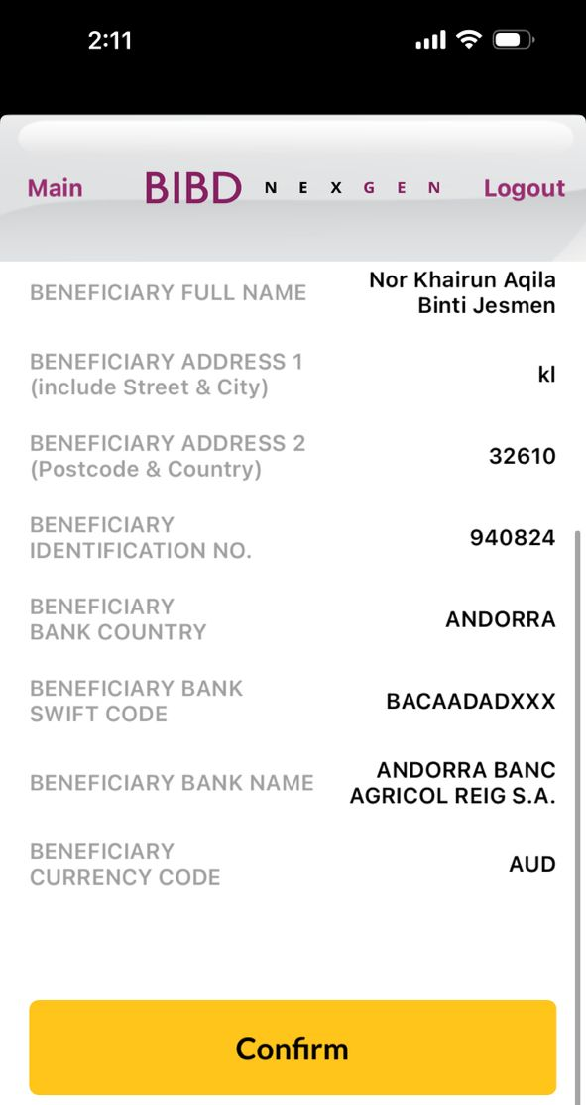
Android
CONFIRM ADD
iOS
Change to ‘BENEFICIARY CURRENCY’
Remove the field
Box size, font size, box color follow as per quickpay module and word should be ‘Confirm’

Slide 12
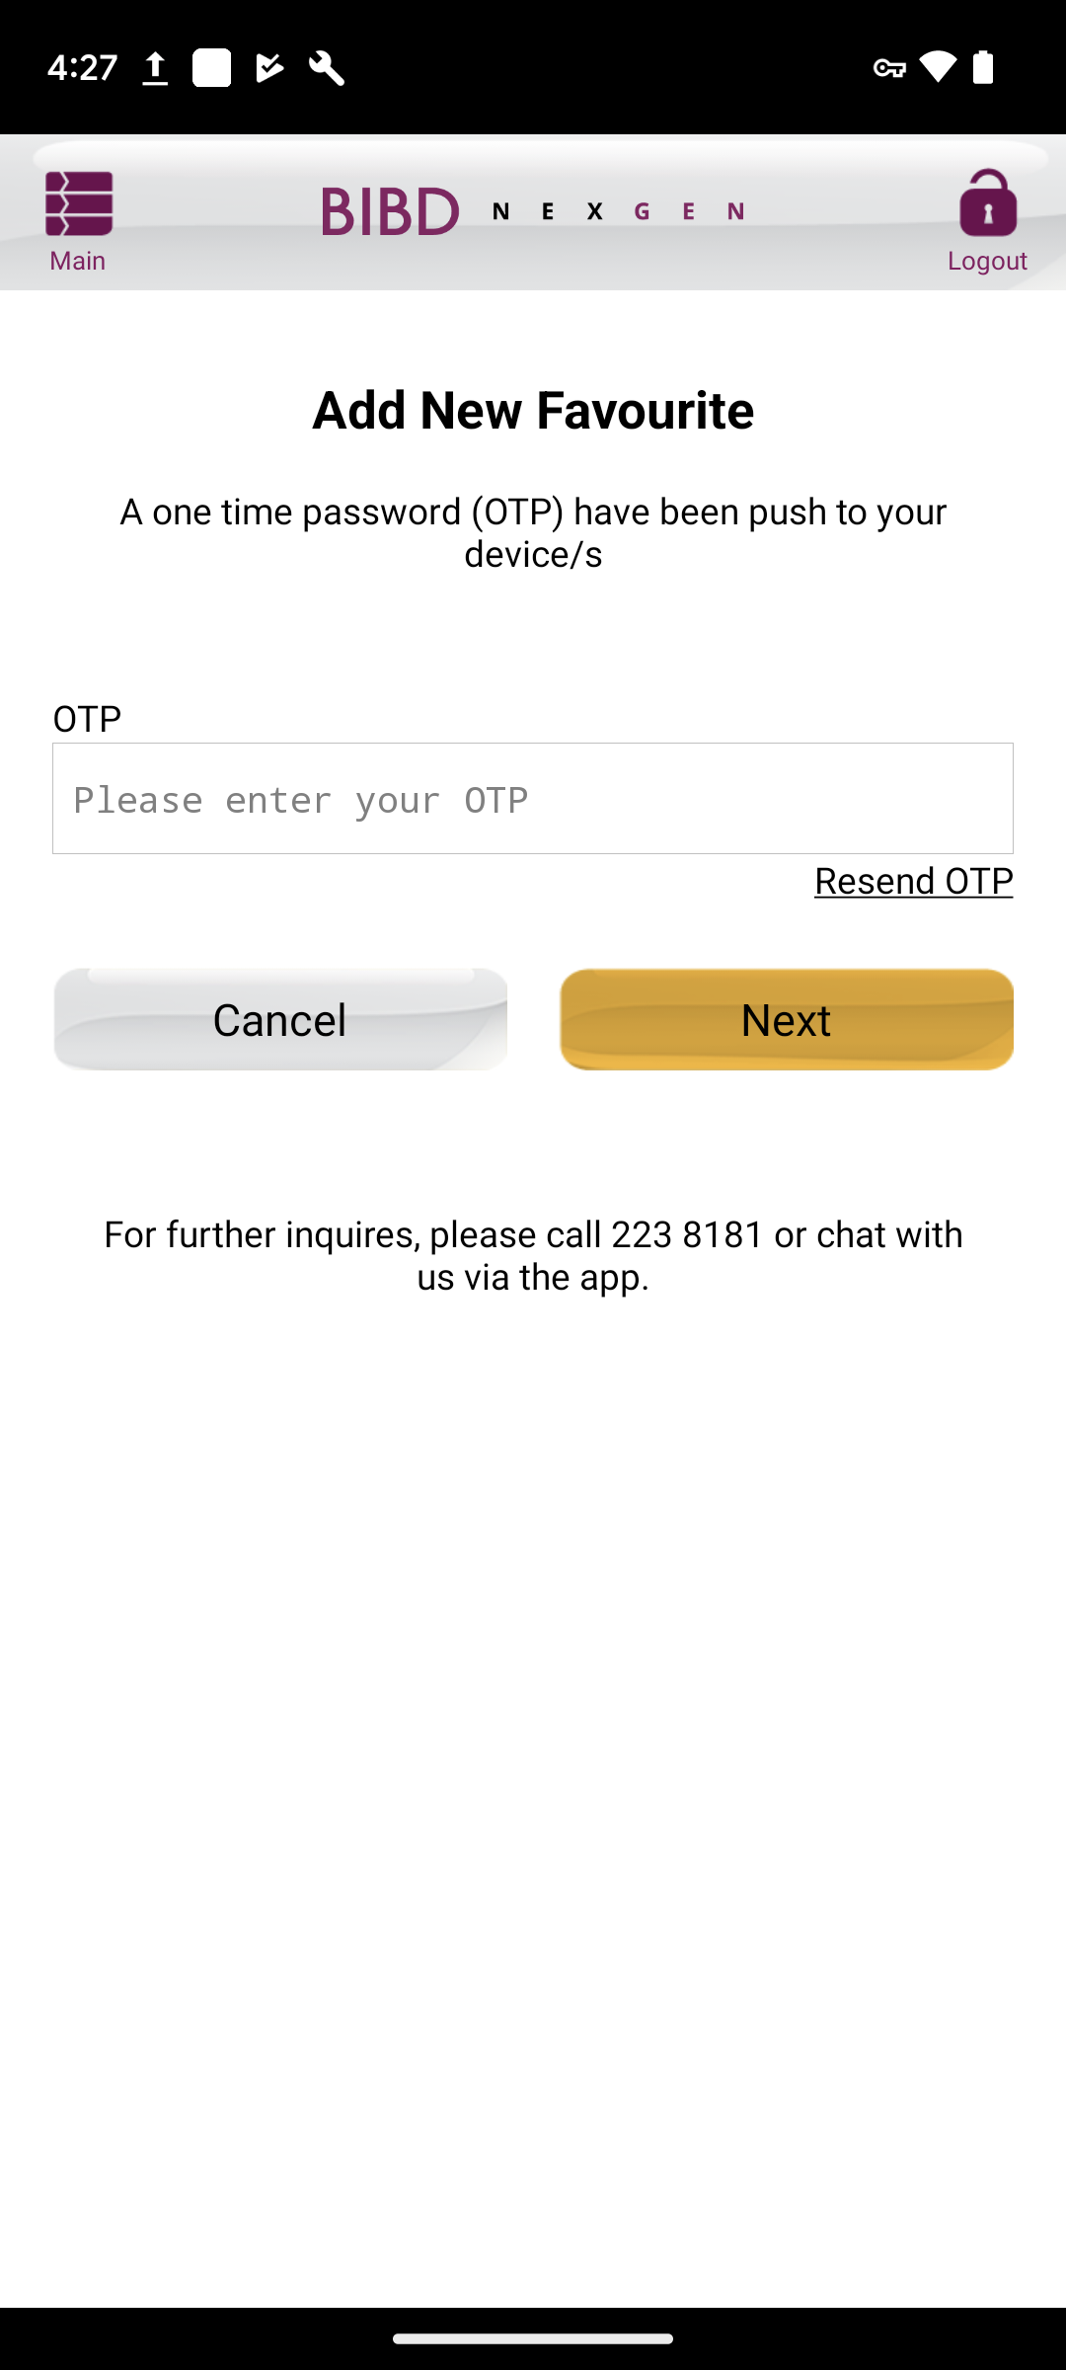
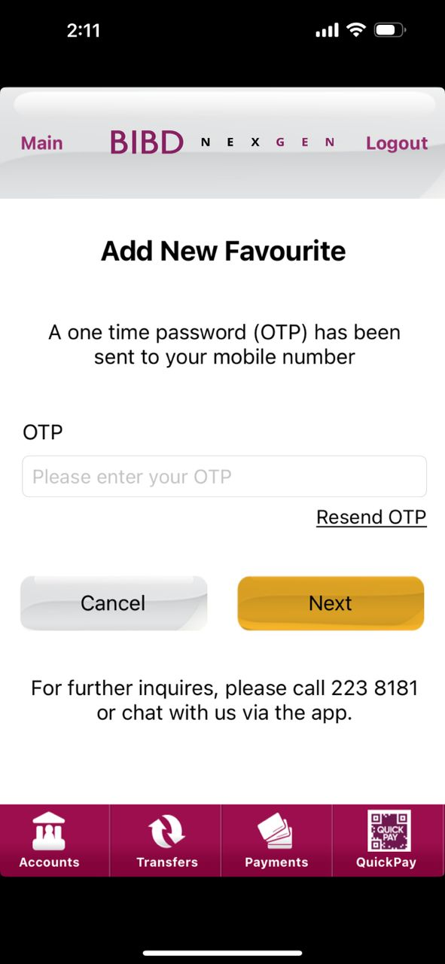
Android
OTP ADD
iOS

Slide 13
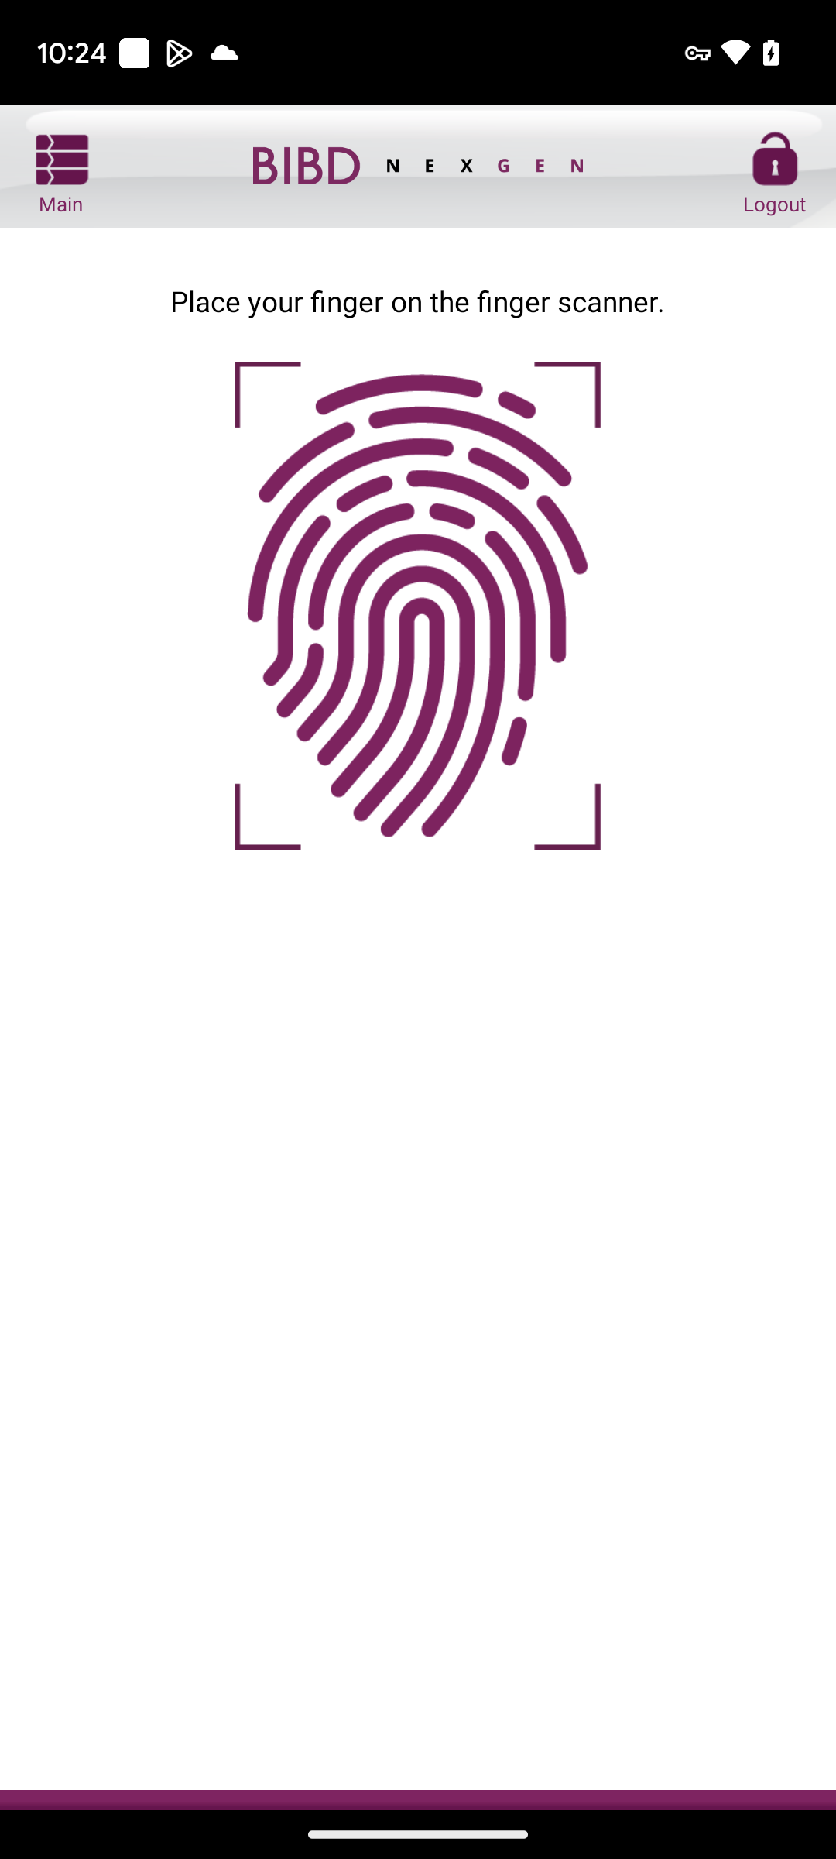
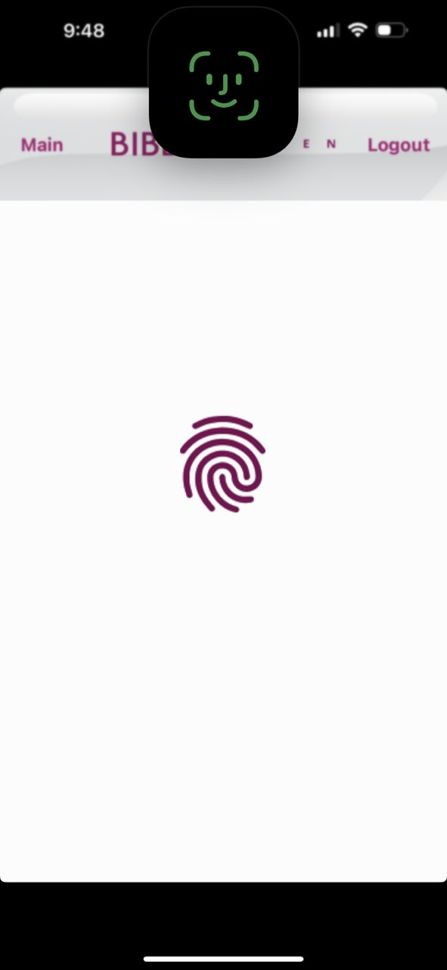
Android
BIO ADD
iOS

Slide 14
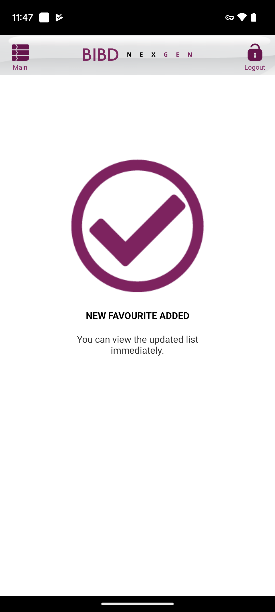
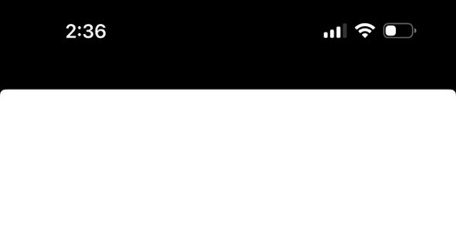
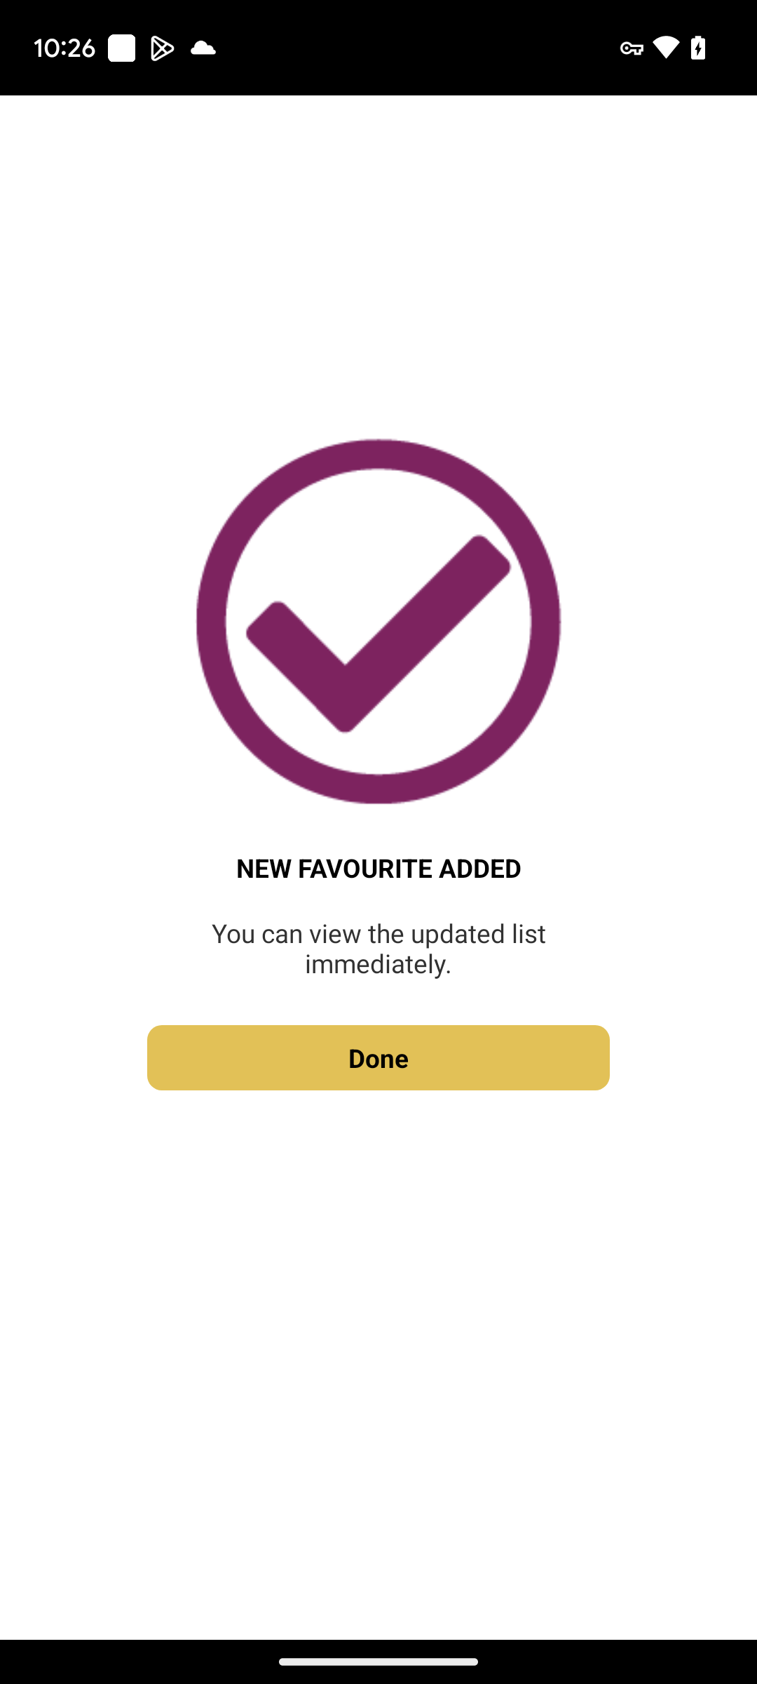
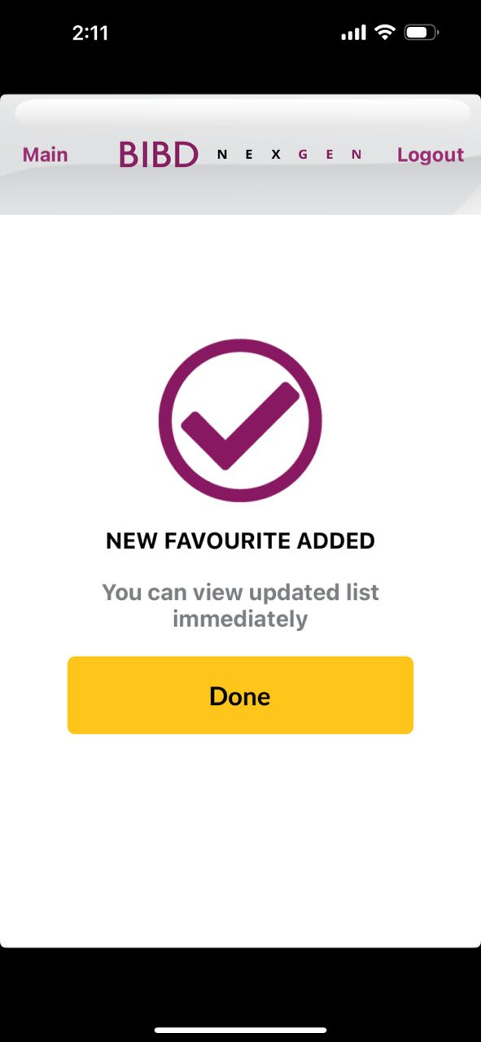
Android
SUCCESS ADD
iOS
Done

Slide 15
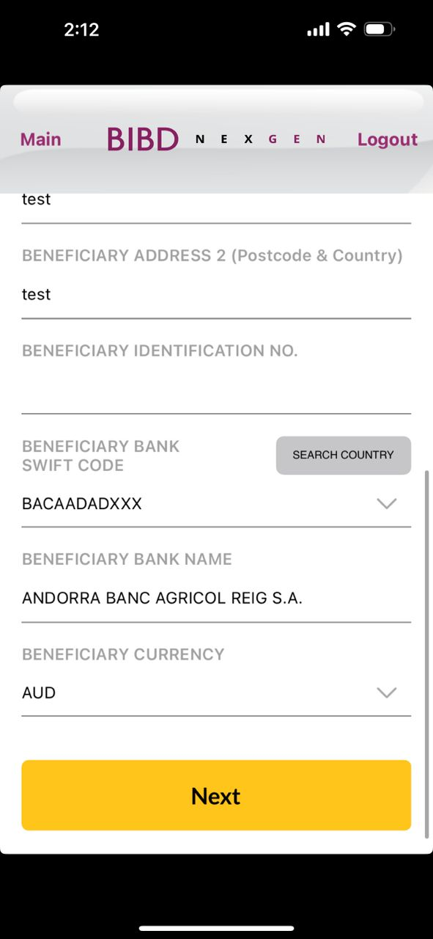
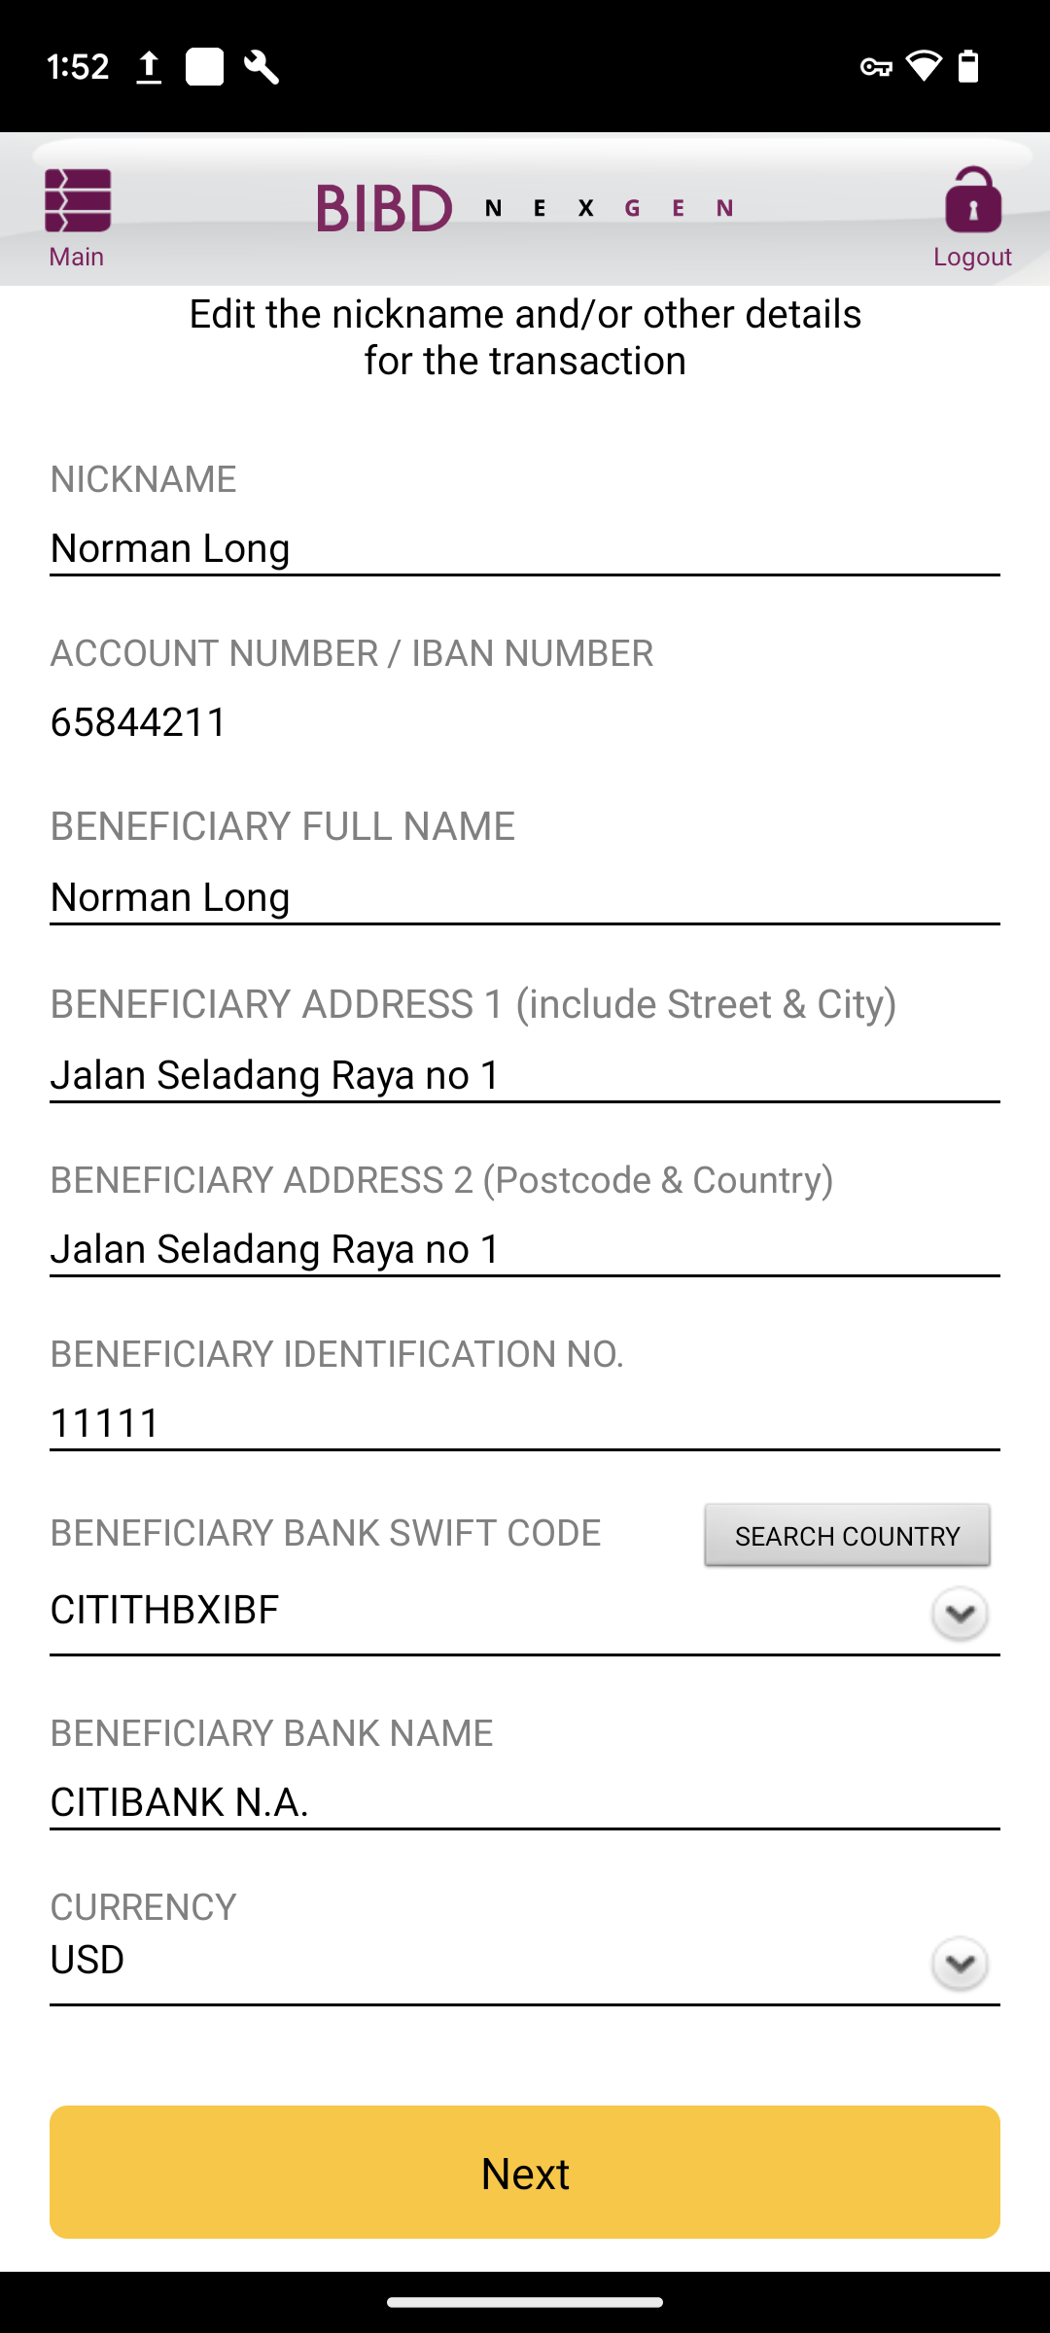
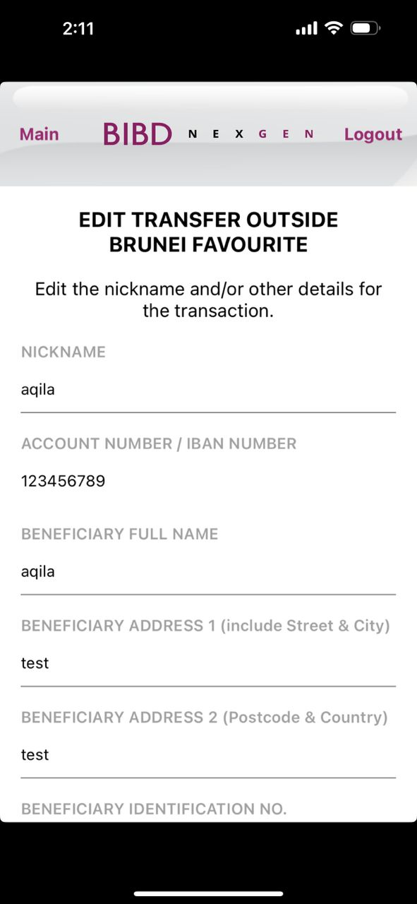
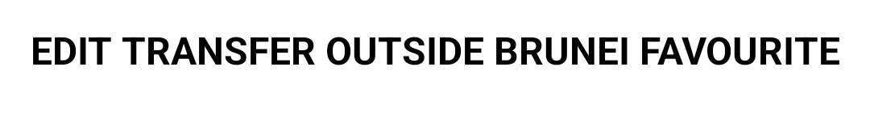
Android
INPUT EDIT
iOS
Change to ‘BENEFICIARY CURRENCY’
Box size, font size, box color follow as per quickpay module and word should be ‘Next’

Slide 16
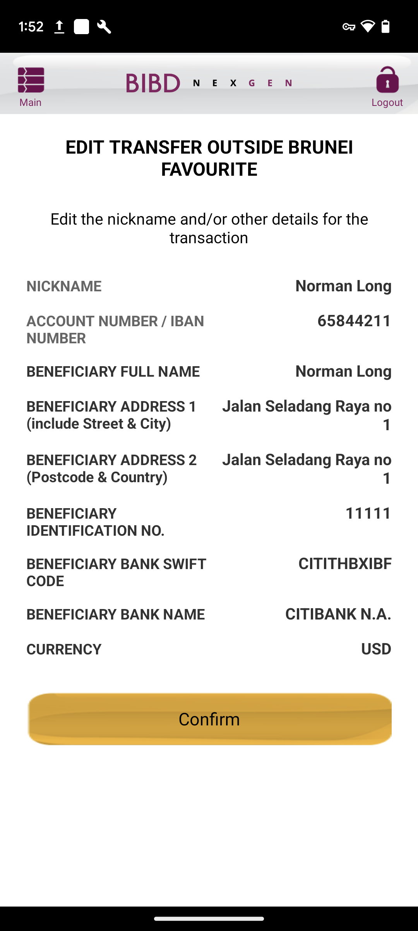
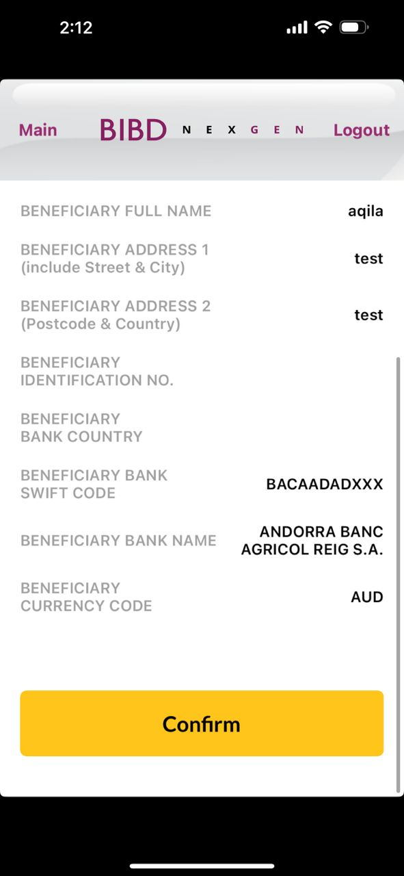
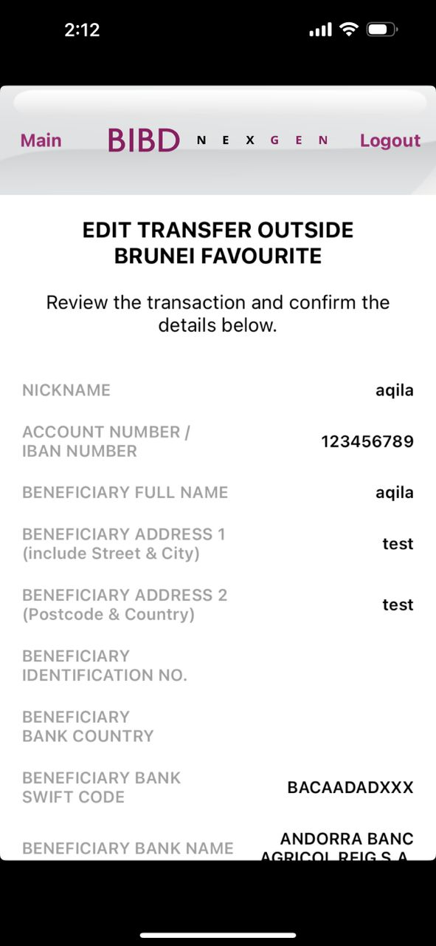
Android
CONFIRM EDIT
iOS
Remove the field
Change to ‘BENEFICIARY CURRENCY’
Box size, font size, box color follow as per quickpay module and word should be ‘Confirm’

Slide 17
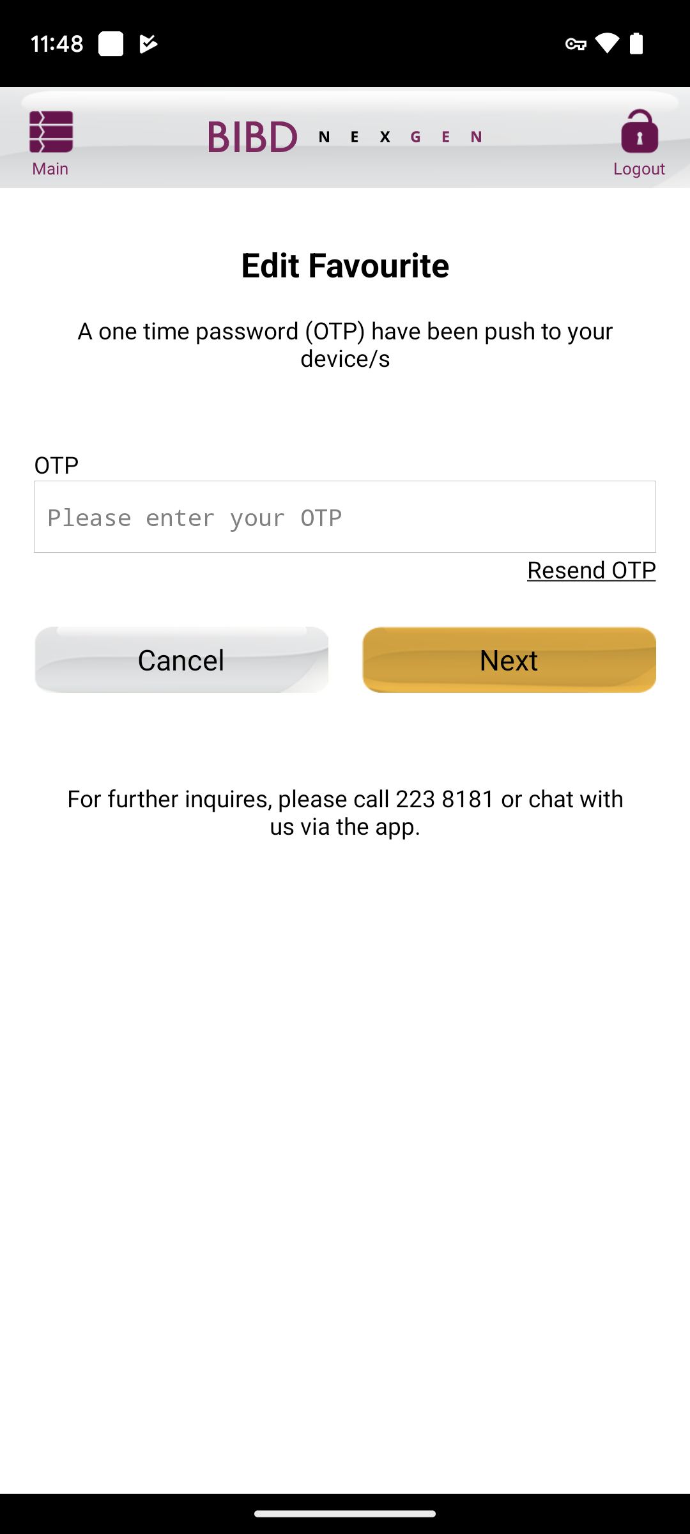

Android
OTP EDIT
iOS
Change to ‘Edit Favourite’

Slide 18
Android
BIO EDIT
iOS

Slide 19
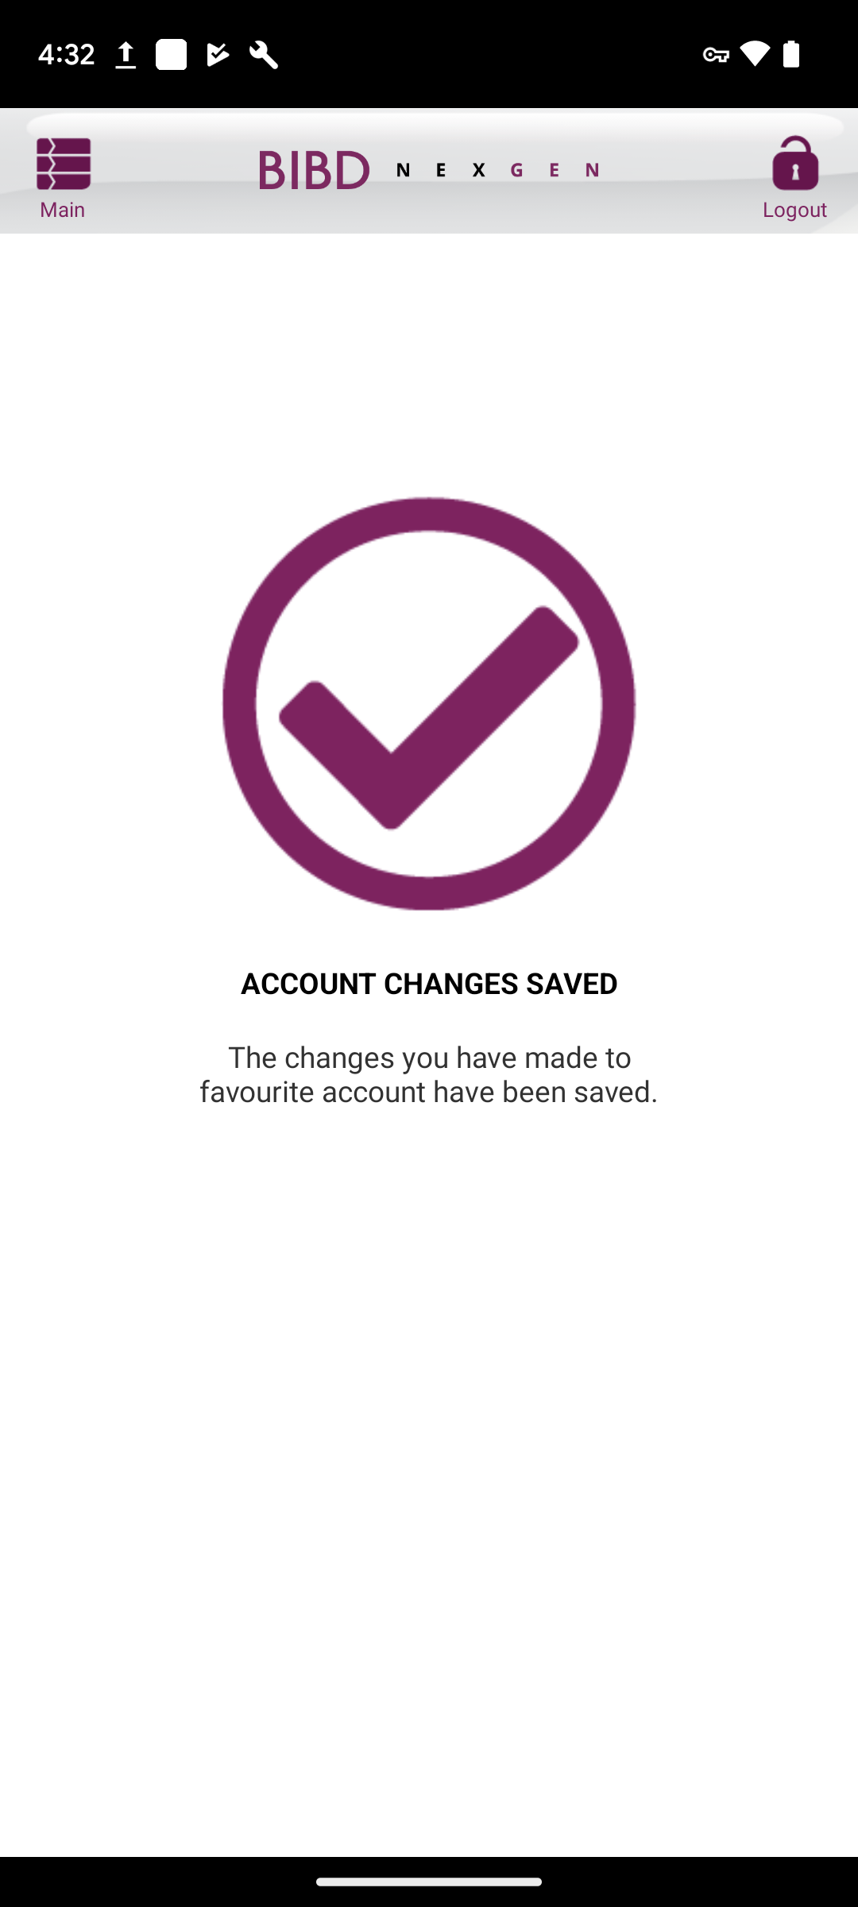
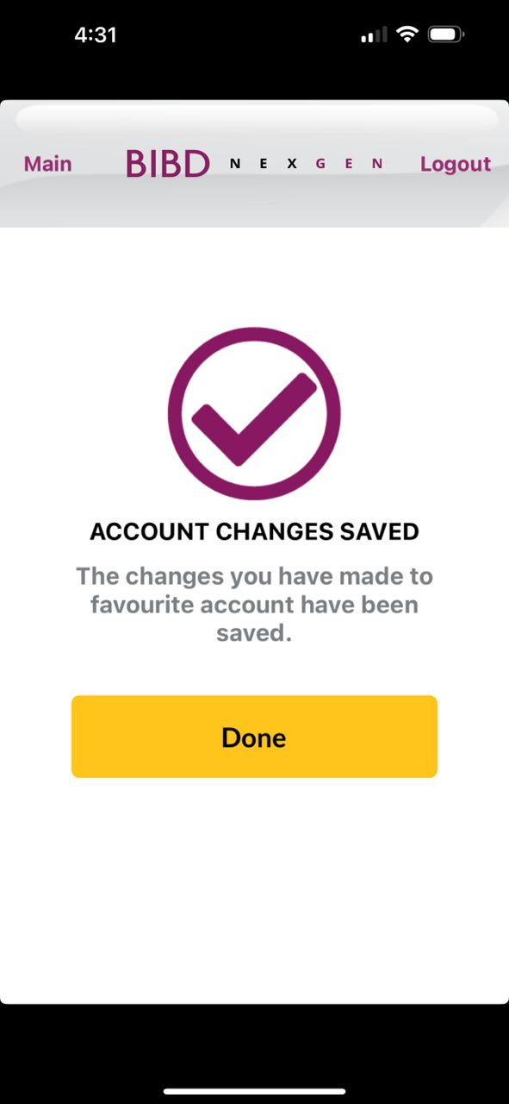
Android
SUCCESS EDIT
iOS
Done

Slide 20
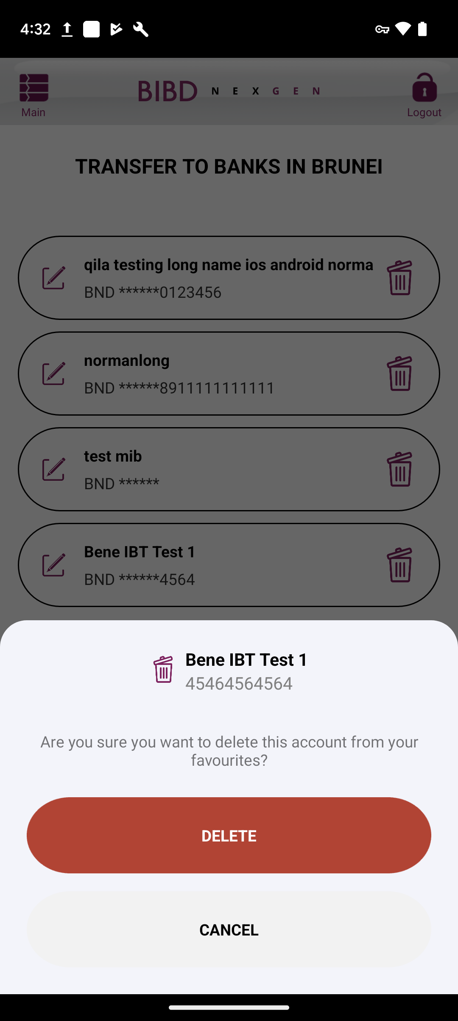
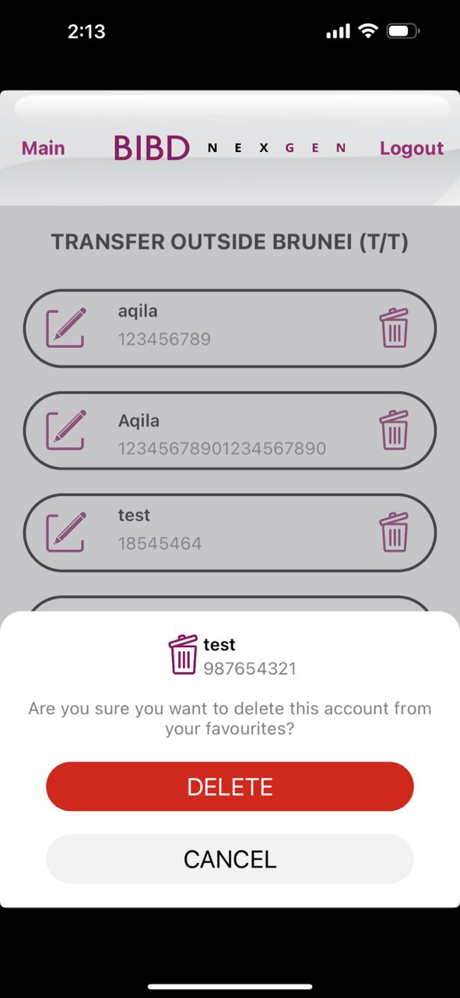
Android
CONFIRM DELETE
iOS
Transparent should be until header. Customer cannot click < or X. only can click DELETE or CANCEL or DONE
Make the icon bigger (check with Tiara)
Make box Delete and Cancel bigger – same size as favourite list box
Box color white

Slide 21
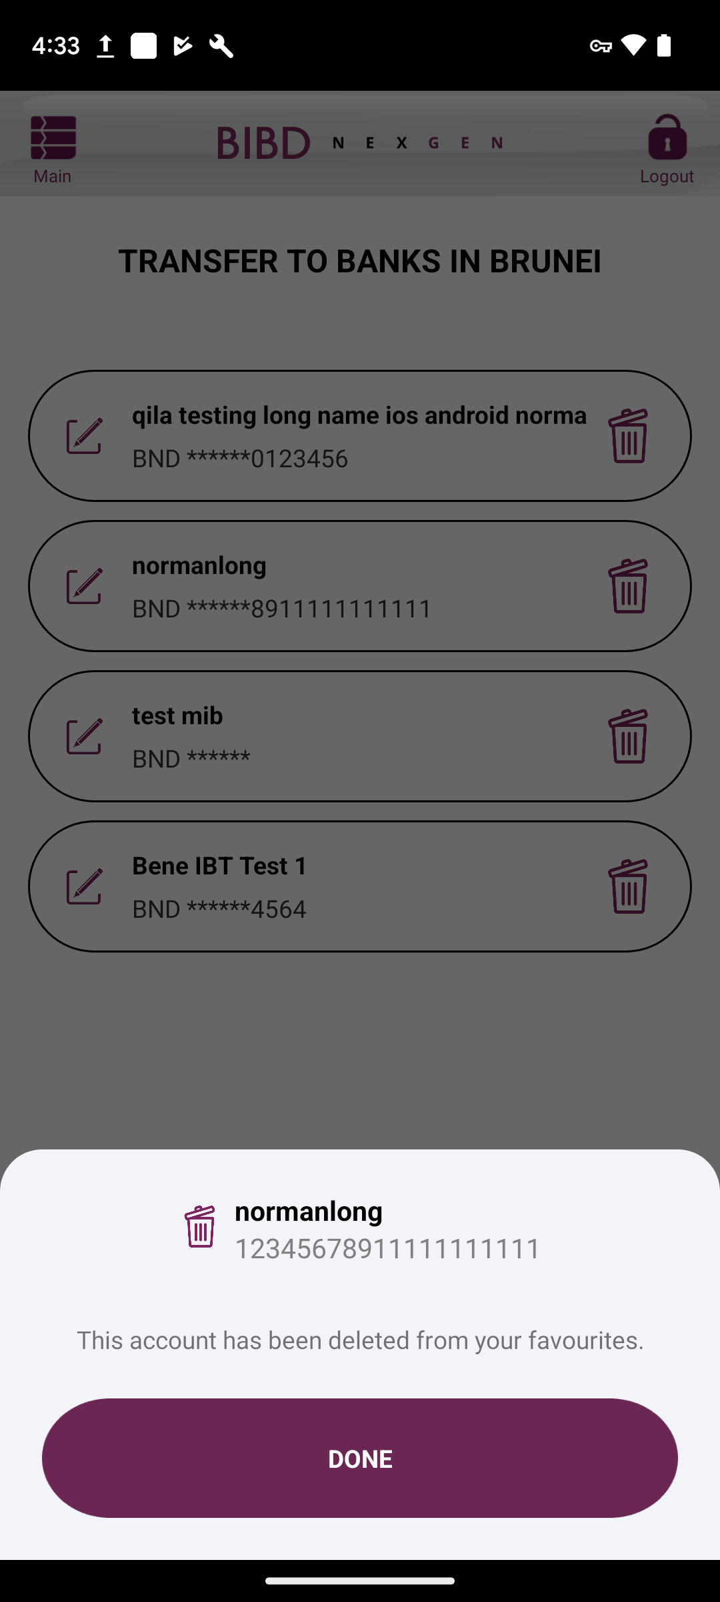
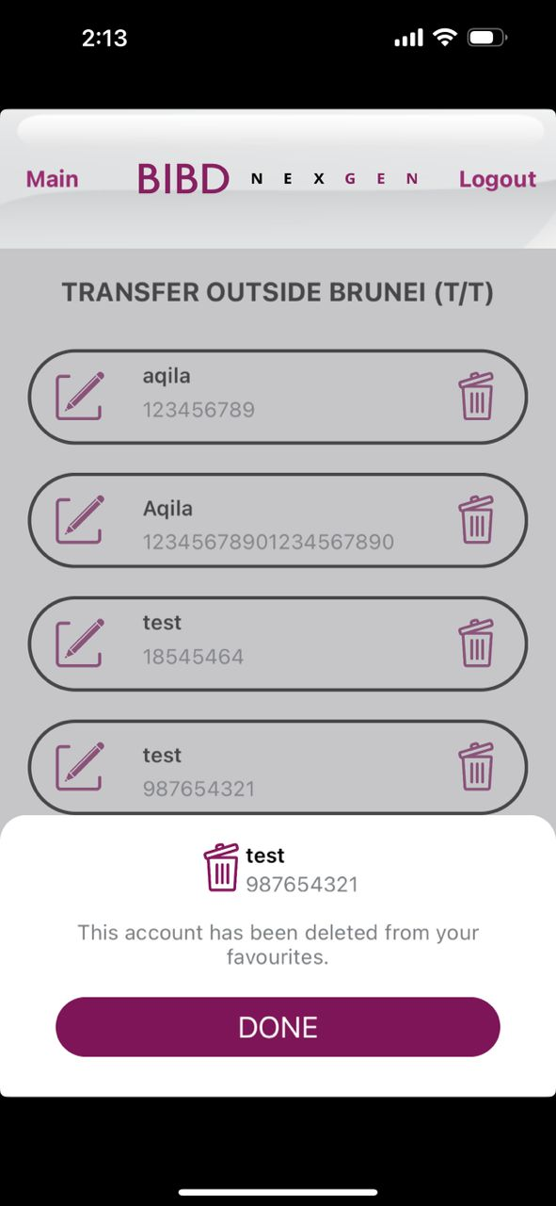
Android
SUCCESS DELETE
iOS
Transparent should be until header. Customer cannot click < or X. only can click DELETE or CANCEL or DONE
Make the icon bigger (check with Tiara)
Make box Delete and Cancel – same size as favourite list box
Box color white

