Slide 1
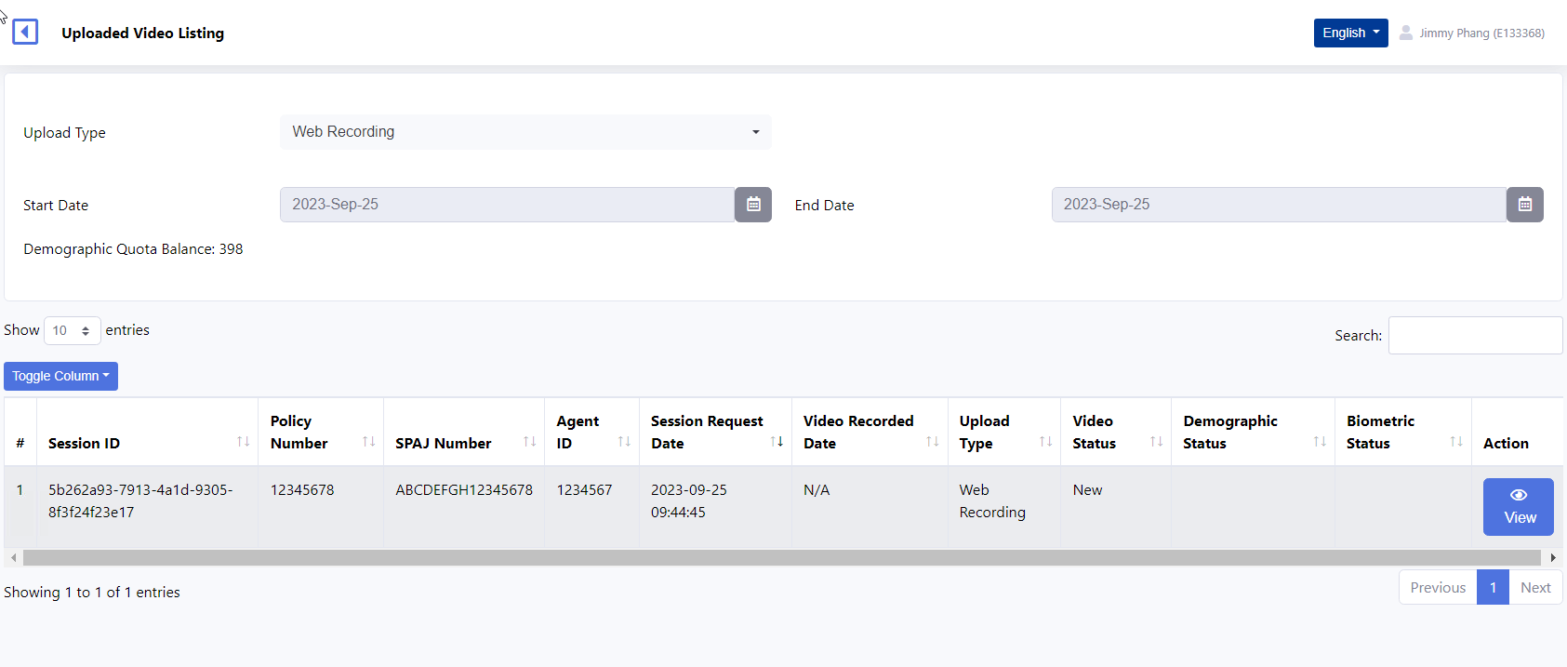
EKYC Portal did not display the video upload recording after complete submission.@ 7:26pm/
https://api-uat.digital.aia.id/digital/ekyc/web/video_record/request/zc4AZW2kmFl3PJJeZjO4uiQTYnUFp-LJWtIHXwUPzpqNghx992BaPCn3P5tw0pbj

