Slide 1
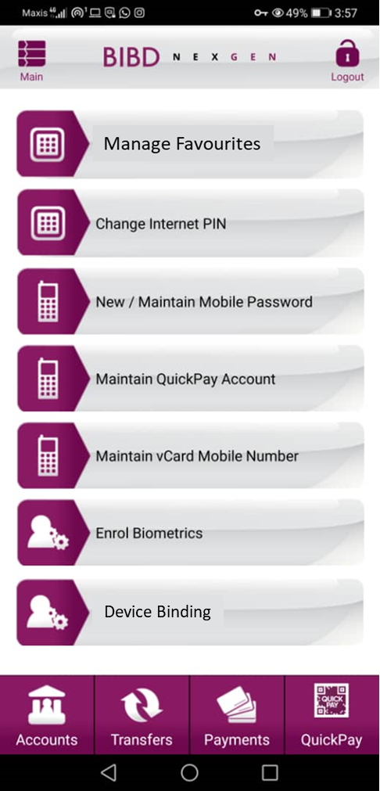
Icon for Manage Favourites >>>
Name: Nexgen Revamp Icons_Manage Favourites 90x60px
2. Icon for Device Binding >>>
Name: Nexgen Revamp Icons_Device Binding 90x60px

Slide 2
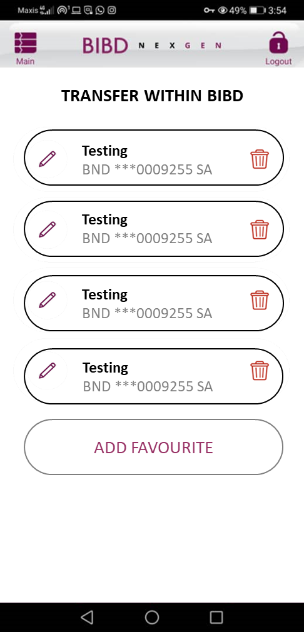
3. Icon for Edit >>>
Name: Nexgen Revamp Icons_Icon for Edit 236x236px
<<< 4. Icon for Delete
Name: Nexgen Revamp Icons_Icon for Delete 236x236px copy

Slide 3
5. Icon for Trying Connect >>>
Name: Nexgen Revamp Icons_Icon for Trying Connect 189x219

Slide 4
6. Icon for Success Connect >>>
Name: Nexgen Revamp Icons_Icon for Success Connect

Slide 5
7. Icon for Device Not Bind >>>
Name: Nexgen Revamp Icons_Icon for Device Not Bind 189x219px

Slide 6
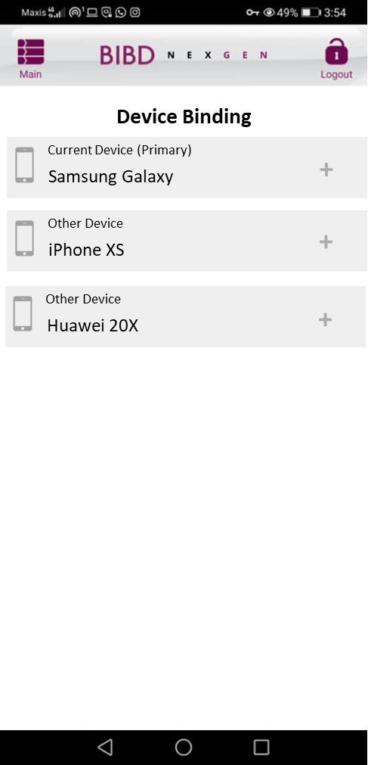
8. Icon for Device Binding List >>>
Nexgen Revamp Icons_Icon for Device Binding List 151x277px

Slide 7
9. Icon for Device Management >>>
Name: Nexgen Revamp Icons_Icon for Device Management 80x80
DEVICE MANAGEMENT

