Slide 1
General Changes

Slide 2
No | Item | Before | After | Action By
1. | OCBC NISP Logo |  |  | Pending Antikode NA 181023: Already available.
Note: Above are General Changes.

Slide 3
No | Item | Before | After | Action By
2. | Velocity Mobile Icon |  |  | Pending Antikode NA 181023: Already available.
Note: Above are General Changes.

Slide 4
No | Item | Before | After | Action By
3. | Brand Name | Velocity@ocbcnisp | OCBC Business | NA
Note: Above are General Changes.

Slide 5
No | Item | Before | After | Action By
4. | Apps Name | Velocity Mobile | OCBC Business Mobile | Pending OCBC Confirmation NA 181023: OCBC Business.
Note: Above are General Changes.

Slide 6
No | Item | Before | After | Action By
5. | Naming on Apps Store or Play Store | OCBC NISP Velocity Mobile | OCBC Business mobile Indonesia | OCBC responsible to change it. NA 181023: Noted.
Note: Above are General Changes.

Slide 7
Starting from Flash Screen > Login > Landing

Slide 8
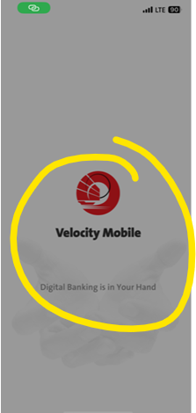
No | Item | Before | After | Action By
Follow Group, will be changed to:
1. | Splash Screen |  |  | Pending Antikode NA 181023: Please check folder ‘OCBC Velocity 20231017’ – Screens – File ‘00a Splash Screen.png’.
Antikode will update the Wireframe
Note:

Slide 9
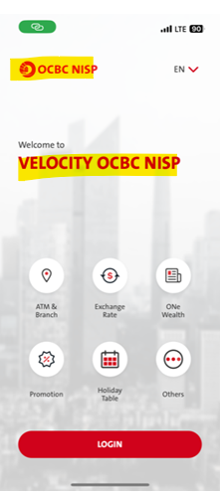
No | Item | Before | After | Action By
2. | Login |  | Plan to change the Login Screen style. Antikode will update the Wireframe Remark: *Oly screen layout change, no backend services/ws calling changes expected | Pending Antikode NA 181023: Please check folder ‘OCBC Velocity 20231017’ – Screens – File ‘01a Landing (Not Binded).png’ and ‘02a Landing (Binded).png’.
Note:

Slide 10
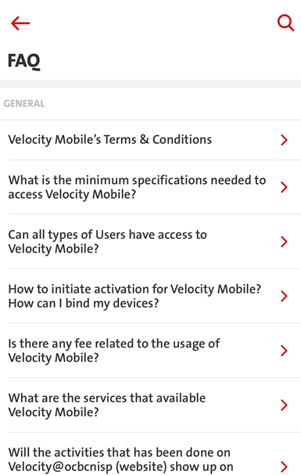
No | Item | Before | After | Action By
3. | Others - FAQ |  | All Velocity Mobile term will be renamed to >> OCBC Business mobile. | FAQ Contents return from Omni. NA 181023: Noted. OMNI will update and rename to OCBC Business mobile. (m in mobile must be in lower case)
Omni - OK
Note: Entries from Landing & Settings.

Slide 11
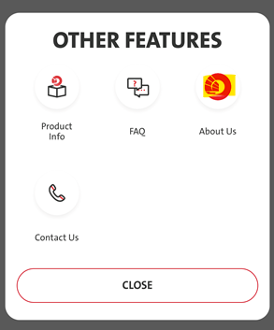
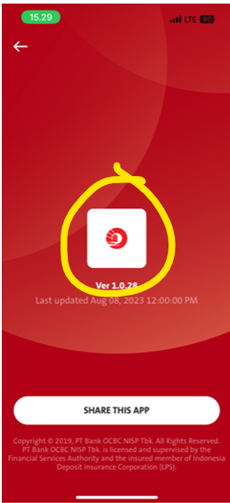
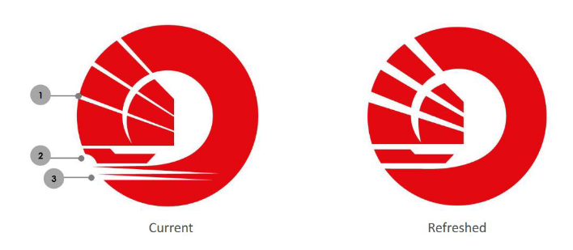
No | Item | Before | After | Action By
4. | Others – About Us |  | Additional: Add Logo ISO | Pending Antikode. NA 181023: Please check folder ‘OCBC Velocity 20231017’ – Screens – File ‘02a Other Features Pop Up.png’ and ‘26a About Us.png’.
iOS – OK
Android - OK
Update Logo
Note:

Slide 12
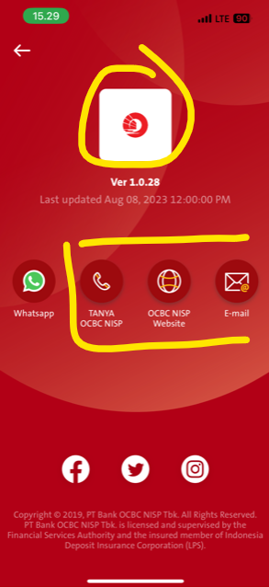
No | Item | Before | After | Action By
5. | Others - Contact Us |  | • Update logo: • TANYA OCBC NISP >> TANYA OCBC • OCBC NISP Website >> OCBC Website • E-mail clientservices@ocbcnisp.com >> clientservices@ocbc.id | Pending Antikode. NA 181023: Please check folder ‘OCBC Velocity 20231017’ – Screens – File ‘27a Contact Us.png’
iOS – OK
Android – OK
BE - OK
Note: From Landing & Settings

Slide 13
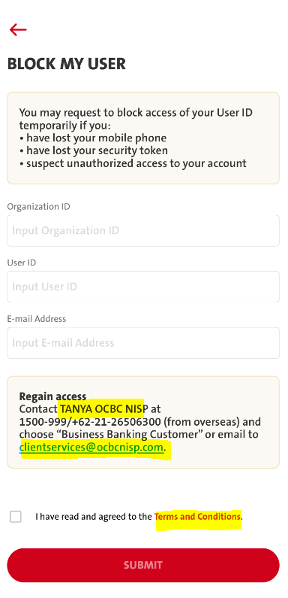
No | Item | Before | After | Action By
6. | Block My User |  | • TANYA OCBC NISP >> TANYA OCBC • E-mail clientservices@ocbcnisp.com >> clientservices@ocbc.id • Update link file Terms and Conditions | SL will change accordingly T&C content return from Omni NA 181023: Noted & confirmed. OMNI will update T&C content.
iOS – OK
Android – OK
Omni – Not Yet
Note:

Slide 14
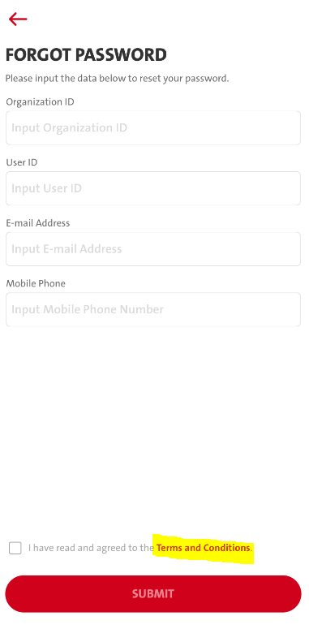
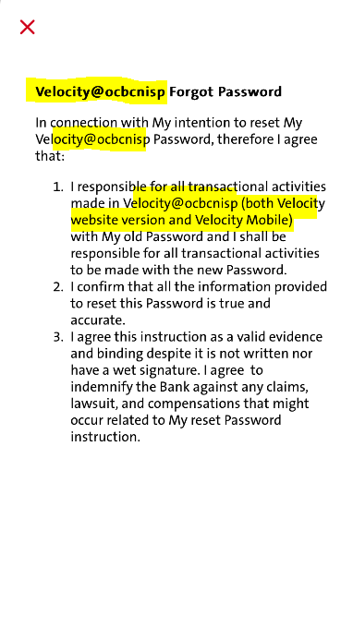
No | Item | Before | After | Action By
7. | Forgot Password |  | Update Velocity@ocbcnisp wording on pop up Terms & Conditions: • >> OCBC Business Forgot Password • In connection with My intention to reset >>My OCBC Business Password….. • I responsible for all transactional activities made in >>OCBC Business (both web and mobile)…….. | T&C content return from Omni NA 181023: Noted & confirmed. OMNI will update T&C content.
Omni - Not Yet
Note:

Slide 15
Home Screen & Details

Slide 16
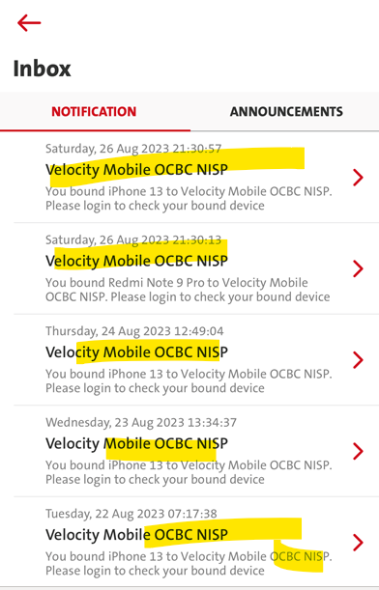
No | Item | Before | After | Action By
1. | Notification |  | OCBC Business mobile | Notification content return from Omni NA 181023: Push notification should be triggered from SL, is it right ? Refer to slide 37. Subject: Velocity Mobile OCBC NISP → OCBC Business mobile Content: You bound [device name] to Velocity Mobile OCBC NISP. Please login to check your bound device → You bound [device name] to OCBC Business mobile. Please login to check your bound device” BE changes – refer to slide 37
iOS – OK
Android - OK
Note: Home Screen Details

Slide 17
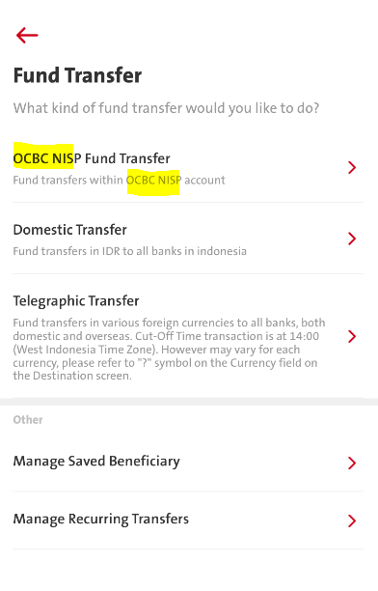
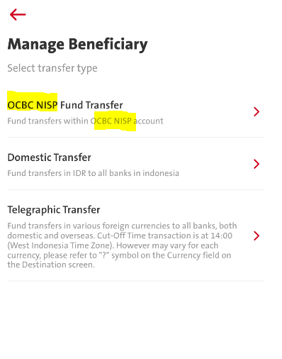
No | Item | Before | After | Action By
2. | Transactions |  | • OCBC NISP Fund Transfer >> OCBC Fund Transfer • OCBC NISP account >> OCBC account | SL will change accordingly. NA 181023: Noted & confirmed.
iOS – OK
Android - OK
Note: Both screens can be found from:- - 4 entries:- Dashboard, (side menu) Fund Transfer & Manage Saved Beneficairy & (side) Administration

Slide 18
Naming in the URL for media linkage - Pending OCBC confirmation

Slide 19
No | Item | Before | After | Action By
1. | Media URL Links | fb_url - https://www.facebook.com/bankocbcnisp Website – https://www.ocbcnisp.com/Home.aspx Instagram – https://www.instagram.com/ocbc_nisp/ Twitter – https://twitter.com/bankocbcnisp whatsapp_url – https://api.whatsapp.com/send?phone=+628121500999&text=Hi%20OCBC%20NISP | fb_url – https://www.facebook.com/OCBCBank Website – https://www.ocbc.id Instagram – https://www.instagram.com/ocbc_indonesia/ Twitter – https://twitter.com/ocbc_indonesia whatsapp_url – https://api.whatsapp.com/send?phone=+628121500999&text=Hi%20OCBC | Pending OCBC Confirmation NA 181023: Will update SL ASAP.
BE - OK
iOS – OK
Android – OK
BE - OK
Note:

Slide 20
Additional screens that consist of the word of [NISP] or [Velocity] - Pending OCBC Confirmation

Slide 21
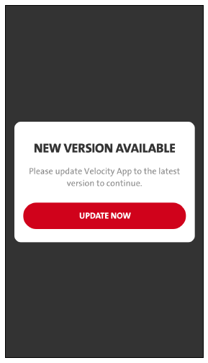
No | Item | Before | After | Action By
2. | Force Update |  | EN: Please update Velocity App to the latest version to continue. >> [OCBC Business Mobile] >> OCBC Business mobile ID: Untuk melanjutkan, mohon perbaharui versi Velocity App terbaru. >> [OCBC Business Mobile] >> OCBC Business mobile | Pending OCBC Confirmation NA 181023: Updated.
iOS – OK
Android – OK
Note:

Slide 22
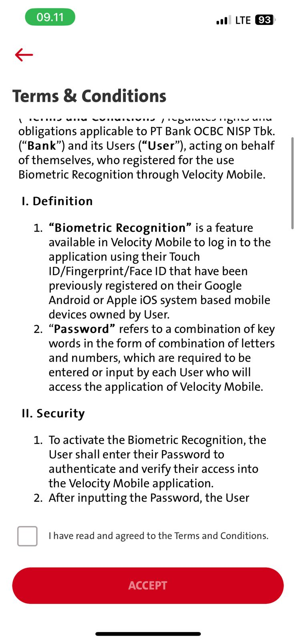
No | Item | Before | After | Action By
3. | Terms & Condition |  |  | Pending OCBC Confirmation T&C content return from Omni NA 181023: Noted & confirmed. OMNI will update the T&C content.
Omni – Not Yet
Note:

Slide 23
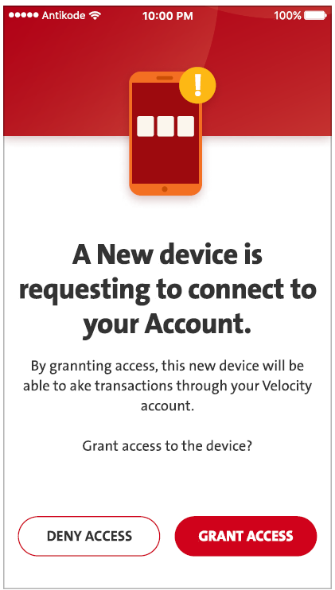
No | Item | Before | After | Action By
4. | Primary & Secondary Device |  | EN: A New Device is requesting to be connected to Your Velocity Mobile. >> [OCBC Business Mobile] >> OCBC Business mobile ID: Perangkat Baru meminta untuk dihubungkan ke Velocity Mobile Anda. >> [OCBC Business Mobile] >> OCBC Business mobile EN: By granting access, this new device will be able to access your Velocity Mobile. If you don't connect the device, immediately deny access or contact TANYA OCBC NISP at 1500–999 to report suspicious activity. Grant access to the device? >> [OCBC Business Mobile] >> OCBC Business mobile >> [TANYA OCBC] TANYA OCBC at 1500-999 or +62-21-2650-6300 (from overseas) and choose "Business Banking Customer" ID: Dengan memberi akses, perangkat baru ini dapat mengakses akun Velocity Mobile anda. Jika anda merasa tidak menyambungkan perangkat, segera tolak akses perangkat atau hubungi TANYA OCBC NISP di 1500–999 untuk melaporkan aktivitas mencurigakan. Beri persetujuan akses pada perangkat? >> [OCBC Business Mobile] >> OCBC Business mobile >> [TANYA OCBC] TANYA OCBC di 1500-999 atau +62-21-2650-6300 (dari luar negeri) dan pilih "Nasabah Bisnis" | Pending OCBC Confirmation NA 181023: Updated.
iOS – OK
Android – OK
Note:

Slide 24
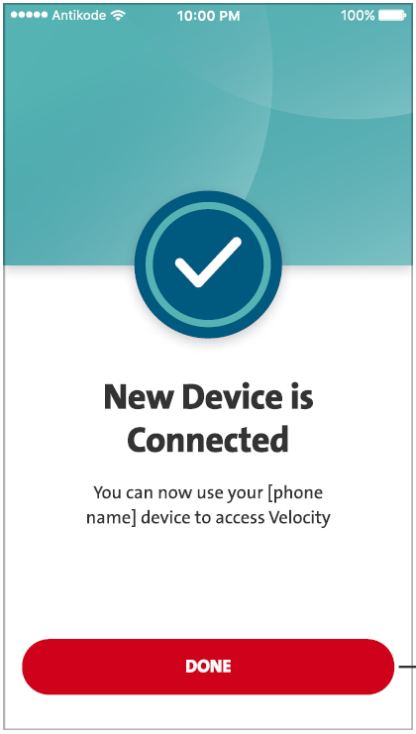
No | Item | Before | After | Action By
5. | Primary & Secondary Device |  | EN: You can now use your device [device name] to access Velocity Mobile. >> [OCBC Business Mobile] >> OCBC Business mobile ID: Anda sudah dapat menggunakan [device name] untuk mengakses Velocity Mobile. >> [OCBC Business Mobile] >> OCBC Business mobile | Pending OCBC Confirmation NA 181023: Updated. Related to [device name], is it possible also to add the info?
iOS – OK
Android – OK
Note:

Slide 25
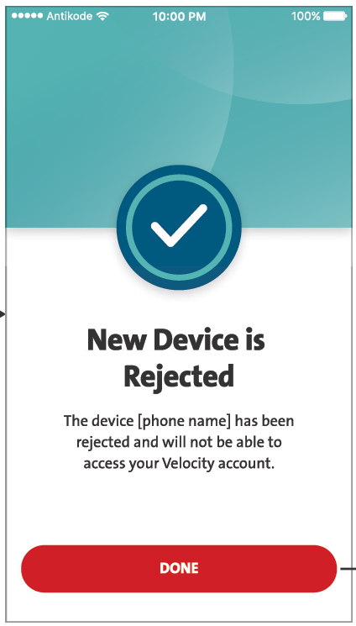
No | Item | Before | After | Action By
6. | Primary & Secondary Device |  | EN: The new device [device name] has been rejected and will not be able to access your Velocity Mobile. >> [OCBC Business Mobile] >> OCBC Business mobile ID: Perangkat baru [device name] ditolak dan tidak dapat mengakses Velocity Mobile anda. >> [OCBC Business Mobile] >> OCBC Business mobile | Pending OCBC Confirmation NA 181023: Updated. Related to [device name], is it possible also to add the info?
iOS – OK
Android – OK
Note:

Slide 26
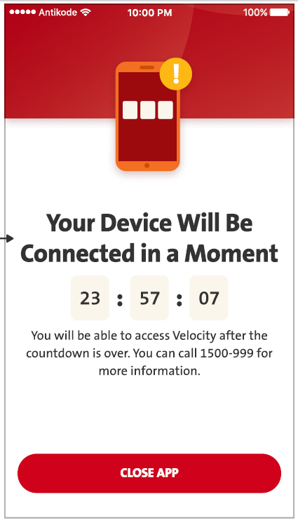
No | Item | Before | After | Action By
7. | Primary & Secondary Device |  | EN: You will be able to access Velocity Mobile after the countdown is over. For more information, please contact TANYA OCBC NISP at 1500–999. >> [OCBC Business Mobile] >> OCBC Business mobile >> [TANYA OCBC] TANYA OCBC at 1500-999 or +62-21-2650-6300 (from overseas) and choose "Business Banking Customer" ID: Anda dapat mengakses Velocity Mobile setelah waktu hitung mundur berakhir. Informasi lebih lanjut, silakan hubungi TANYA OCBC NISP di 1500–999. >> [OCBC Business Mobile] >> OCBC Business mobile >> [TANYA OCBC] TANYA OCBC di 1500-999 atau +62-21-2650-6300 (dari luar negeri) dan pilih "Nasabah Bisnis" | Pending OCBC Confirmation NA 181023: Updated.
iOS – OK
Android – OK
Note:

Slide 27
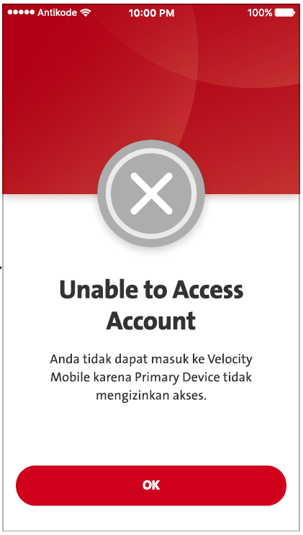
No | Item | Before | After | Action By
8. | Primary & Secondary Device |  | EN: Unable to Access Velocity Mobile >> [OCBC Business Mobile] >> OCBC Business mobile EN: You are not allowed to login to Velocity Mobile from this new device, because the Primary Device doesn't grant the access. >> [OCBC Business Mobile] >> OCBC Business mobile ID: Tidak Dapat Mengakses Velocity Mobile >> [OCBC Business Mobile] >> OCBC Business mobile ID: Anda tidak diizinkan masuk ke Velocity Mobile dari perangkat ini, karena Perangkat Utama tidak memberikan akses. >> [OCBC Business Mobile]] >> OCBC Business mobile | Pending OCBC Confirmation NA 181023: Updated.
iOS – OK
Android – OK
Note:

Slide 28
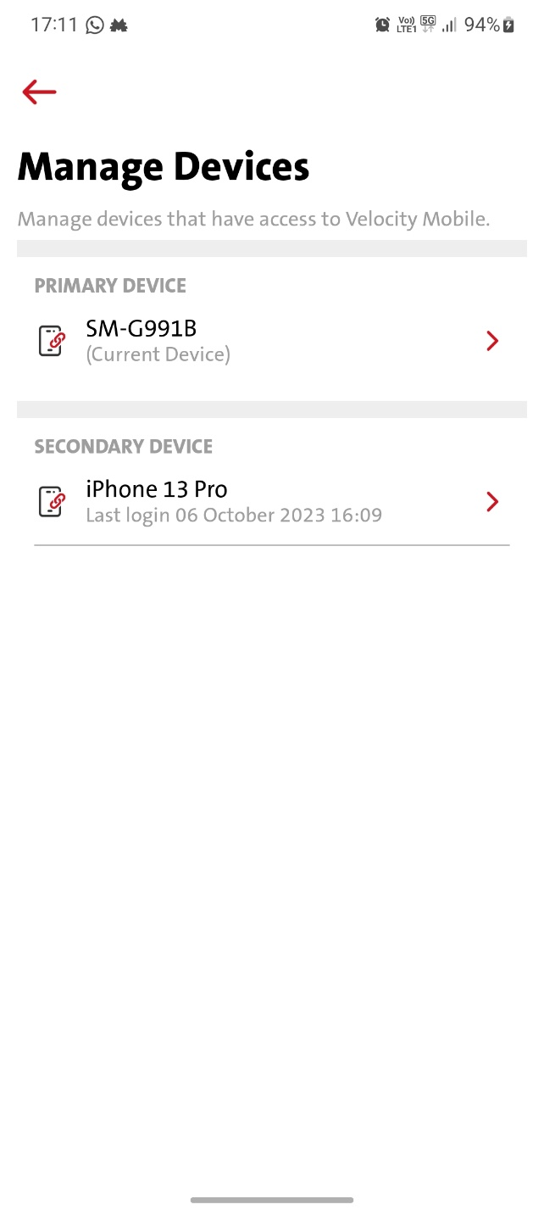
No | Item | Before | After | Action By
9. | Settings – Manage Devices |  | EN: Manage devices that have access to Velocity Mobile. >> [OCBC Business Mobile] >> OCBC Business mobile ID: Atur perangkat yang memiliki akses ke Velocity Mobile. >> [OCBC Business Mobile] >> OCBC Business mobile | Pending OCBC Confirmation NA 181023: Updated.
iOS – OK
Android – OK
Note:

Slide 29
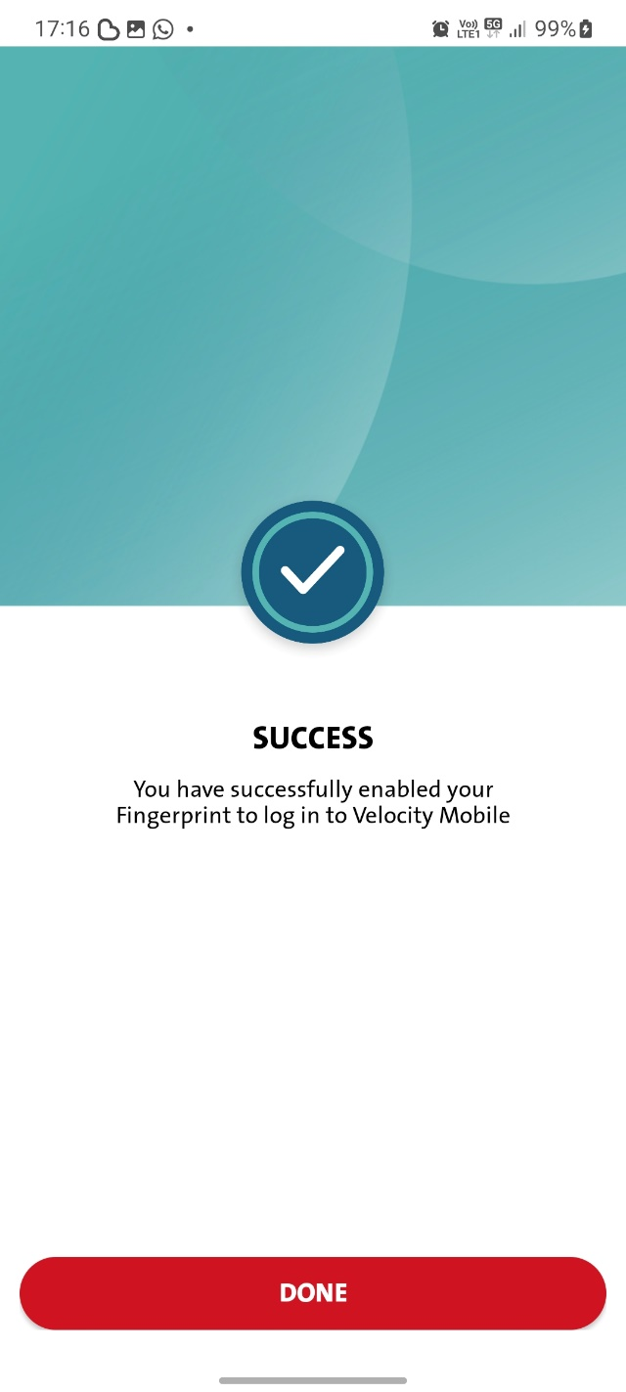
No | Item | Before | After | Action By
10. | Biometric Enrollment |  | EN: You have successfully enabled your Fingerprint to log in to Velocity Mobile >> [OCBC Business Mobile] >> OCBC Business mobile ID: Sidik Jari Anda telah berhasil diaktifkan untuk login Velocity Mobile >> [OCBC Business Mobile] >> OCBC Business mobile | Pending OCBC Confirmation NA 181023: Updated.
iOS – OK
Android – OK
Note:

Slide 30
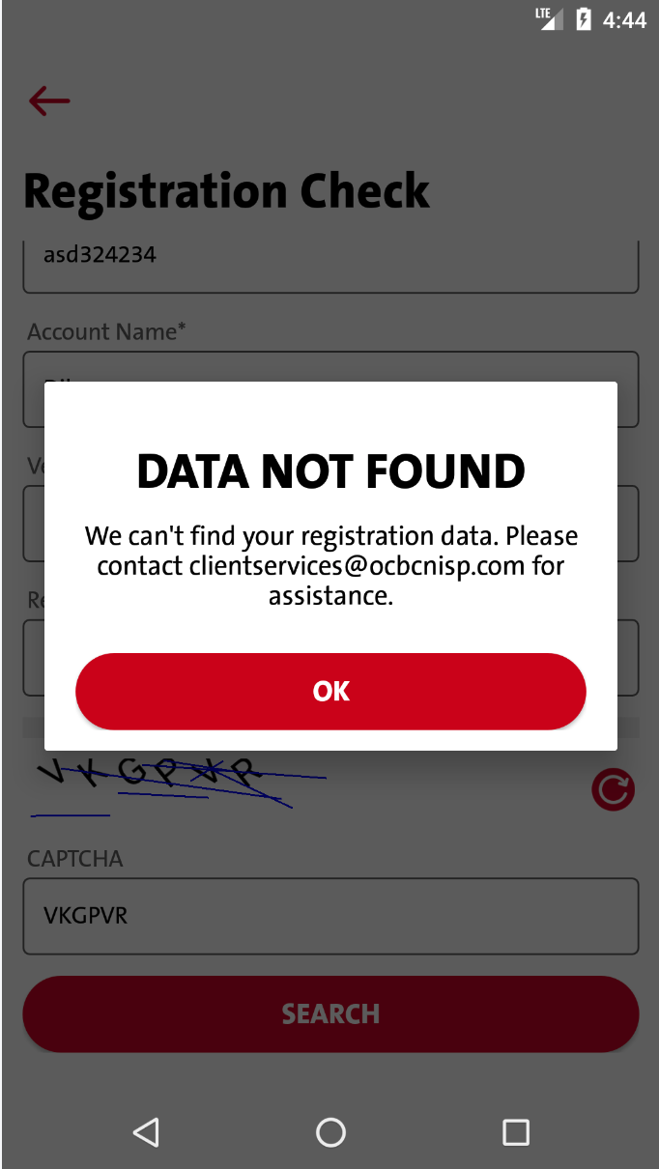
No | Item | Before | After | Action By
11. | Registration Check |  | We can't find your registration data. Please contact clientservices@ocbcnisp.com for assistance. >> clientservices@ocbc.id We cannot find your registration data. Please contact TANYA OCBC at 1500-999 or +62-21-2650-6300 (from overseas) and choose "Business Banking Customer" for assistance. Kami tidak dapat menemukan data pendaftaran anda. Silakan hubungi clientservices@ocbcnisp.com untuk bantuan. >> clientservices@ocbc.id Kami tidak dapat menemukan data pendaftaran Anda. Silakan hubungi TANYA OCBC di 1500-999 atau +62-21-2650-6300 (dari luar negeri) dan pilih "Nasabah Bisnis". | SL will change accordingly. NA 181023: Updated. Inline with slide 38 No. 11. BE – refer to slide 38
iOS – OK
Android – OK
BE - OK
Note:

Slide 31
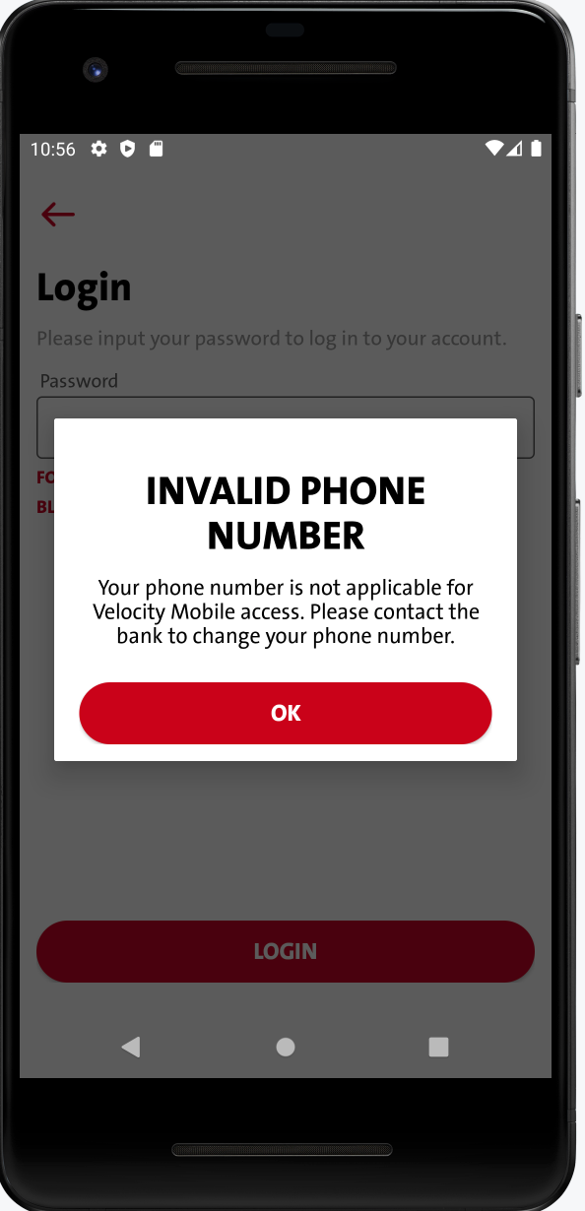
No | Item | Before | After | Action By
12. | Login With Password |  | EN: Your phone number is not applicable for Velocity Mobile access. Please contact the bank to change your phone number. >> [OCBC Business Mobile] >> OCBC Business mobile ID: Nomor telepon anda tidak berlaku untuk akses Velocity Mobile . Silakan hubungi bank untuk mengganti nomor telepon anda. >> [OCBC Business Mobile] >> OCBC Business mobile | Pending OCBC for the Apps Name NA 181023: Updated.
Note:

Slide 32
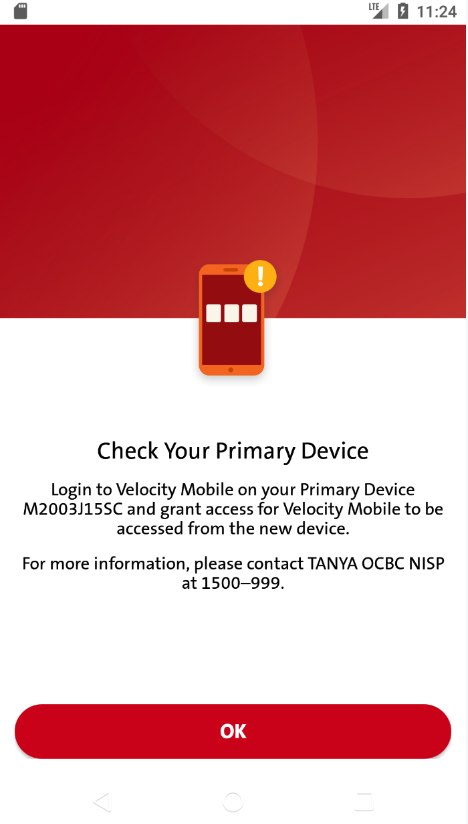
No | Item | Before | After | Action By
13. | Secondary Device Binding |  | EN : Login to Velocity Mobile on your Primary Device [DEVICE NAME] and grant access for Velocity Mobile to be accessed from the new device. >> [OCBC Business Mobile] >> OCBC Business mobile >> [TANYA OCBC] TANYA OCBC at 1500-999 or +62-21-2650-6300 (from overseas) and choose "Business Banking Customer" IN: Masuk ke Velocity Mobile pada Perangkat Utama anda [DEVICE NAME] dan berikan persetujuan agar Velocity Mobile dapat diakses dari perangkat baru. >> [OCBC Business Mobile] >> OCBC Business mobile >> [TANYA OCBC] TANYA OCBC di 1500-999 atau +62-21-2650-6300 (dari luar negeri) dan pilih "Nasabah Bisnis" | Pending OCBC Confirmation NA 181023: Updated.
iOS – OK
Android – OK
Note:

Slide 33
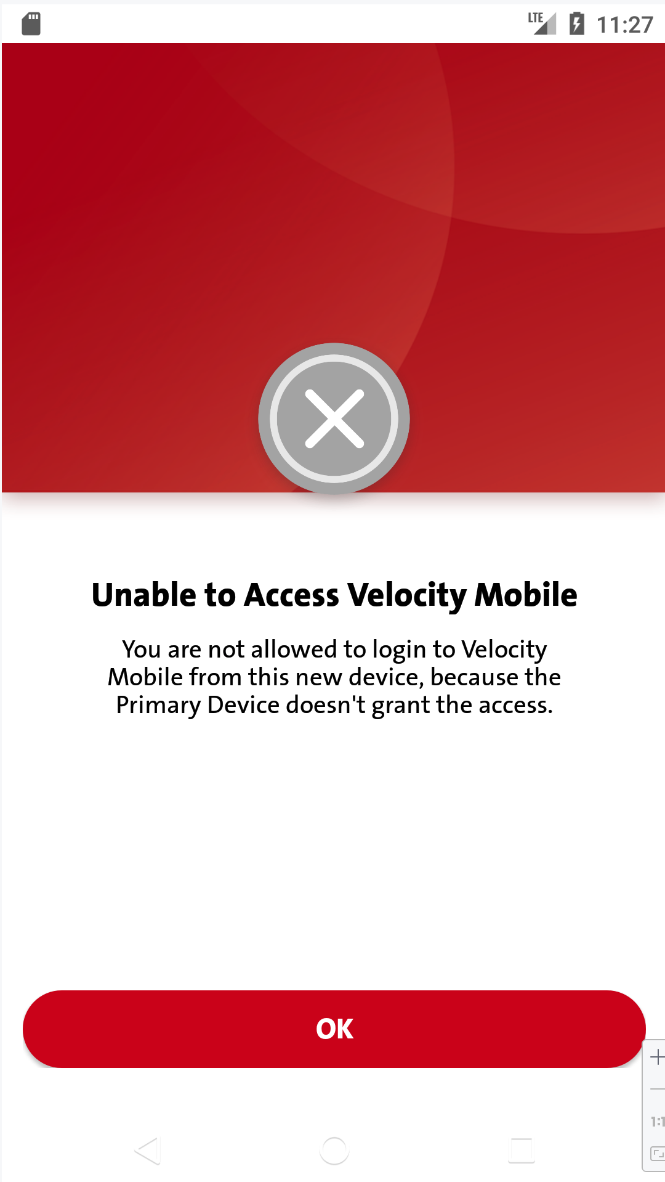
No | Item | Before | After | Action By
14. | Secondary Device binding failed |  | EN : Unable to Access Velocity Mobile >> [OCBC Business Mobile] >> OCBC Business mobile EN : You are not allowed to login to Velocity Mobile from this new device, because the Primary Device doesn\'t grant the access. >> [OCBC Business Mobile] >> OCBC Business mobile IN:Tidak Dapat Mengakses Velocity Mobile Message >> [OCBC Business Mobile] >> OCBC Business mobile IN : Anda tidak diizinkan masuk ke Velocity Mobile dari perangkat ini, karena Perangkat Utama tidak memberikan akses. >> [OCBC Business Mobile] >> OCBC Business mobile | NA 181023: Updated.
iOS – OK
Android – OK
Note:

Slide 34
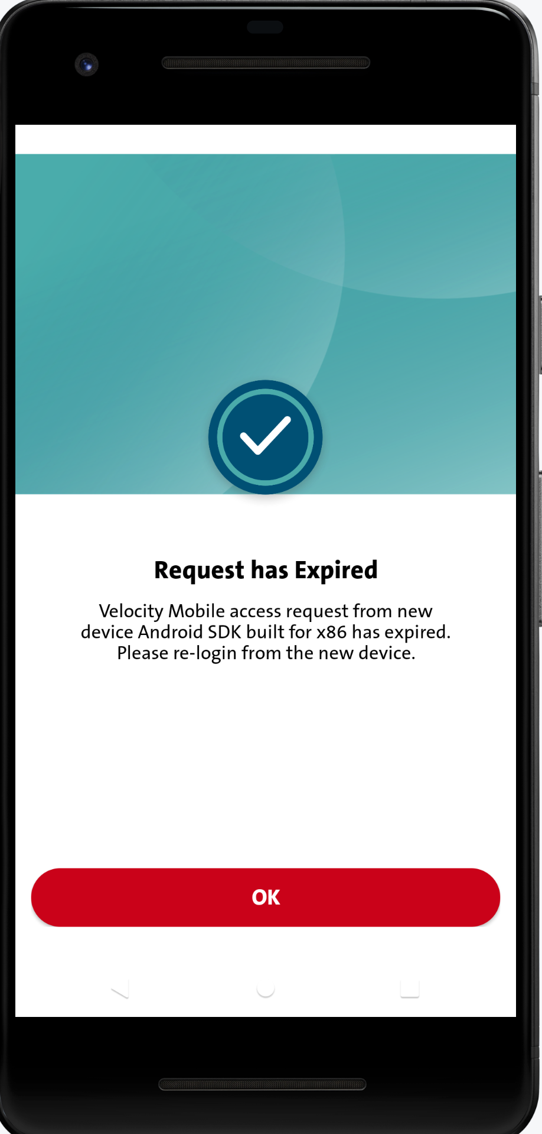
No | Item | Before | After | Action By
15. | Secondary Device binding request expired on Primary Device |  | EN : Velocity Mobile access request from new device [DEVICE NAME] has expired. Please re-login from the new device. >> [OCBC Business Mobile] >> OCBC Business mobile IN : Permintaan akses Velocity Mobile dari perangkat baru [DEVICE NAME] telah kadaluarsa. Silakan melakukan login ulang dari perangkat baru. >> [OCBC Business Mobile] >> OCBC Business mobile | NA 181023: Updated.
iOS – OK
Android – OK
Note:

Slide 35
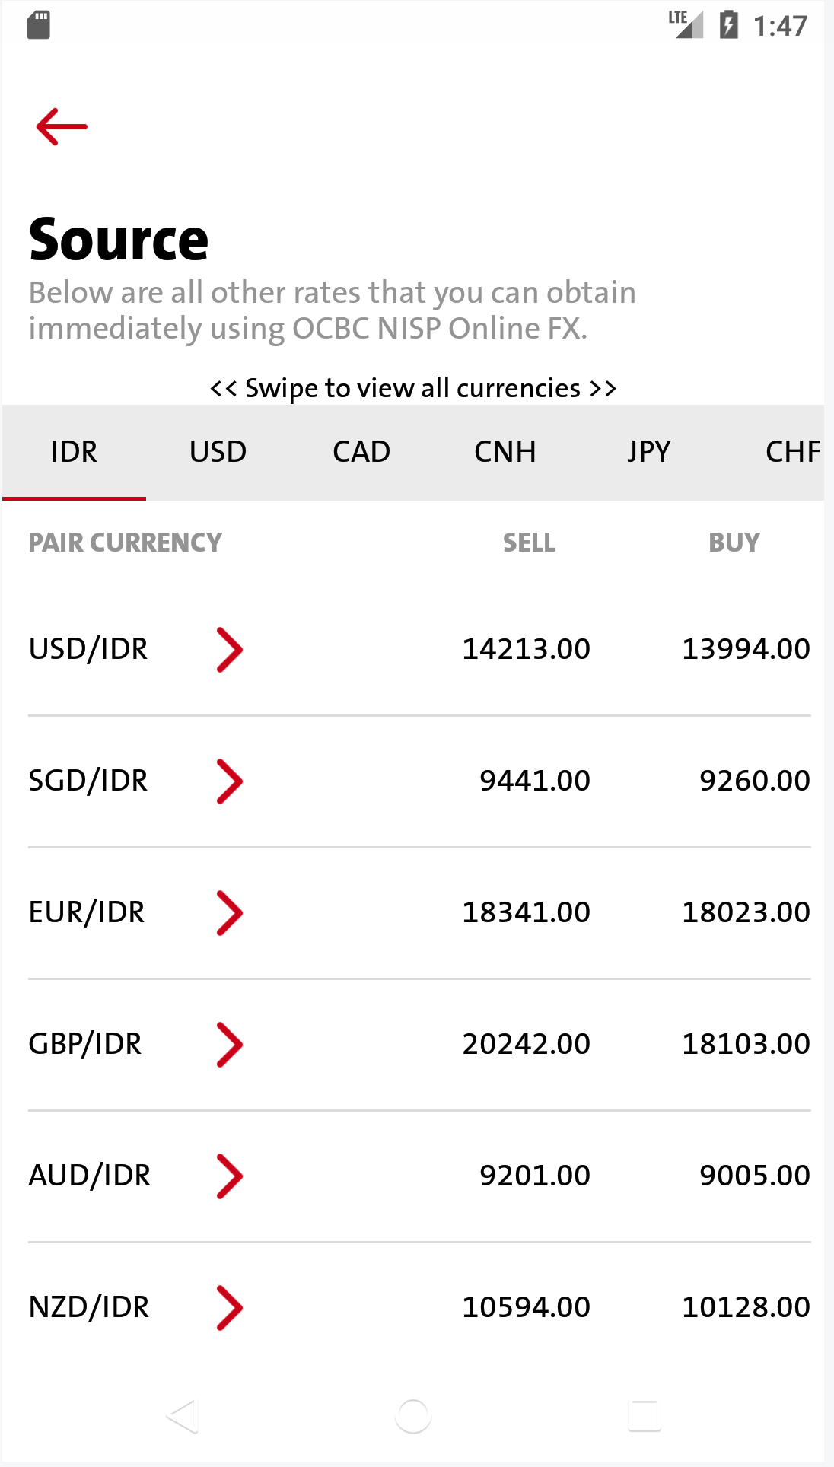
No | Item | Before | After | Action By
16. | View All Online FX |  | EN : Below are all other rates that you can obtain immediately using OCBC NISP Online FX. >> [OCBC] IN : Dibawah ini adalah semua nilai kurs mata uang lainnya yang Anda bisa dapatkan dengan menggunakan OCBC NISP Online FX. >> [OCBC] | Pending OCBC Confirmation NA 181023: Noted & confirmed.
iOS – OK
Android – OK
Note:

Slide 36
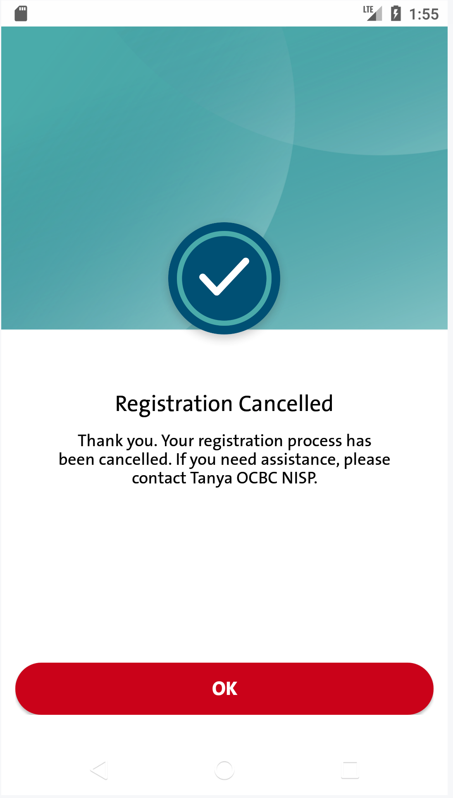
No | Item | Before | After | Action By
17. | Registration Status Cancelled |  | EN : Thank you. Your registration process has been cancelled. If you need assistance, please contact Tanya OCBC NISP. >> [TANYA OCBC] TANYA OCBC at 1500-999 or +62-21-2650-6300 (from overseas) and choose "Business Banking Customer" IN : Thank you. Your registration process has been cancelled. If you need assistance, please contact Tanya OCBC NISP. ( STILL USING ENGLISH) >> [TANYA OCBC] TANYA OCBC di 1500-999 atau +62-21-2650-6300 (dari luar negeri) dan pilih "Nasabah Bisnis" | Pending OCBC Confirmaton NA 181023: Updated.
Note:

Slide 37
No | Error Message Code | Before | After | Action By
1 | PUSH_NOTI_TITLE | Velocity Mobile OCBC NISP Velocity Mobile OCBC NISP | >>> OCBC Business mobile >>> OCBC Bisnis mobile | Pending OCBC Confirmation NA 181023: OCBC Business mobile (both ENG & IND)
2 | PUSH_NOTI_BOUND_DEVICE | You bound to Velocity Mobile OCBC NISP. Please login to check your bound device You bound to Velocity Mobile OCBC NISP. Please login to check your bound device | >>> OCBC Business mobile >>> OCBC Bisnis mobile | Pending OCBC Confirmation NA 181023: OCBC Business mobile (both ENG & IND)
3 | omni.O0095 | Your phone number is not applicable for Velocity Mobile access. Please contact the bank to change your phone number. Nomor telepon anda tidak berlaku untuk akses Velocity Mobile. Silakan hubungi bank untuk mengganti nomor telepon anda. | >>> OCBC Business Mobile Your phone number is not applicable for OCBC Business mobile access. Please contact TANYA OCBC at 1500-999 or +62-21-2650-6300 (from overseas) and choose "Business Banking Customer" to change Your phone number. >>> OCBC Bisnis Mobile Nomor telepon Anda tidak berlaku untuk akses OCBC Business mobile. Silakan hubungi TANYA OCBC di 1500-999 atau +62-21-2650-6300 (dari luar negeri) dan pilih "Nasabah Bisnis“ untuk mengganti nomor telepon Anda. | Pending OCBC Confirmation NA 181023: Updated.
4 | omni.00252 | [Transaction Failed] Please contact Call OCBC NISP at 500999 atau 66999 (HP) [Transaksi Gagal] Mohon hubungi Call OCBC NISP di 500999 atau 66999 (HP) | >>> OCBC Business [Transaction Failed] Please contact TANYA OCBC at 1500-999 or +62-21-2650-6300 (from overseas) and choose "Business Banking Customer". >>> OCBC Bisnis [Transaksi Gagal] Hubungi TANYA OCBC di 1500-999 atau +62-21-2650-6300 (dari luar negeri) dan pilih "Nasabah Bisnis“. | Pending OCBC Confirmation NA 181023: Updated.
5 | omni.00015 | This CIF not permitted to do the transaction. Please Contact OCBC NISP Nasabah tidak diijinkan untuk melakukan transaksi. Hub OCBC NISP | >>> OCBC Business This CIF is not permitted to do the transaction. Please contact TANYA OCBC at 1500-999 or +62-21-2650-6300 (from overseas) and choose "Business Banking Customer". >>> OCBC Bisnis CIF ini tidak diijinkan untuk melakukan transaksi. Hubungi TANYA OCBC di 1500-999 atau +62-21-2650-6300 (dari luar negeri) dan pilih "Nasabah Bisnis“. | Pending OCBC Confirmation NA 181023: Updated.
6 | omni.00168 | [Being Processed] Please check your balance or contact Call OCBC NISP at 500999 atau 66999 (HP) [Sedang dalam proses] Mohon cek saldo Anda atau hubungi Call OCBC NISP di 500999 atau 66999 (HP) | >>> OCBC Business [Being Processed] Please check your balance or contact TANYA OCBC at 1500-999 or +62-21-2650-6300 (from overseas) and choose "Business Banking Customer". >>> OCBC Bisnis [Sedang dalam proses] Mohon cek saldo Anda atau hubungi TANYA OCBC di 1500-999 atau +62-21-2650-6300 (dari luar negeri) dan pilih "Nasabah Bisnis“. | Pending OCBC Confirmation NA 181023: Updated.
Note: Copywriting of Error Message that returns from Omni.

Slide 38
No | Error Message Code | Before | After | Action By
7. | omni.US002 | This account has been locked. Please contact Your administrator or Call OCBC NISP. Akun ini terkunci. Silakan hubungi administrator Anda atau Call OCBC NISP. | >>> OCBC Business This account has been locked. Please contact Your administrator or TANYA OCBC at 1500-999 or +62-21-2650-6300 (from overseas) and choose "Business Banking Customer". >>> OCBC Bisnis Akun ini terkunci. Silakan hubungi administrator Anda atau TANYA OCBC di 1500-999 atau +62-21-2650-6300 (dari luar negeri) dan pilih "Nasabah Bisnis“. | NA 181023: Updated.
8 | omni.US003 | This account is inactive. Please contact Your administrator or Call OCBC NISP. Akun ini tidak aktif. Silakan hubungi administrator Anda atau Call OCBC NISP. | >>> OCBC Business This account is inactive. Please contact TANYA OCBC at 1500-999 or +62-21-2650-6300 (from overseas) and choose "Business Banking Customer". >>> OCBC Bisnis Akun ini tidak aktif. Silakan hubungi TANYA OCBC di 1500-999 atau +62-21-2650-6300 (dari luar negeri) dan pilih "Nasabah Bisnis“. | NA 181023: Updated.
9. | omni.TE002 | This account reset has not been approved. Please contact Your administrator or Call OCBC NISP. Pengaturan ulang akun ini belum disetujui. Silakan hubungi administrator Anda atau Call OCBC NISP. | >>> OCBC Business This account reset has not been approved. Please contact Your administrator or TANYA OCBC at 1500-999 or +62-21-2650-6300 (from overseas) and choose "Business Banking Customer". >>> OCBC Bisnis Pengaturan ulang akun ini belum disetujui. Silakan hubungi administrator Anda atau TANYA OCBC di 1500-999 atau +62-21-2650-6300 (dari luar negeri) dan pilih "Nasabah Bisnis“. | NA 181023: Updated.
10. | omni.TE003 | This account reset has been rejected. Please contact Your administrator or Call OCBC NISP. Pengaturan ulang akun ini telah ditolak. Silakan hubungi administrator Anda atau Call OCBC NISP. | >>> OCBC Business This account reset has been rejected. Please contact Your administrator or TANYA OCBC at 1500-999 or +62-21-2650-6300 (from overseas) and choose "Business Banking Customer". >>> OCBC Bisnis Pengaturan ulang akun ini telah ditolak. Silakan hubungi administrator Anda atau TANYA OCBC di 1500-999 atau +62-21-2650-6300 (dari luar negeri) dan pilih "Nasabah Bisnis“. | NA 181023: Updated.
11. | omni.REG04 | Kami tidak dapat menemukan data pendaftaran anda. Silakan hubungi clientservices@ocbcnisp.com untuk bantuan. We cannot find your registration data. Please contact clientservices@ocbcnisp.com for assistance. | >>> clientservices@ocbc.id We cannot find your registration data. Please contact TANYA OCBC at 1500-999 or +62-21-2650-6300 (from overseas) for assistance and choose "Business Banking Customer". >>> clientservices@ocbc.id Kami tidak dapat menemukan data pendaftaran Anda. Silakan hubungi TANYA OCBC di 1500-999 atau +62-21-2650-6300 (dari luar negeri) dan pilih "Nasabah Bisnis“. | NA 181023: Updated.
12. | omni.O0120 | Please contact clientservices@ocbcnisp.com to reset your password. Silakan hubungi clientservices@ocbcnisp.com untuk memperbarui kata sandi anda. | >>> clientservices@ocbc.id >>> clientservices@ocbc.id | NA 181023: Noted & confirmed.

Slide 39
No | Error Message Code | Before | After | Action By
13. | omni.O0139 | Transaction service is currently unavailable. Please contact TANYA OCBC NISP at 1500-999 or +62-21-26506300 (from overseas) and choose "Business Banking Customer" or e-mail at clientservices@ocbcnisp.com for assistance. Layanan transaksi tidak tersedia saat ini. Silakan hubungi TANYA OCBC NISP di 1500-999 atau +62-21-26506300 (dari luar negeri) dan pilih "Nasabah Bisnis" atau e-mail di clientservices@ocbcnisp.com untuk bantuan. | >>> >>> TANYA OCBC >>> >>> clientservices@ocbc.id >>> >>> TANYA OCBC >>> >>> clientservices@ocbc.id | Pending OCBC Confirmation NA 181023: Noted & confirmed.
- | - | - | - | -
Note: Copywriting of Error Message that returns from Omni.

Slide 40
QC – checking for changes

Slide 41
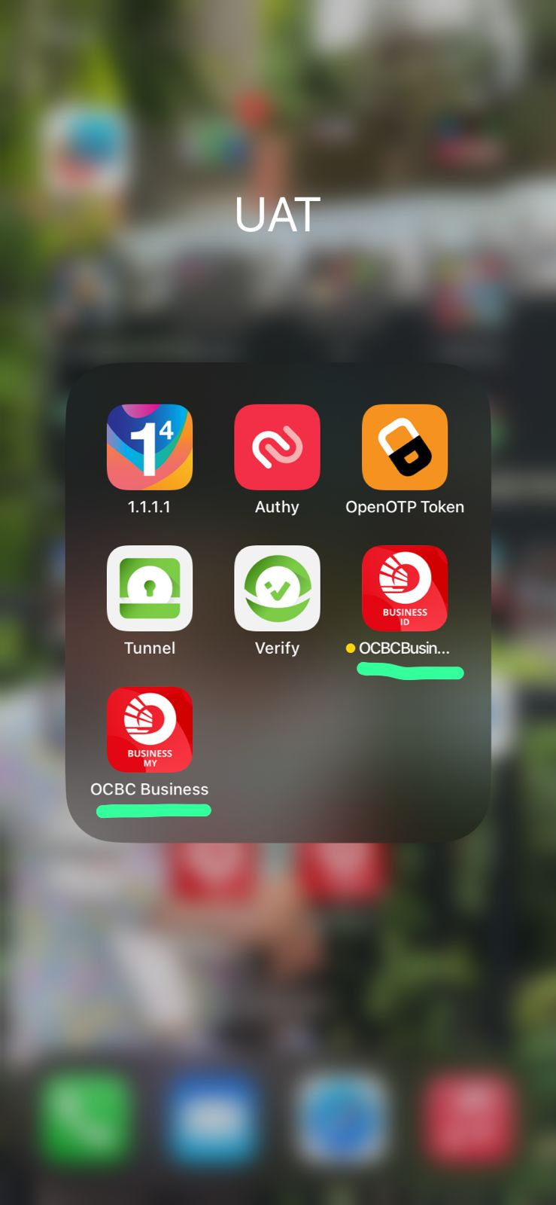
From Slide #5 – Apps Name = Should be OCBC Business.
Android & iOS need to fix this.

Slide 42
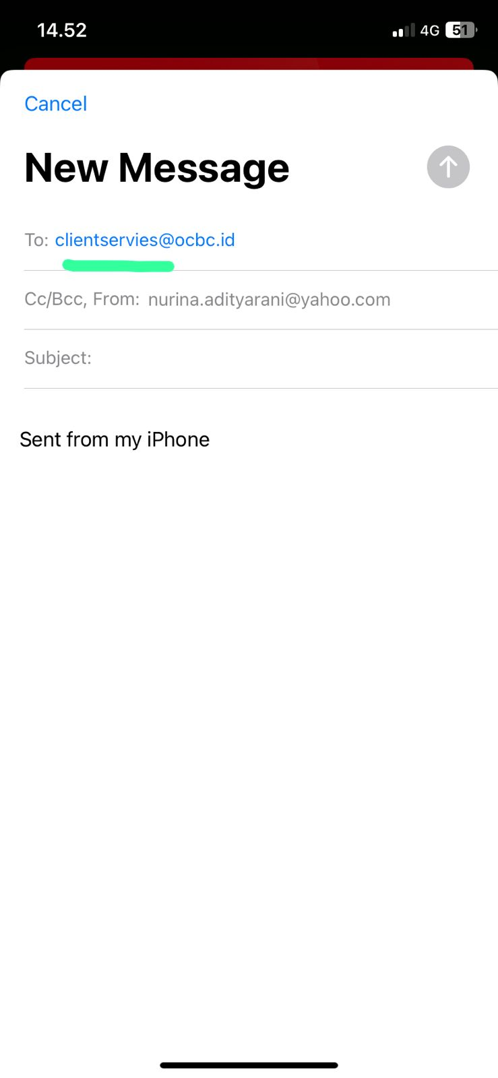
From Slide #12 – email address should change = clientservices@ocbc.id
BE need to fix this.

Slide 43
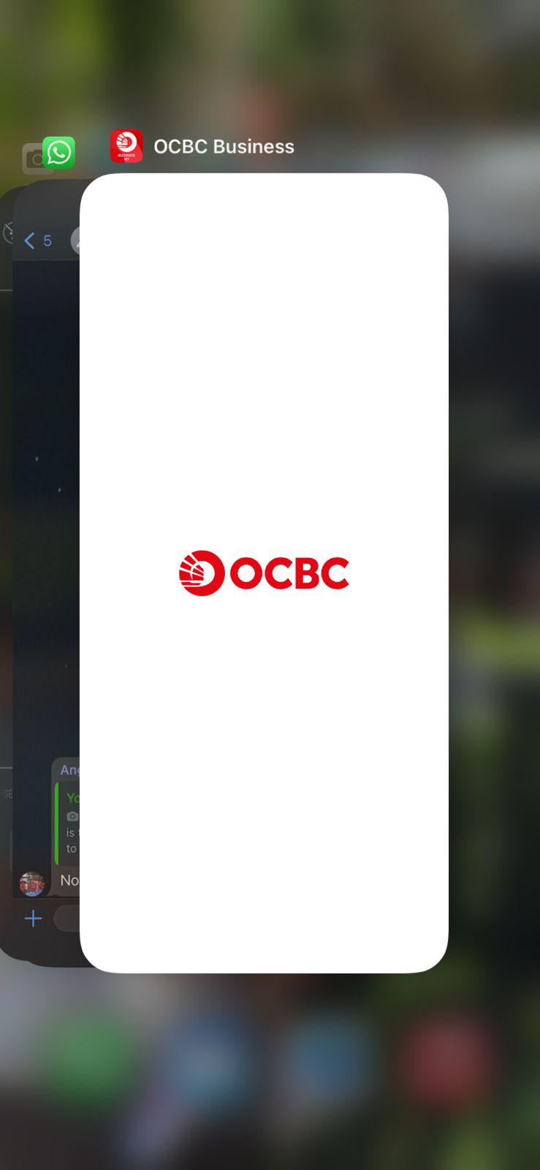
This is from ID
This is OCBC Malaysia logo
Check with Android what size is android using
Logo_full@3x？ Or.2x?

Slide 44
Raised on 07/11/2023
Please assist to update our source code for pointing the dynatrace URL:
- change from dynatracegateway.ocbcnisp.com to >>>>> dynatracegateway.ocbc.id

