Slide 1
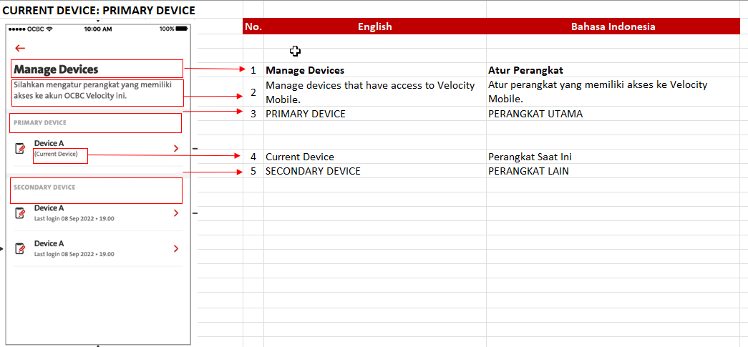
iOS Internal bug found Setting – Manage Device – Copywriting issue
Please help to fix with copywriting below:
Atur perangkat yang memiliki akses ke Velocity Mobile.

