Slide 1
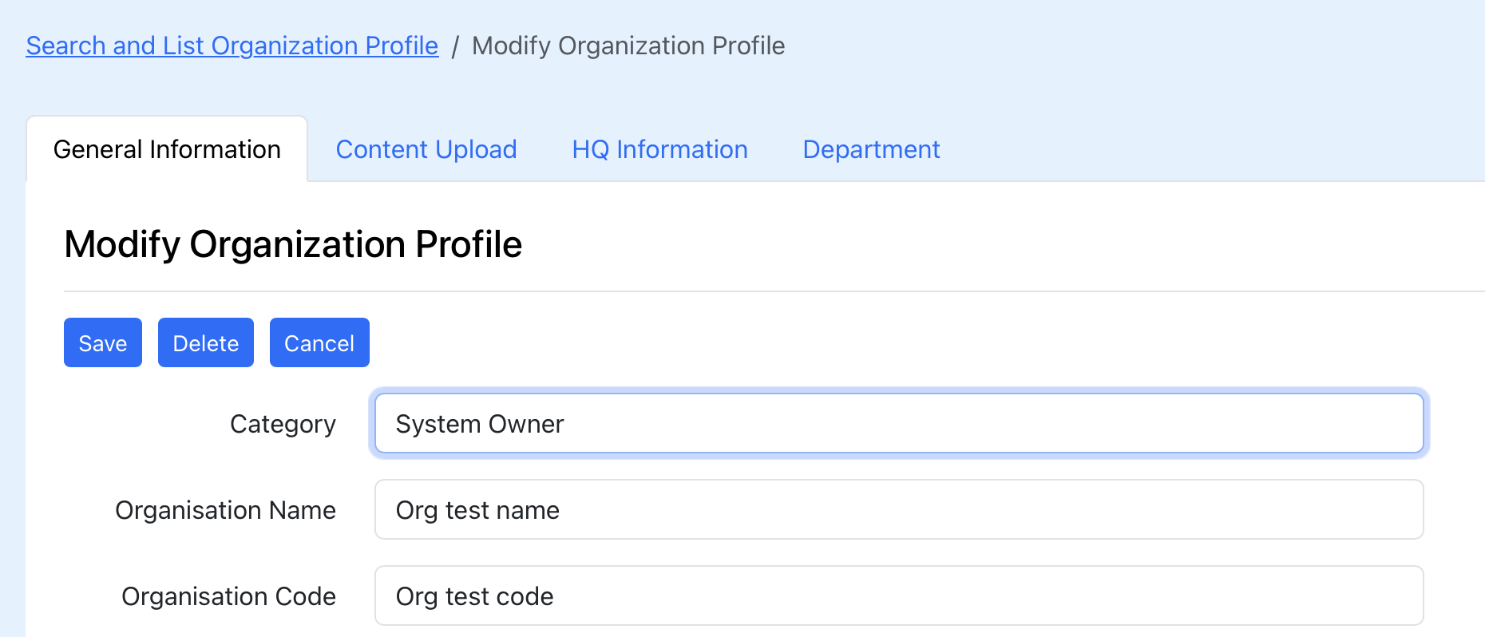
Organisation Structure
Parent Organisation
Jabatan Perangkaan Malaysia (JPM)
Add Parent Organisation
X
display {organisationEntity.parentOrgName}
field mapping {organisationEntity.parentOrgId}
Delete the value at organisationEntity.parentOrgId
No web service for this action

Slide 2
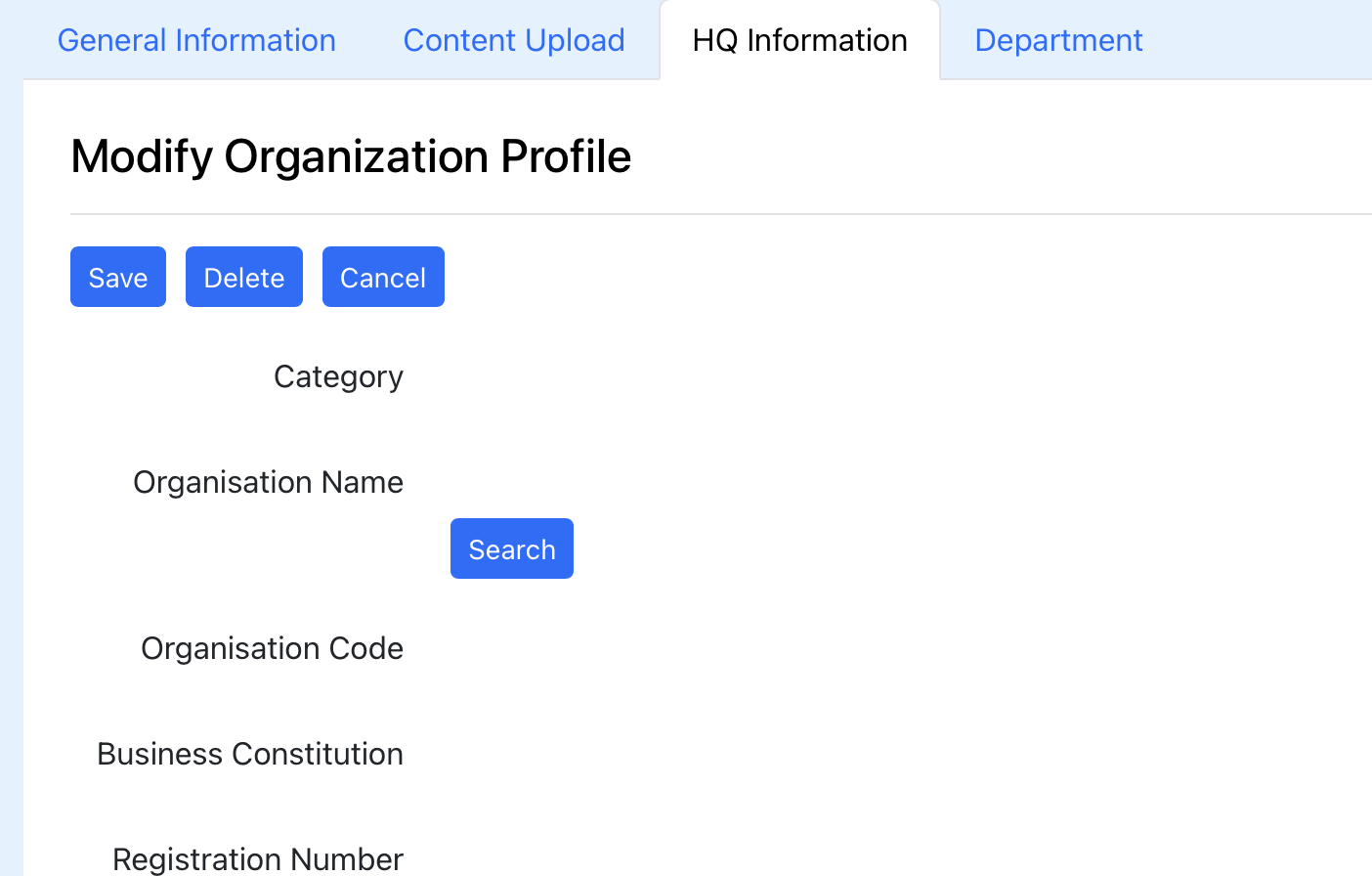
Organisation Structure
When user click the ‘Organisation Structure’ tab, trigger API
/organisationWs/viewOrgStructureAction
No C/U/D. Retrive (R) only the tree table with the following column:
Org Code | Org Name | Status

