Slide 1
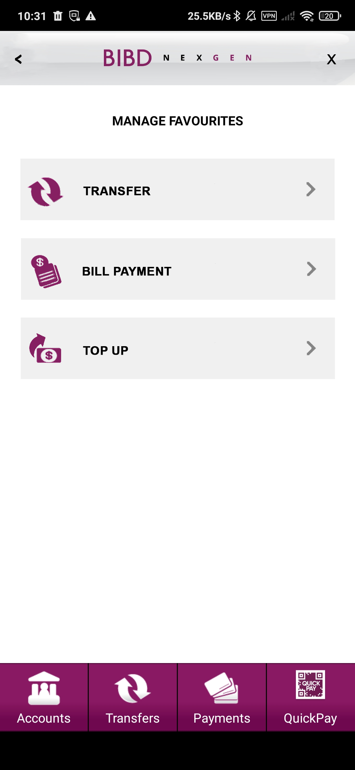
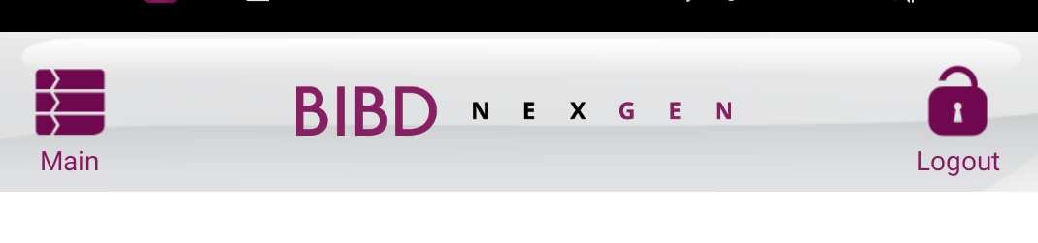
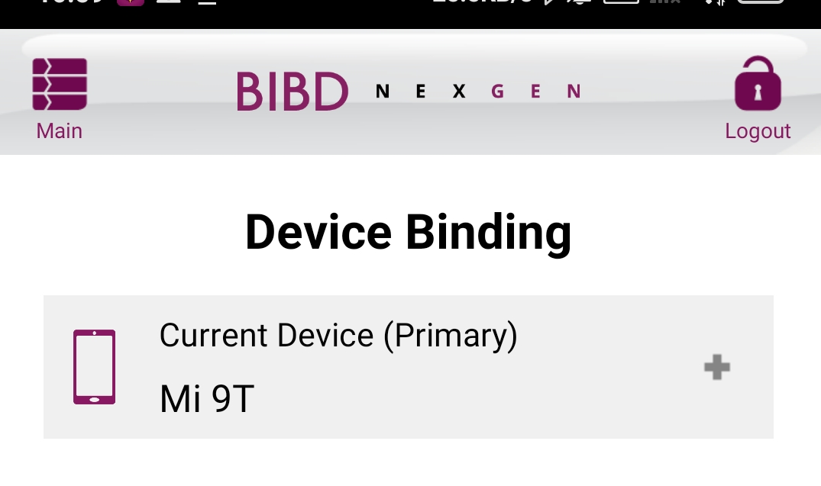
Maintain Favourite screen 1
Refer BAU header
Add header
- Replace Main and Logout into < and X
Add box (refer device binding module)
Text all capital letter
Add footer

Slide 2
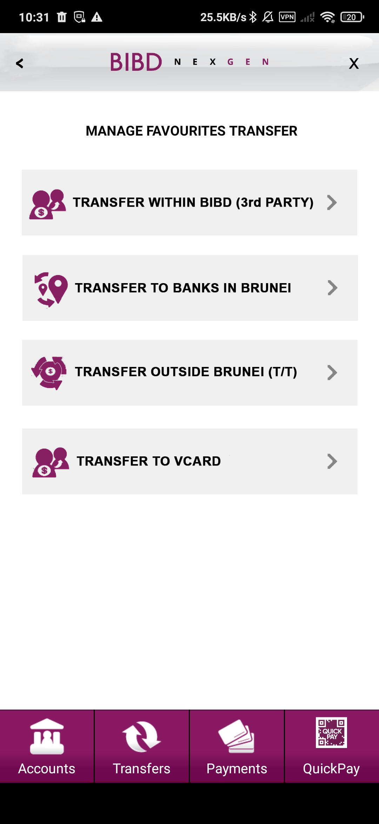
Maintain Favourite screen 2
Refer BAU header
Add header
- Replace Main and Logout into < and X
Add box (refer device binding module)
Text all capital letter
Add footer

Slide 3
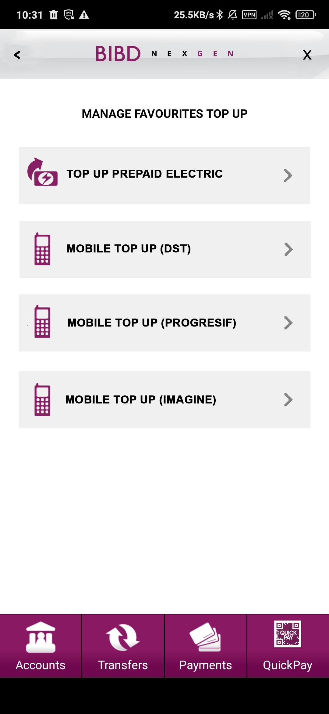
Maintain Favourite screen 3
Refer BAU header
Add header
- Replace Main and Logout into < and X
Add box (refer device binding module)
Text all capital letter
Add footer

Slide 4
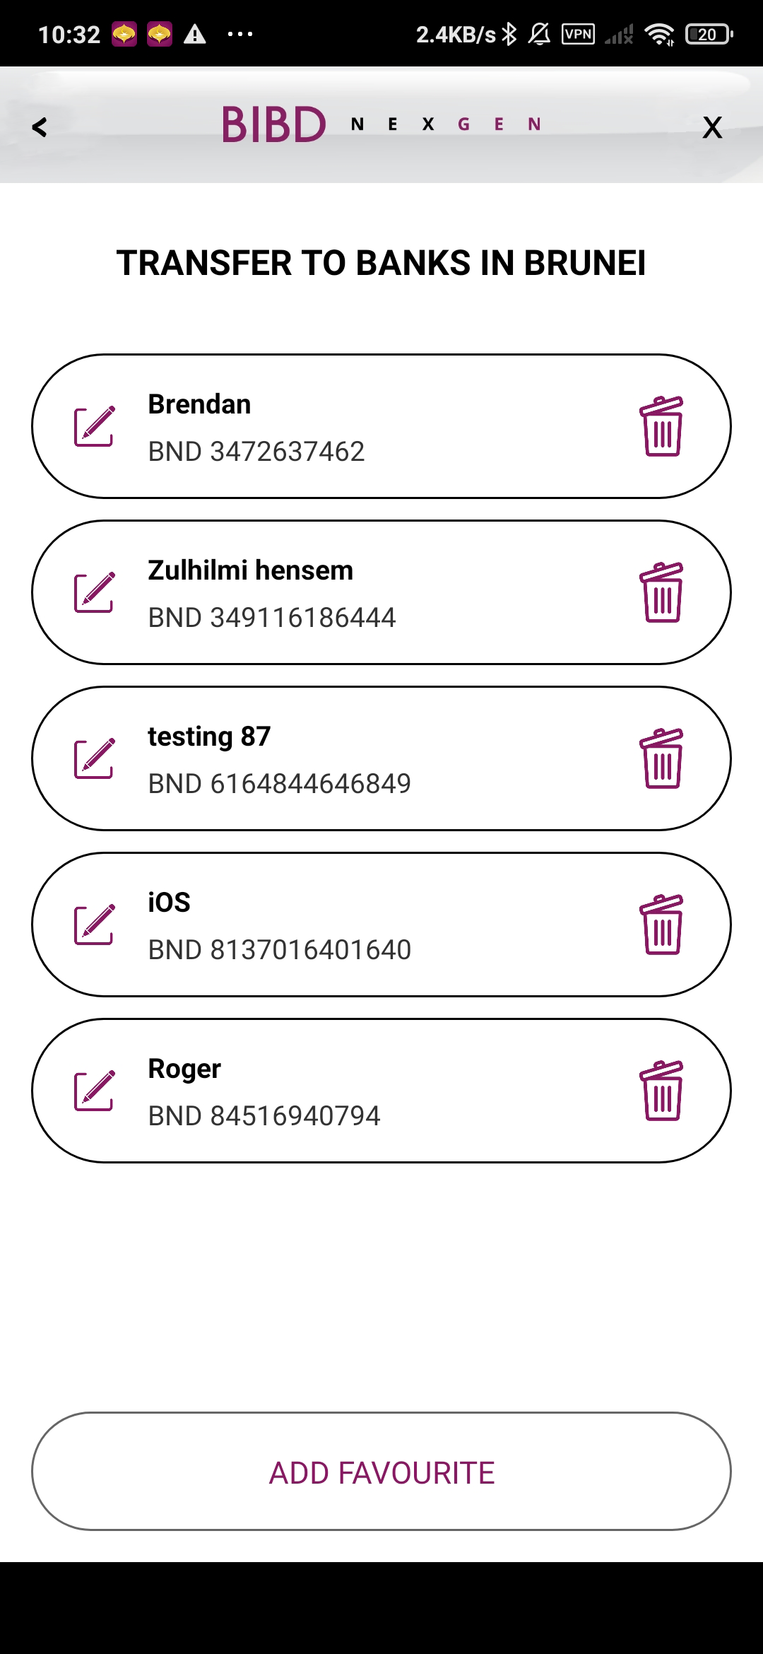
Maintain Favourite – Favourite List
Add header
- Replace Main and Logout into < and X
Refer BAU header
**Apply to all other module fav list

Slide 5
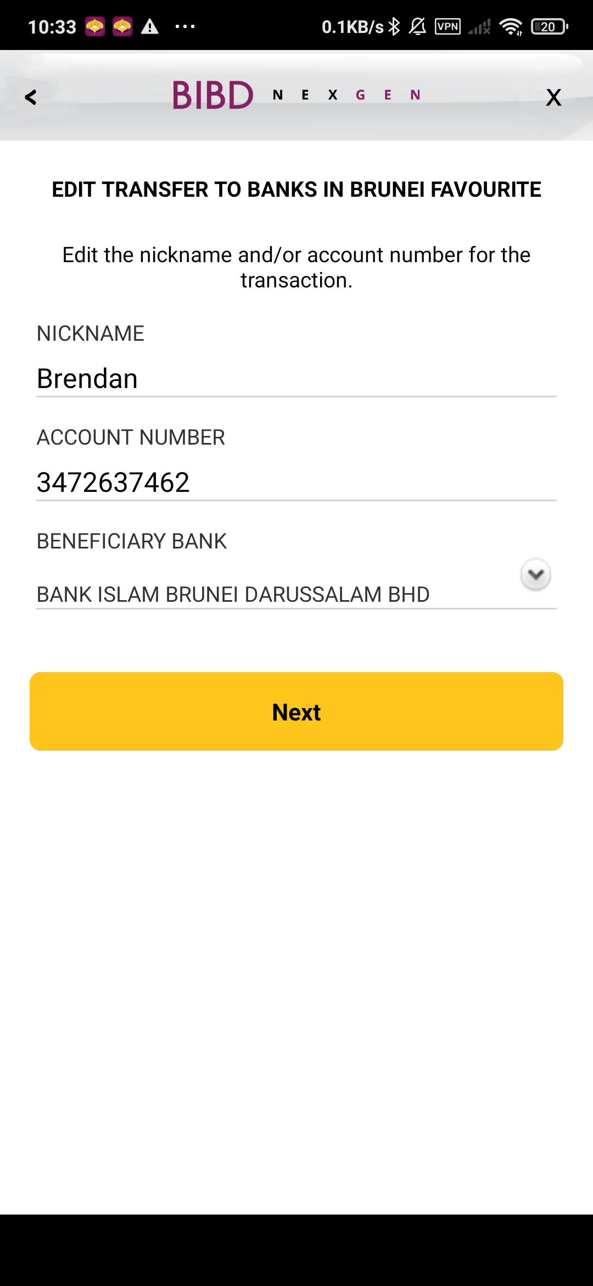
Maintain Favourite – Input Details (Add/Edit)
Add header
- Replace Main and Logout into < and X
Refer BAU header
**Apply to all other module add/edit input fav

Slide 6
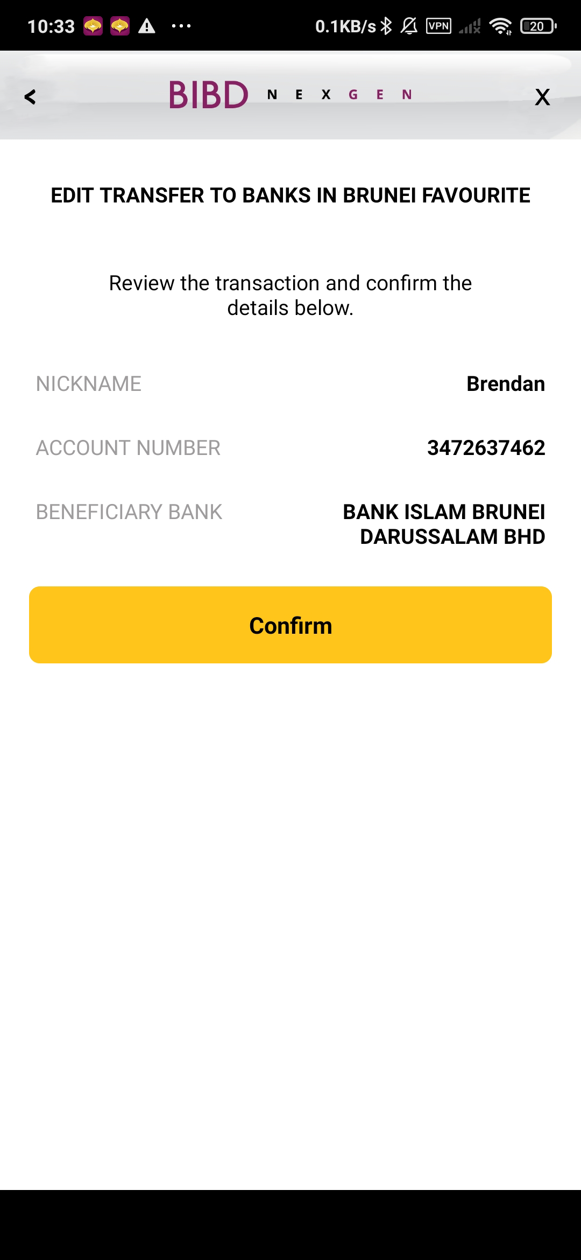
Maintain Favourite – Confirmation Details (Add/Edit)
Add header
- Replace Main and Logout into < and X
Refer BAU header
**Apply to all other module fav edit/add confirmation

Slide 7
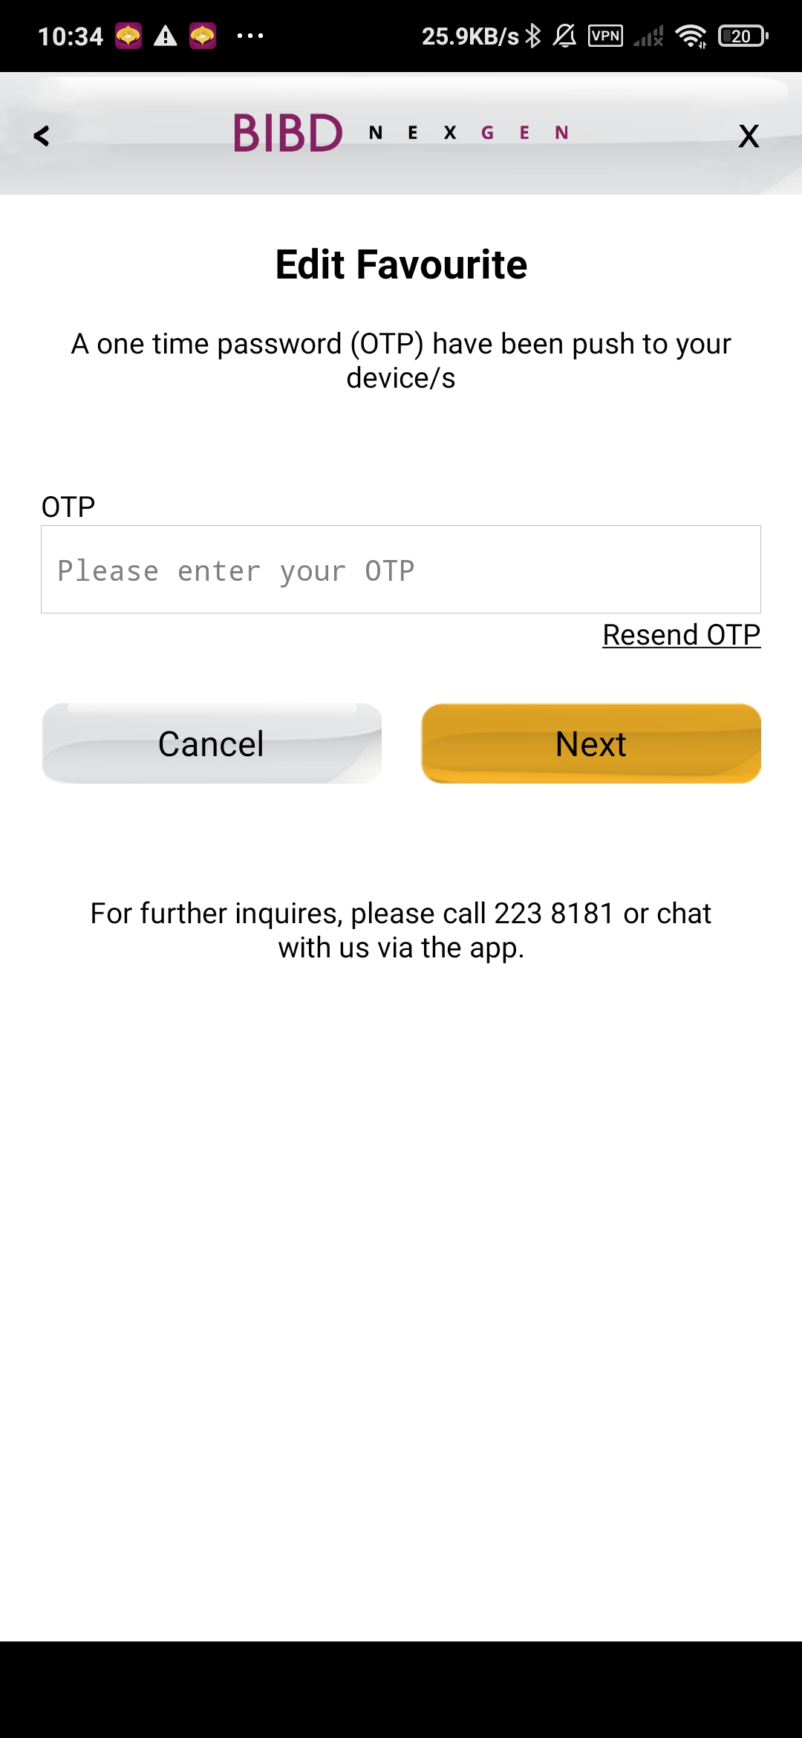
Maintain Favourite – OTP screen (Add/Edit)
Add header
- Replace Main and Logout into < and X
Refer BAU header
**Apply to all other module fav edit/add OTP screen

Slide 8
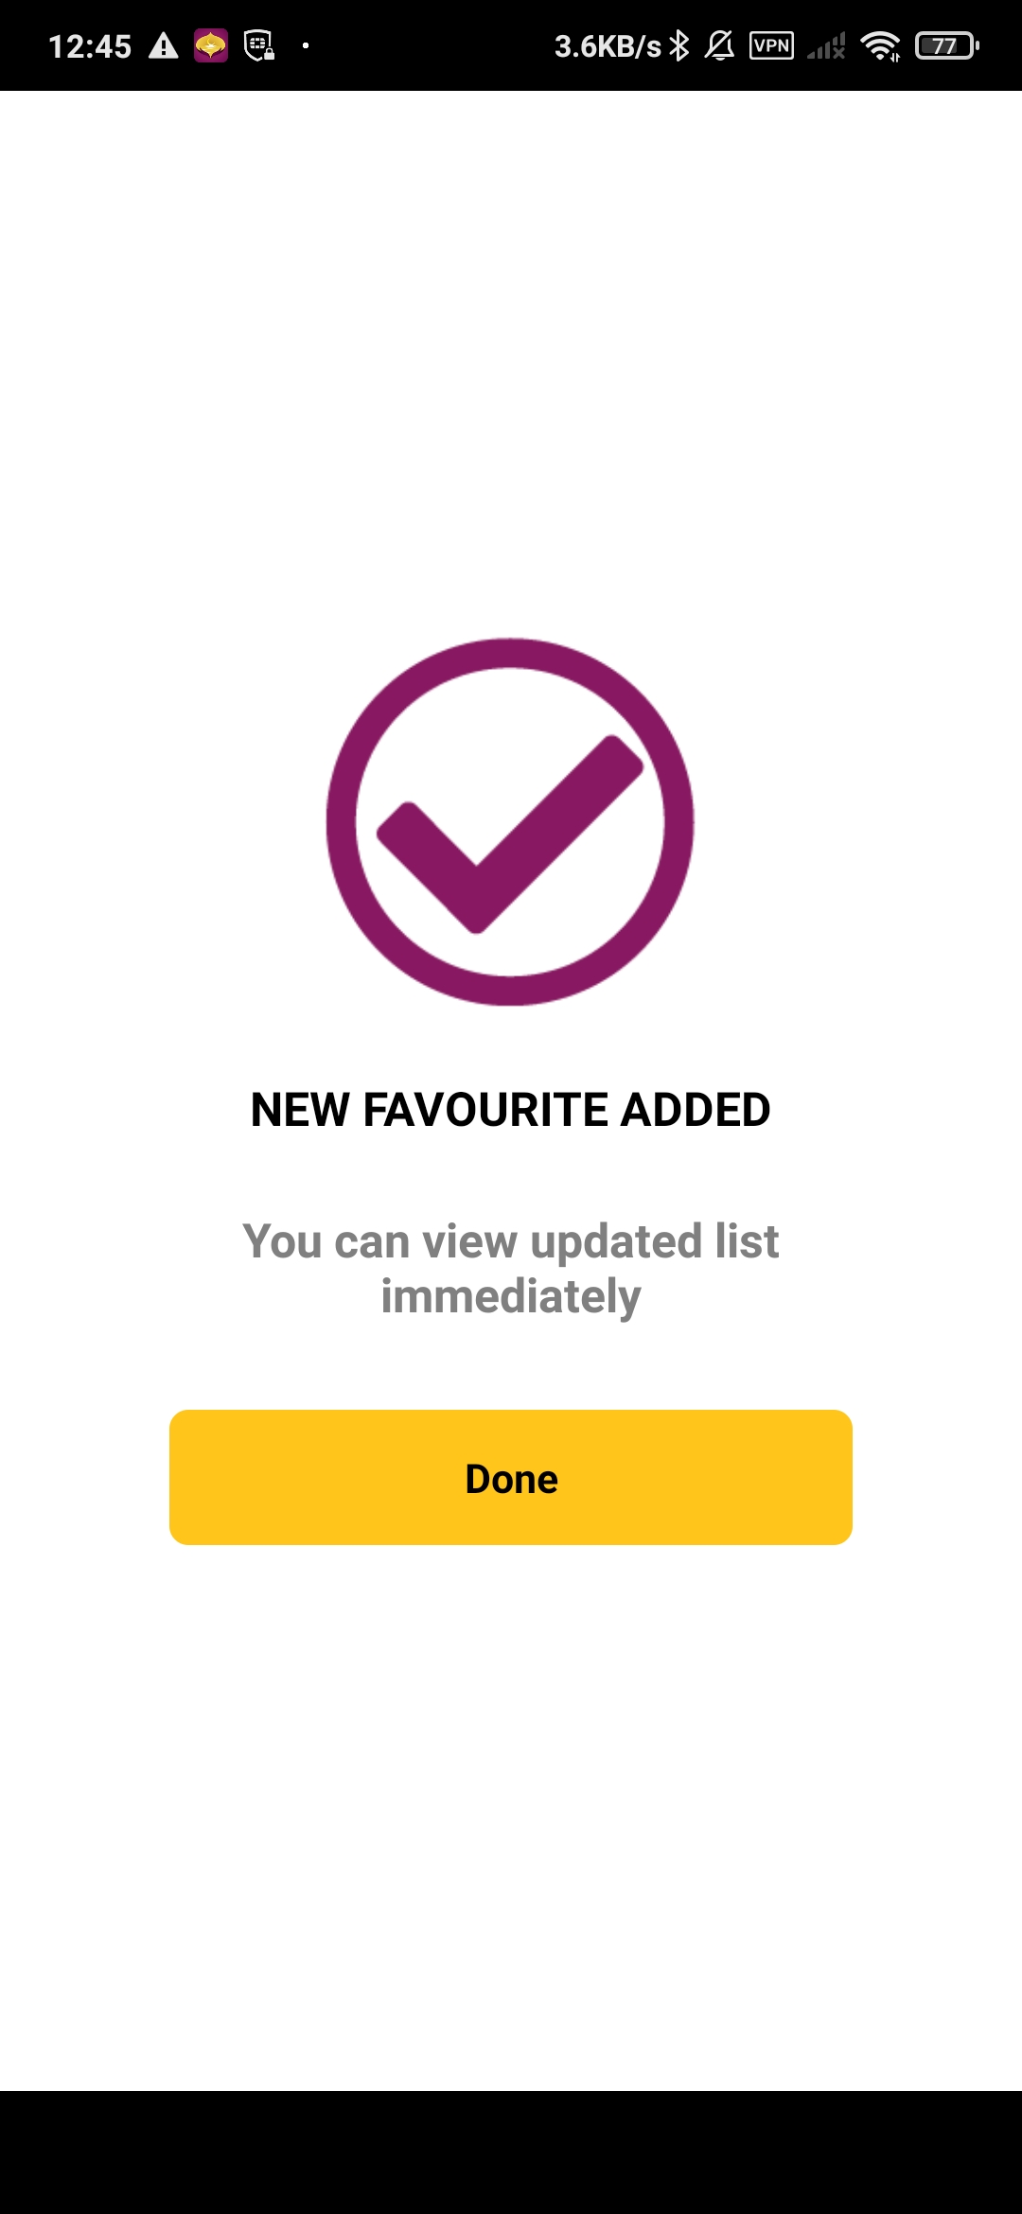
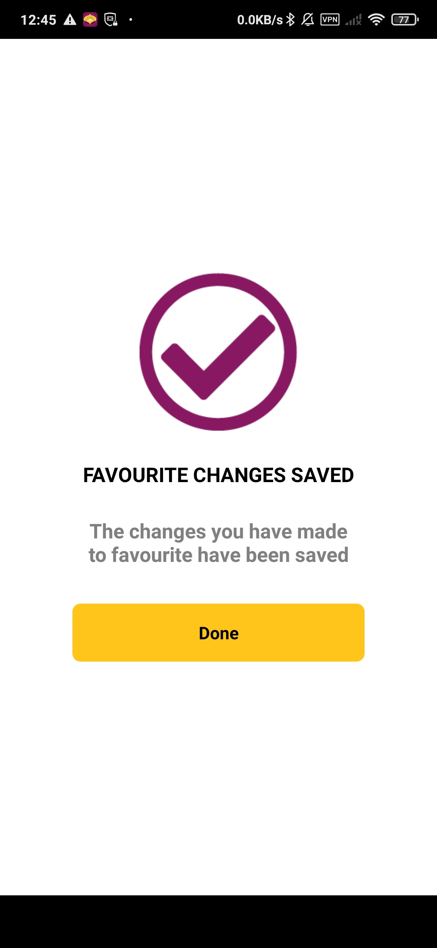
Maintain Favourite – Success screen (Add/Edit)
**No changes in success screen of add and edit

Slide 9
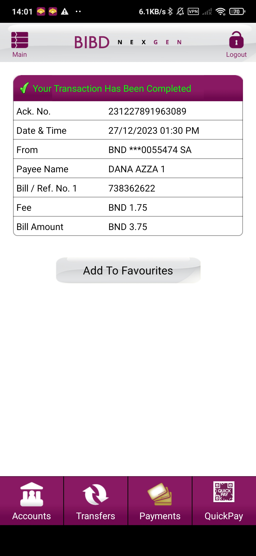
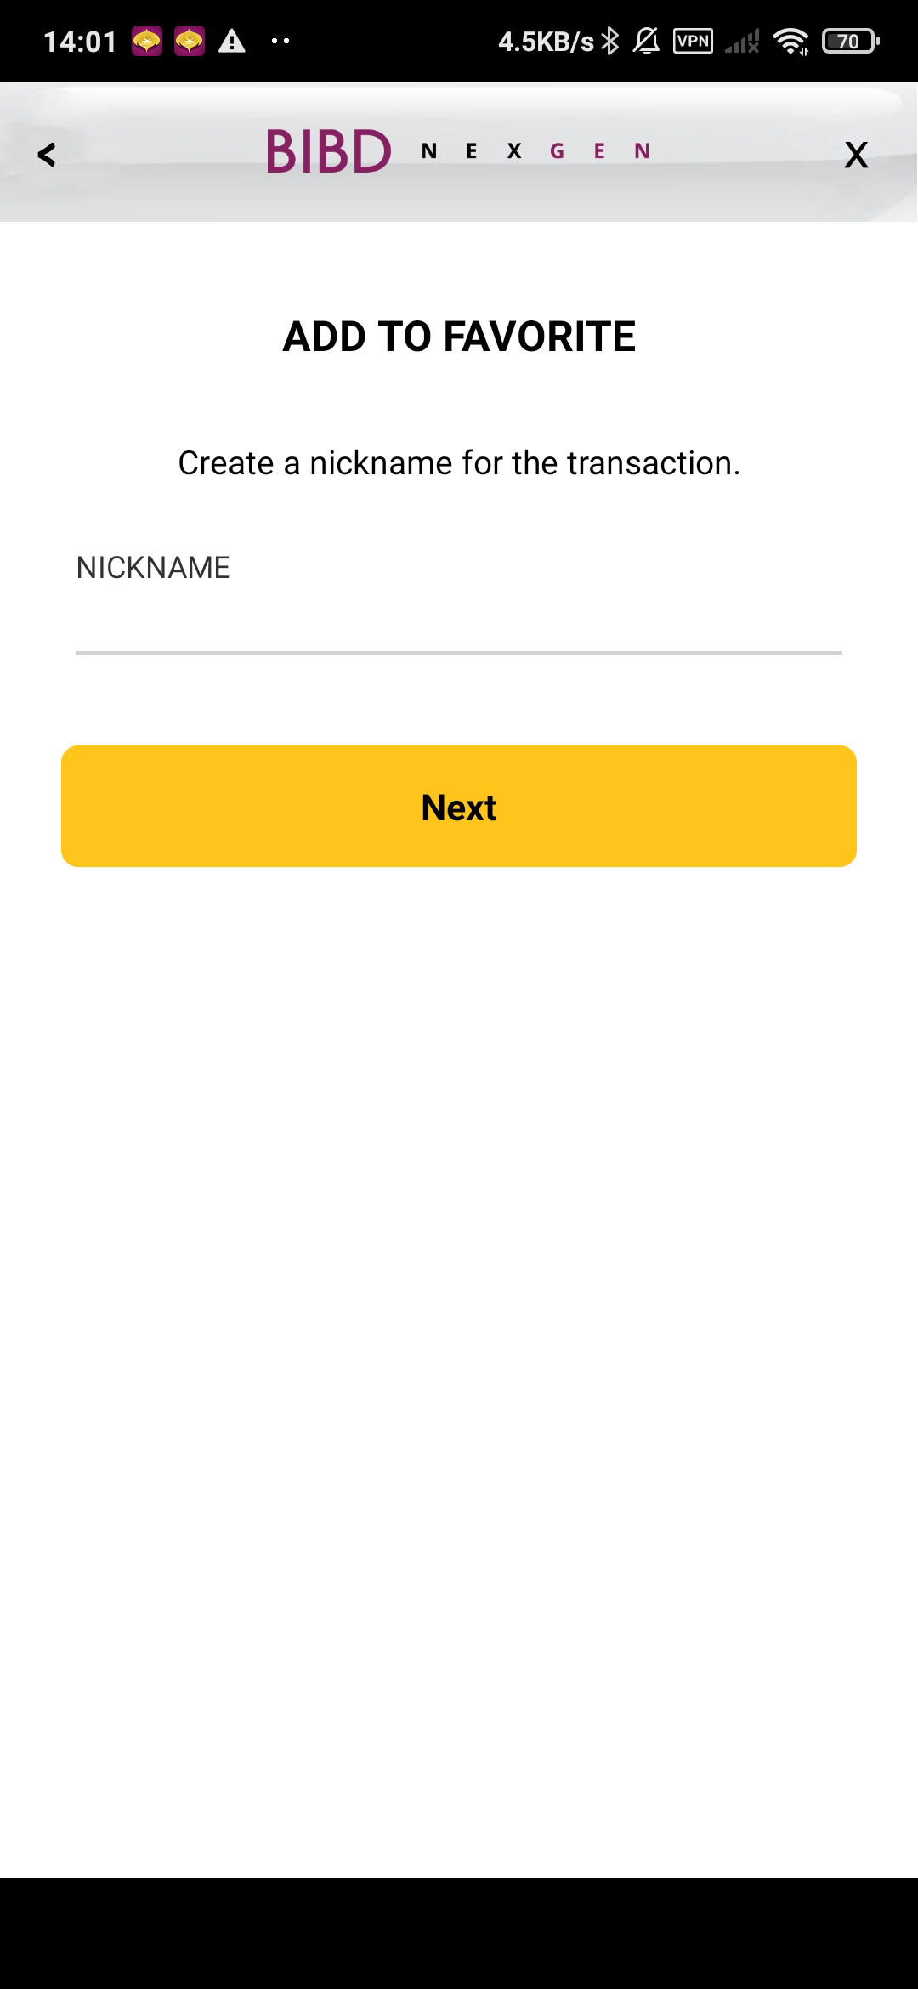
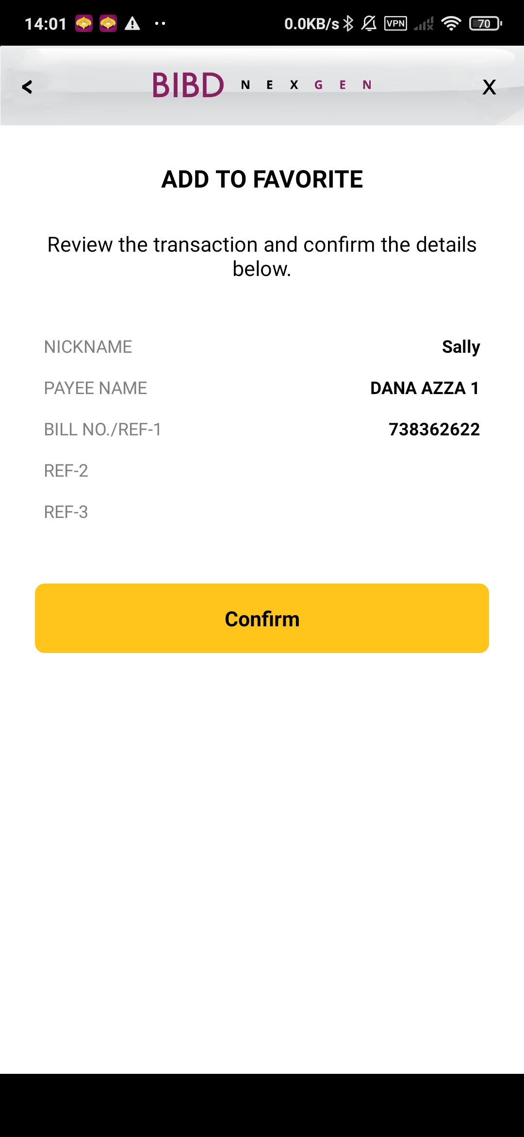

Add Favourite after transaction
**Apply to Bill payment and all other Top Up module add fav
after transaction
Add header
- Replace Main and Logout into < and X

