Slide 1
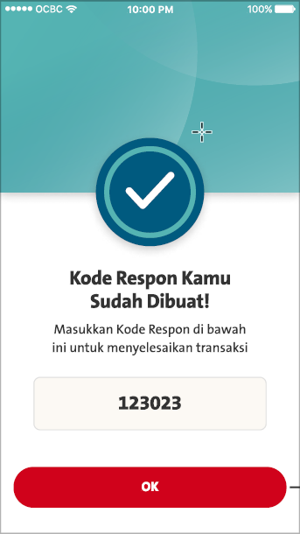
Please apply Appli Changes below in Prod Source Code Pointing @
1. Production – Current Old Server: >>> Need Production Package
Weblogic 12 : https://businessmobile.ocbc.id/ccmcb/ws/McBWSServices
2. Production - New Server: >>> Need Production Package
Weblogic 14 : https://businessmobile.ocbc.id/wl14/ccmcb/ws/McBWSServices
-----------------------------
Current Phase: PIN IB
1. Yes, when PIN IB is displayed, which is temporarily hide [ Appli 1 & 3 ] other than appli2. [Cater by FE temporarily]
Remark for Next Phase:
Going forward, the front end should read the list_appli_no field value,
which should be pretty straightforward (1 for appli1, 2 for appli2, 3 for appli3, qr for QR code)
2. Copywriting on Acknowledgement screen [Appli 2]
ENGLISH
Your Response Code Has Been Created!
Enter the Response Code below to complete Your transaction on OCBC Business web.
BAHASA
Kode Respon Anda Sudah Dibuat!
Masukkan Kode Respon di bawah ini untuk menyelesaikan transaksi Anda di OCBC Business web.
QC1381 - Add Temporary hidden items [Appli 1 & Appli 3]
QC1380 - Update The English Copywriting on Response Code Form PIN IB

Slide 2
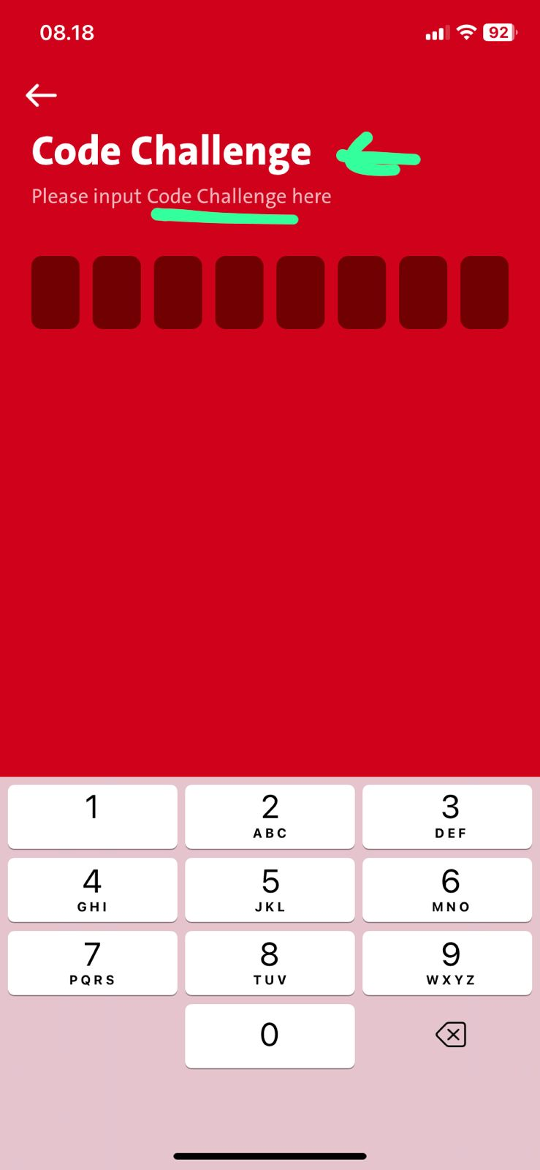
In ENGLISH, It must be Challenge Code instead of Code Challenge

Slide 3
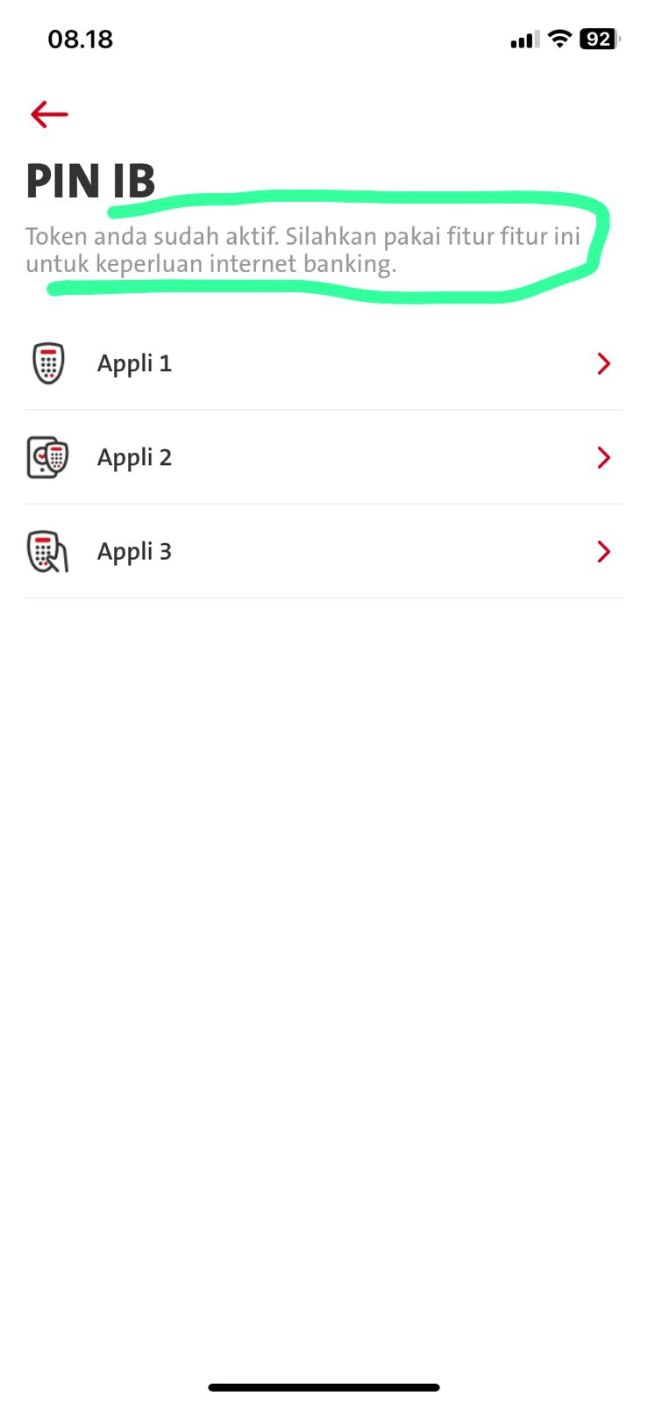
Related to rebranding:
ENG
Your token is active. You can use for transaction purposes on OCBC Business web.
ID
Token Anda sudah aktif. Silakan gunakan fitur ini untuk keperluan transaksi di OCBC Business web.

Slide 4
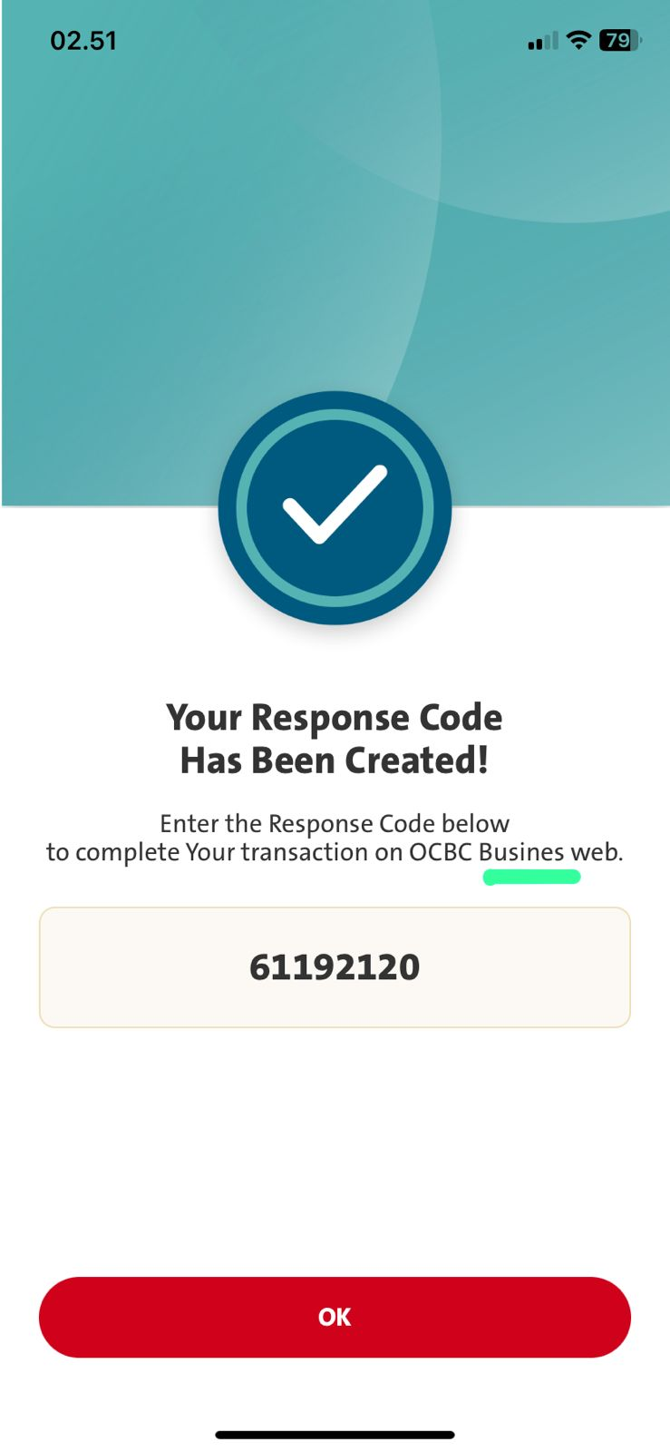
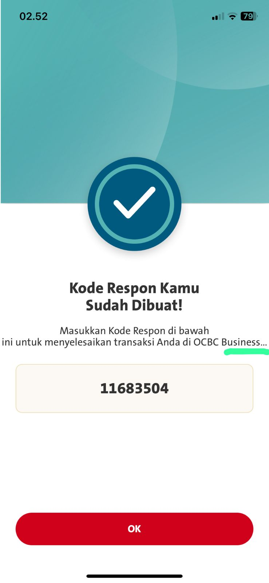

Slide 5
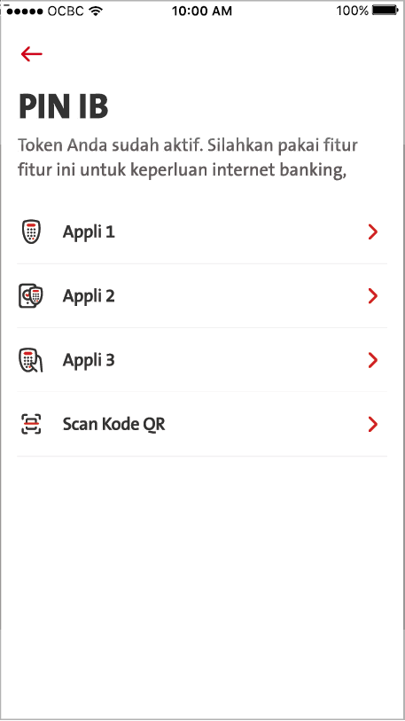
QC1382 - QC1382 - Implementation Dynamic Visibility of appli 1,2,3 based on response from omni
Changes below in Prod Source Code Pointing @
1. Production – Current Old Server: >>> Need Production Package
Weblogic 12 : https://businessmobile.ocbc.id/ccmcb/ws/McBWSServices
2. Production - New Server: >>> Need Production Package
Weblogic 14 : https://businessmobile.ocbc.id/wl14/ccmcb/ws/McBWSServices
-----------------------------
BE: Will cater below in RetriveSecInfo Response for FE
Please refer to Omni Spec 4.1 [token/inquiry] & 18.94 [list_appli_no]
--------------------------------------------------------------------------------------------------------------------------------------------------------------
FE: Check appliNo: value under RetrieveSecInfo Response by BE
REMOVE - Yes, when PIN IB is displayed, which is temporarily hide [ Appli 1 & 3 ] other than appli2. [Cater by FE temporarily]
Sample:
To display [Appli 1] when BE returns appliNo: 1
To display [Appli 2] when BE returns appliNo: 2
To display [Appli 3] when BE returns appliNo: 3
To display [Appli 1,3] when BE returns appliNo: 1, 3
To display [Appli 1,QR] when BE returns appliNo: 1, QR

