Slide 1
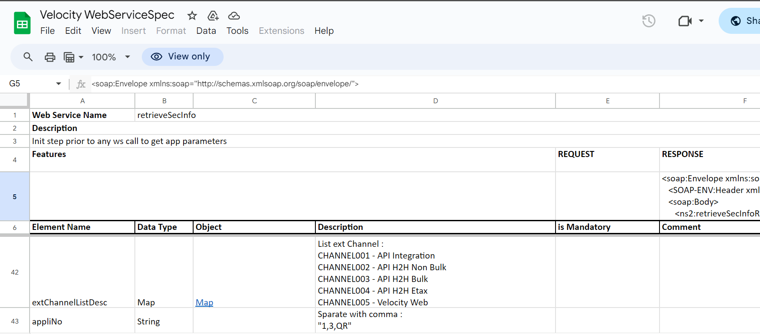
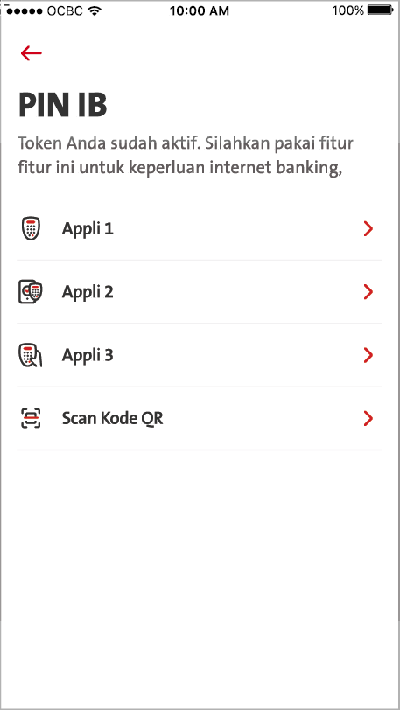
QC1382 - Hide Checking
Remove the Appli 1 and 3 temporary hide.
Check appliNo that return from BE in retrieveSecInfo.
  1: Display Appli 1
  2: Display Appli 2
  3: Display Appli 3
  Omni will return “2” by default and it wont return 0 or blank in future.
* No need to display Scan QR because it is not available yet

Slide 2
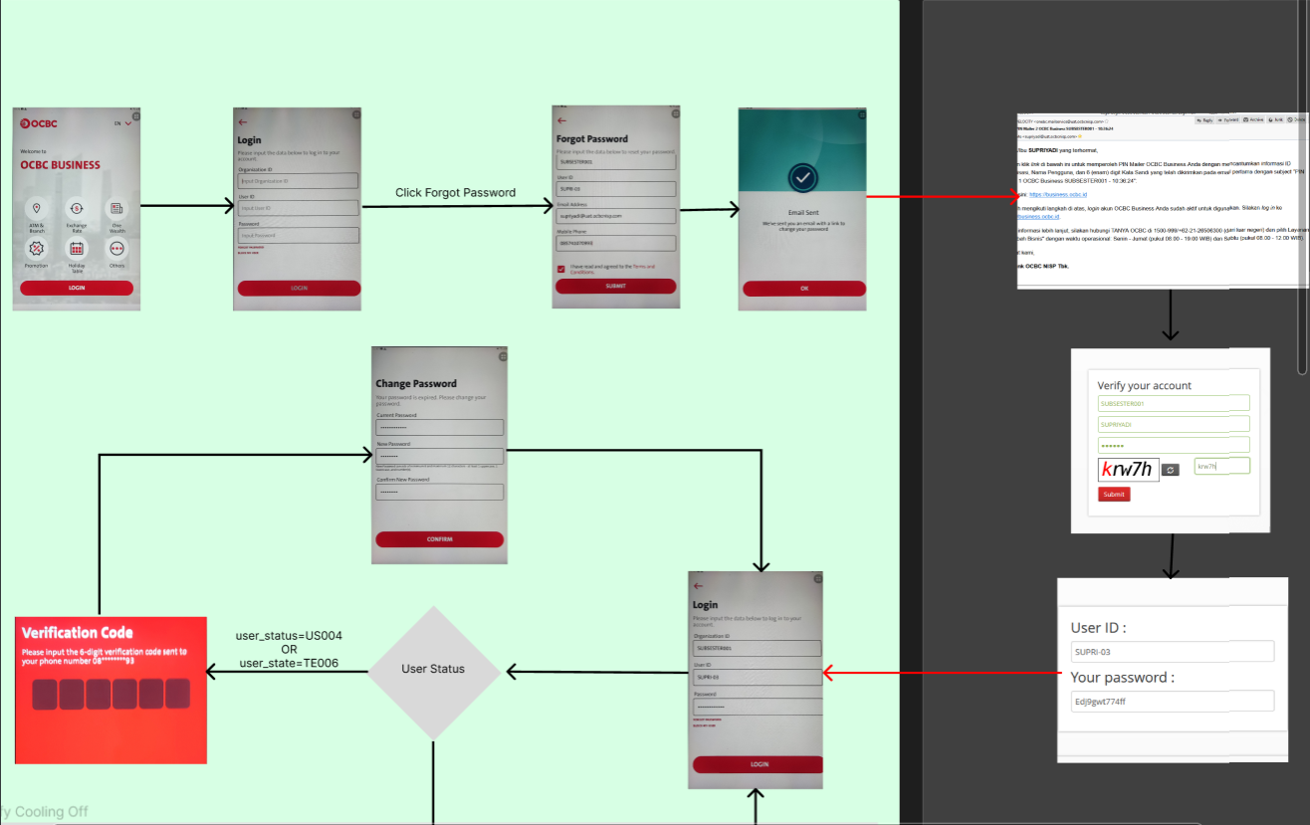
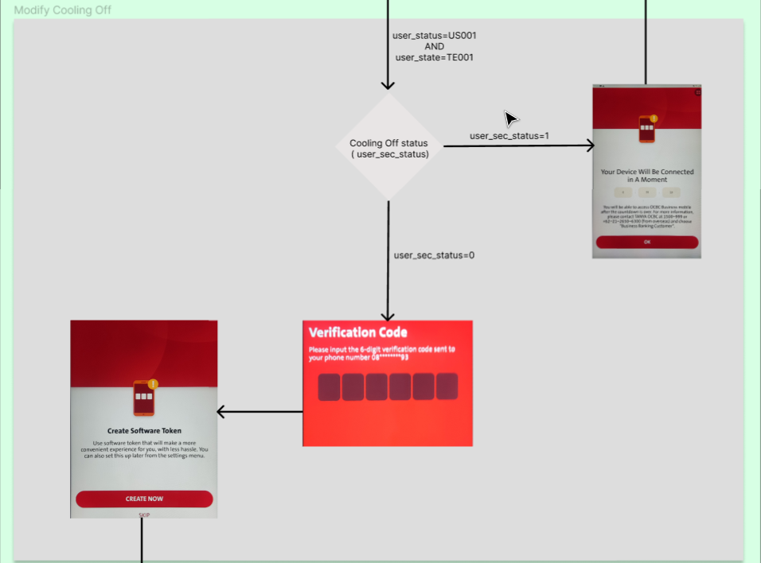
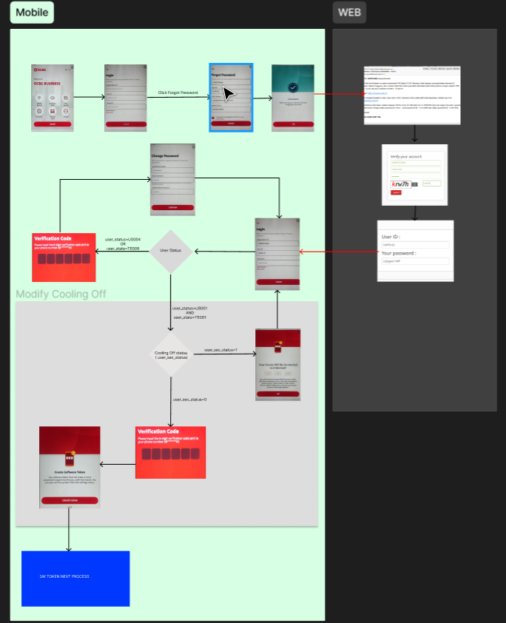

Slide 3
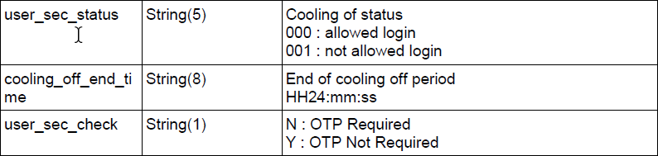
Inherited from Slide # 5 QC1368 – OTP/ TIMER to be displayed during login
BE: cater 3.3 Authenticate – Response for below (Should have already catered – Need to cross check) >> Already Catered
In General:- Under Performloginv2 Response << Follow given Figma >>
FE – checks below: Checking sequence #1 > #2 > #3
  #1
  BE returns usr_status = US001 & usr_state = TE001
  FE checks on the return of usr_status = US001 & usr_state = TE001
  #2 [Display of TIMER]
  BE returns userSecStatus = 001
  FE checks on the return of userSecStatus= 001
  THEN
  #3
  BE returns remainingCoolOff > BE returns in milliseconds >>>>>> FE maps with >>>> remainingCoolOff value
  FE checks remainingCoolOff > Display Timer
-------------------------------------------------------------------------------------
  FE – checks below: Checking sequence #1 > #2 > #3
  IF
  #1
  BE returns usr_status = US001 & usr_state = TE001
  FE checks on the return of usr_status = US001 & usr_state = TE001
  #2
  BE returns userSecStatus = 000
  FE checks on the return of userSecStatus = 000
  THEN
  #3
  Display and continue with “Create Software Token” screen flow
Refer to slide #4
Refer to slide #5

Slide 4
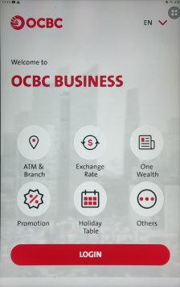
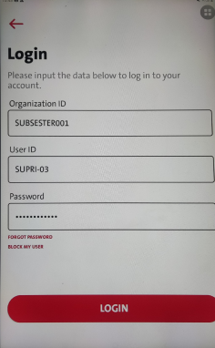
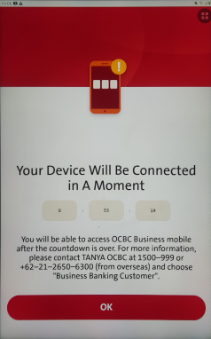
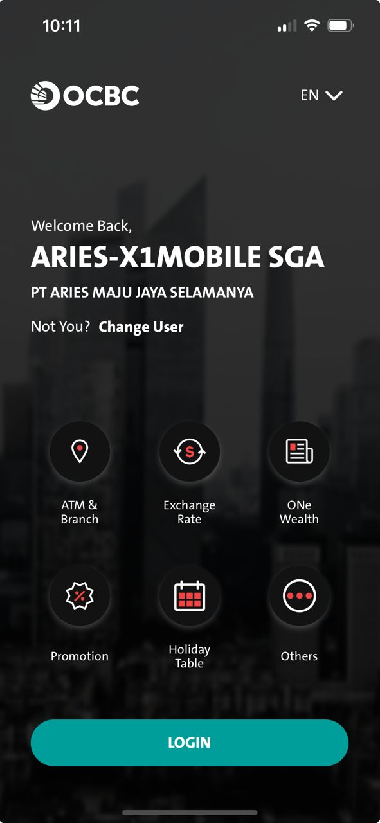
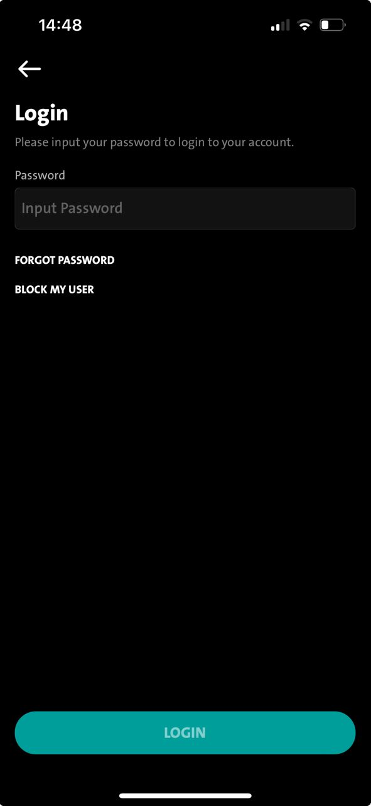
1. Unbinded landing
2. Unbinded login screen
3. TIMER
4. Binded Landing Screen
5. Password Input Screen
6. TIMER
SCREEN FLOW REFER TO SLIDE #
2.1 > FE checks MCB.1000101 / 0000000
2.2 > FE checks usr_status = US001 & usr_state = TE001
2.3 > FE checks userSecStatus = 001
3.1 > FE - Display TIMER [map with remaningCoolOff (Millisecond) ]
3.2 > FE – Press ok button [Go back to binded landing screen]
4.1 > FE – Display Binded Landing Screen
5.1 > FE - Display password login input screen (After TIMER is FINISHED on TIMER screen.)
5.2 > FE - calling RetrieveSecInfo >>> When ApprovalCountdown is Empty/ “0”
  FE will continue to call PerformLoginv2 / MLEB calling Authenticate
  FE checks remairnigCoolOff to display TIMER.
6.1 > FE - Display TIMER again (after password input login screen).
In BAU, from Unbinded login screen > Binded Landing screen > After TIMER finish > Display Password Login Screen > after performlogin > [Should not be displaying TIMER again]
Concern: OCBC acceptable ? OCBC ACCEPTED
If follow by the given wireframe , FE is taking the RemainCoolOff value by the Authenticate Response, – the screen flow will be like this
…

Slide 5
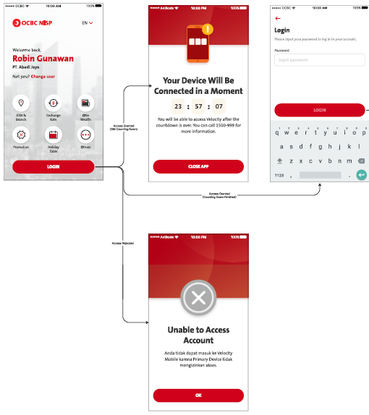
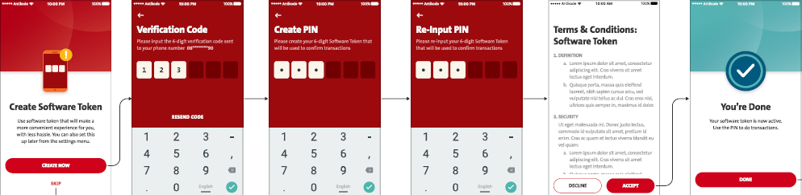
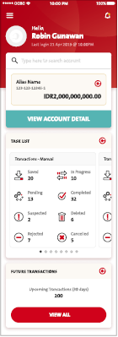
2ndary device login flow – After Primary device approval
Software Token Enrollment screens will replace here
OCBC advice/ requested to have TIMER (RemainingCoolOff) to be displayed after OTP
- Need to avoid this happen because 2ndary Device may already gone thru the TIMER that handles by MLEB
- If Omni return the userSecStatus=001 during authenticate... the user might go thru with the TIMER AGAIN

Slide 6
BE
Return MCB.1000101 = MCB_UNTAGGED_DEVICE
This is what BE will check on that particular device profile by CIF not having device status ACTIVE or PENDING
so when Device is Tagged, meaning device status = ATIVE or PENDING, and BE will return = MCB.0000000
FE
Therefore, FE needs to check both
StatusCode = MCB.1000101/ 0000000
usr_status = US001 & usr_state = TE001
userSecStatus = 001

Slide 7
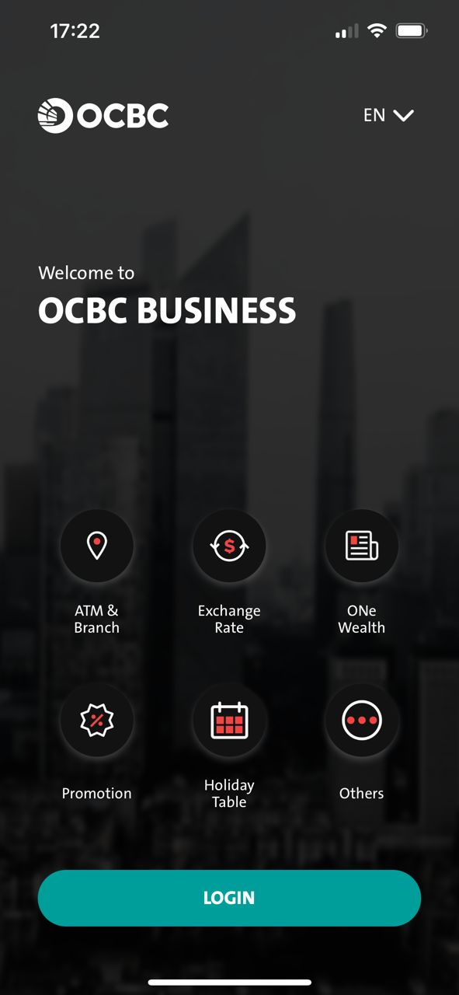
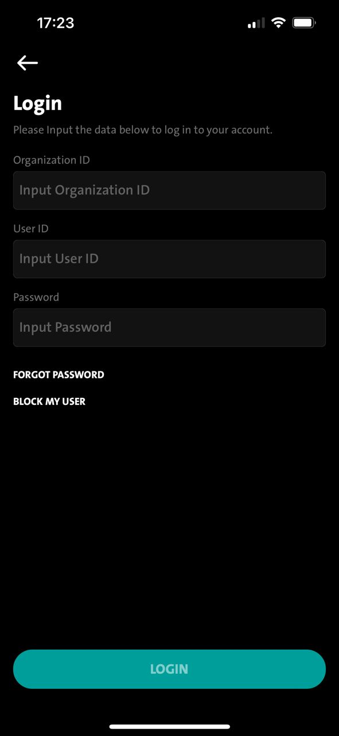
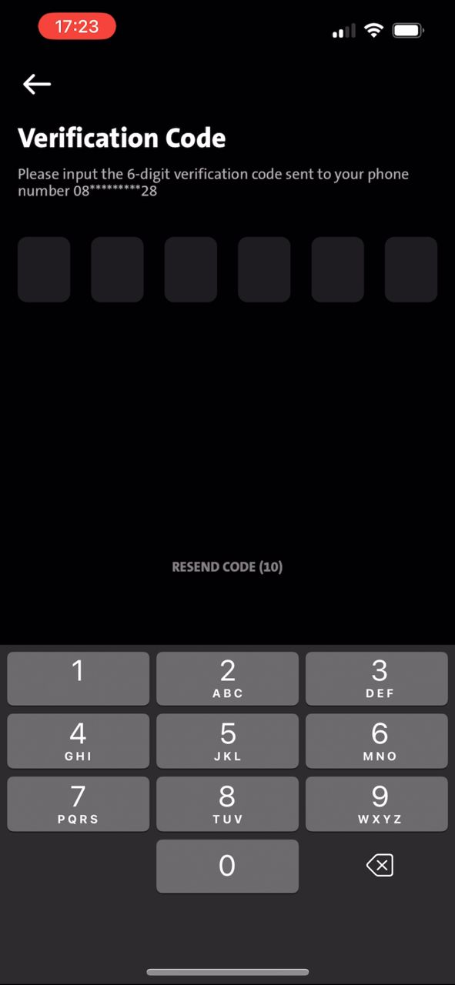
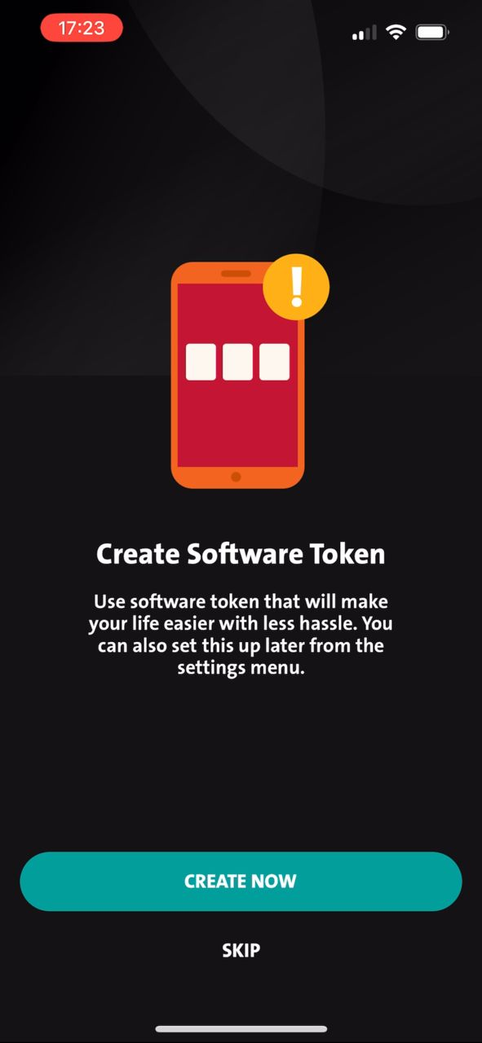
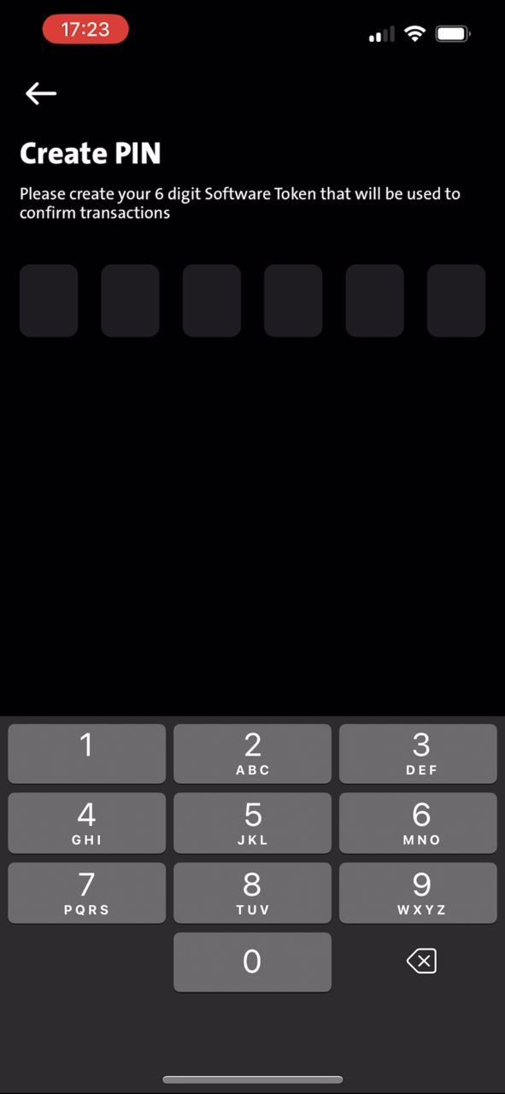
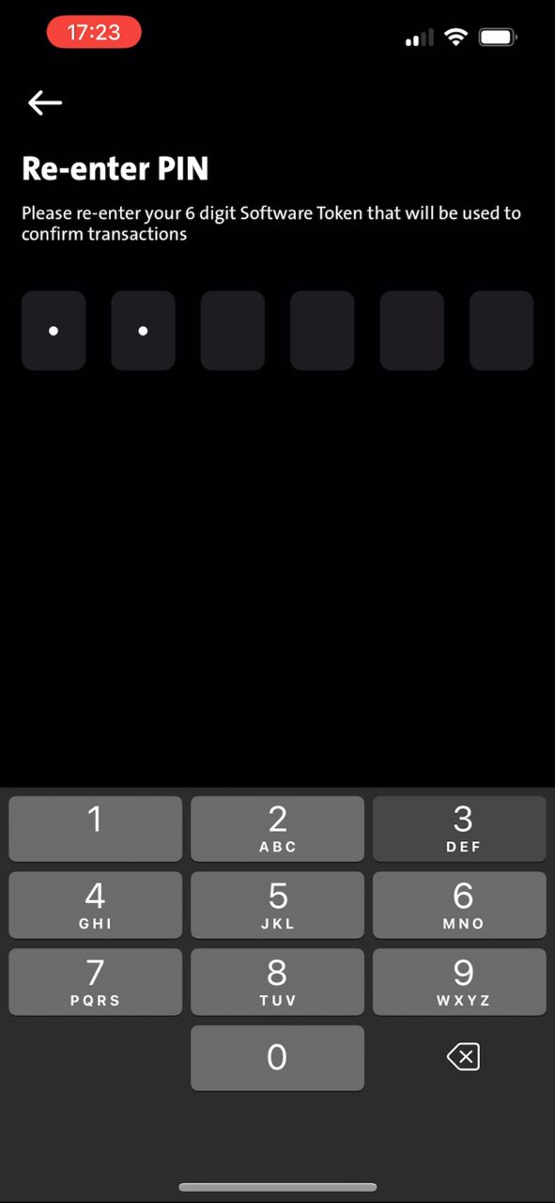
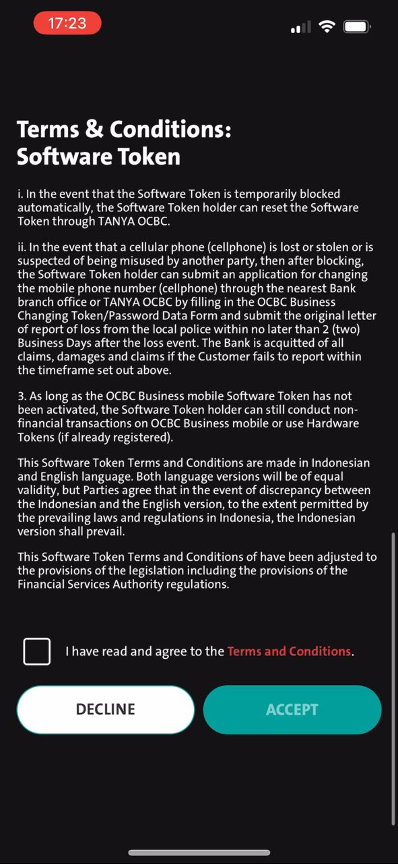
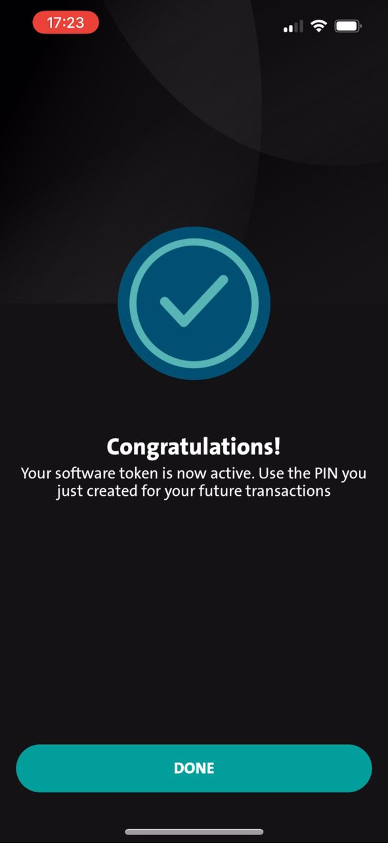
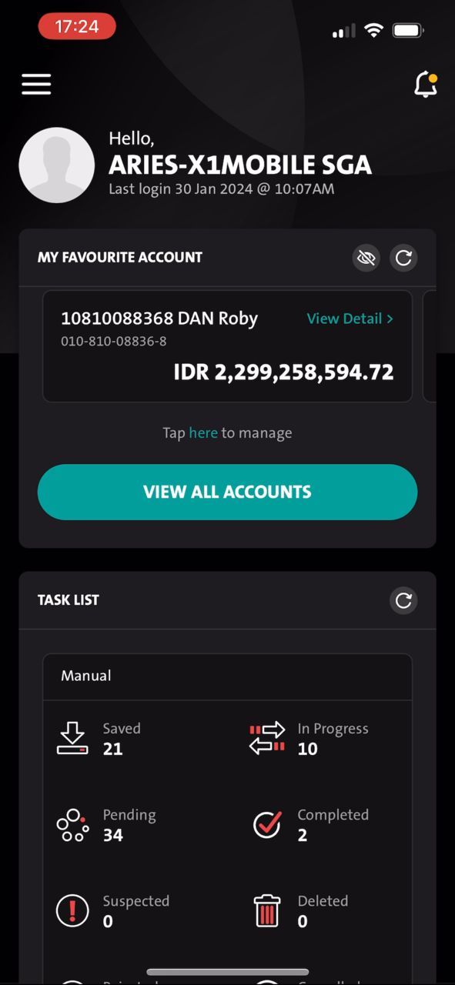
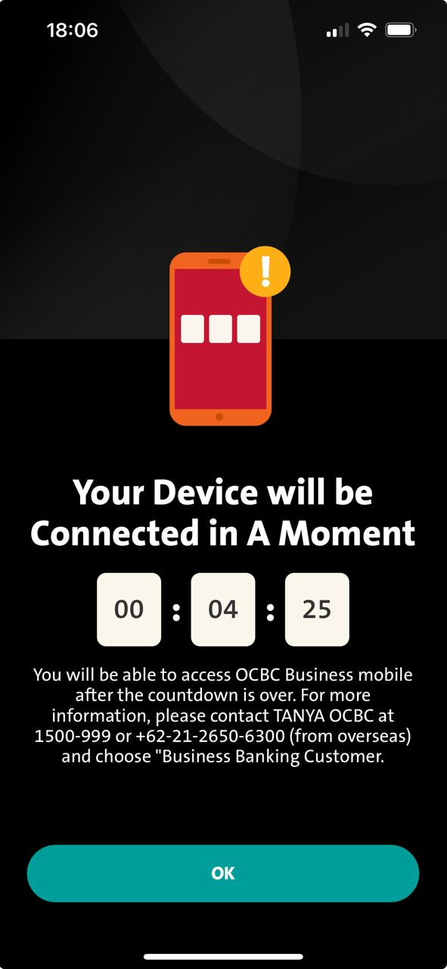
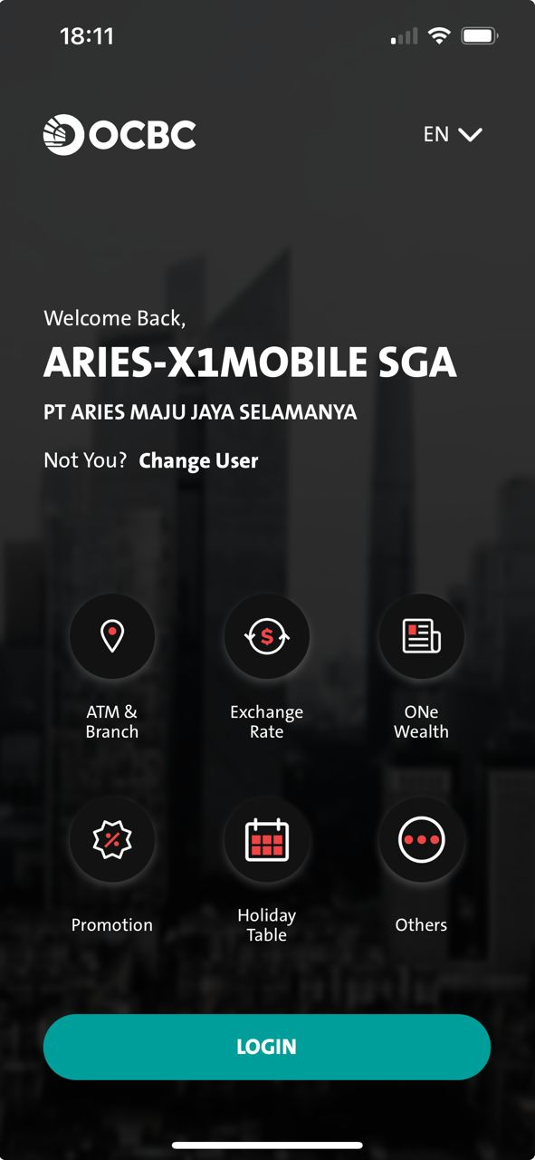
Primary – Display TIMER after OTP
BAU
1. Unbinded landing
2. Unbinded login
3. OTP
4 SW Token
5 PIN #1
5 PIN #1
NEW
BAU
1. Unbinded landing
2. Unbinded login
3. OTP
5. TIMER
FE calling PerformLoginv2
FE checks below during performLoginv2 response:-
> FE checks usr_status = US001 & usr_state = TE001
> FE checks userSecStatus = 001
> FE checks RemainingCoolOff = (Value in milliseconds)
Ok button will go back to BINDED Landing Screen by calling RetrieveSecInfo
> FE checks usr_status = US001 & usr_state = TE001
> FE checks userSecStatus = 000
> FE checks remainingCoodOff = 0/ EMPTY
Remain on TIMER screen until finishes will auto isplay Binded Login Screen

Slide 8
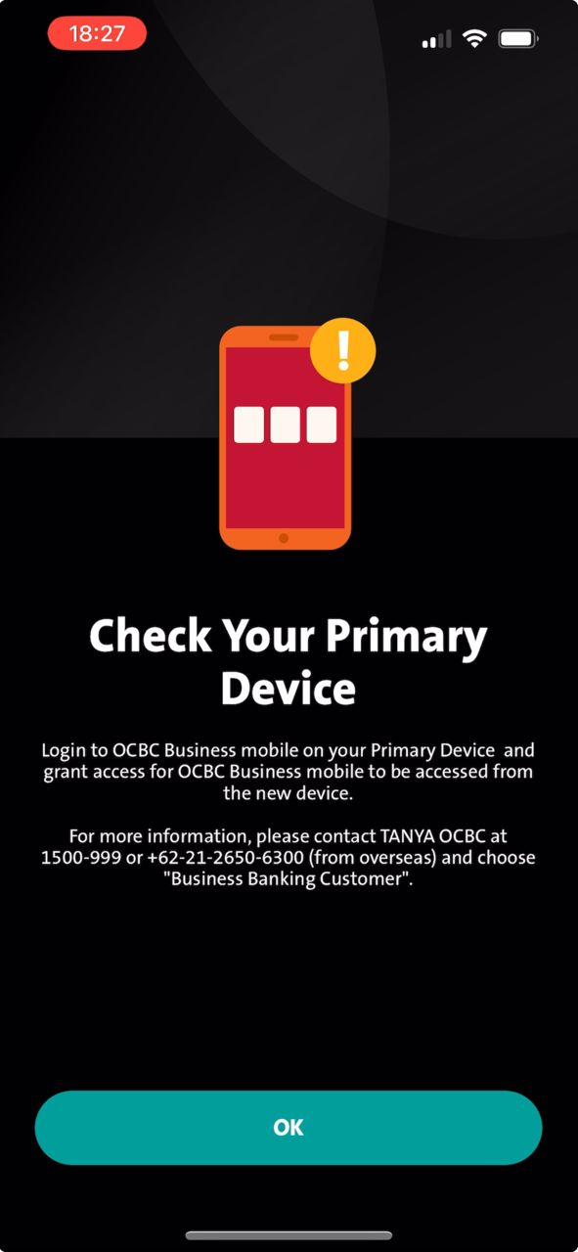
2ndary – Display TIMER after OTP
1. Unbinded landing
2. Unbinded Login
3. OTP
4. Pending Approval
5. Timer (MLEB)
6. BINDED Landing
7. BINDED Login
8. TIMER
9. BINDED Landing
10. BINDED Login
Ok button will go back to BINDED Landing Screen by calling RetrieveSecInfo
FE calling PerformLoginv2
Ok button will go back to BINDED Landing Screen by calling RetrieveSecInfo to display Binded Landing Screen
Existing checking on MLEB for 2ndary Device after approval [REMAIN 2NDARY DEVICE EVERY CHECKING AS BAU]
FE checks below during performLoginv2 response:-
> FE checks usr_status = US001 & usr_state = TE001
> FE checks userSecStatus = 001
> FE checks RemainingCoolOff = (Value in milliseconds)
Remain on TIMER screen until finishes will auto isplay Binded Login Screen
BAU
10. BINDED Login
2.2 > FE checks usr_status = US001 & usr_state = TE001
2.3 > FE checks userSecStatus = 000
2.4 > FE checks remainingCoodOff = 0/ EMPTY

Slide 9
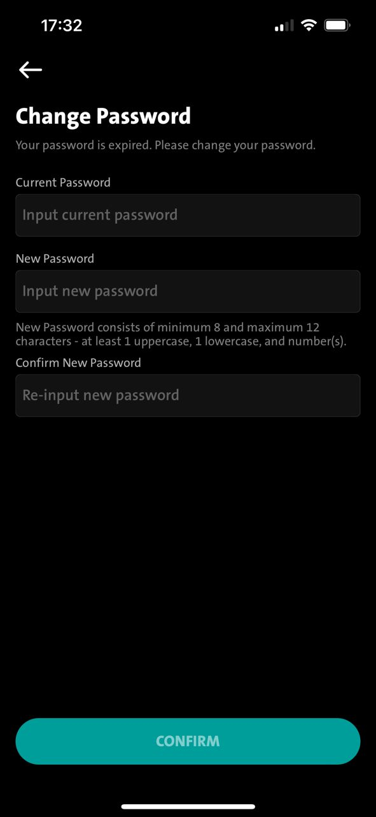
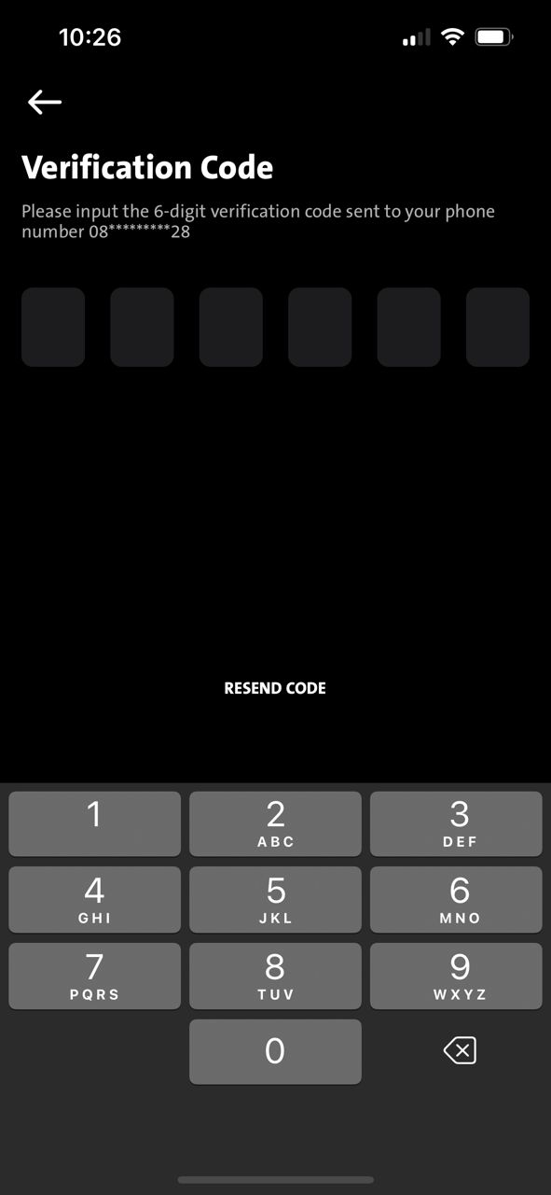
CURRENT CHECKING PerformLoginv2 Response:- "usr_state": "TE006"
Applicable in Android
Applicable in iOS
CURRENT - performDeviceBindingv2 (After perform Device Binding)
"usr_state": "TE006“ OR "usr_status": “US004"
performDeviceBindingv2

Slide 10
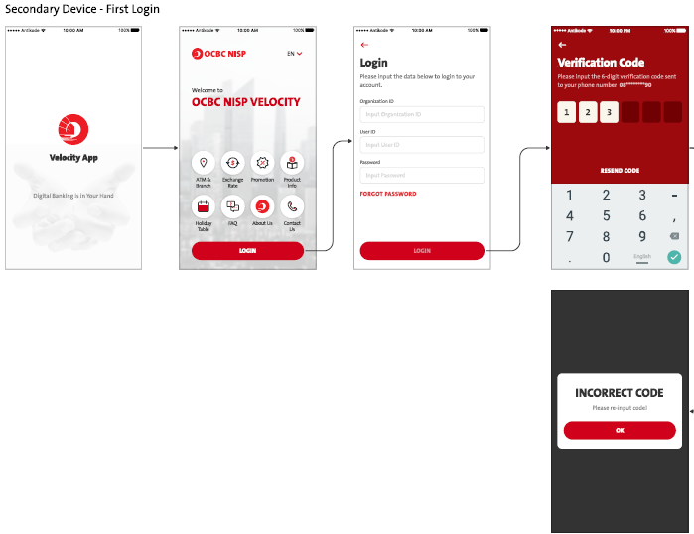
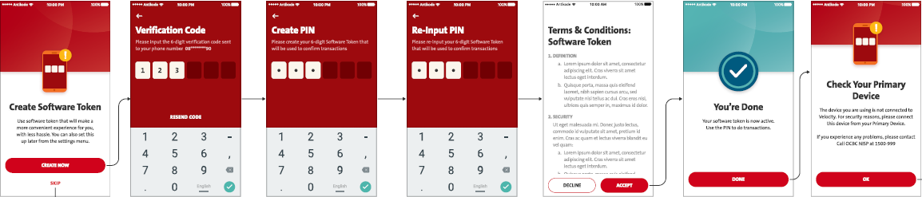
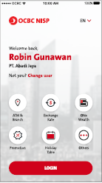
Primary – Display TIMER after BINDING Flow

Slide 11
1. Unbinded landing
2. Unbinded login screen
3. OTP Screen
4. Binded Landing Screen
5. Password Input Screen
OR
BAU – The Rest will BAU
2.1 > FE checks MCB.1000101
2.2 > FE checks usr_status = US001 & usr_state = TE001
2.3 > FE checks userSecStatus = 000
3.1 > FE - Display TIMER [map with remaningCoolOff (Millisecond) ]
3.2 > FE – Press ok button [Go back to binded landing screen]
4.1 > FE – Display Binded Landing Screen
5.1 > FE - Display password login input screen (After TIMER is FINISHED on TIMER screen.)
5.2 > FE - calling RetrieveSecInfo >>> When ApprovalCountdown is Empty/ “0”
  FE will continue to call PerformLoginv2 / MLEB calling Authenticate
  FE checks remairnigCoolOff to display TIMER.
6.1 > FE - Display TIMER again (after password input login screen).
In BAU, from Unbinded login screen > Binded Landing screen > After TIMER finish > Display Password Login Screen > after performlogin > [Should not be displaying TIMER again]
…

Slide 12
1. Unbinded landing
2. Unbinded login screen
3. TIMER
5. Unbinded Landing Screen
6 Unbinded Login Screen.
7. TIMER
8. Unbinded Landing
10. Unbinded Login Screen
11. OTP as BAU
Ok button will go back to unbinded Landing Screen by calling RetrieveSecInfo
9. Unbinded Login Screen
When Timer is finished [condition are met] > Continue BAU from here
2.1 > FE checks MCB.1000101 / 0000000
2.2 > FE checks usr_status = US001 & usr_state = TE001
2.3 > FE checks userSecStatus = 001
2.1 > FE checks MCB.1000101/ 0000000
2.2 > FE checks usr_status = US001 & usr_state = TE001
2.3 > FE checks userSecStatus = 000
If TIMER remain on screen until finishes countdown, it will auto display Unbinded Login Screen by calling RetrieveSecInfo
FE call RetrieveSecInfo
SCREEN FLOW NOT ACCEPETED AS MENTIONED TIMER WILL ONLY PROMPTED AFTER OTP (binded)

