Slide 1
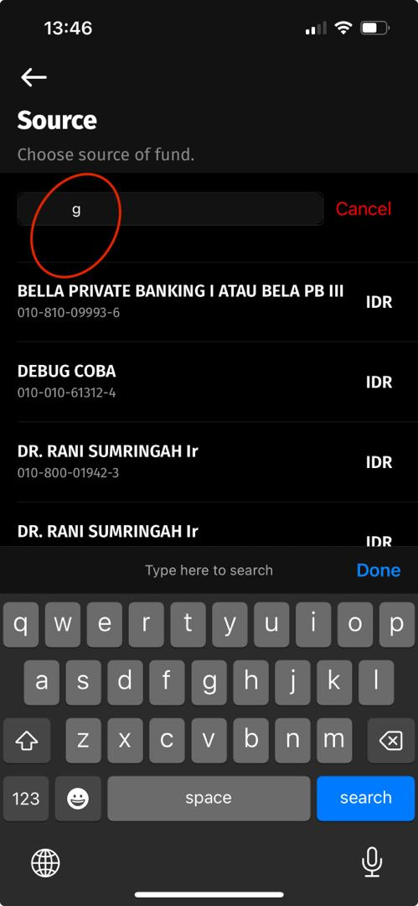
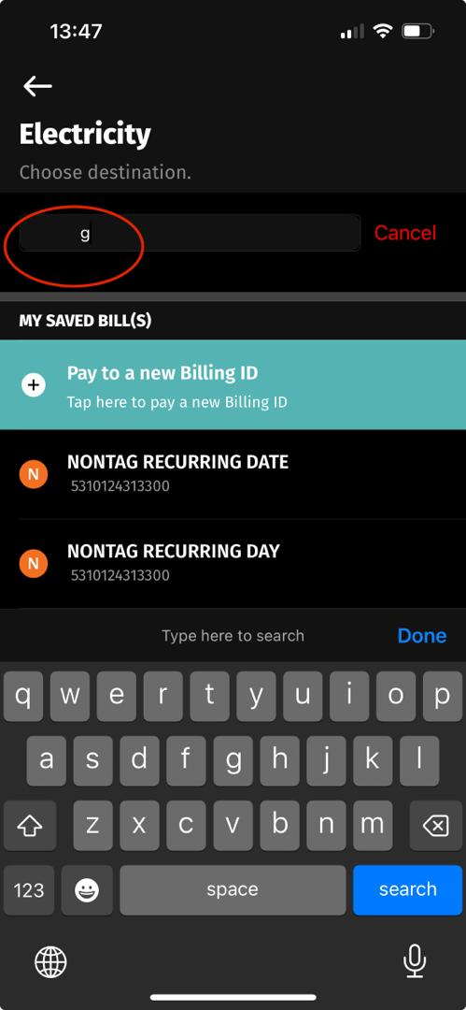
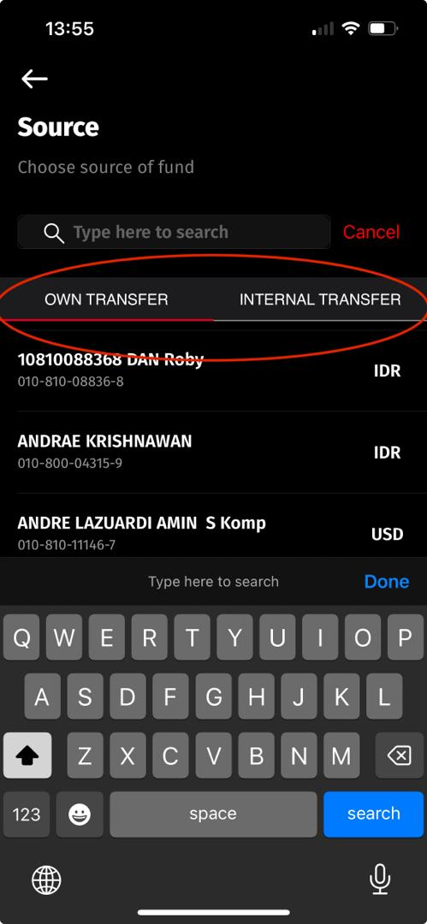
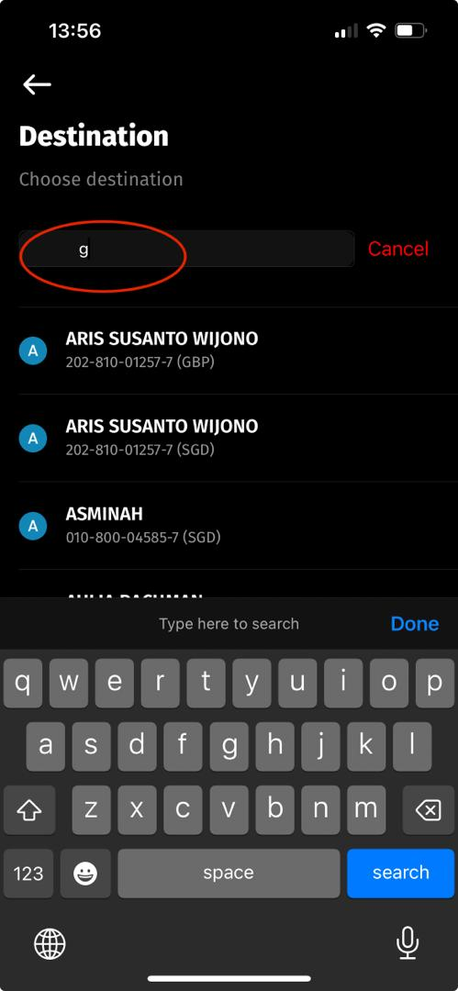
Payment & Purchase Pls check each of the screen – The Input search Bar – below is one of the samples

Slide 2
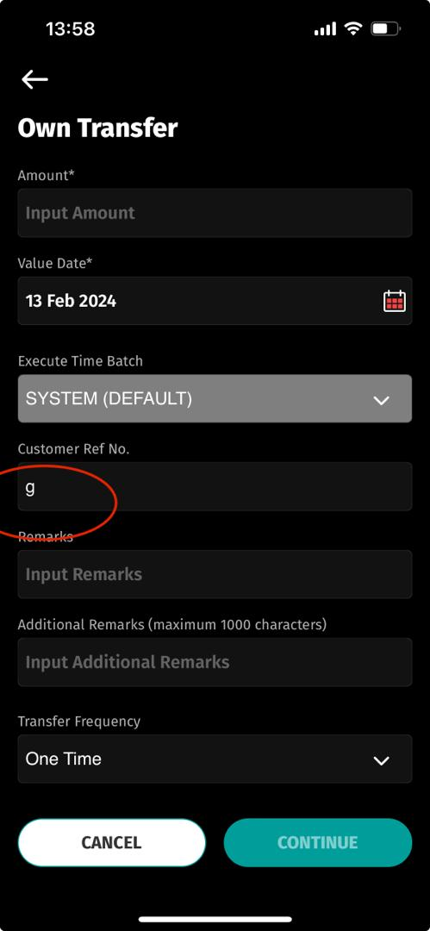
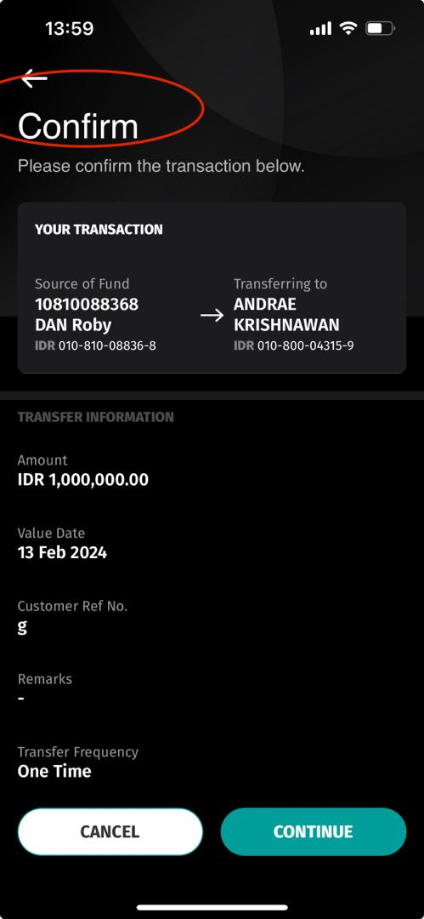
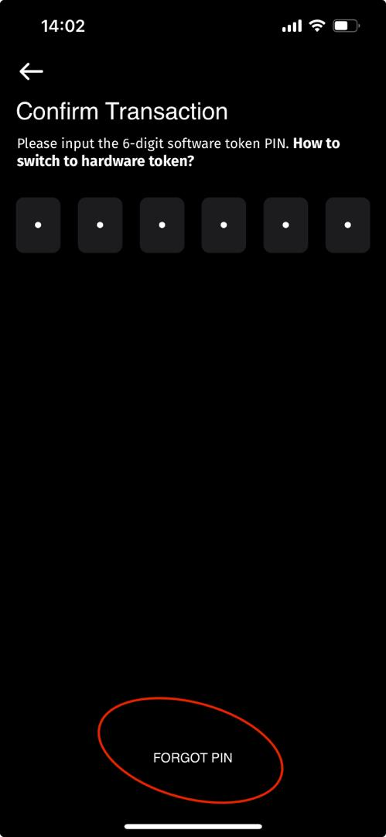
Fund Transfer – Own Transfer & Internal Transfer Pls check each of the screen – below is one of the samples
Please also update the entry from benelist

Slide 3
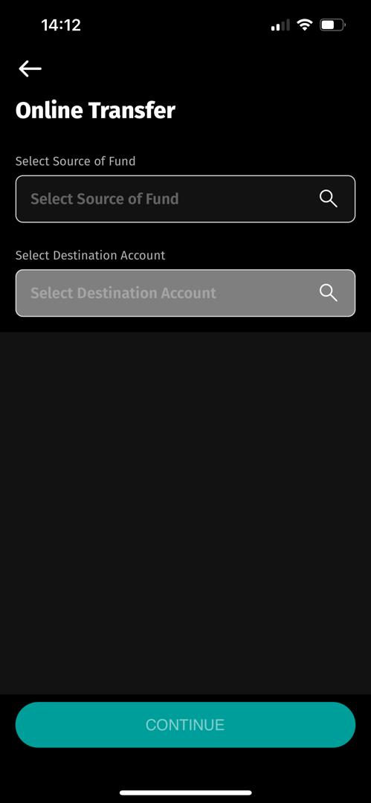
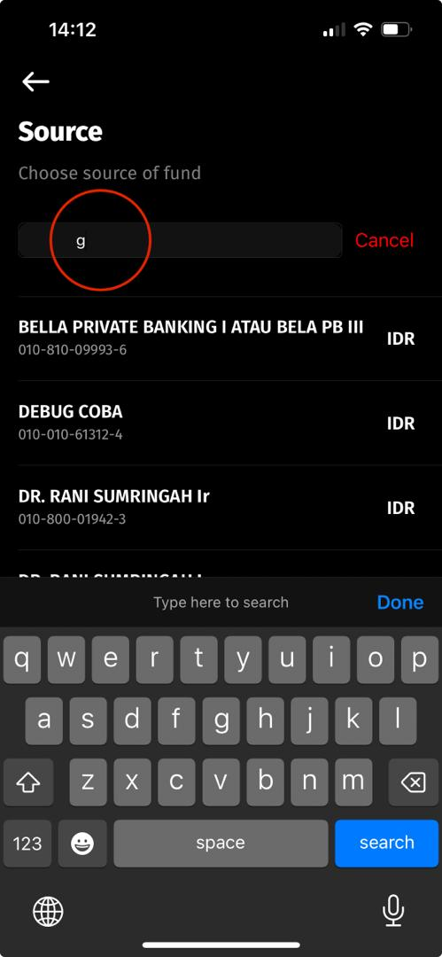
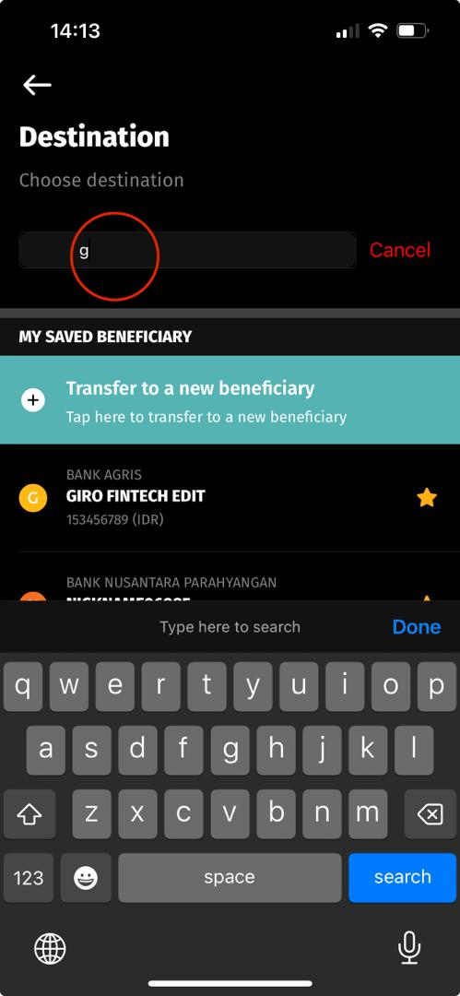
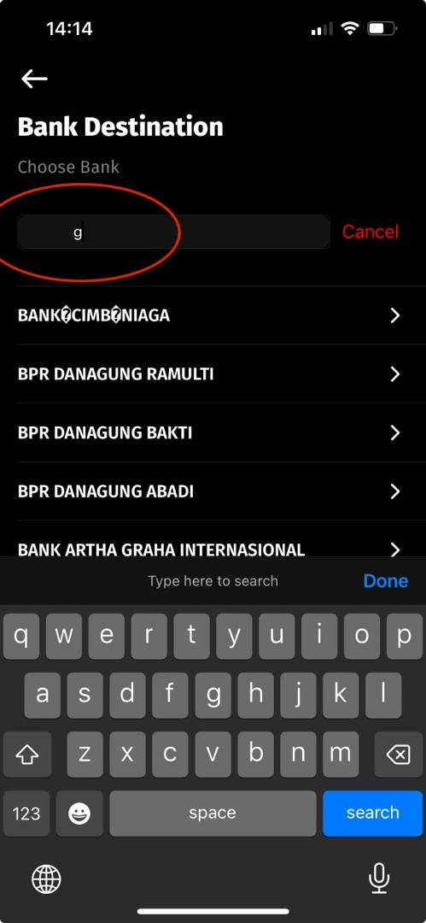
Fund Transfer – Online Transfer Pls check each Domestic Transaction screen
- Online
- RTGS
- LLG
- Bi-Fast
Pls also check each screens and update (each of the input fields) on the highlighted screens.
Please also update the entry from benelist

Slide 4
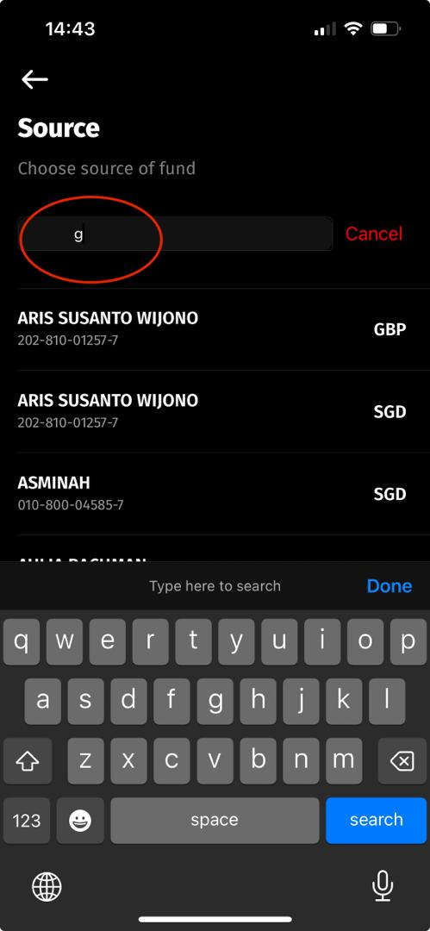
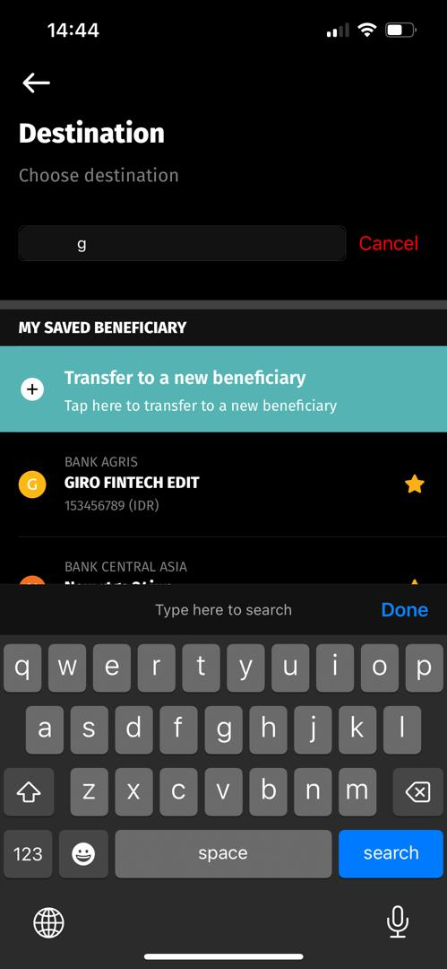
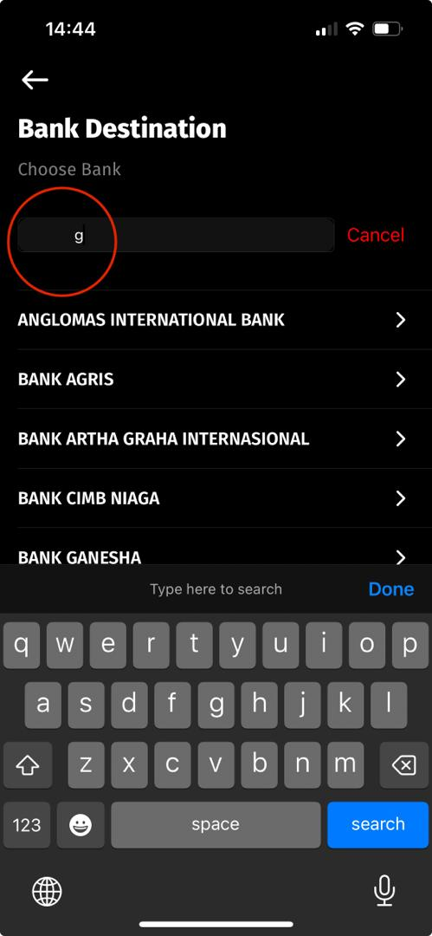
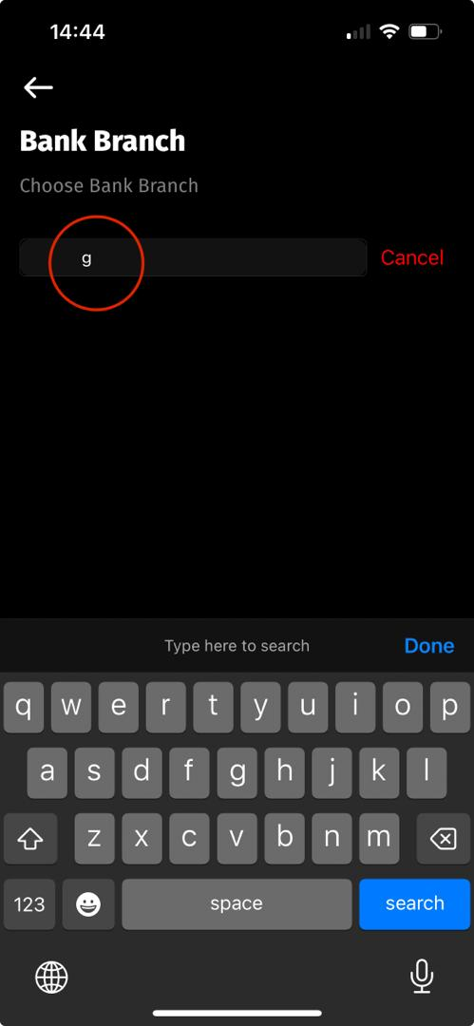
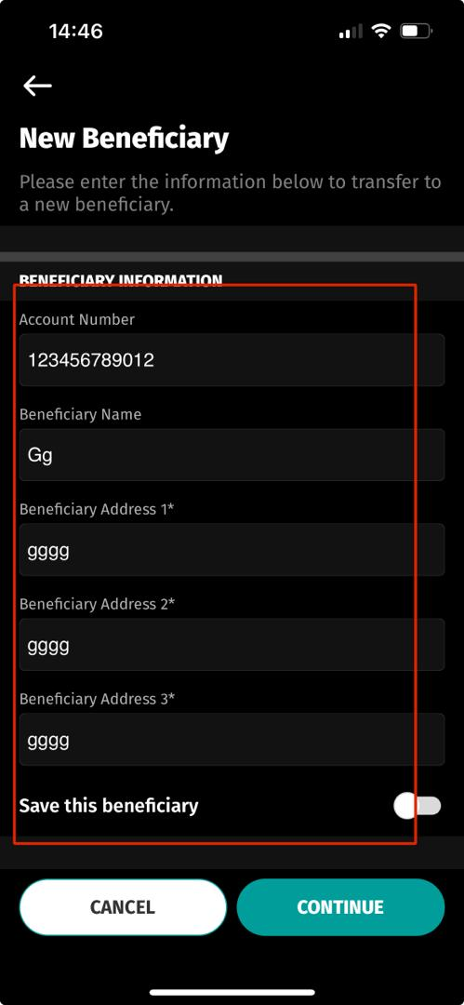
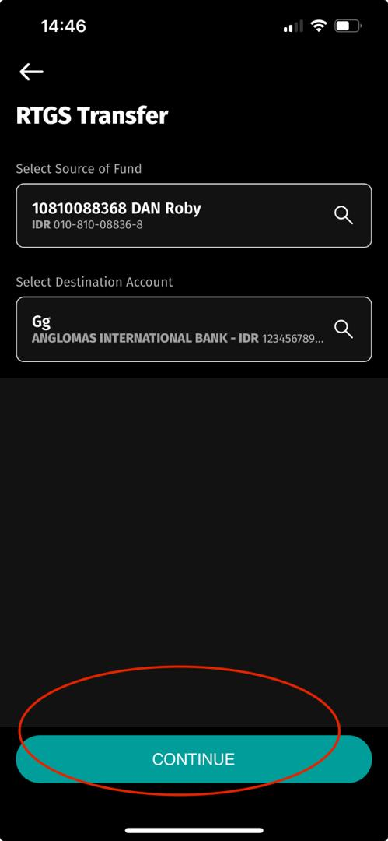
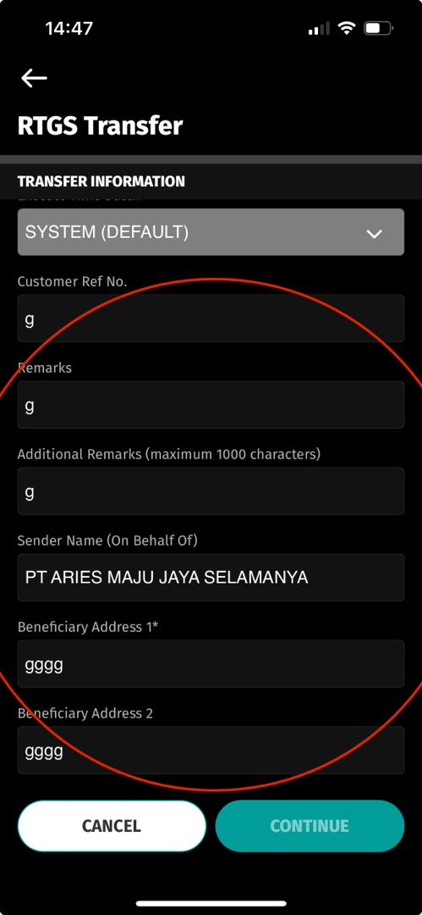
Fund Transfer – RTGS Pls check each Domestic Transaction screen
- Online
- RTGS
- LLG
- Bi-Fast
Pls also check each screens and update (each of the input fields) on the highlighted screens.
Please also update the entry from benelist

Slide 5
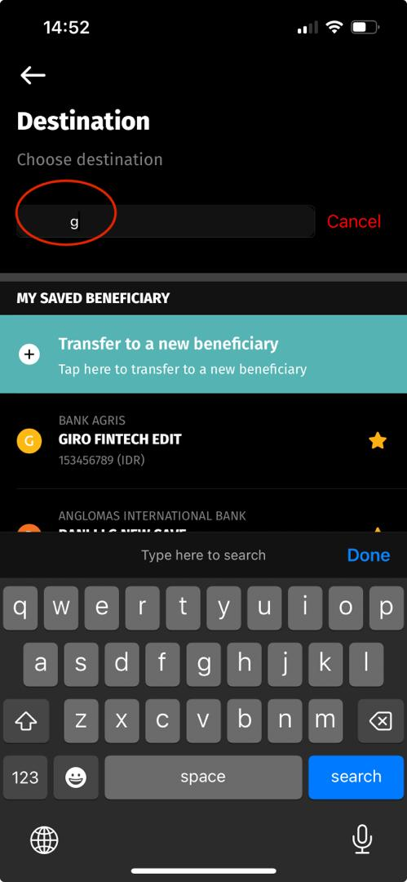
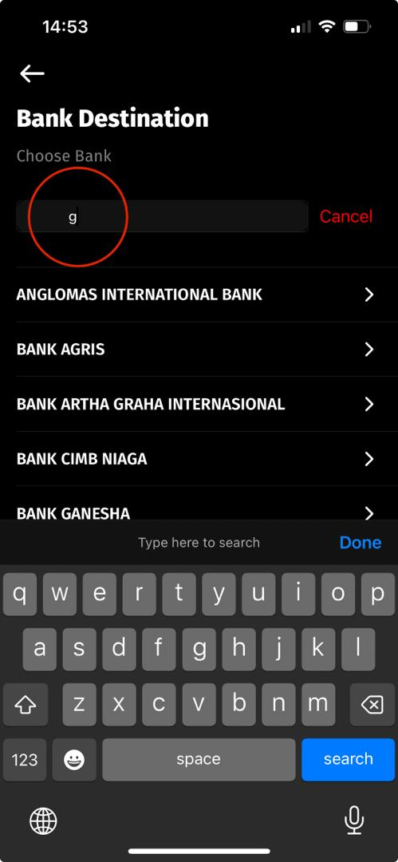
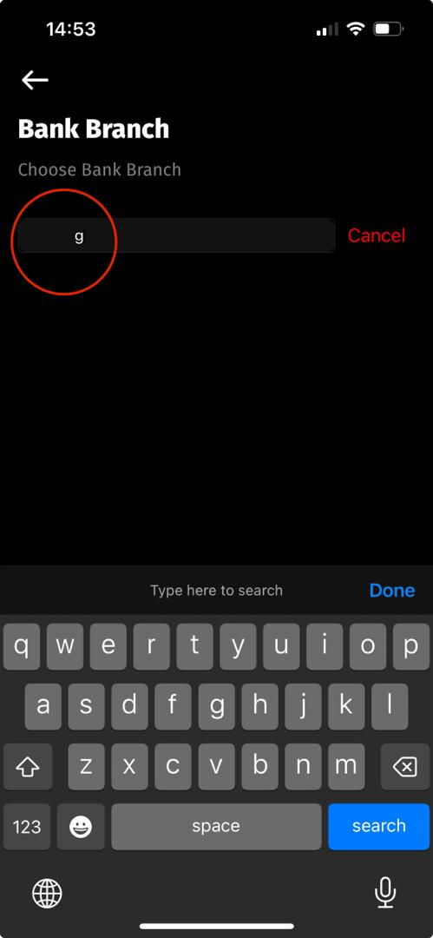
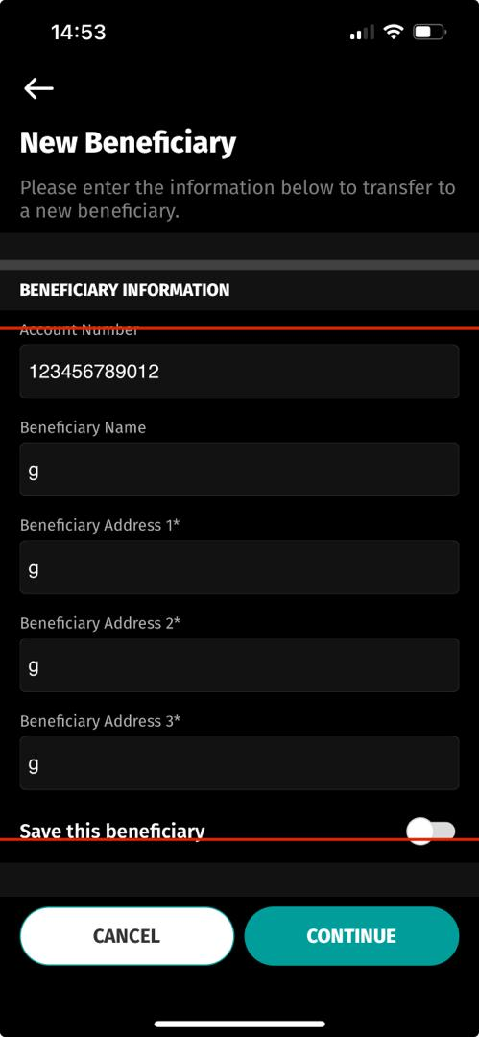
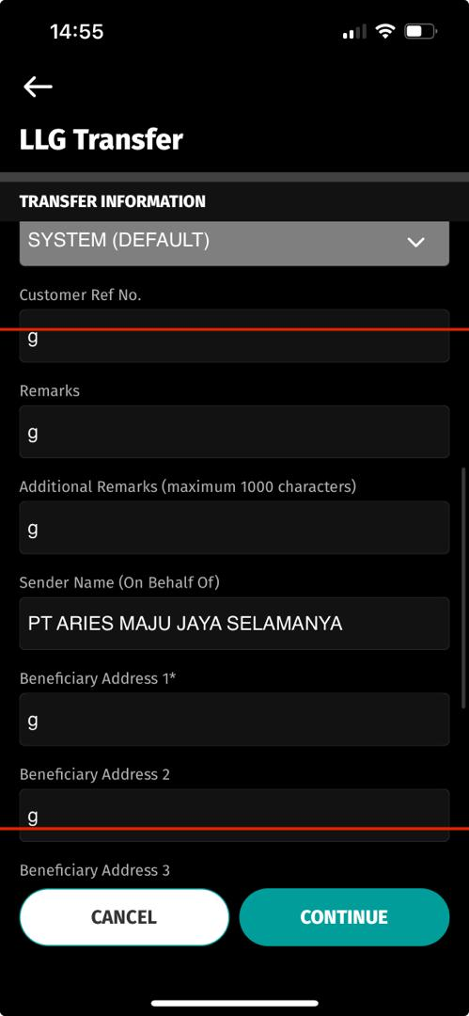
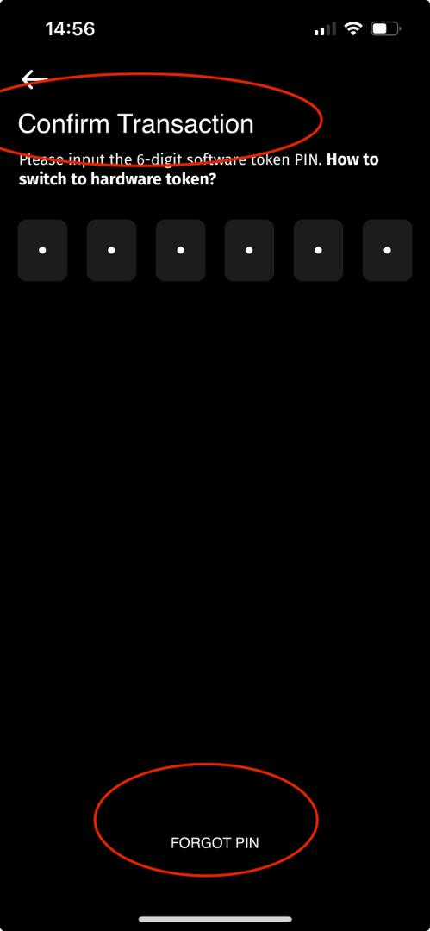
Fund Transfer – LLG Pls check each Domestic Transaction screen
- Online
- RTGS
- LLG
- Bi-Fast
Pls also check each screens and update (each of the input fields) on the highlighted screens.
Please also update the entry from benelist

Slide 6
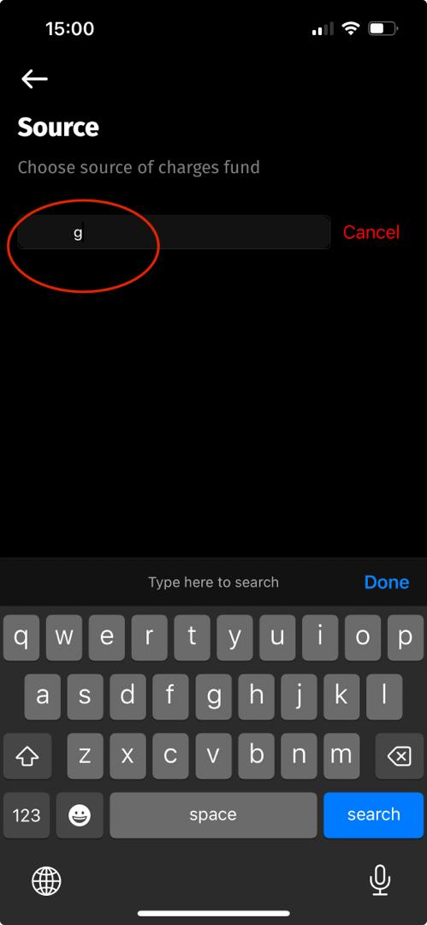
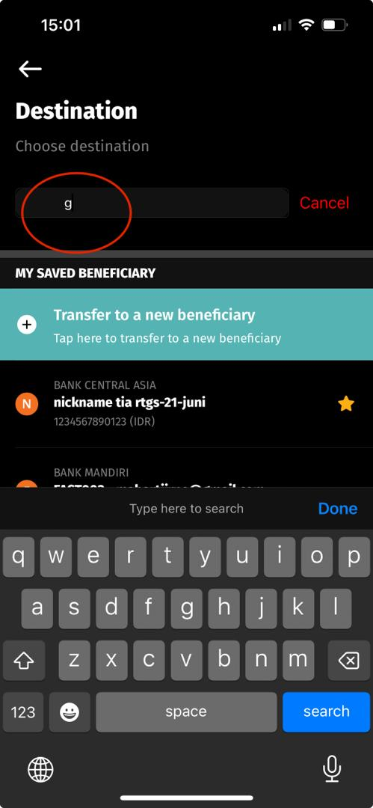
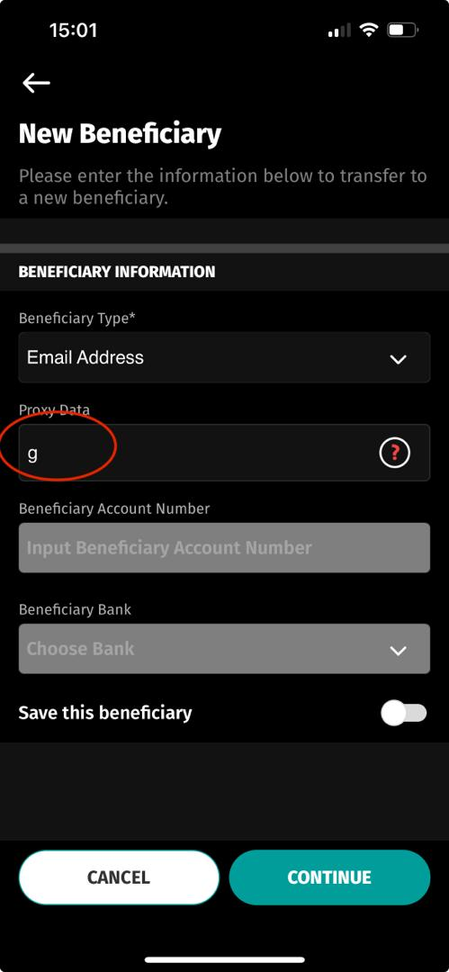
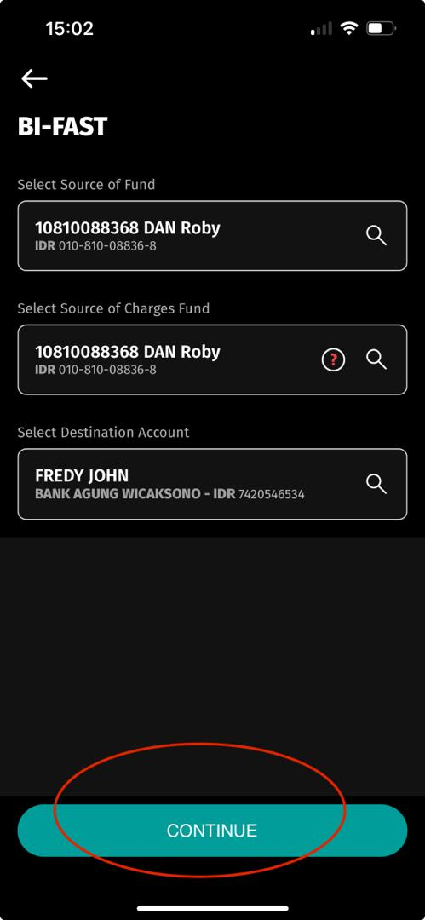
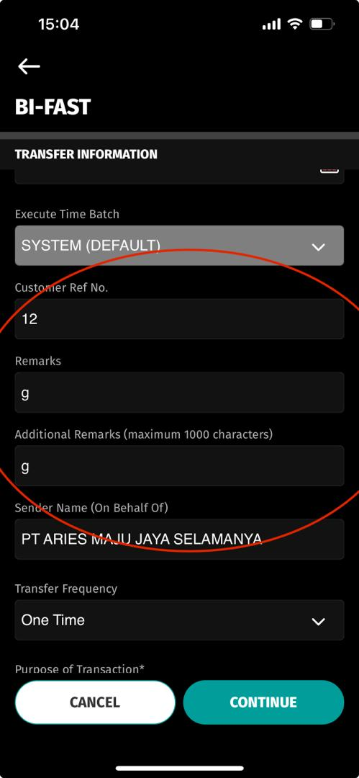
2024.02.16
Fund Transfer – Bi-Fast Pls check each Domestic Transaction screen
- Online
- RTGS
- LLG
- Bi-Fast
Pls also check each screens and update (each of the input fields) on the highlighted screens.
Please also update the entry from benelist

Slide 7
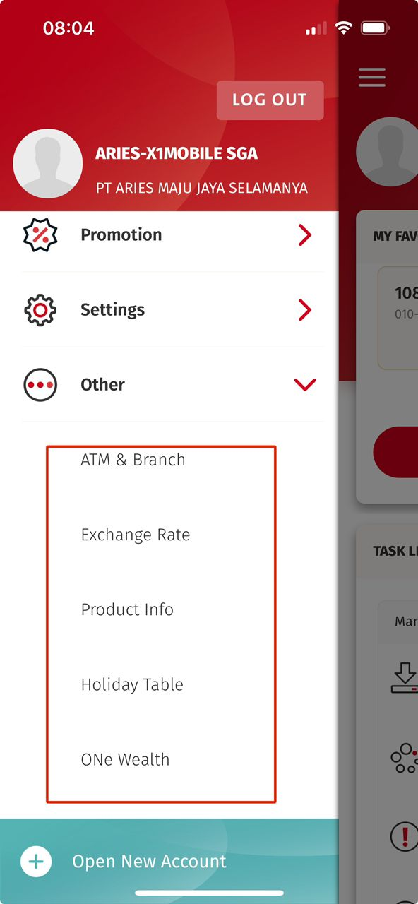
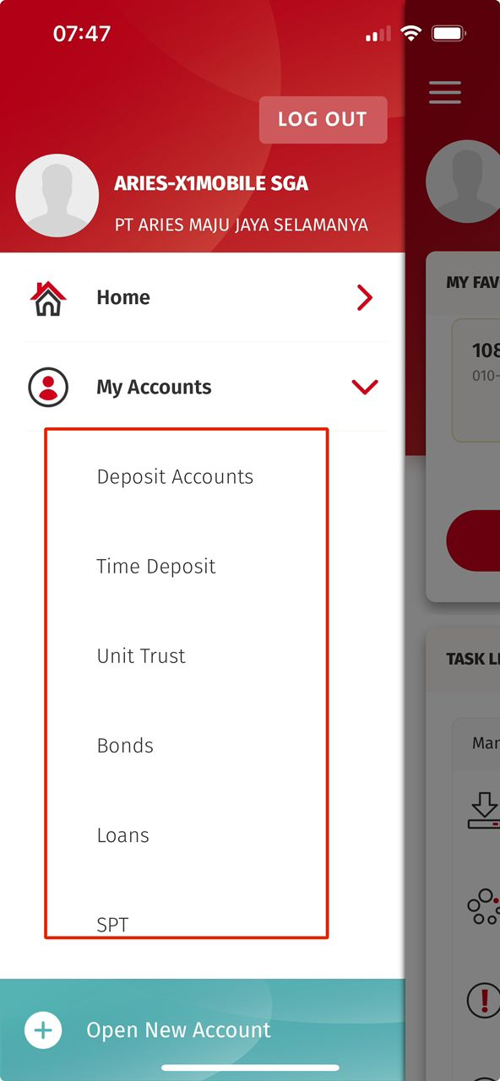
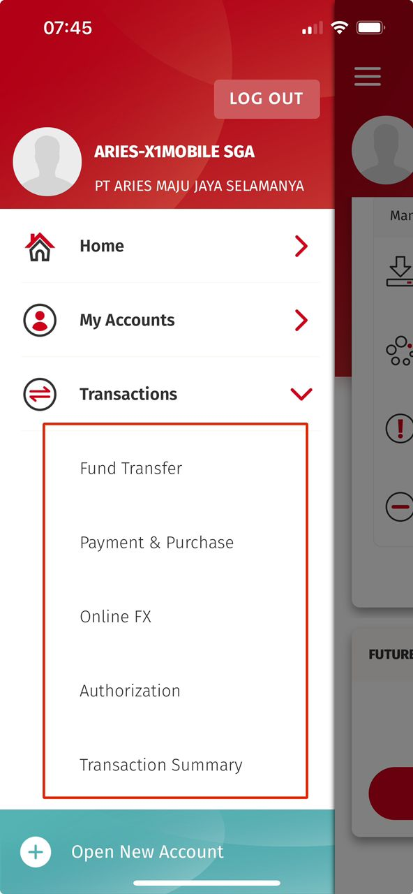
Currently on the [Expanded Menu from Side menu] – Highlighted area – Need adjustment
Can we try with for Light Mode & Dark Mode with below? (Need your advice)
[Fira Regular] or
[Fira Semi Bold]
Possible to advice? Just to be looked like same as those on Side Menu

Slide 8
iOS
Side Menu > Semibold
- Expanded > Semibold
Settings Screen > Semibold
Android
Side Menu > Semibold
- Expanded > Semibold
Settings Screen > Regular
iOS
Side Menu > Regular
- Expanded > Regular
Settings Screen > Regular
Android
Side Menu > Regular
- Expanded > Regular
Settings Screen > Regular

