Slide 1
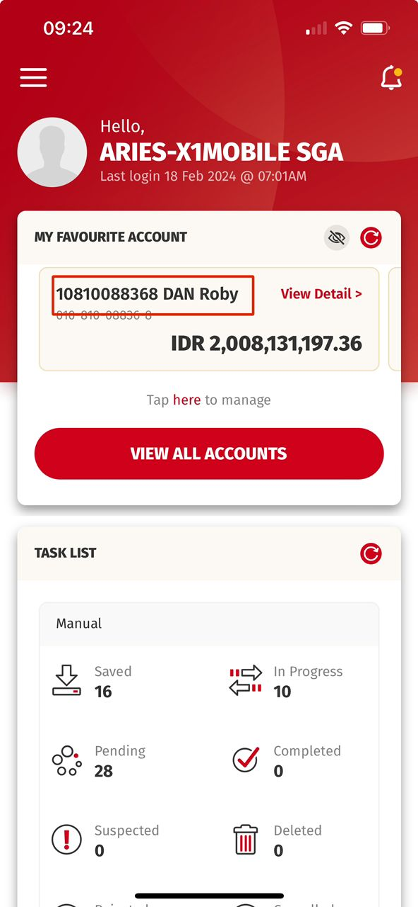
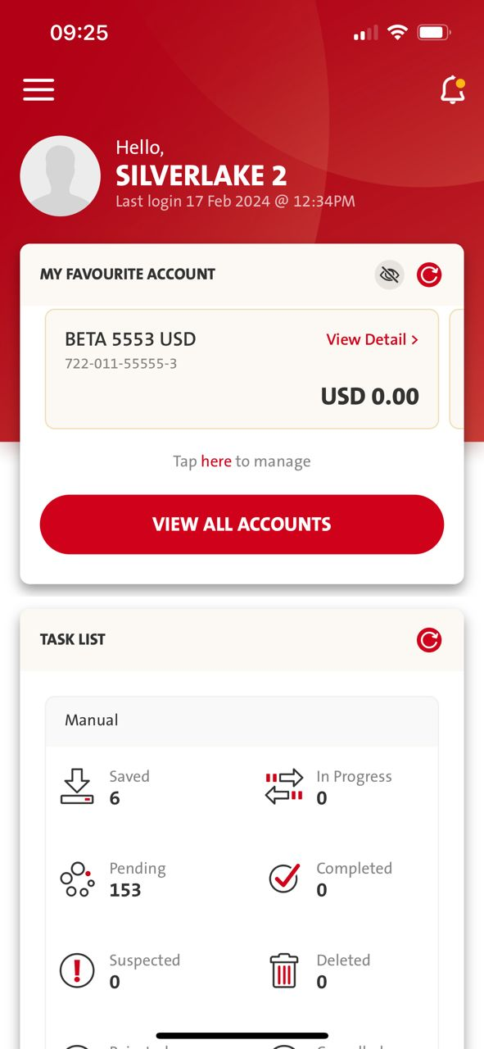
Need OCBC’s confirmation if iOS need to readjust fonts on the screen as mentioned in ppt.
OLD - When using < The Sans – Semi Bold > is more like a highlighted regular on iOS.
NEW - When it comes to < Fira Sans – Semi Bold > which will be like “Extra Bold” on screen.
Suggested screens in PPT may need some adjustment.
Fira Sans
iOS UAT:
Current Highlighted = Semi Bold
Expected Highlighted = Regular
The Sans
iOS Production:
Current Highlighted = Semi Bold

Slide 2
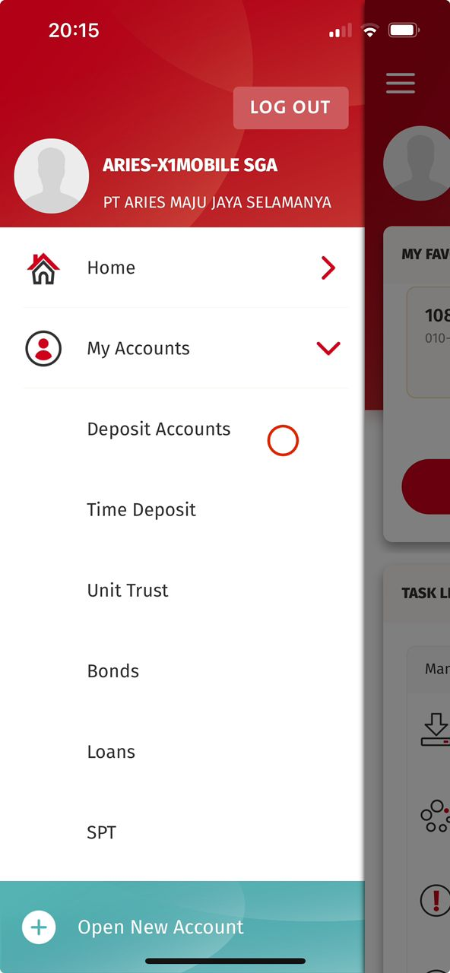
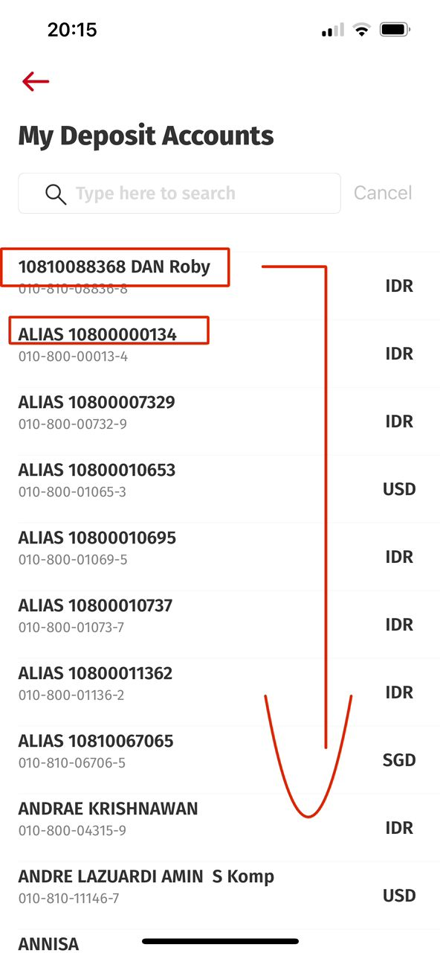
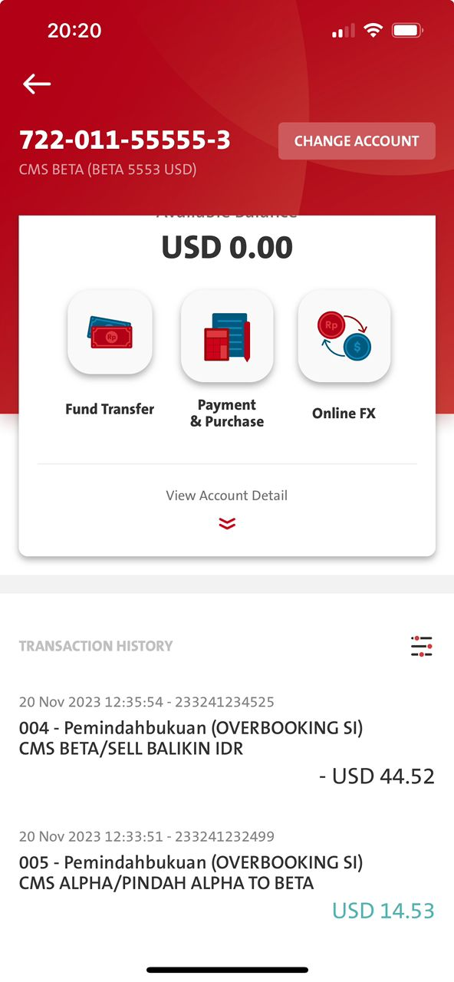
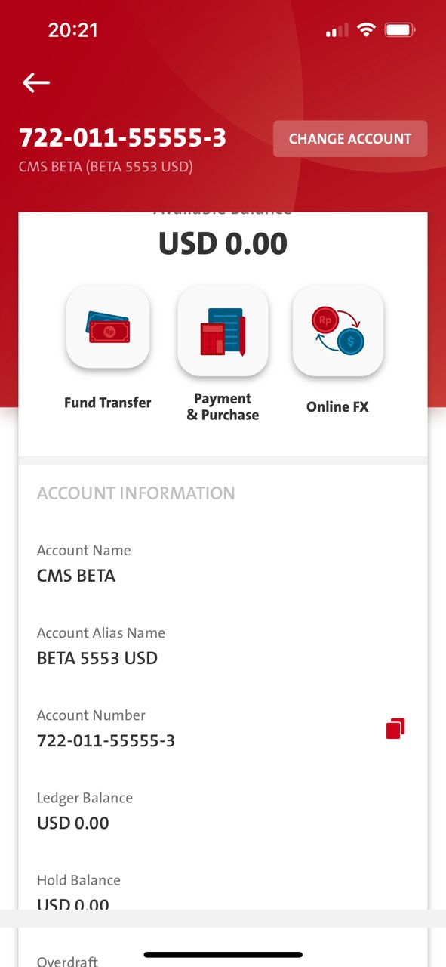
Need to change to > Regular
Is this Semi Bold?

Slide 3
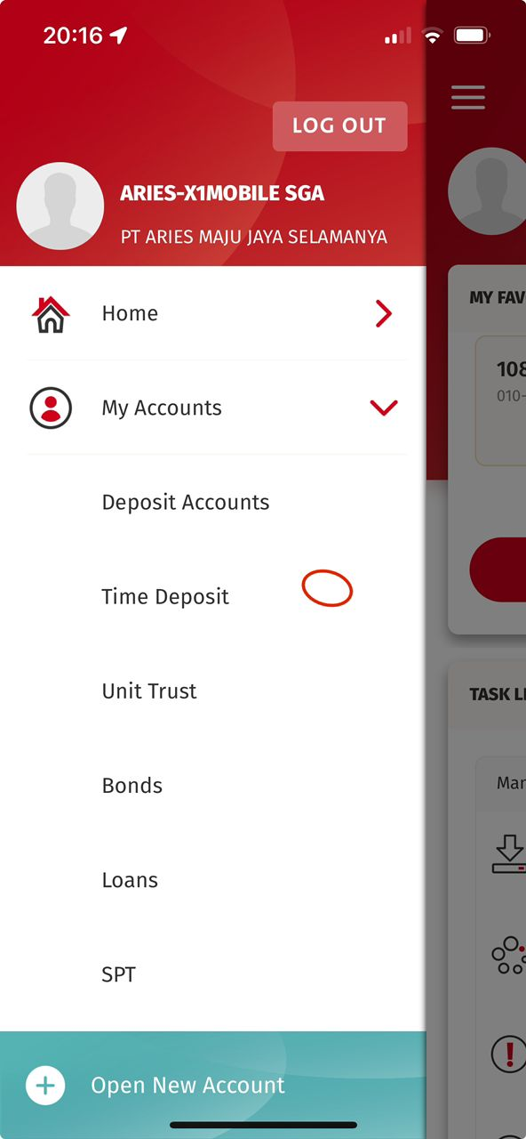
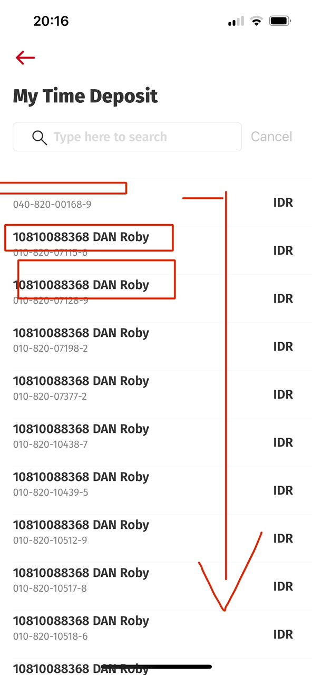
What is the next screen?
The next Input Screen
All Fields (Description) need change to > Regular
All Fields (Description) need change to > Regular

Slide 4
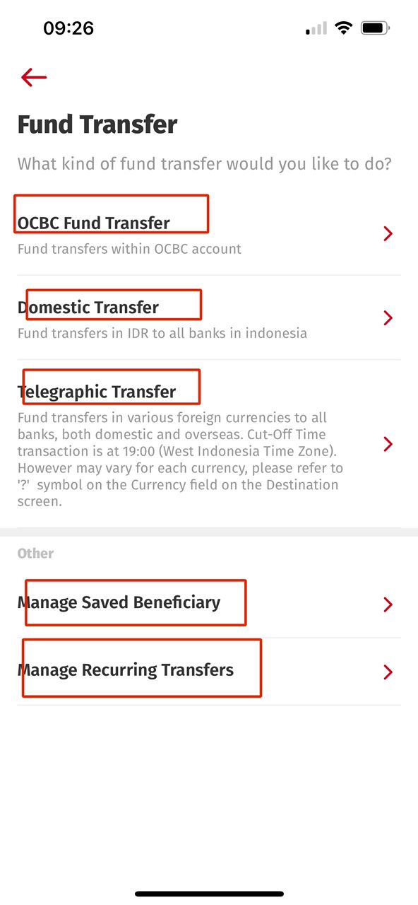
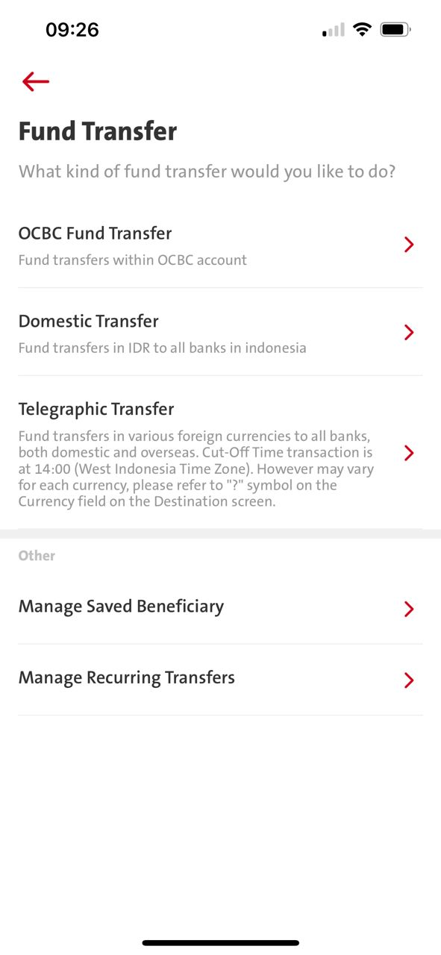
Fira Sans
iOS UAT:
Current Highlighted = Semi Bold
Expected Highlighted = Regular
The Sans
iOS Production: = Semi Bold

Slide 5
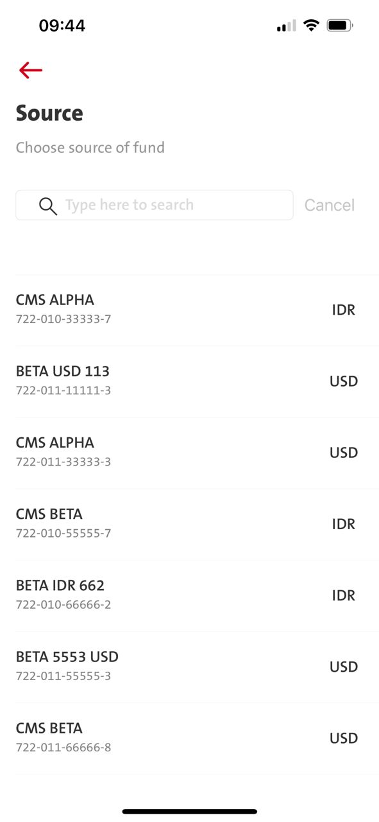
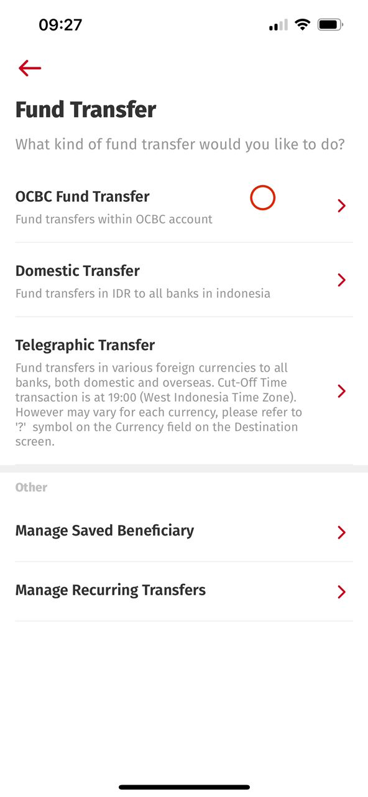
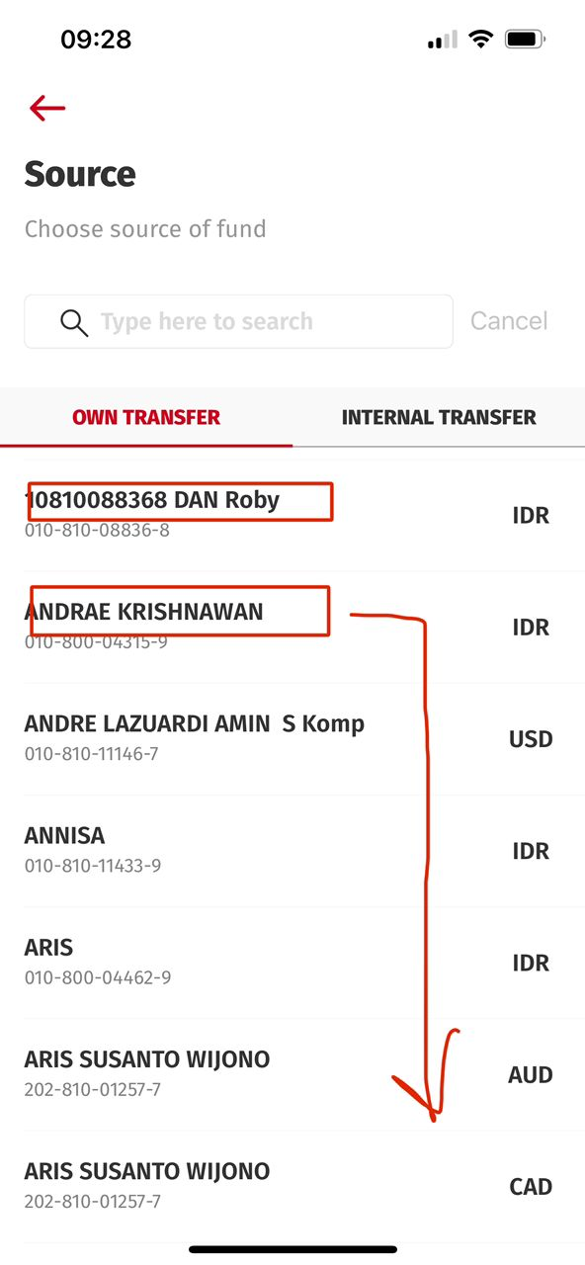
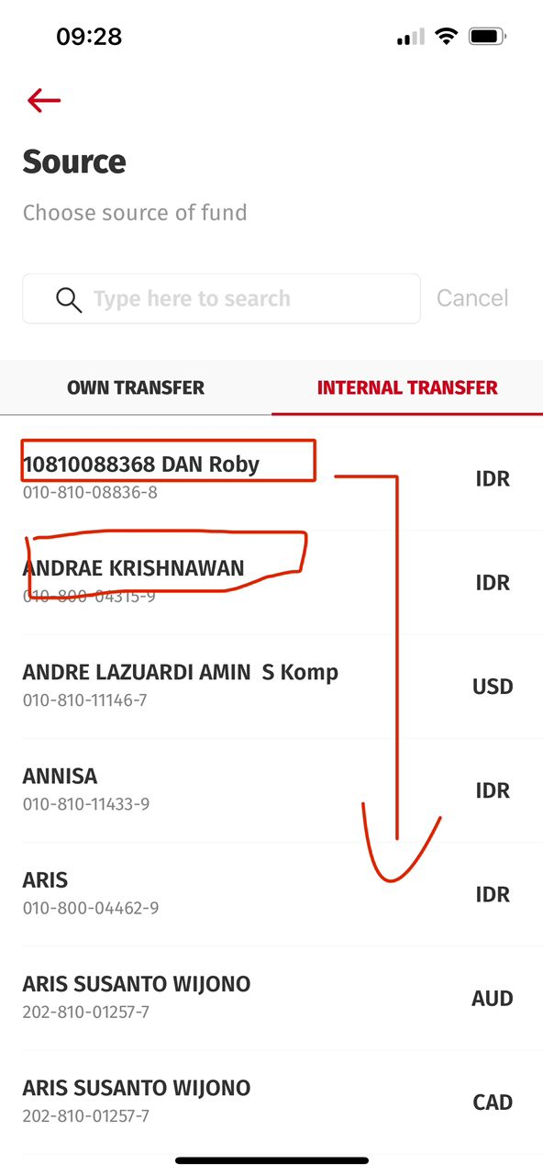
Fira Sans
iOS UAT:
Current Highlighted = Semi Bold
Expected Highlighted = Regular
Title Acct Name on the list shall be Regular
The Sans
iOS Production: = Semi Bold

Slide 6
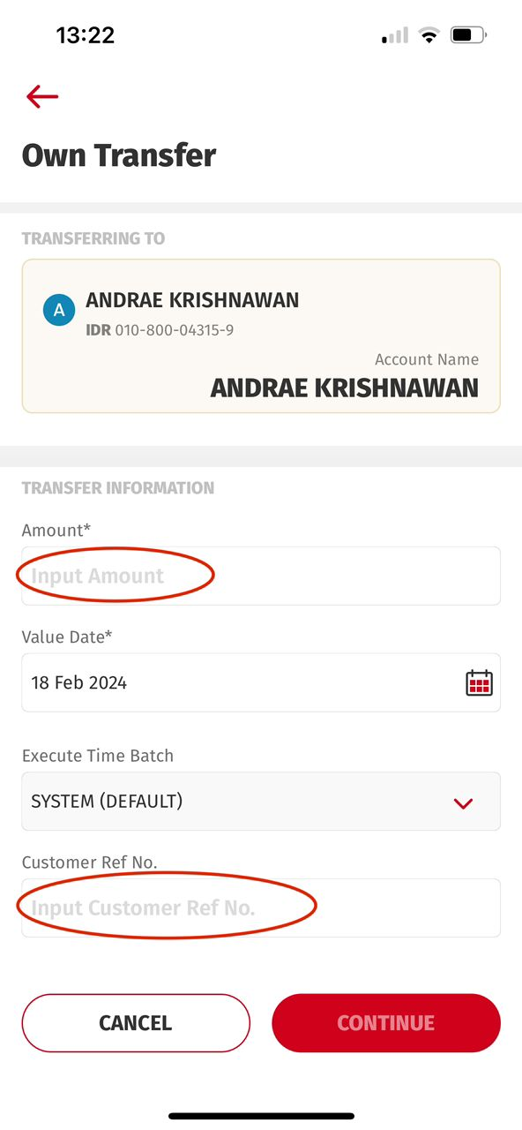
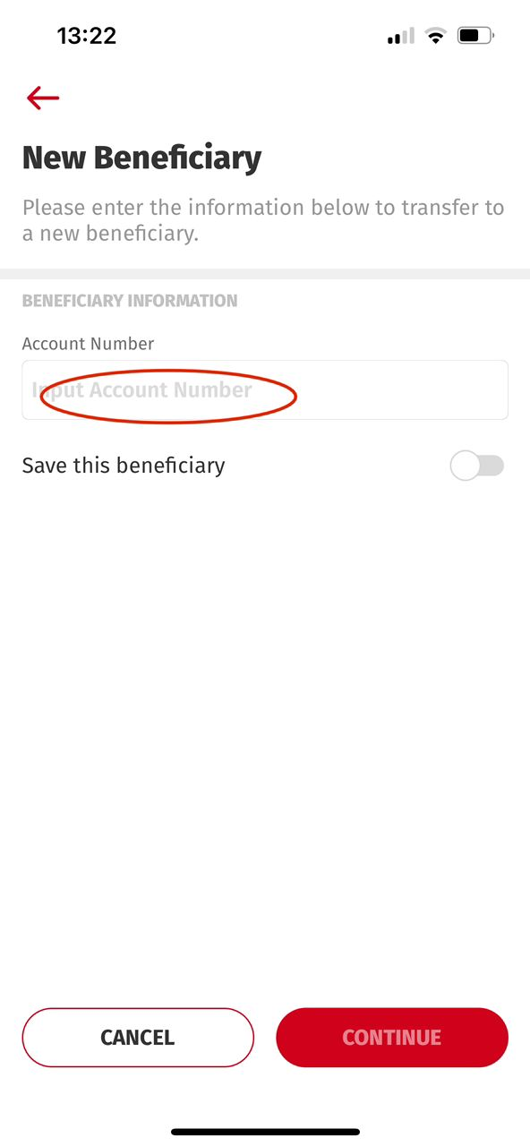
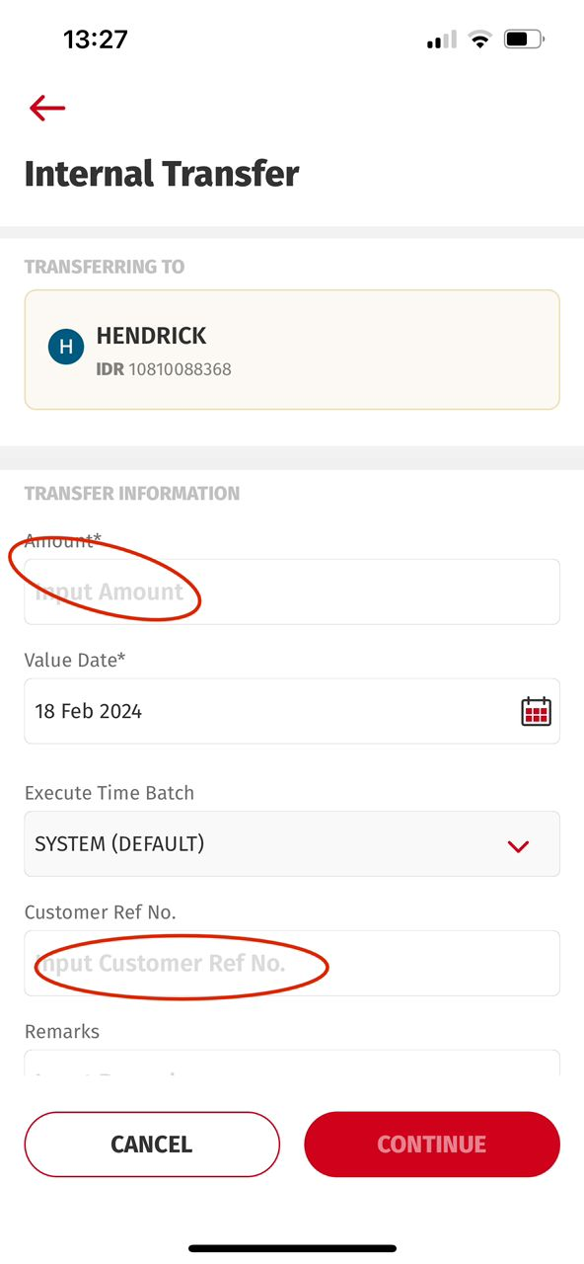
Own Transfer
Internal Transfer
All the Input Field (Description) need change to > Regular

Slide 7
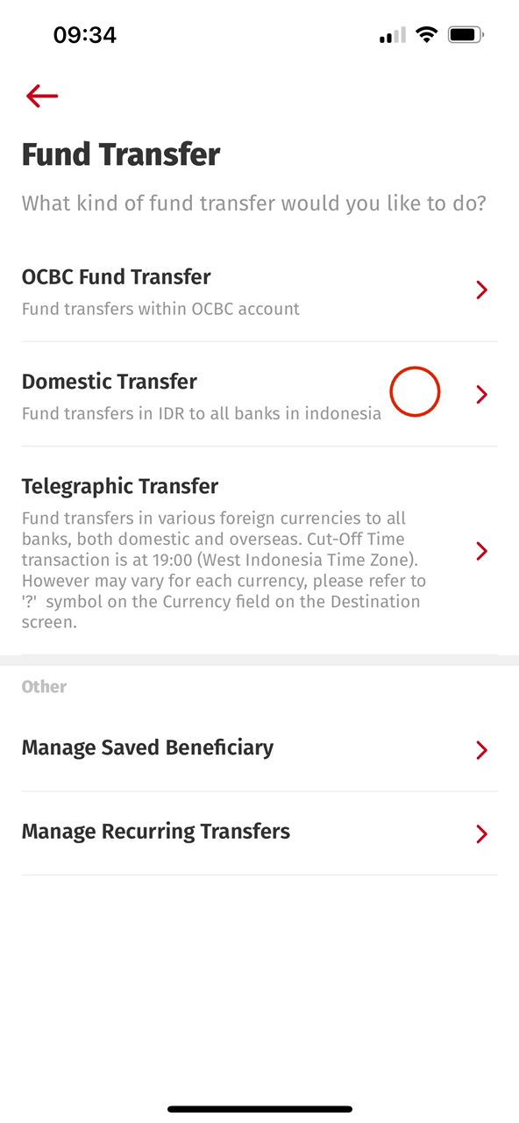
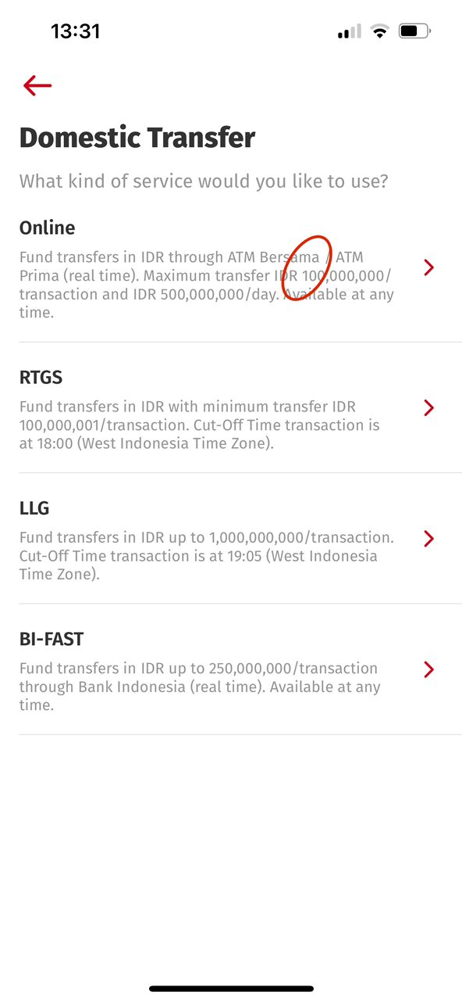
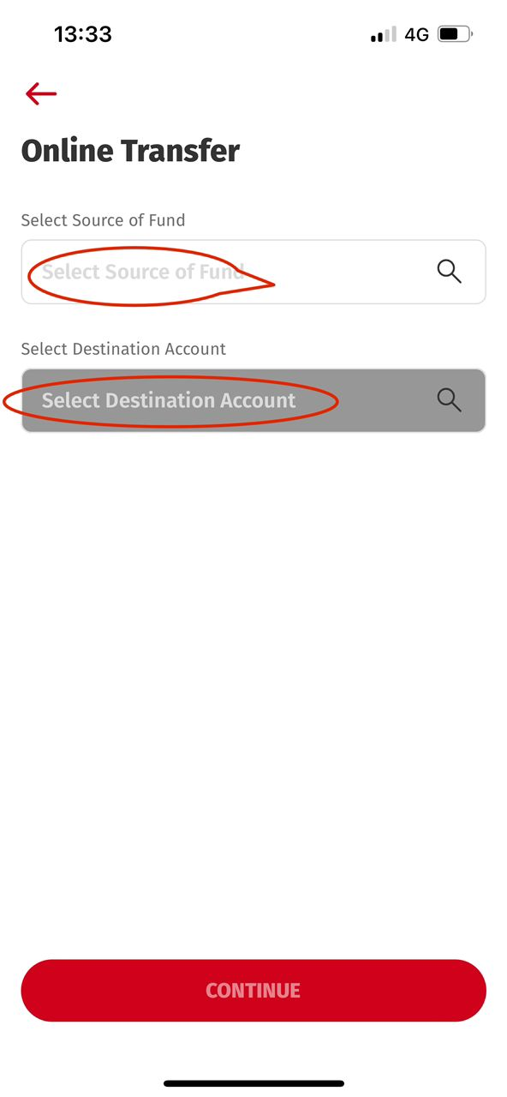
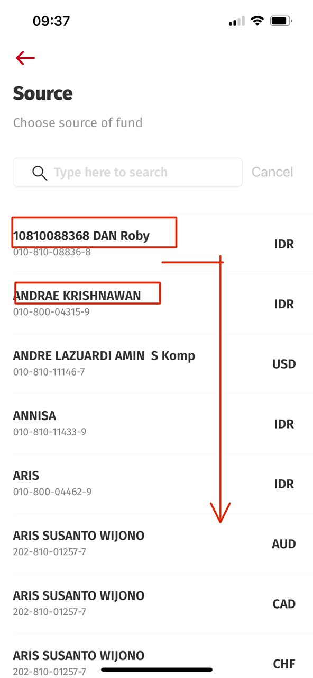
Fira Sans
iOS UAT:
Current Highlighted = Semi Bold
Expected Highlighted = Regular
Title Acct Name on the list shall be Regular
Field (Description) need change to > Regular

Slide 8
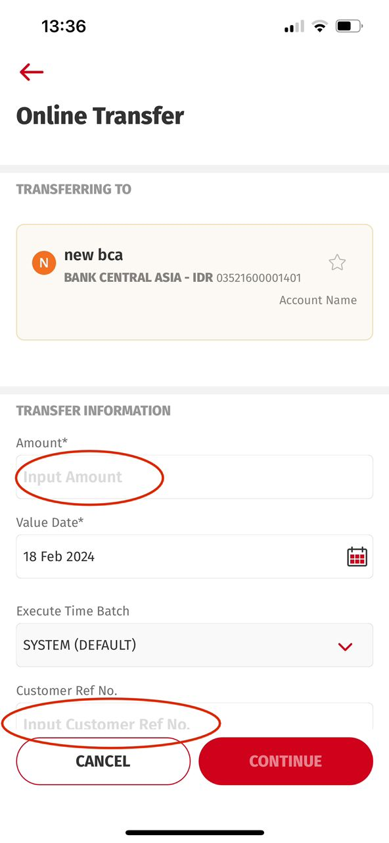
All Fields (Description) need change to > Regular

Slide 9
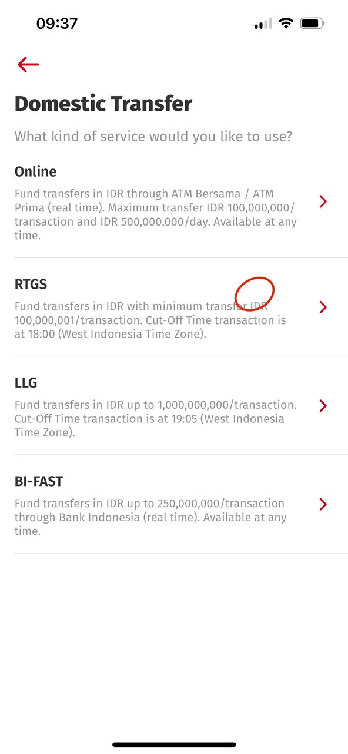
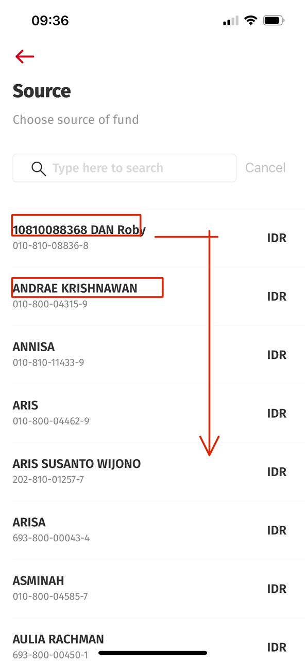
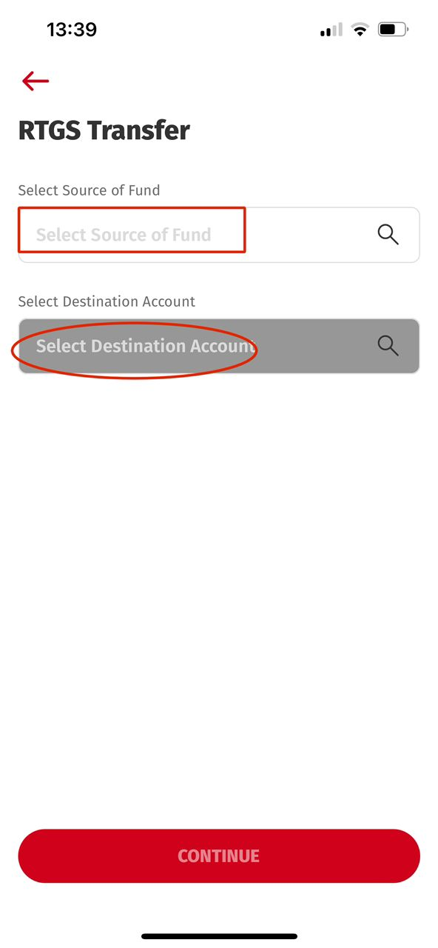
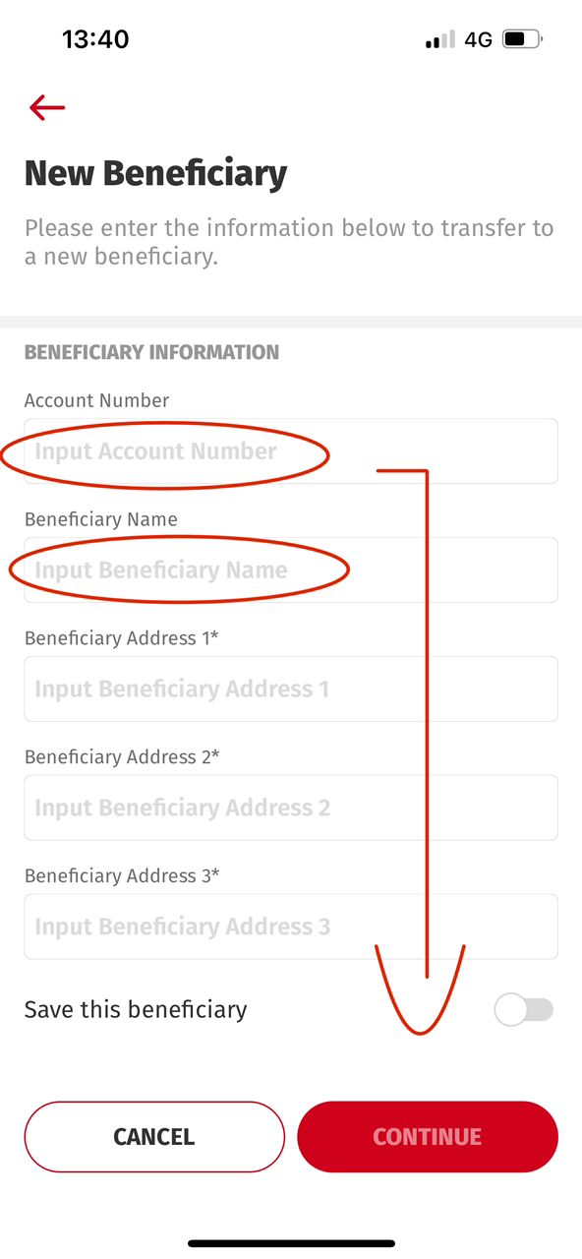
Fira Sans
iOS UAT:
Current Highlighted = Semi Bold
Expected Highlighted = Regular
Title Acct Name on the list shall be Regular
All Fields (Description) need change to > Regular
All Fields (Description) need change to > Regular

Slide 10
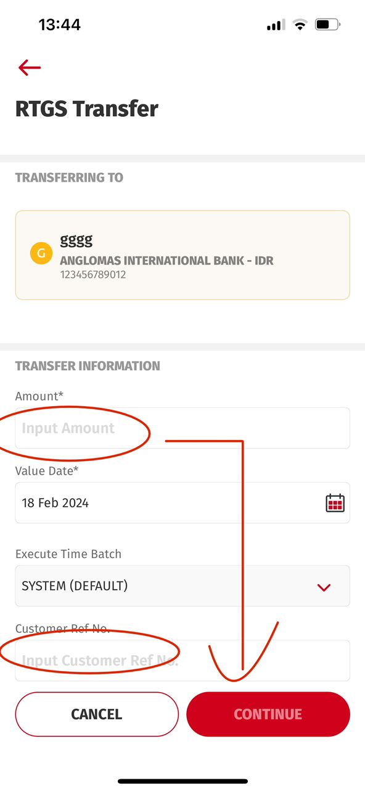
All Fields (Description) need change to > Regular

Slide 11
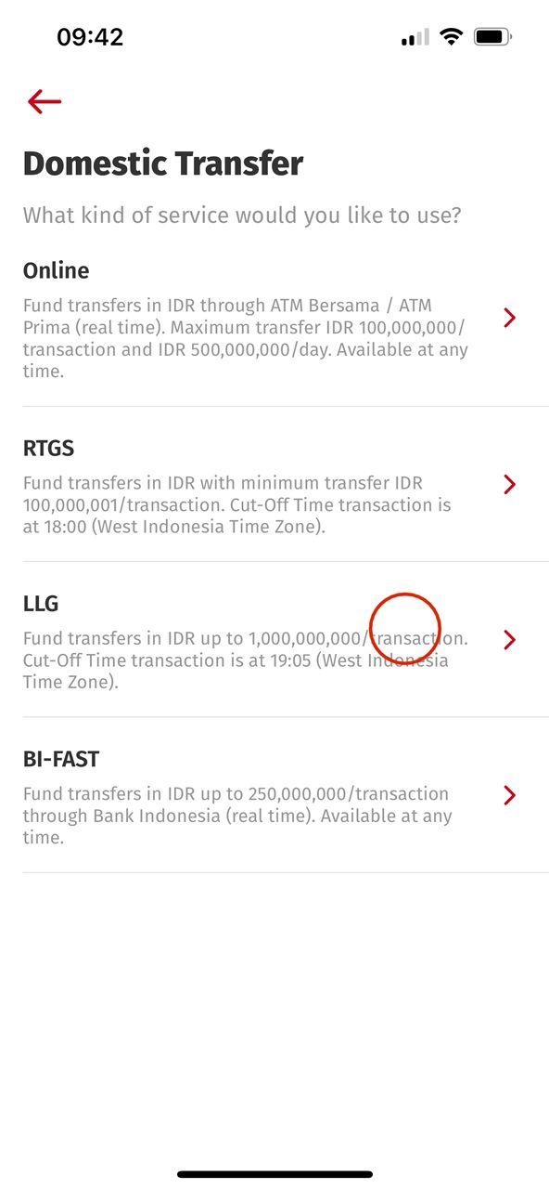
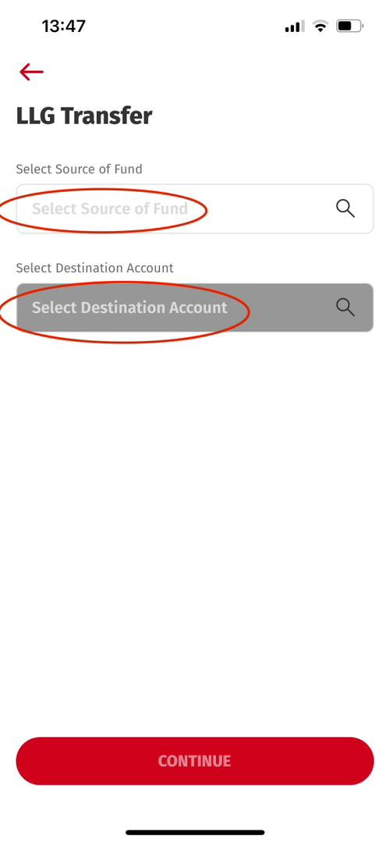
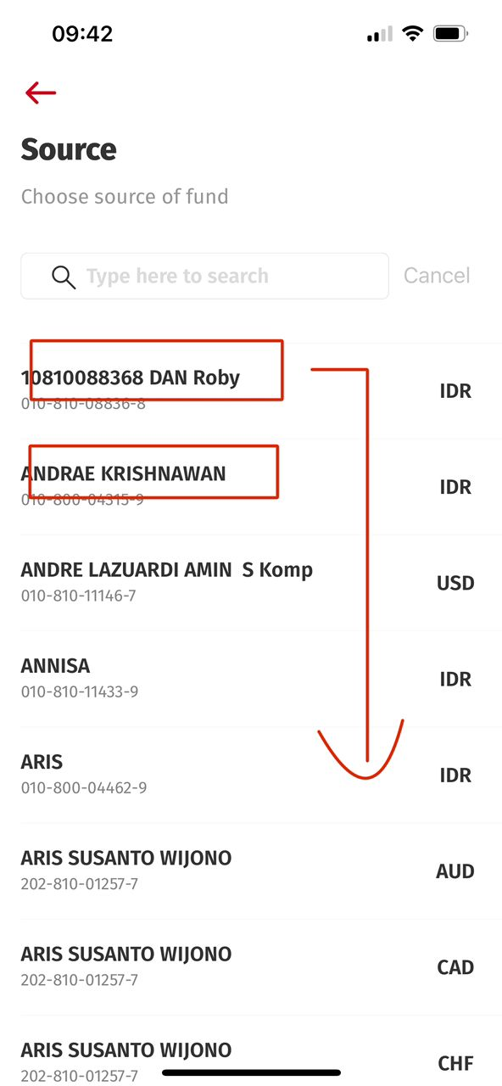
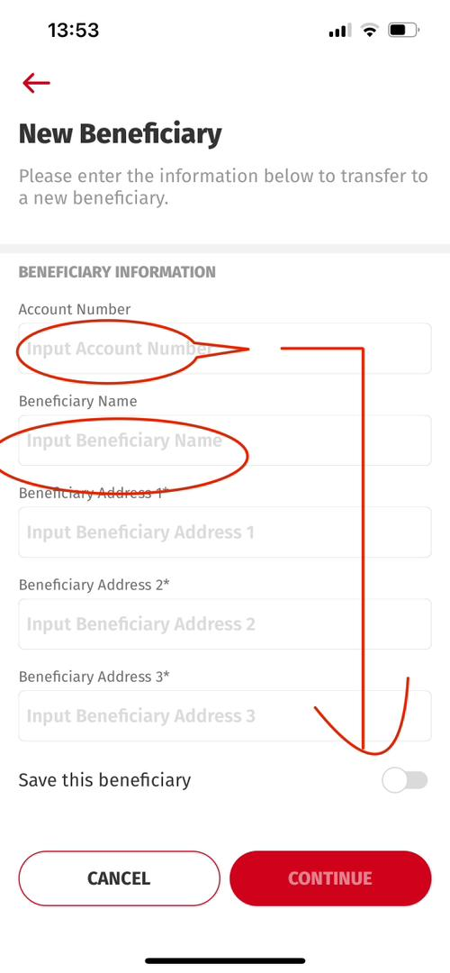
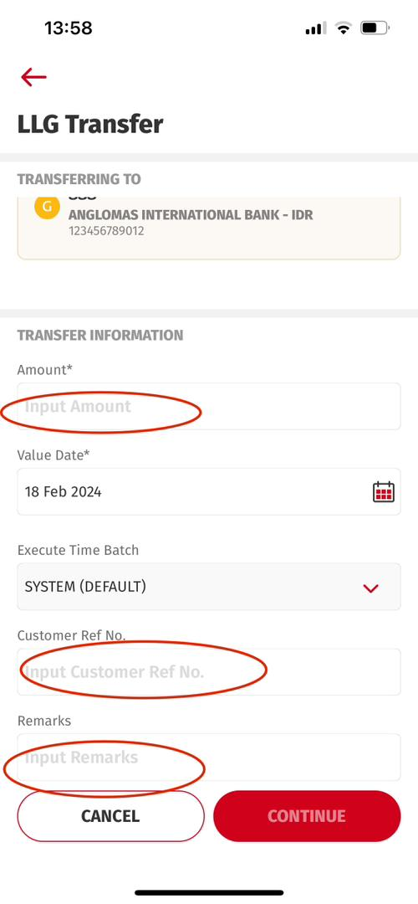
Fira Sans
iOS UAT:
Current Highlighted = Semi Bold
Expected Highlighted = Regular
Title Acct Name on the list shall be Regular
All Fields (Description) need change to > Regular

Slide 12
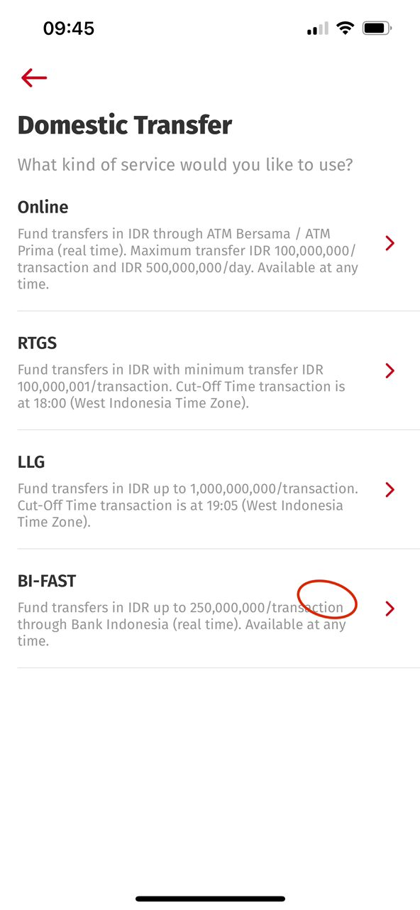
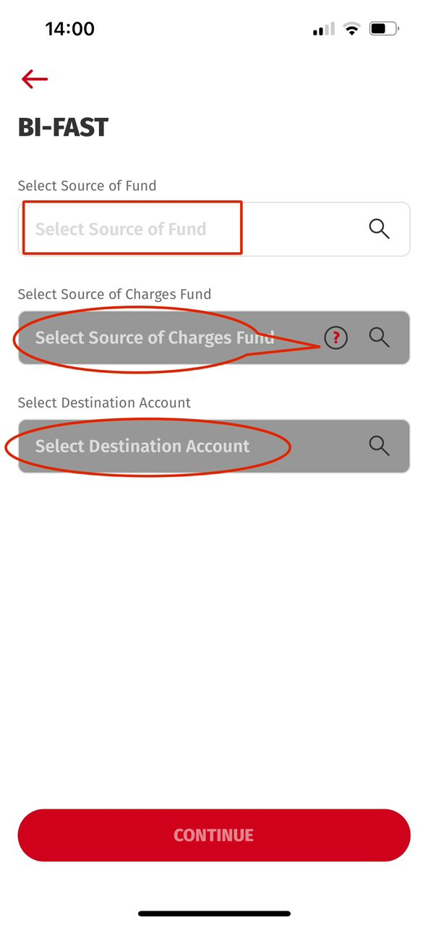
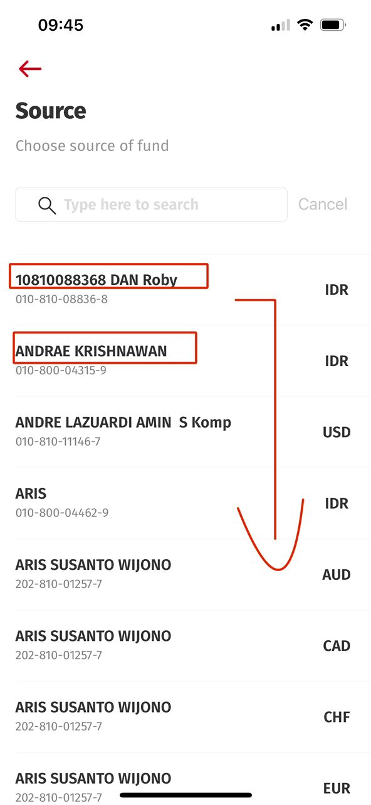
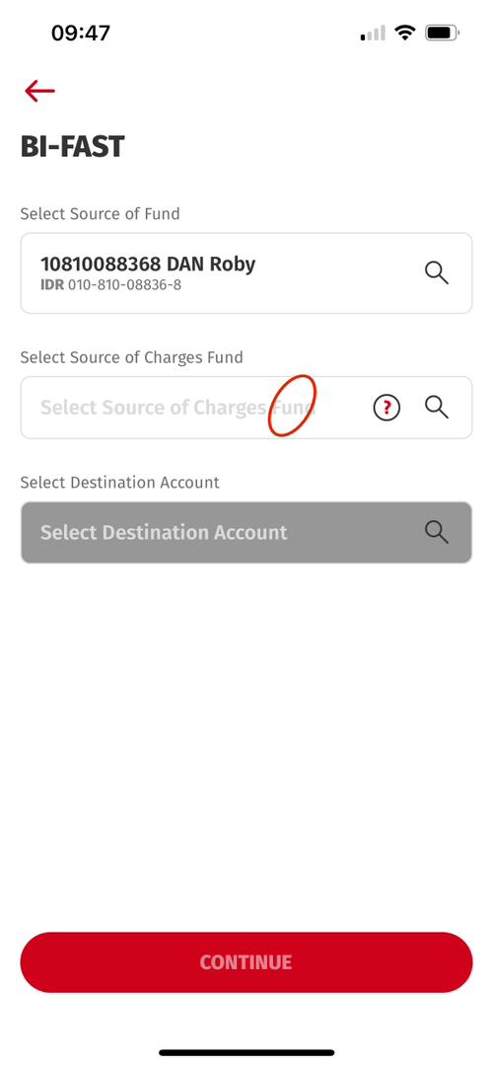
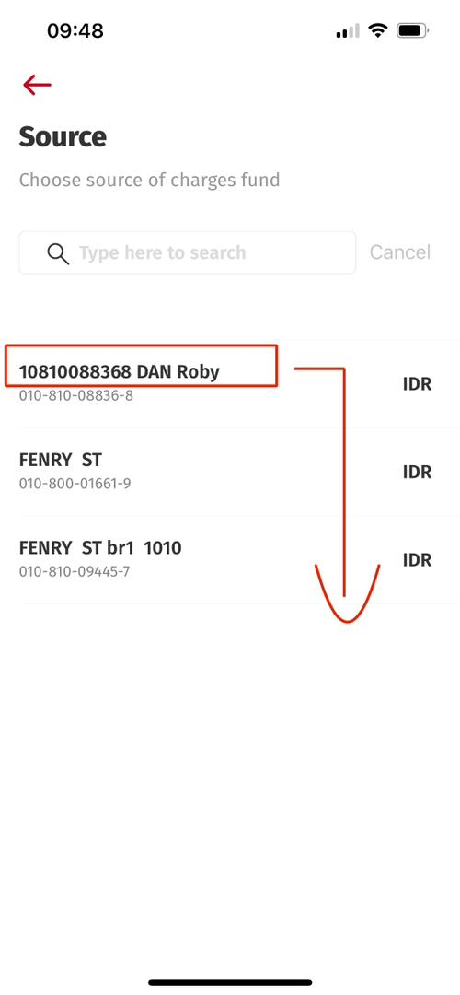
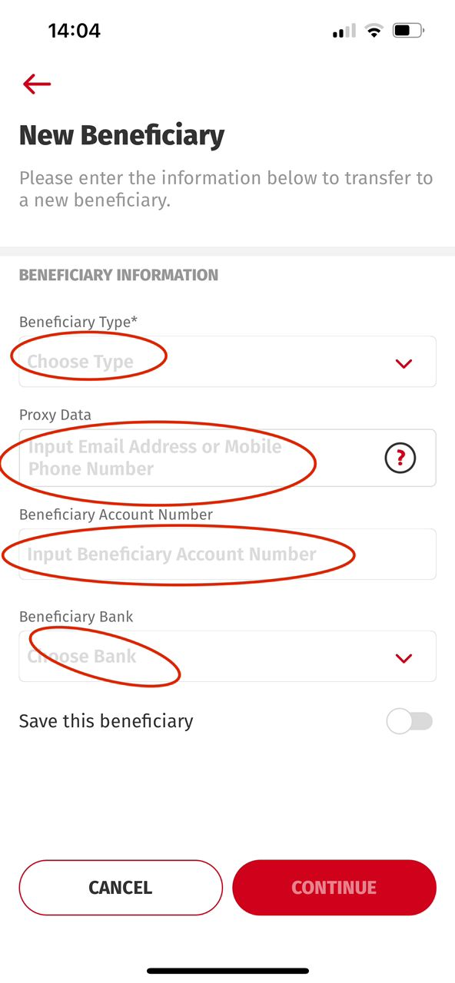
Fira Sans
iOS UAT:
Current Highlighted = Semi Bold
Expected Highlighted = Regular
Title Acct Name on the list shall be Regular
All Fields (Description) need change to > Regular

Slide 13
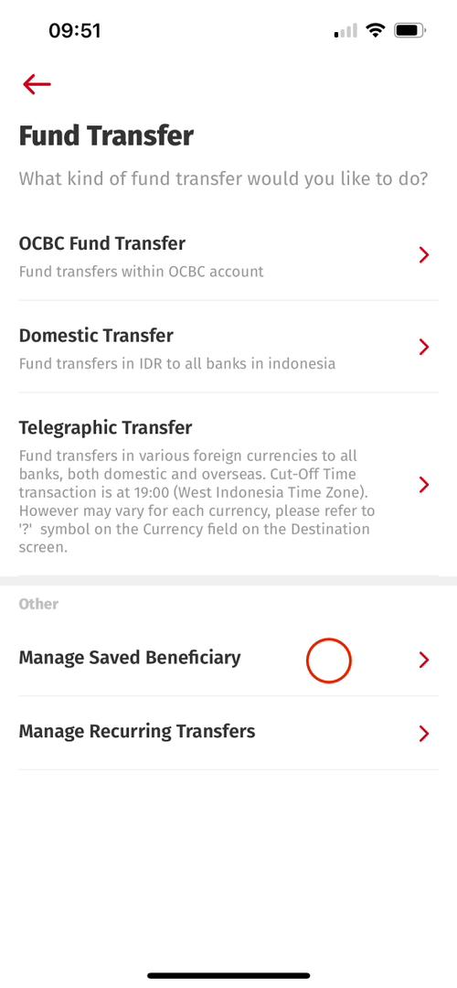
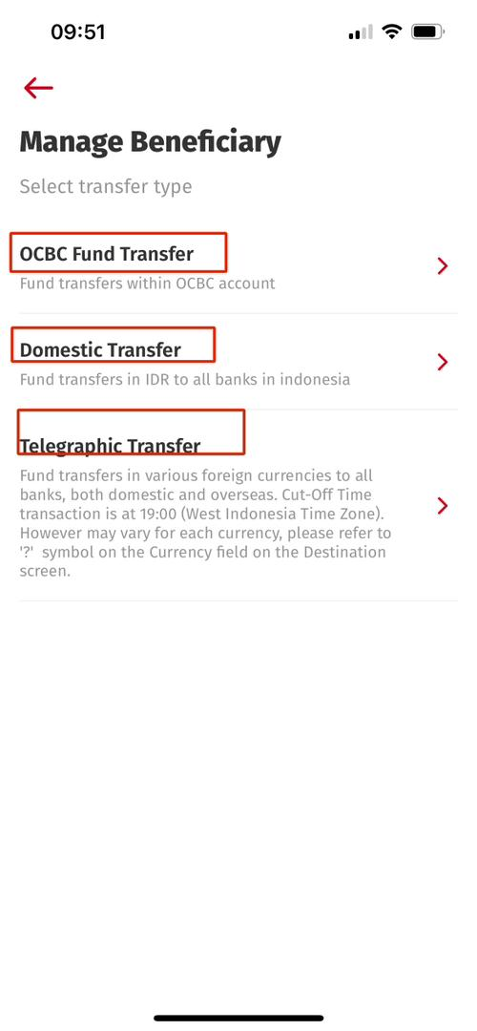
Fira Sans
iOS UAT:
Current Highlighted = Semi Bold
Expected Highlighted = Regular

Slide 14
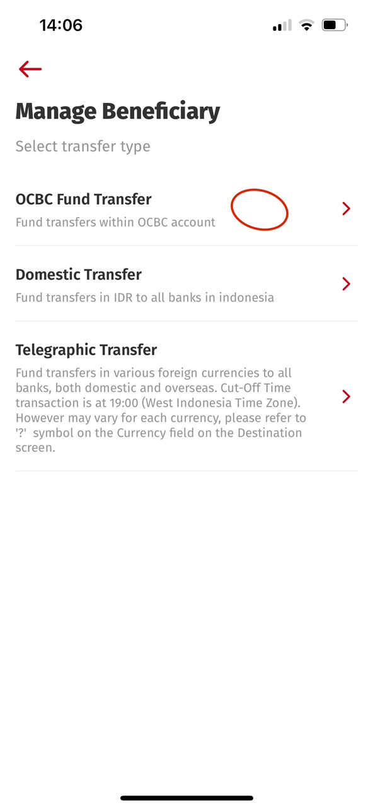
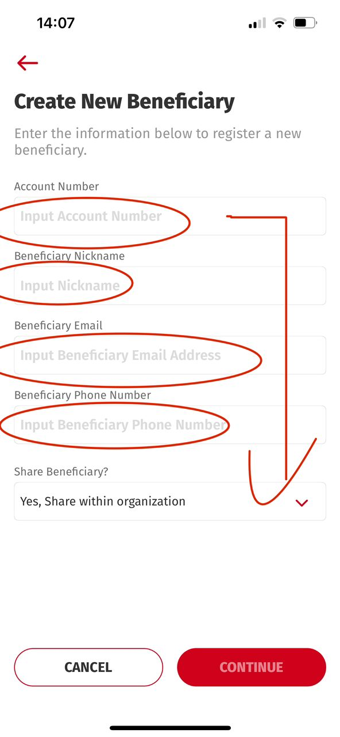
The next Input Screen
All Fields (Description) need change to > Regular
All Fields (Description) need change to > Regular

Slide 15
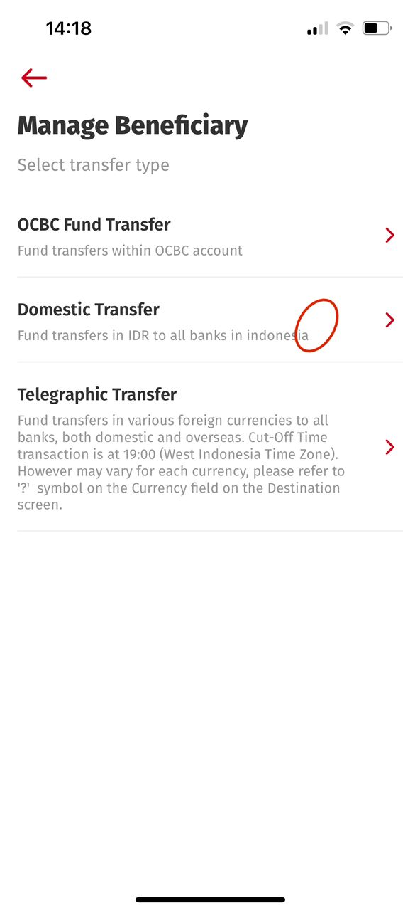
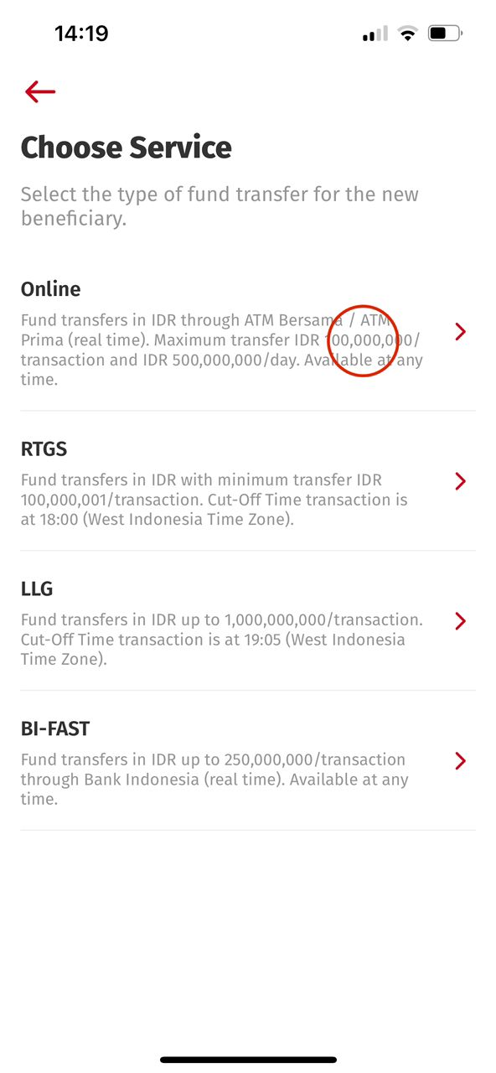
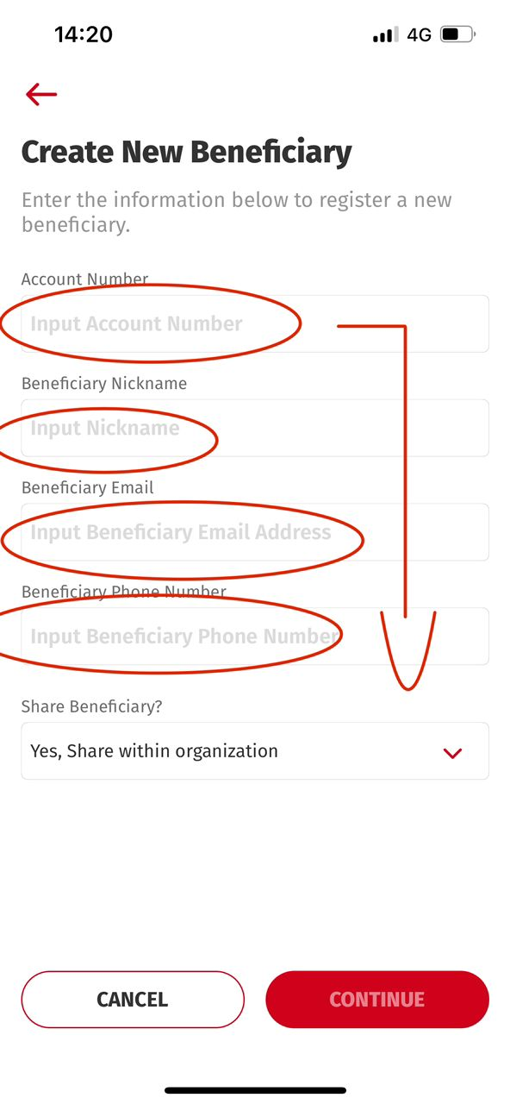
The next Input Screen
All Fields (Description) need change to > Regular
All Fields (Description) need change to > Regular

Slide 16
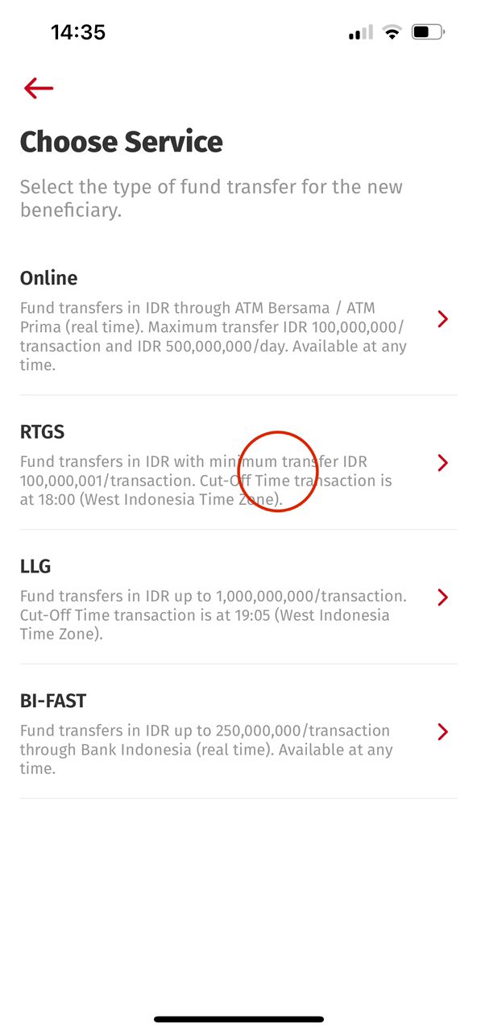
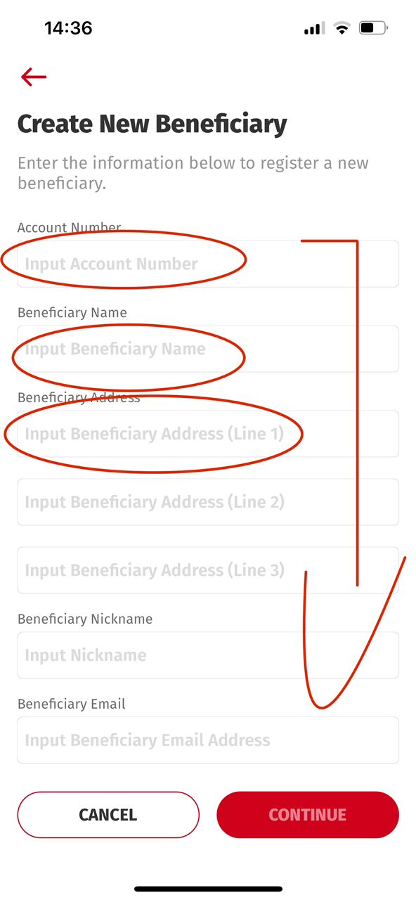
The next Input Screen
All Fields (Description) need change to > Regular
All Fields (Description) need change to > Regular

Slide 17
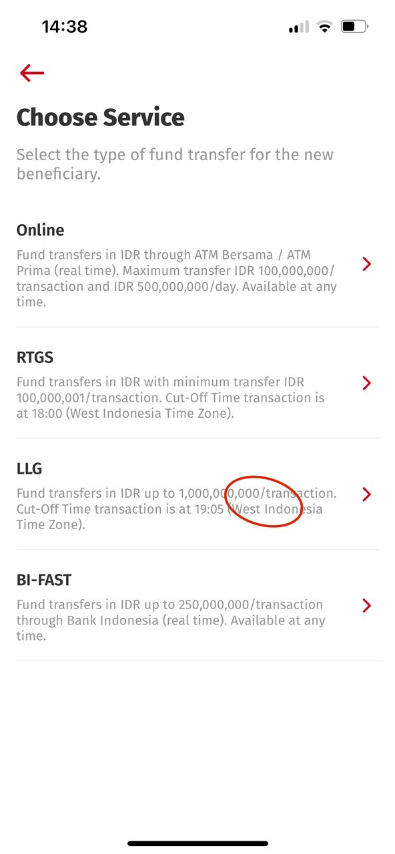
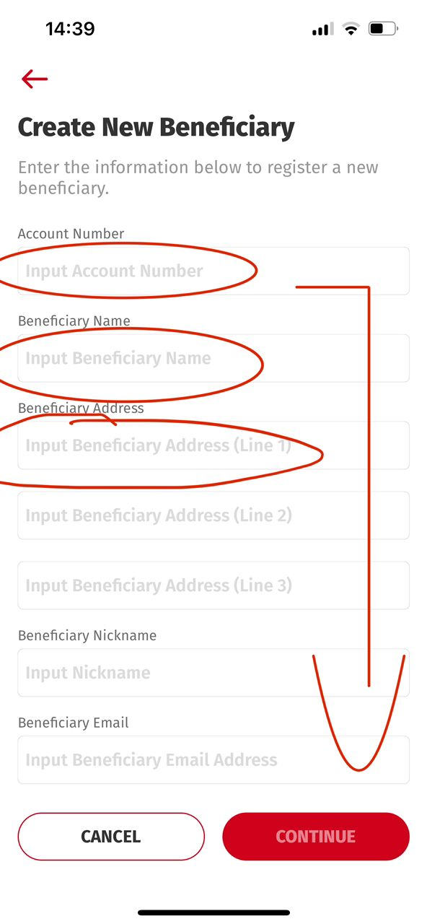
The next Input Screen
All Fields (Description) need change to > Regular
All Fields (Description) need change to > Regular

Slide 18
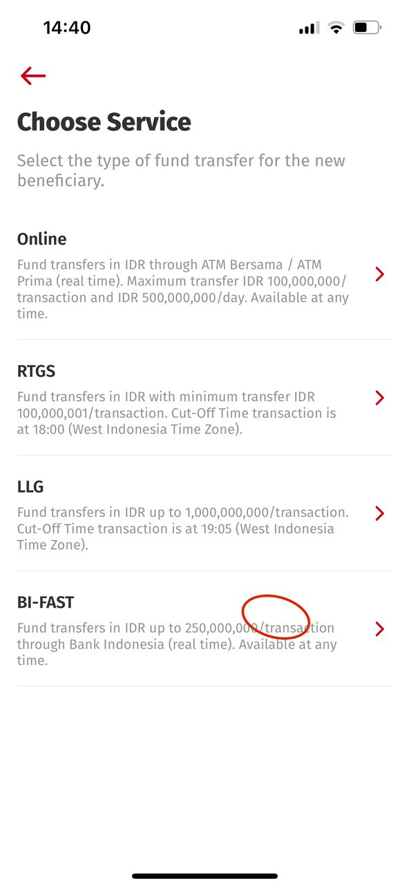
The next Input Screen
All Fields (Description) need change to > Regular
All Fields (Description) need change to > Regular

Slide 19
Subtitle Adjustment needed.
Android needs to display in full text

Slide 20
Fira Sans
iOS UAT:
Current Highlighted = Semi Bold
Expected Highlighted = Regular

Slide 21
Fira Sans
iOS UAT:
Current Highlighted = Semi Bold
Expected Highlighted = Regular

Slide 22
Fira Sans
iOS UAT:
Current Highlighted = Semi Bold
Expected Highlighted = Regular

Slide 23
Fira Sans
iOS UAT:
Current Highlighted = Semi Bold
Expected Highlighted = Regular
Title Acct Name on the list shall be Regular

Slide 24
Fira Sans
iOS UAT:
Current Highlighted = Semi Bold
Expected Highlighted = Regular
Title Acct Name on the list shall be Regular

Slide 25
Fira Sans
iOS UAT:
Current Highlighted = Semi Bold
Expected Highlighted = Regular

Slide 26
Fira Sans
iOS UAT:
Current Highlighted = Semi Bold
Expected Highlighted = Regular

