Slide 1
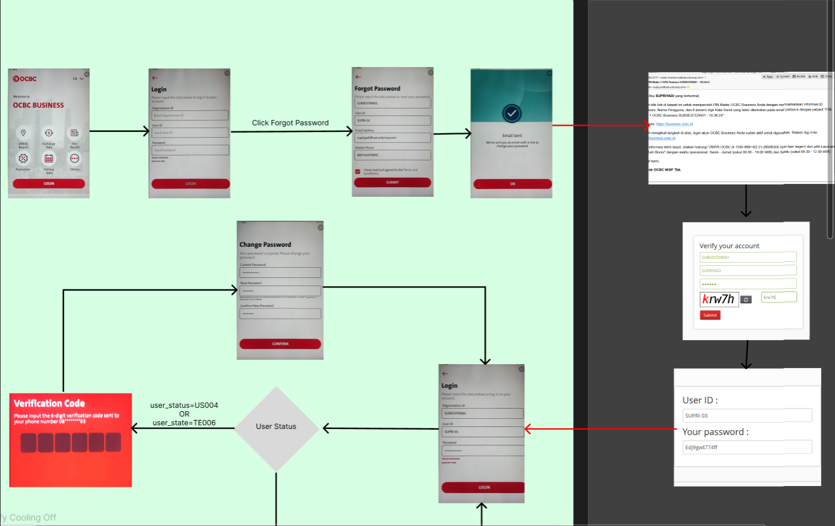
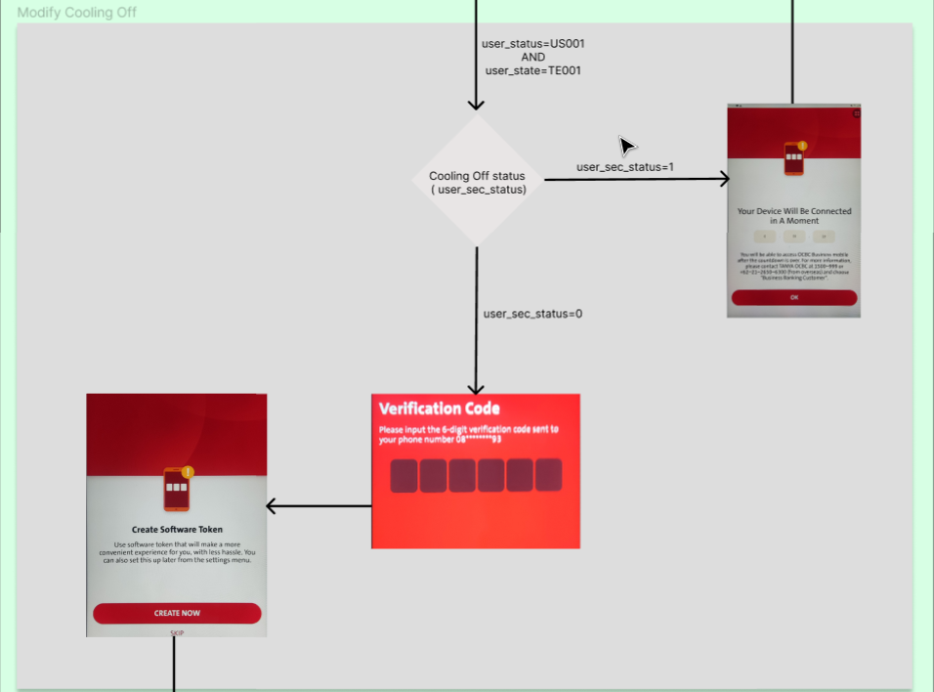
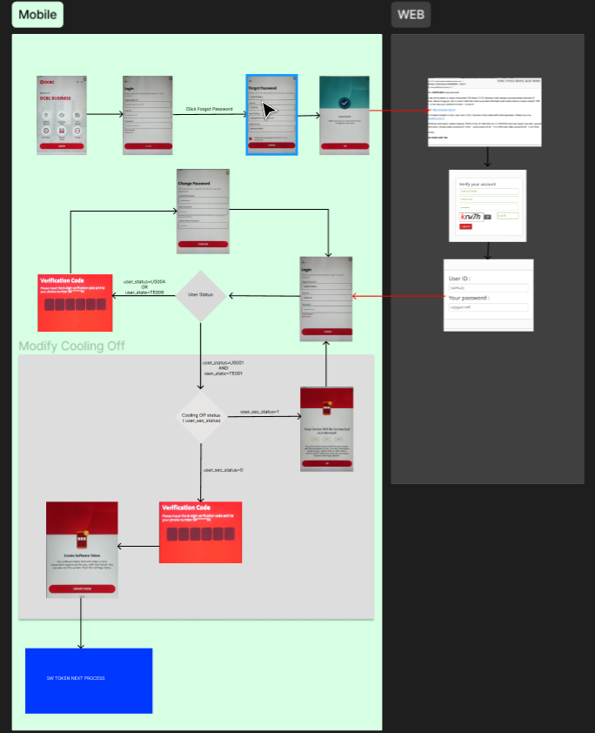

Slide 2
Inherited from Slide # 5 QC1368 – OTP to be displayed during login
BE: cater 3.3 Authenticate – Response for below (Should have already catered – Need to cross check) >> Already Catered
In General:- Under Performloginv2 Response << Follow given Figma >>
FE – checks below: Checking sequence #1 > #2 > #3
#1
BE returns usr_status = US001 & usr_state = TE001
FE checks on the return of usr_status = US001 & usr_state = TE001
#2 [Display of TIMER]
BE returns userSecStatus = 001
FE checks on the return of userSecStatus= 001
THEN
#3
BE returns remainingCoolOff > BE returns in milliseconds >>>>>> FE maps with >>>> remainingCoolOff value
FE checks remainingCoolOff > Display Timer
-------------------------------------------------------------------------------------
FE – checks below: Checking sequence #1 > #2 > #3
IF
#1
BE returns usr_status = US001 & usr_state = TE001
FE checks on the return of usr_status = US001 & usr_state = TE001
#2
BE returns userSecStatus = 000
FE checks on the return of userSecStatus = 000
THEN
#3
Display and continue with “Create Software Token” screen flow

Slide 3
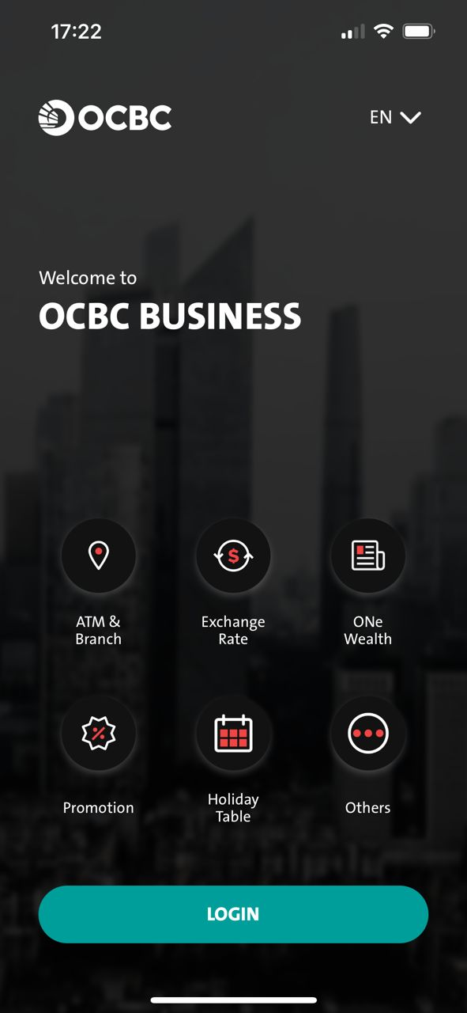
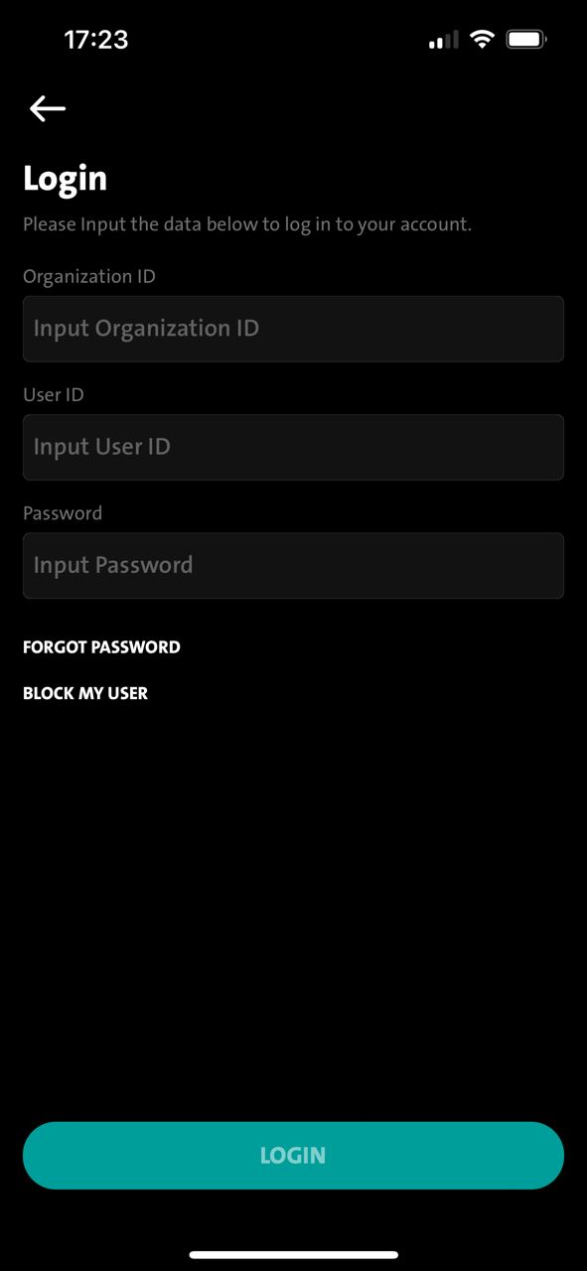
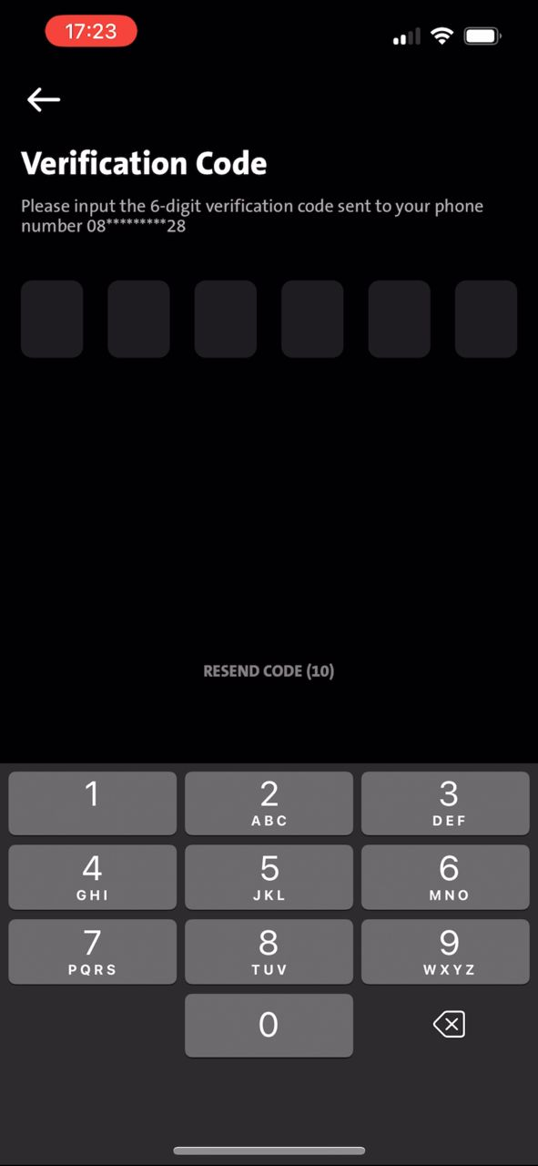
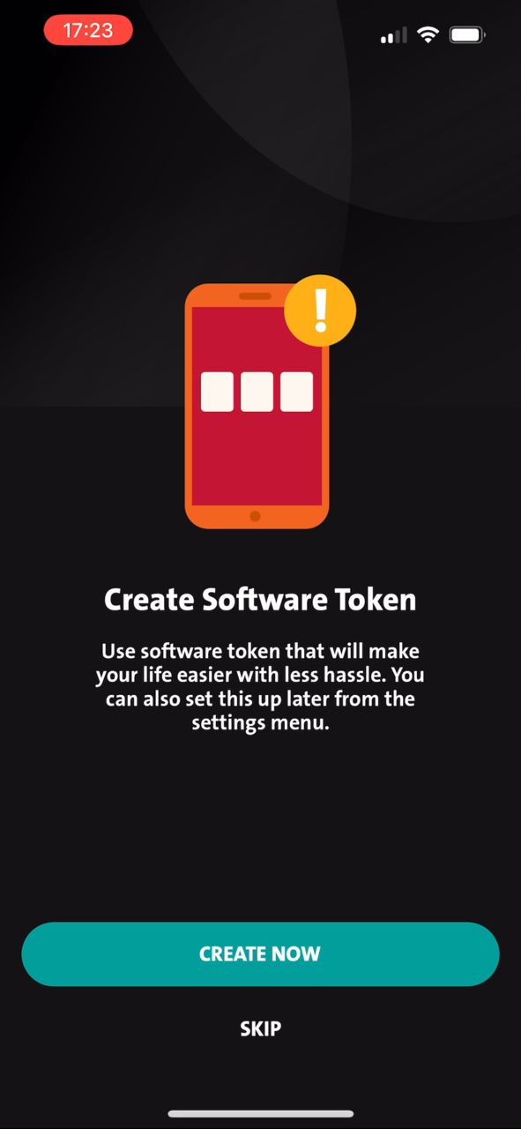
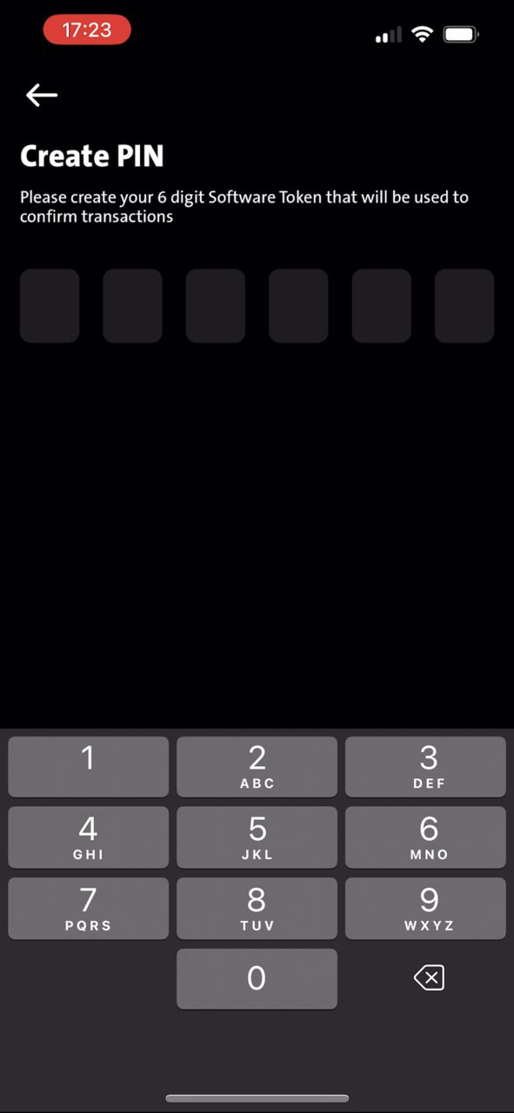
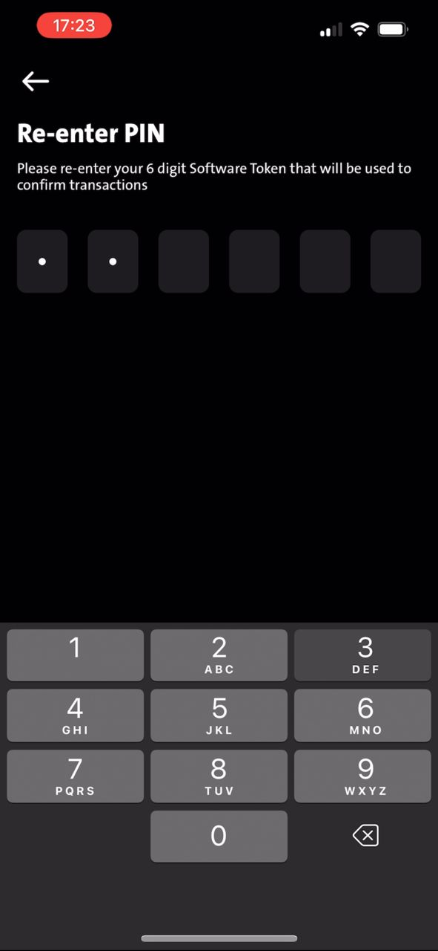
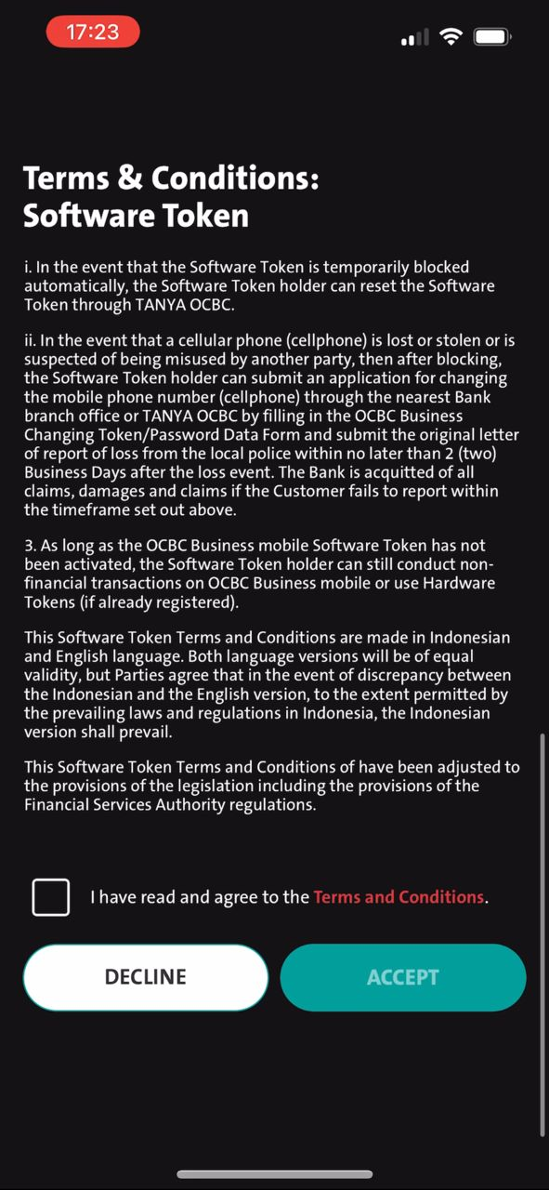
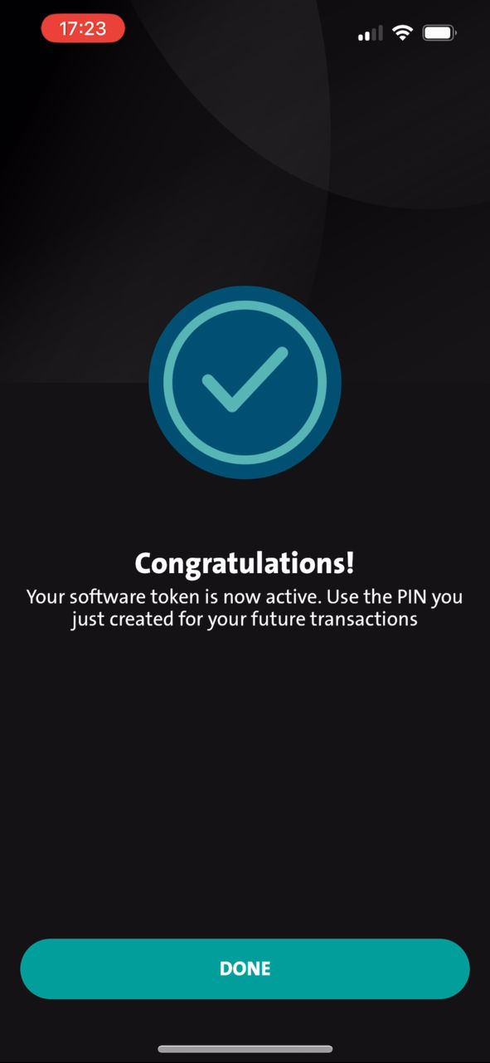
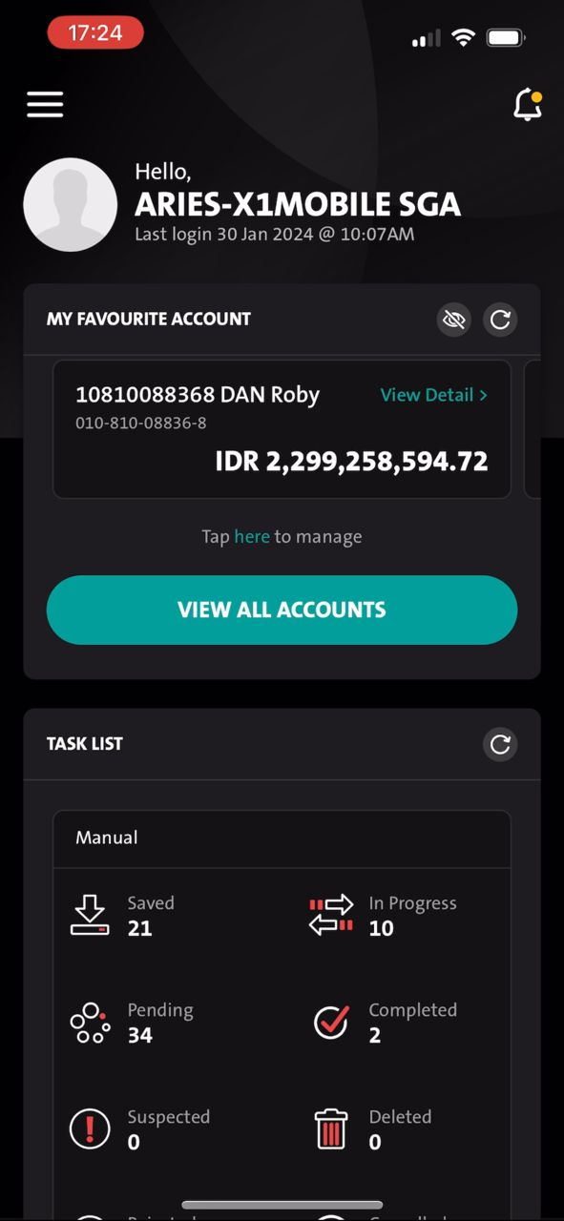
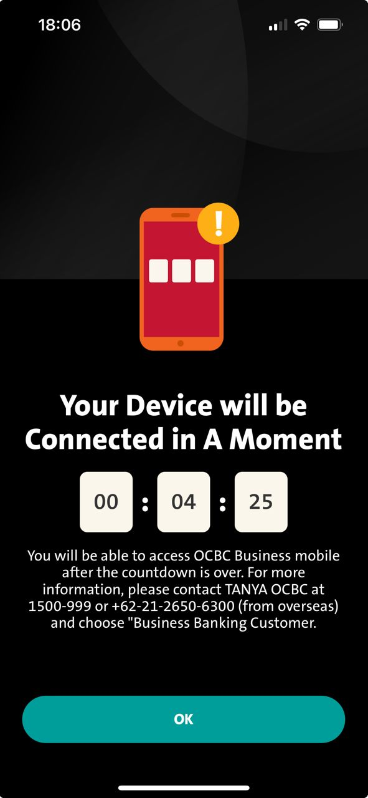
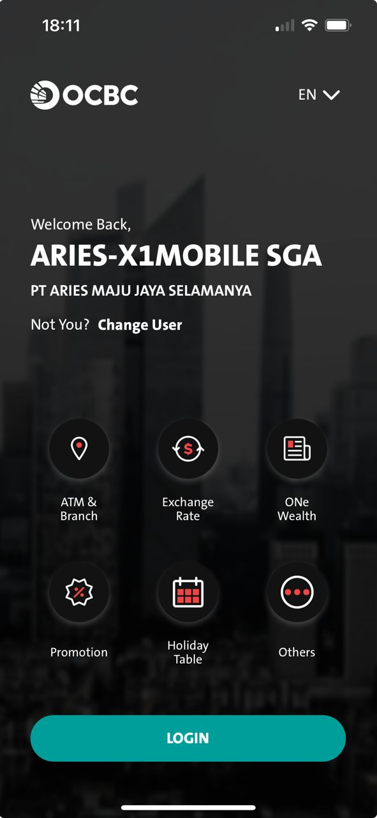
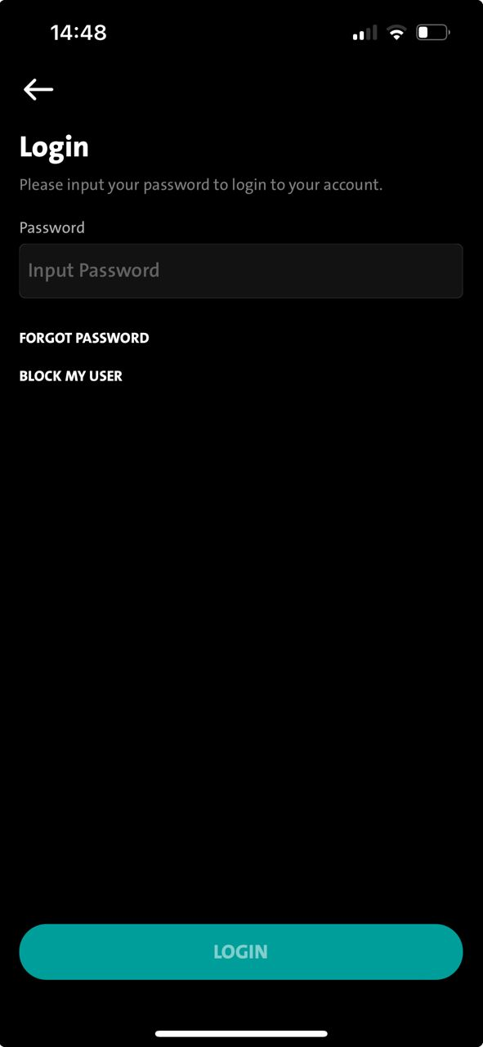
Primary – Display TIMER after OTP
BAU
1. Unbinded landing
2. Unbinded login
3. OTP
4 SW Token
5 PIN #1
5 PIN #1
NEW
BAU
1. Unbinded landing
2. Unbinded login
3. OTP
5. TIMER
FE calling PerformLoginv2
FE checks below during performLoginv2 response:-
> FE checks usr_status = US001 & usr_state = TE001
> FE checks userSecStatus = 001
> FE checks RemainingCoolOff = (Value in milliseconds)
Ok button will go back to BINDED Landing Screen by calling RetrieveSecInfo
> FE checks usr_status = US001 & usr_state = TE001
> FE checks userSecStatus = 000
> FE checks remainingCoodOff = 0/ EMPTY
Remain on TIMER screen until finishes will auto isplay Binded Login Screen

Slide 4
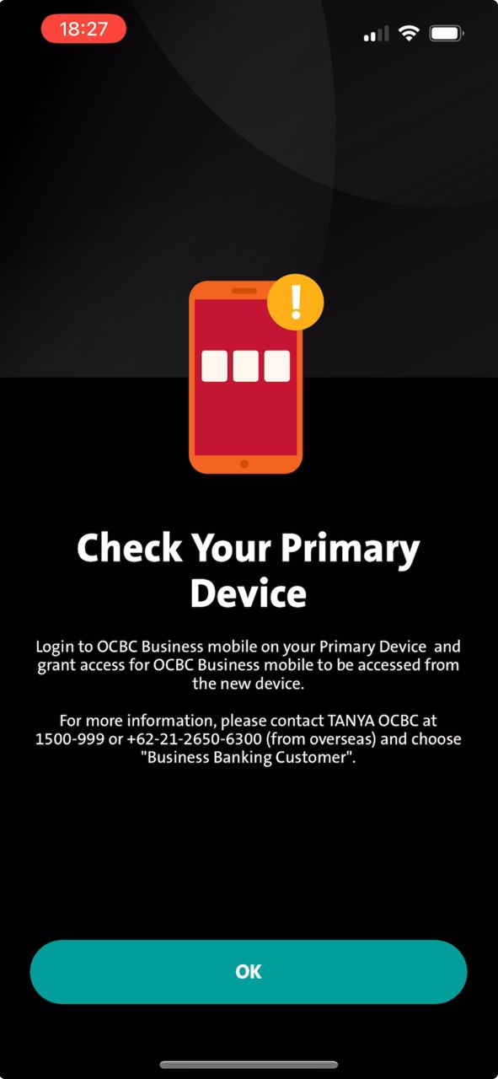
2ndary – Display TIMER after OTP
1. Unbinded landing
2. Unbinded Login
3. OTP
4. Pending Approval
5. Timer (MLEB)
6. BINDED Landing
7. BINDED Login
8. TIMER
9. BINDED Landing
10. BINDED Login
Ok button will go back to BINDED Landing Screen by calling RetrieveSecInfo
FE calling PerformLoginv2
Ok button will go back to BINDED Landing Screen by calling RetrieveSecInfo to display Binded Landing Screen
Existing checking on MLEB for 2ndary Device after approval [REMAIN 2NDARY DEVICE EVERY CHECKING AS BAU]
FE checks below during performLoginv2 response:-
> FE checks usr_status = US001 & usr_state = TE001
> FE checks userSecStatus = 001
> FE checks RemainingCoolOff = (Value in milliseconds)
Remain on TIMER screen until finishes will auto isplay Binded Login Screen
BAU
10. BINDED Login
2.2 > FE checks usr_status = US001 & usr_state = TE001
2.3 > FE checks userSecStatus = 000
2.4 > FE checks remainingCoodOff = 0/ EMPTY

Slide 5
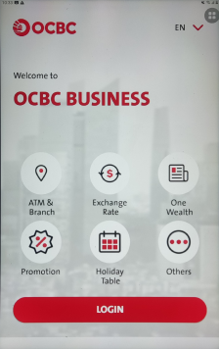
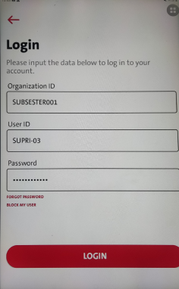
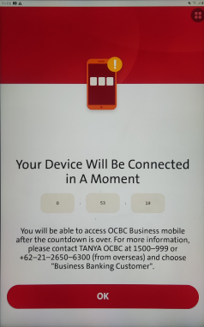
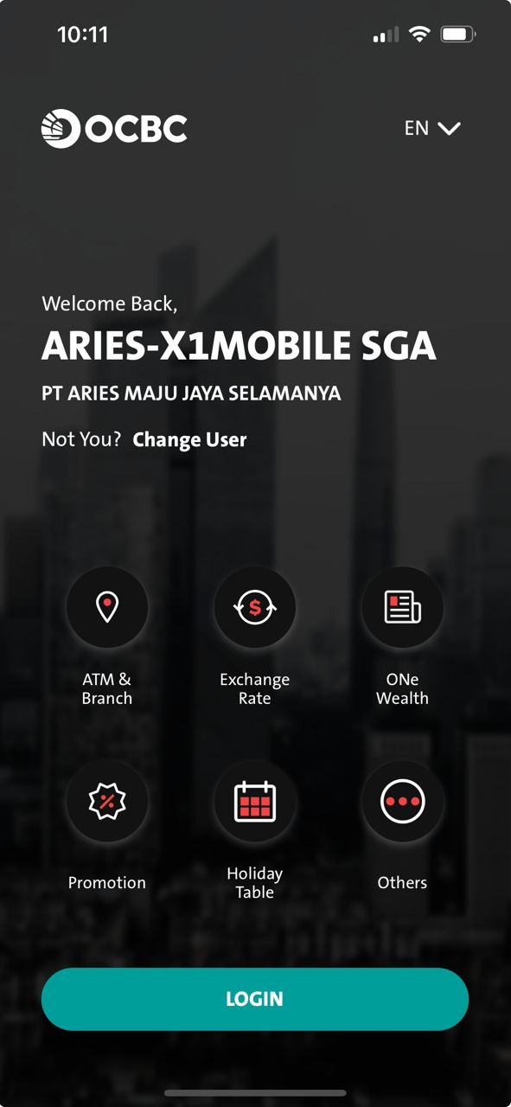
1. Unbinded landing
2. Unbinded login screen
3. TIMER
4. Binded Landing Screen
5. Password Input Screen
6. TIMER
2.1 > FE checks usr_status = US001 & usr_state = TE001 THEN remaningCoolOff
3.1 > FE - Display TIMER [map with remaningCoolOff (Millisecond) ]
3.2 > FE - Press ok button [Go back to binded landing screen]
4.1 > FE – Display Binded Landing Screen
5.1 > FE - Display password login input screen (After TIMER is FINISHED on TIMER screen.)
5.2 > FE - calling RetrieveSecInfo >>> When ApprovalCountdown is Empty/ “0”
FE will continue to call PerformLoginv2 / MLEB calling Authenticate
FE checks remairnigCoolOff to display TIMER.
6.1 > FE - Display TIMER again (after password input login screen).
In BAU, from Unbinded login screen > Binded Landing screen > After TIMER finish > Display Password Login Screen > after performlogin > [Should not be displaying TIMER again]
Concern: OCBC acceptable ?
If follow by the given wireframe , FE is taking the RemainCoolOff value by the Authenticate Response, – the screen flow will be like this
…

Slide 6
1. Unbinded landing
2. Unbinded login screen
3. TIMER
4. Binded Landing Screen
6. Password Input Screen
5. TIMER
We can still go with performLoginv2/ Authenticate for FE to get remainingCoolOff to display TIMER
Mleb will return ApprovalCountDown for FE under RetrieveSecInfo
FE calls RetrieveSecInfo
BE returns ApprovalCountDown
If ApprovalCountDown with values = Display Timer
IF values – 0/ Empty > Display Password Login Input screen
2.1 > FE checks usr_status = US001 & usr_state = TE001 THEN remaningCoolOff
3.1 > FE - Display TIMER [map with remaningCoolOff (Millisecond) ]
3.2 > FE - Press ok button [Go back to binded landing screen]
4.1 > FE – Display Binded Landing Screen
4.1 > FE - Login again
4.2 > FE - calling RetrieveSecInfo >>> When ApprovalCountdown with Value [Millisecond]
5.1 > FE – Display TIMER.
6.1 > FE - Display password login input screen after TIMER is FINISHED Continue to call PerformLoginv2/ Authenticate.
From binded landing screen - When calling RetrieveSecInfo > NO ApprovalCountDown Value > Continue to call PerformLoginv2 > NO remainingCoolOff Value > Display password login input screen
Concern:
MLEB may return ApprovalCountDown Value for FE to display TIMER
>> (Based on Omni successful Response [ TimeDate – Current RetriveSecTime]
when FE calling RetrieveSecInfo but it may not be accurate.
If we cater above {Need to make sure}
>> what if Authenticate is going to return the RemainingCoolOff? [Authenticate/ performLoginv2]
..
..

Slide 7
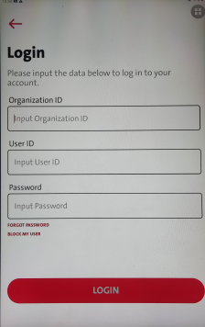
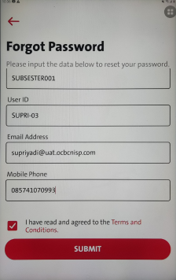
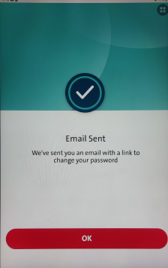
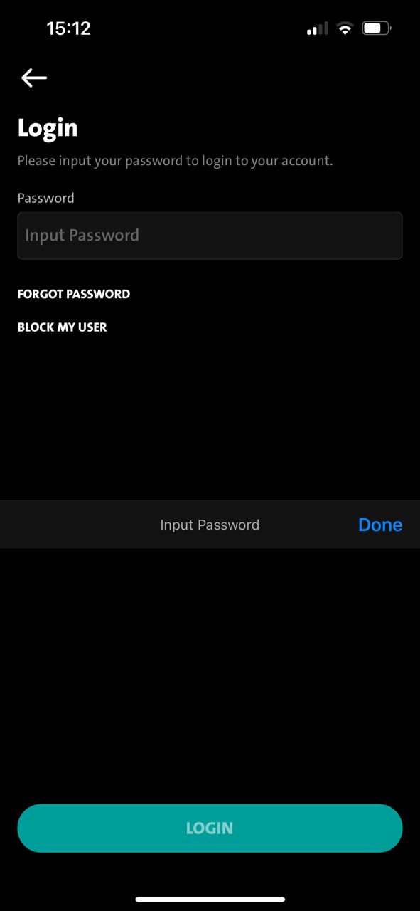
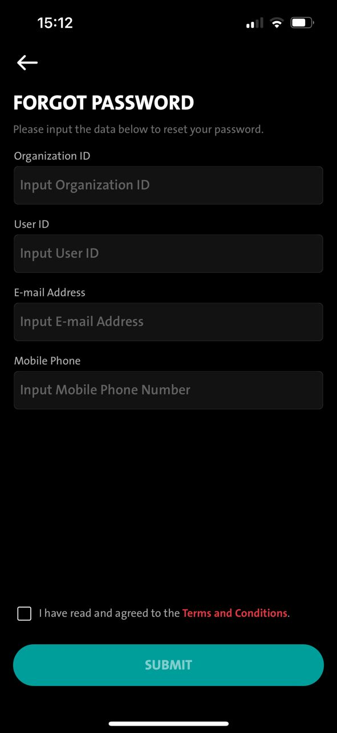
Perform FORGOT Password
Call performlogin/ Authenticate
RemainingCoolOff
Call RetrieveSecInfo
ApprovalCountDown
FE Call RetrieveSecInfo to check on ApprovalCOuntdown
BE - Based on Omni successful Response ResetPassword [ TimeDate – Current RetriveSecTime]
BE - Return ApprovalCountdown in millisecond to FE.
Perform FORGOT Password
Call RetrieveSecInfo
ApprovalCountDown

Slide 8
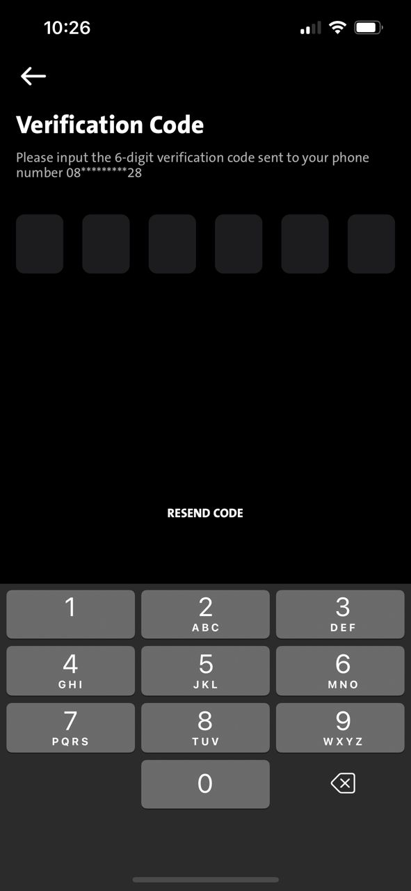
1. Unbinded landing
2. Unbinded login screen
3. TIMER
5. Unbinded Landing Screen
6 Unbinded Login Screen.
7. TIMER
8. Unbinded Landing
10. Unbinded Login Screen
11. OTP as BAU
Ok button will go back to unbinded Landing Screen by calling RetrieveSecInfo
9. Unbinded Login Screen
When Timer is finished [condition are met] > Continue BAU from here
2.1 > FE checks MCB.1000101 / 0000000
2.2 > FE checks usr_status = US001 & usr_state = TE001
2.3 > FE checks userSecStatus = 001
2.1 > FE checks MCB.1000101/ 0000000
2.2 > FE checks usr_status = US001 & usr_state = TE001
2.3 > FE checks userSecStatus = 000
If TIMER remain on screen until finishes countdown, it will auto display Unbinded Login Screen by calling RetrieveSecInfo
FE call RetrieveSecInfo

