Slide 1
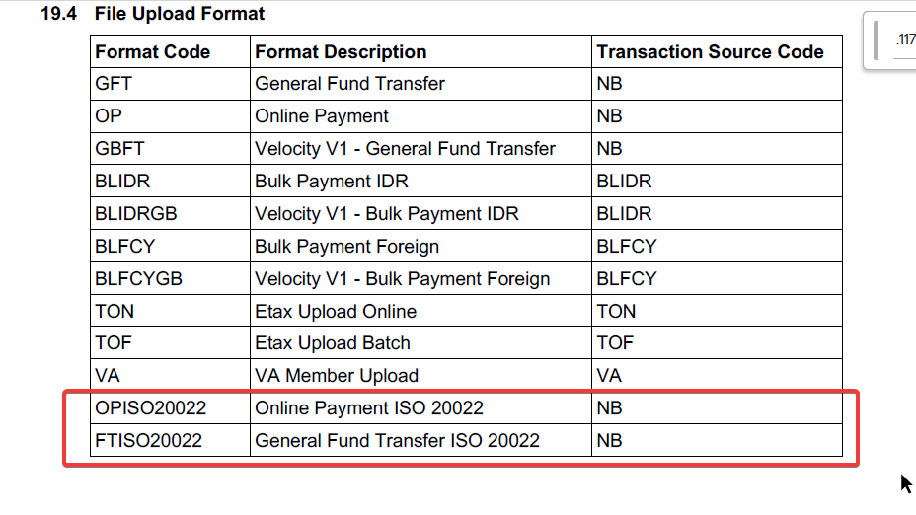
VMB-1176 Add 2 New ISO format code

Slide 2
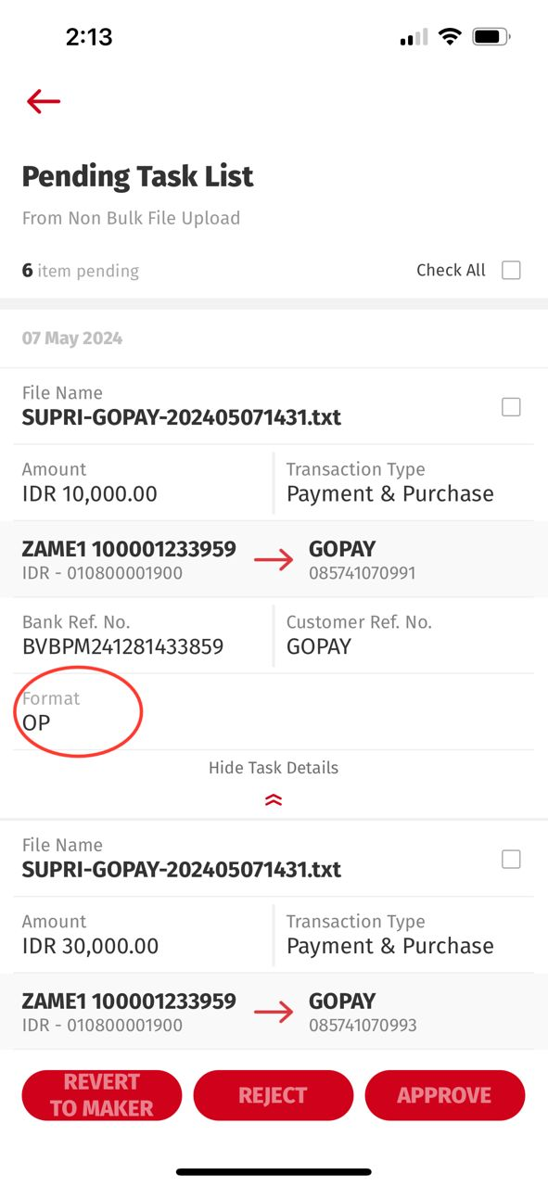
VMB-1176 Add 2 New ISO format code
To apply in after clicking "VIEW DETAIL" button under Format Field.
OPISO20022 as Online Payment ISO20022
FTISO20022 as General Fund Transfer ISO20022
This is going to be applied into entry below:
Entry from Dashboard > Task List > Non Bulk File Upload > Pending
Entry from Dashboard > Task List > Non Bulk File Upload > Pending > VIEW DETAIL
Entry from Side Menu > Authorization > Non-Bulk File Upload > VIEW DETAIL
Currently we unable display Format Description as (This is confirmed with Tia that we will need to display Format Description)
A. Entry from Dashboard > Task List > Non Bulk File Upload > Pending
>> Omni Spec [7.2 task_list/list_trx] > Currently not returning neither upload_format nor Upload Description
B. Entry from Dashboard > Task List > Non Bulk File Upload > Pending > VIEW DETAIL
>> Omni Spec [9.1 authorization/list_pending_trx]
C. Entry from Side Menu > Authorization > Non-Bulk File Upload > VIEW DETAIL
>> Omni Spec [9.1 authorization/list_pending_trx] > Currently only returning upload_format but not returning Format Description
BE needs to make sure upload_format_desc will be returning to FE for above WSs
[7.2 task_list/list_trx] Omni returns upload_format; BE [Needs to map with the description],
> BE returns upload_format_desc to FE under RetrieveTaskTransaciton Response
[9.1 authorization/list_pending_trx]
> BE returns upload_format_desc to FE under RetrieveTaskTransaciton Response

