Slide 1
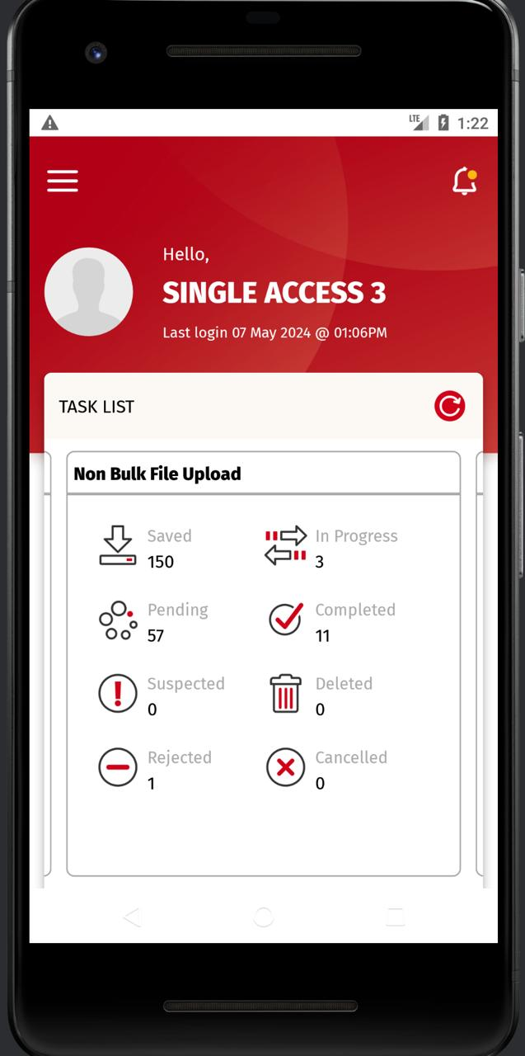
A. Entry from Dashboard > Task List > Non Bulk File Upload UAT
Clicking on below: (We are calling RetrieveTaskTransaction/ task_list/list_trx)
Saved > Saved Task List Screen
> iOS > Format display FTISO20022/ OPISO20022 > Android > Format display FTISO20022/ OPISO20022
In Progress > In Progress Task List Screen
> iOS > Need to check with developer if mapping already catered
> Android > Need to check with developer if mapping already catered
Pending > Pending Task List Screen
> iOS > Format display FTISO20022/ OPISO20022 > Android > Format display ??
Completed > Completed Task List Screen
> iOS > Format display FTISO20022/ OPISO20022 > Android > Format display ??
Suspected > Suspected Task List Screen
> iOS > Need to check with developer if mapping already catered
> Android > Need to check with developer if mapping already catered
Deleted > Deleted Task List Screen
> iOS > Need to check with developer if mapping already catered
> Android > Need to check with developer if mapping already catered
Rejected > Rejected Task List Screen
> iOS > Format display FTISO20022/ OPISO20022 > Android > Format display ??
Cancelled > Cancelled Task List Screen
> iOS > Need to check with developer if mapping already catered
> Android > Need to check with developer if mapping already catered

Slide 2
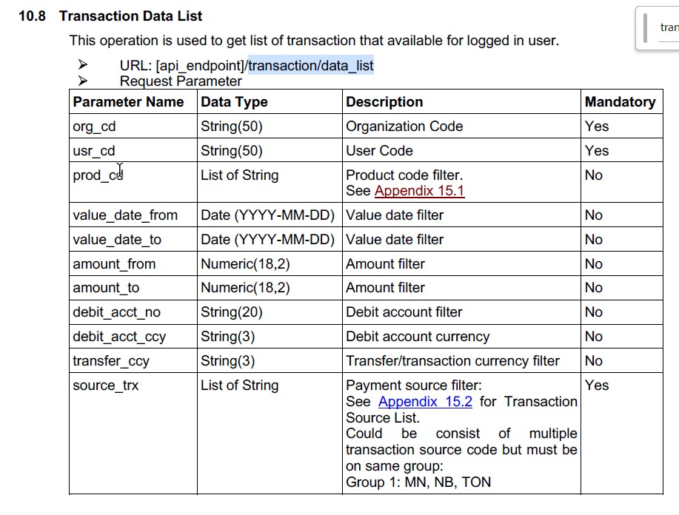
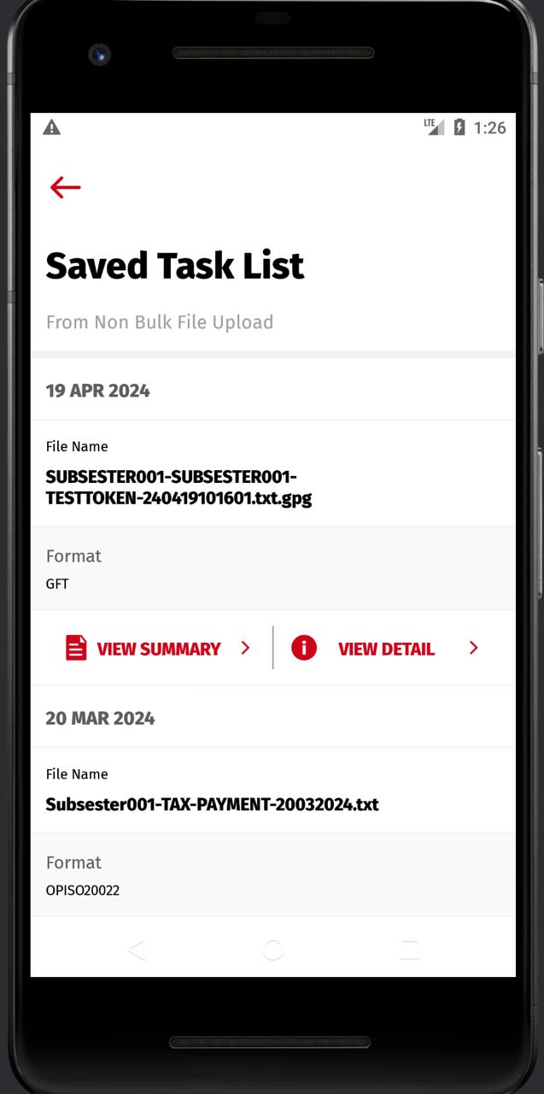
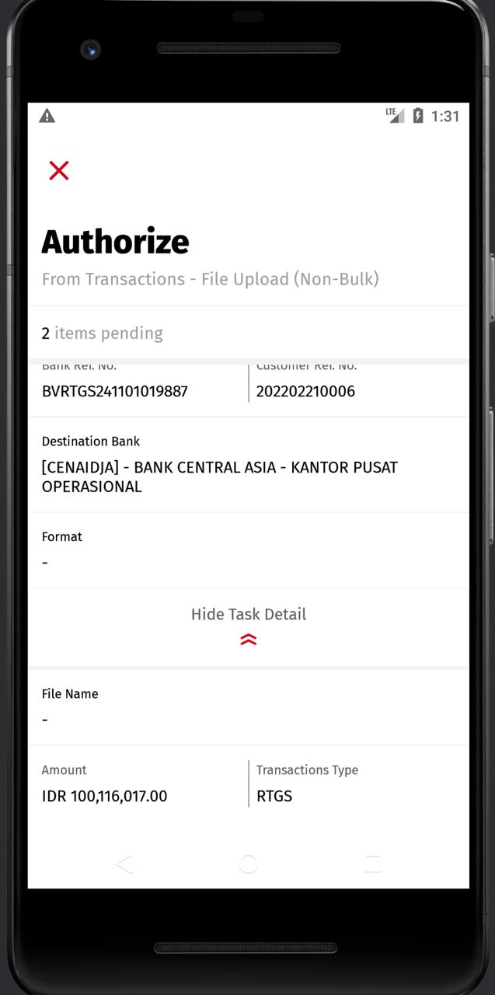
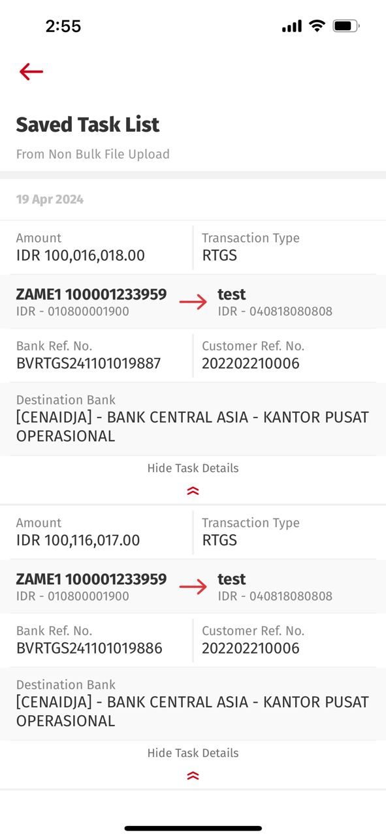
A. Entry from Dashboard > Task List > Non Bulk File Upload
iOS & Android are different when it comes to
Clicking on below: (We are calling RetrieveTransactionDataList/ transaction/data_list
VIEW DETAILS Button (Currently, Omni is not returning upload_format to Mleb as BAU for a long time. Pls refer to the latest Omni Spec below)
1. Saved > Saved Task List Screen > View Details Button > Saved Task List Screen
> iOS > Format Field Doesn’t Exist on Saved Task List Screen > Android > Format Field Exist on Saved Task List Screen
> Android > After clicking View Details > Need to follow iOS [Seems like taking the screen from Authorization module]
2. In Progress > In Progress Task List Screen > View Details Button > In Progress Task List Screen
> iOS > Format Field Doesn’t Exist on In Progress Task List Screen > Android > Format Field Exist on In Progress Task List Screen
> Android > After clicking View Details > Need to follow iOS [Seems like taking the screen from Authorization module]
3. Pending > Pending Task List Screen [calling RetrieveAuthorizeTransaction/ authorization/list_pending_trx]
> iOS > Format Field Not Display – Need to check with Developer > Android > Format parameter Display
> Android > Header Copywriting need to change
4. Completed > Completed Task List Screen
> iOS > Format Field Doesn’t Exist on Completed Task List Screen > Android > Format Field Exist on Completed Task List Screen
> Android > After clicking View Details > Need to follow iOS [Seems like taking the screen from Authorization module]
5. Suspected > Suspected Task List Screen
> iOS > Need to check with developer if Format Parameter does exist on the screen
> Android > The header is displaying Suspected Task List – which means [1,2,4,5] after clicking View Details Button, Android should follow iOS.
6. Deleted > Deleted Task List Screen
> iOS > Need to check with developer if Format Parameter does exist on the screen
> Android > The header is displaying Deleted Task List – which means [1,2,4,5,6] after clicking View Details Button, Android should follow iOS.
7. Rejected > Rejected Task List Screen
> iOS > Format Field Doesn’t Exist on Rejected Task List Screen > Android > Format Field Exist on Rejected Task List Screen
> Android > After clicking View Details > Need to follow iOS [Seems like taking the screen from Authorization module]
8. Cancelled > Cancelled Task List Screen
> iOS > Need to check with developer if Format Parameter does exist on the screen
> Android > The header is displaying Deleted Task List – which means [1,2,4,5,6] after clicking View Details Button, Android should follow iOS.
I think for View Detail button [1, 2, 4,5,6,7,8 ], Android should follow iOS as there should not be having Format Field – Pls refer to slide #5
Seems like Only [#3] should have Format parameter.

Slide 3
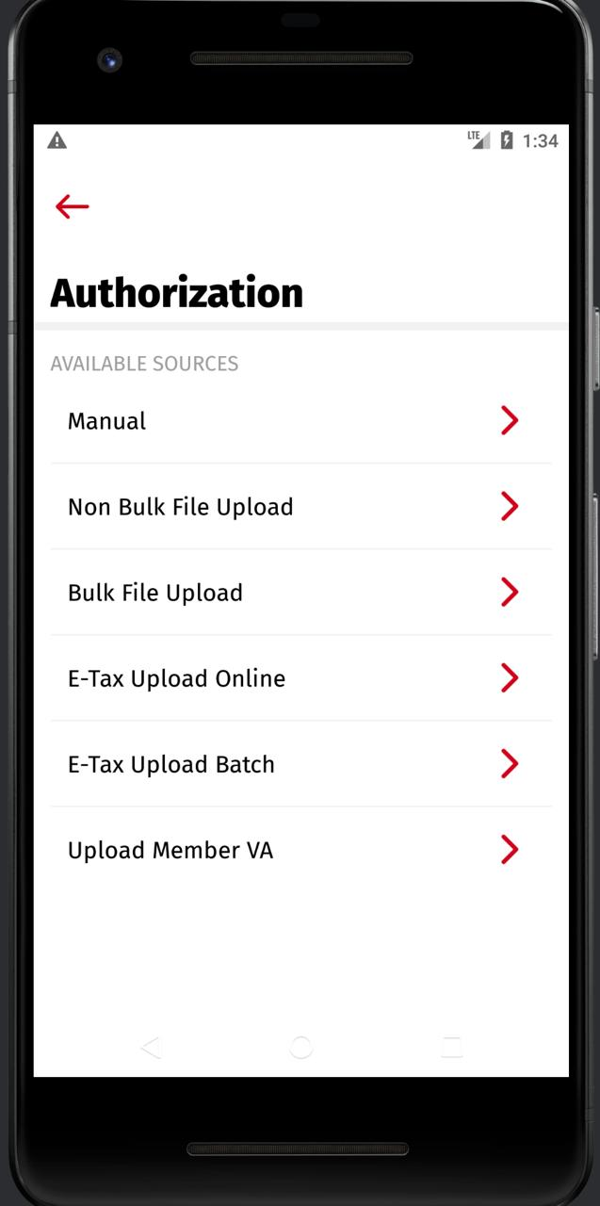
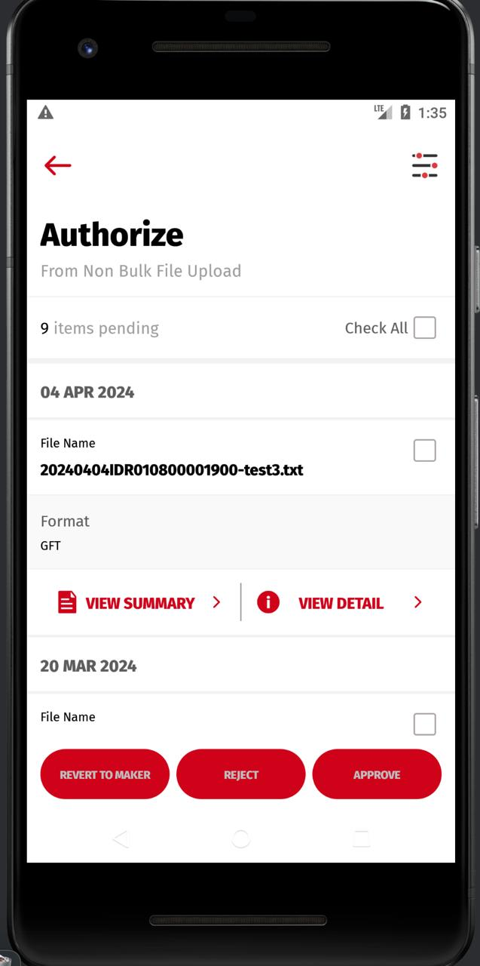
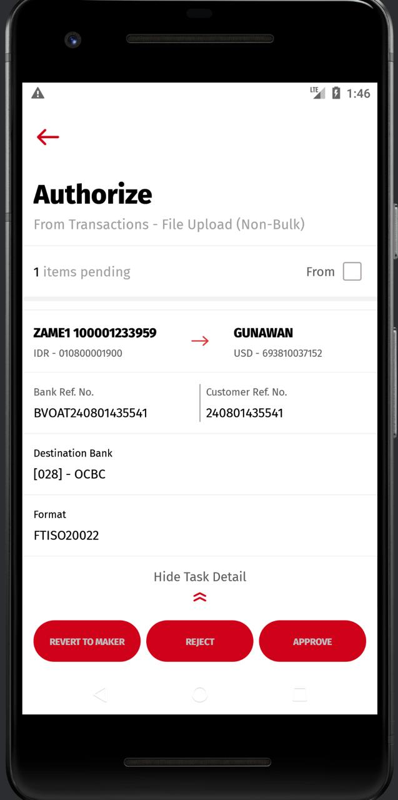
B. Entry from Side Menu > Authorization > Non-Bulk File Upload
Nothing wrong with this
Same for iOS & Android
Clicking on below: (We are calling RetrieveTaskTransaction/ task_list/list_trx)
Clicking on below: (We are calling RetrieveAuthorizeTransaction / list_pending_trx)
iOS > Authorization Screen > need to map with upload_format parameter
Able to map and display
upload_format

Slide 4
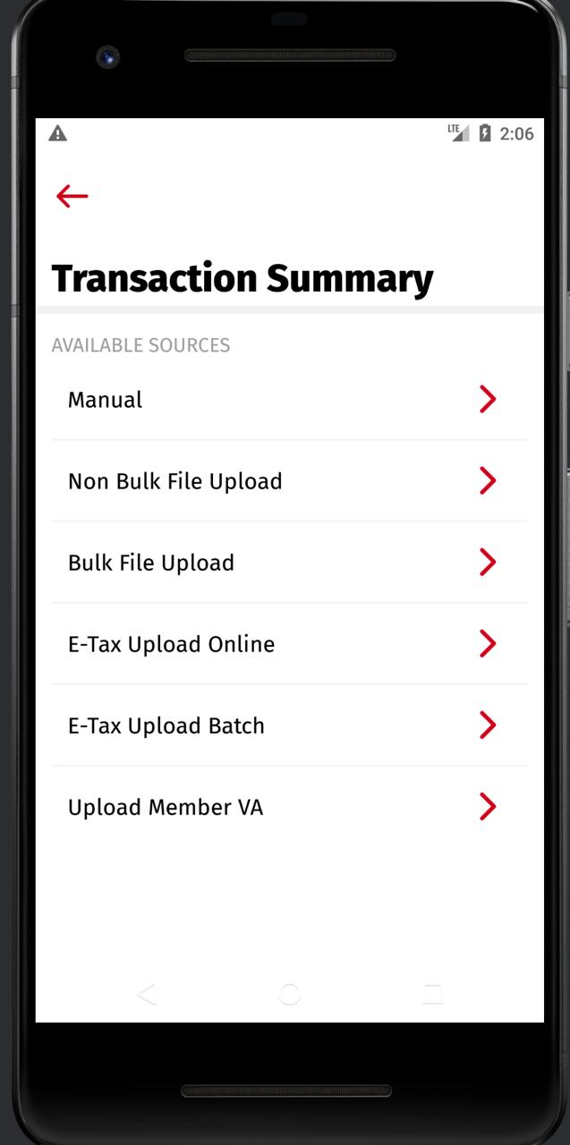
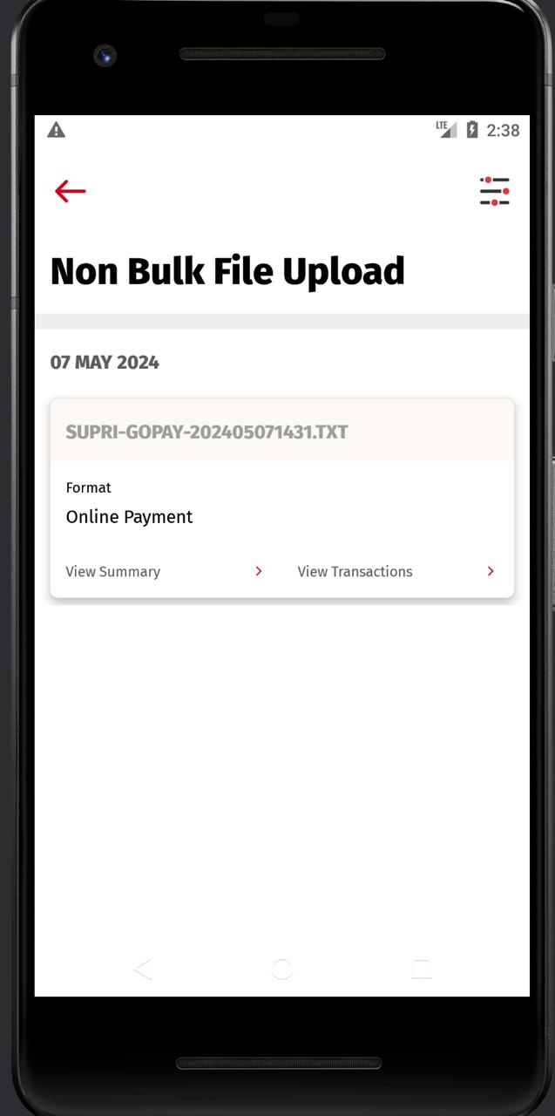
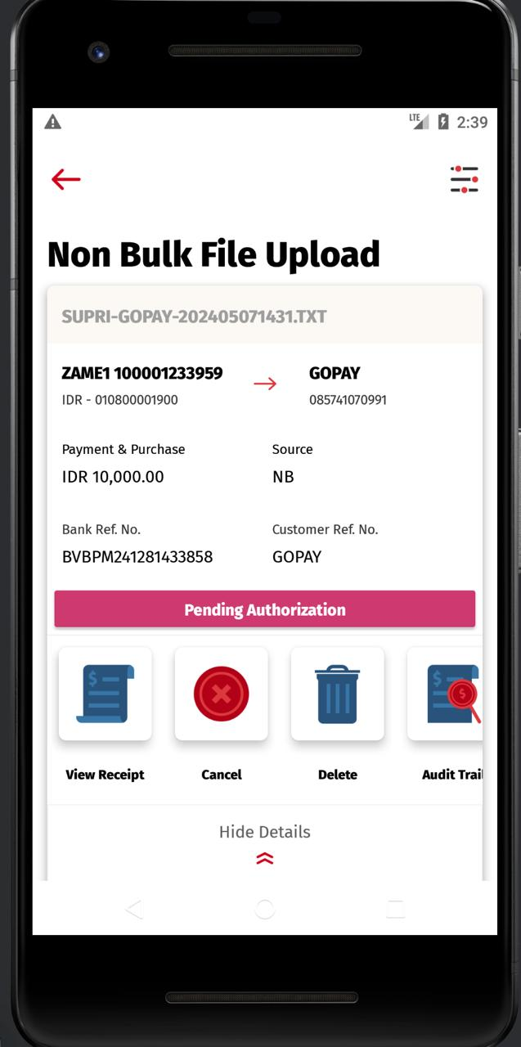
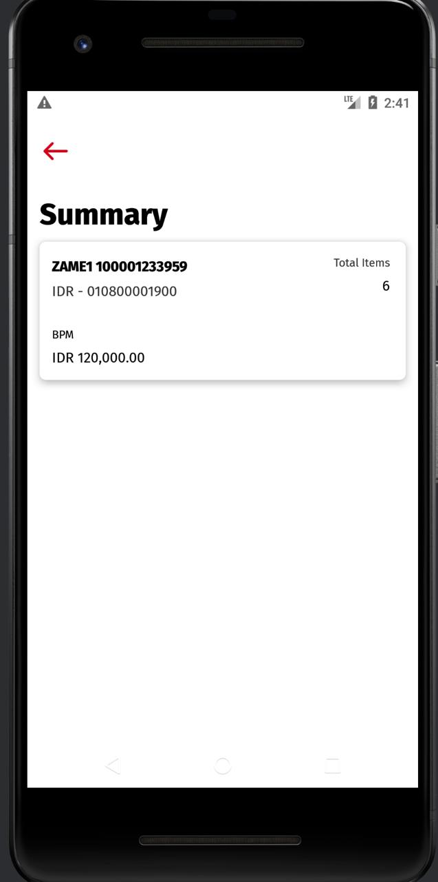
C. Entry from Side Menu > Transaction Summary > Non-Bulk File Upload
Format parameter seems not applicable cos UI design is different
Clicking on below: (We are calling RetrieveTaskTransaction/ transaction/trx_summary)
this is after i tap on view transaction
this is after i tap on view summary

Slide 5
Inherited from Slide #2 – Screen differences between iOS & Android
Dashboard > Task List > Non Bulk File Upload > This is going to standardize the mapping for entry above & WSs that involves as below:
- RetrieveTaskTransaction
- RetrieveTransactionDataList
To Standardize FE Checking for WS response of above: (from Slide #6 until Slide #13)
> FE checks upload_format_desc from BE response > Display upload_format_desc value in Format Field.
> If there is no upload_format_desc;
> FE check upload_format from BE response > Display upload_format value in Format Field.
> If there is no upload_format_desc nor upload_format value being return by BE response, Pls display “-”
Items from Dashboard > Task List > Non Bulk File Upload
- Saved > Saved Task List Screen > Format Field [Standardize Mapping]
- In Progress > In Progress Task List Screen > Format Field [Standardize Mapping]
- Pending > Pending Task List Screen > Format Field [Standardize Mapping] > Also > [VIEW DETAILS] Pending Task List Screen > Format Field [Standardize Mapping]
- Completed > Completed Task List Screen > Format Field [Standardize Mapping]
- Suspected > Suspected Task List Screen > Format Field [Standardize Mapping]
- Deleted > Deleted Task List Screen > Format Field [Standardize Mapping]
- Rejected > Rejected Task List Screen > Format Field [Standardize Mapping] - Cancelled > Cancelled Task List Screen > Format Field [Standardize Mapping]

Slide 6
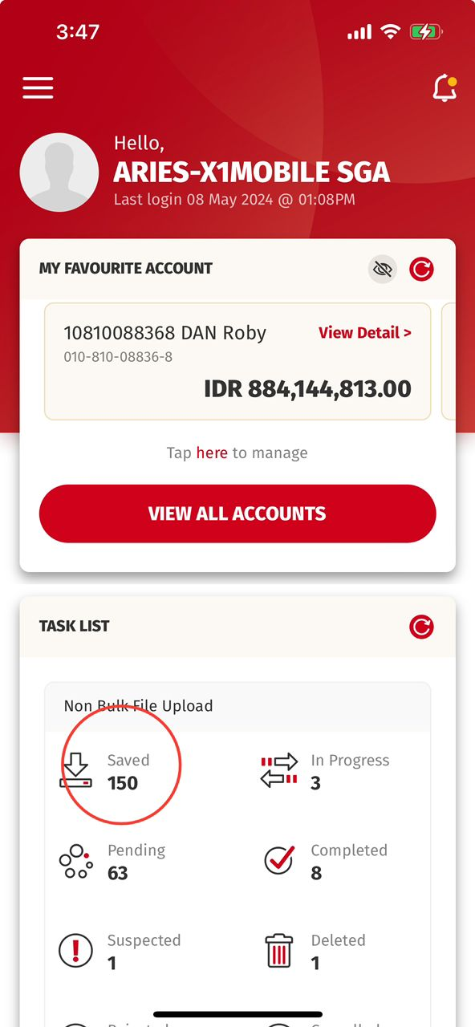
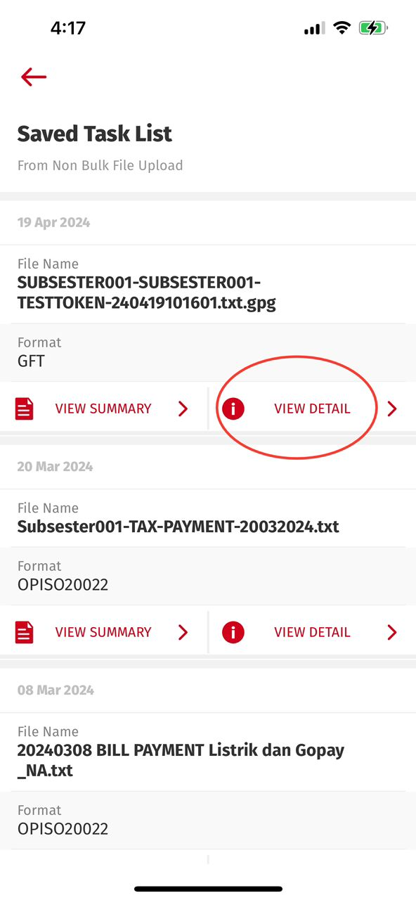
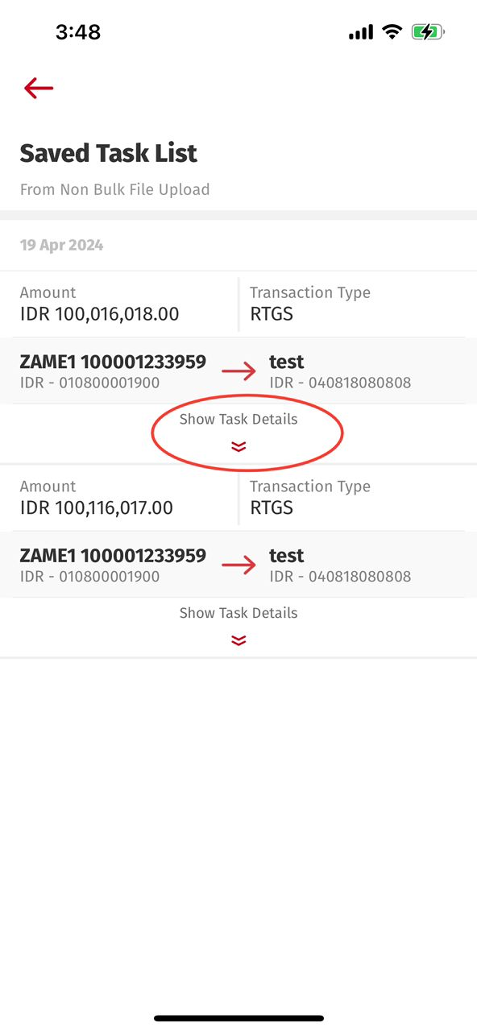
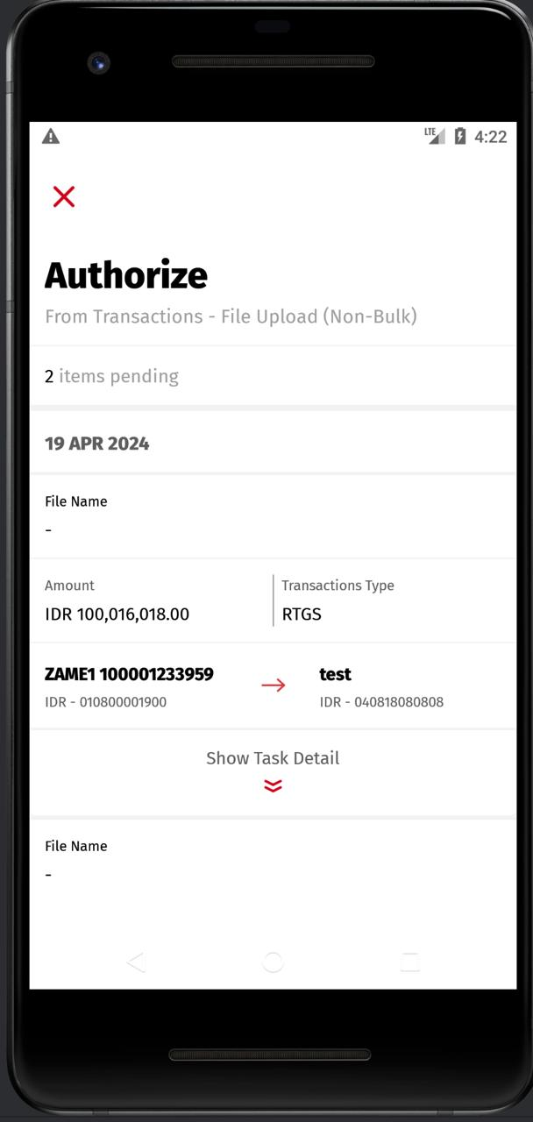
Inherited from Slide #2 – Screen differences between iOS & Android
1. Entry from Dashboard > Task List > Non Bulk File Upload > Saved > VIEW DETAIL
Android: RetrieveTaskTransaction
iOS: retrieveTaskTranx BE: task_list/list_trx
Android: RetrieveTransactionDataList
iOS: retrieveTransactionDataList BE: transaction/data_list
Format Field Mapping:-
Need to map with upload_format_desc
iOS:
Android:

Slide 7
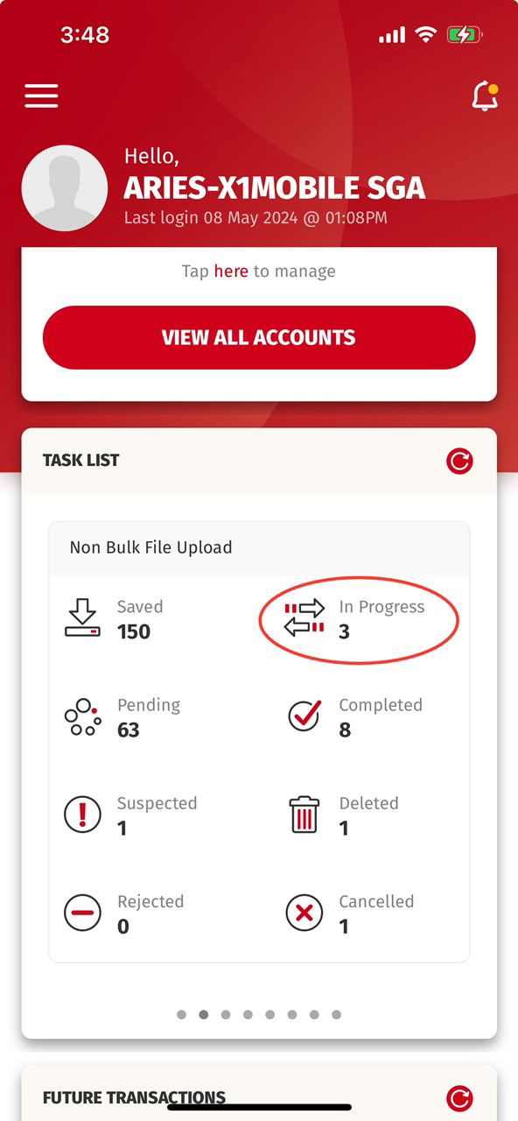
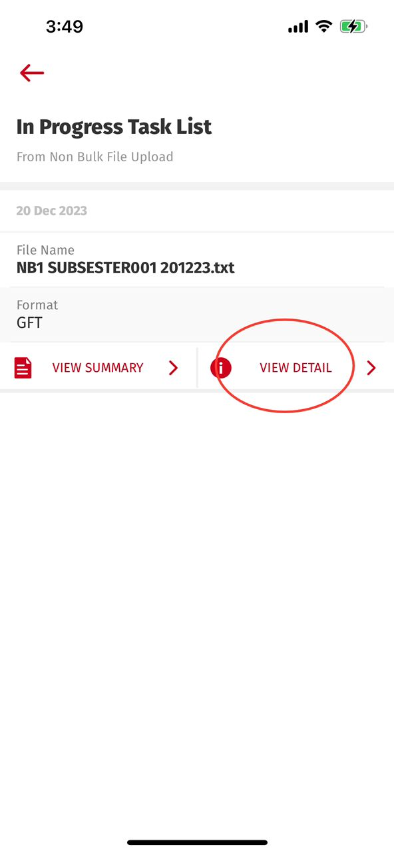
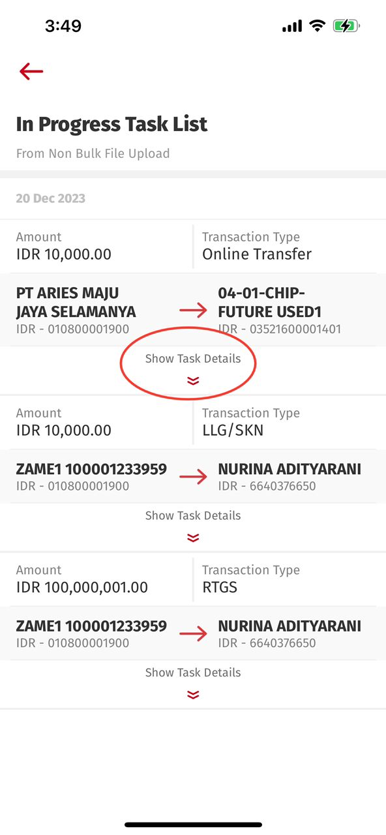
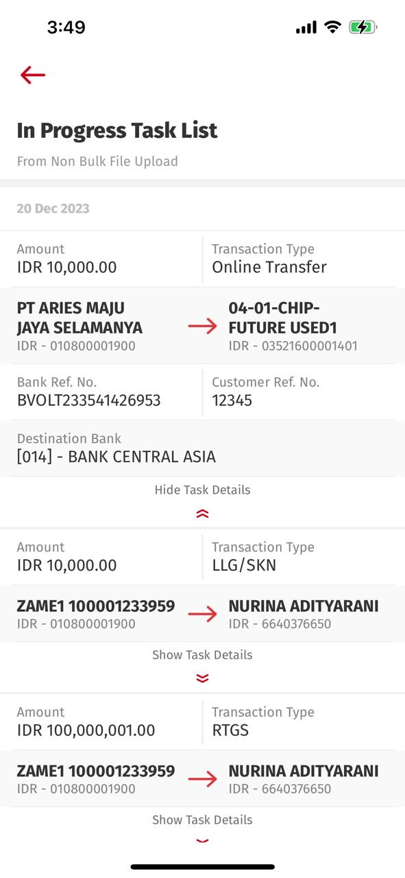
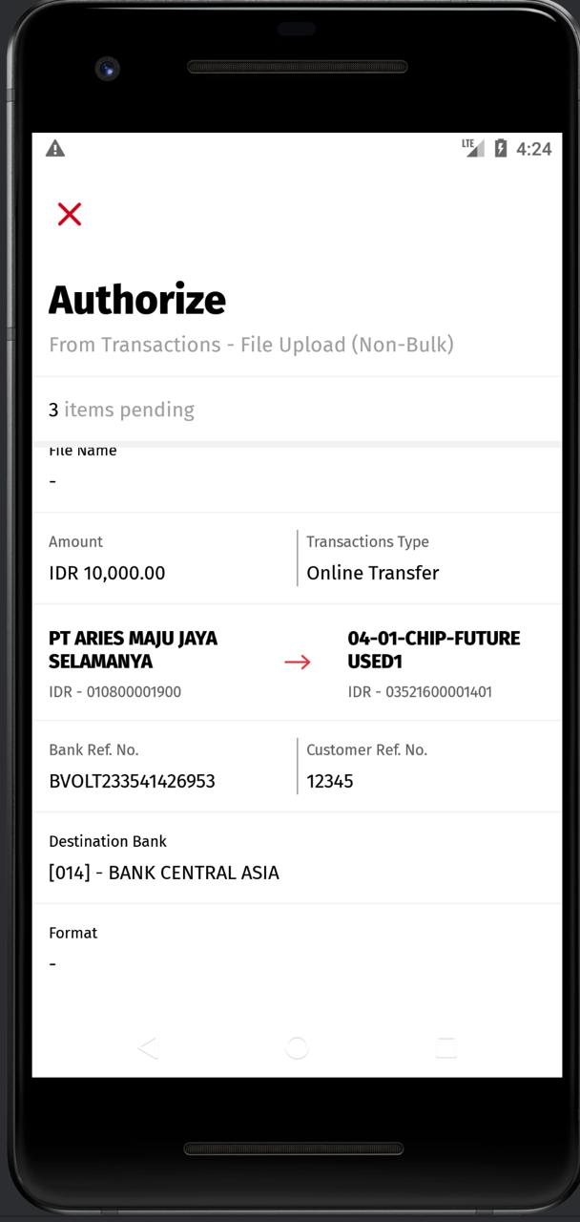
Inherited from Slide #2 – Screen differences between iOS & Android
2. Entry from Dashboard > Task List > Non Bulk File Upload > In Progress > VIEW DETAIL
Android: RetrieveTaskTransaction
iOS: retrieveTaskTranx BE: task_list/list_trx
Android: RetrieveTransactionDataList
iOS: retrieveTransactionDataList BE: transaction/data_list
Format Field Mapping:-
Need to map with upload_format_desc
iOS:
Android:

Slide 8
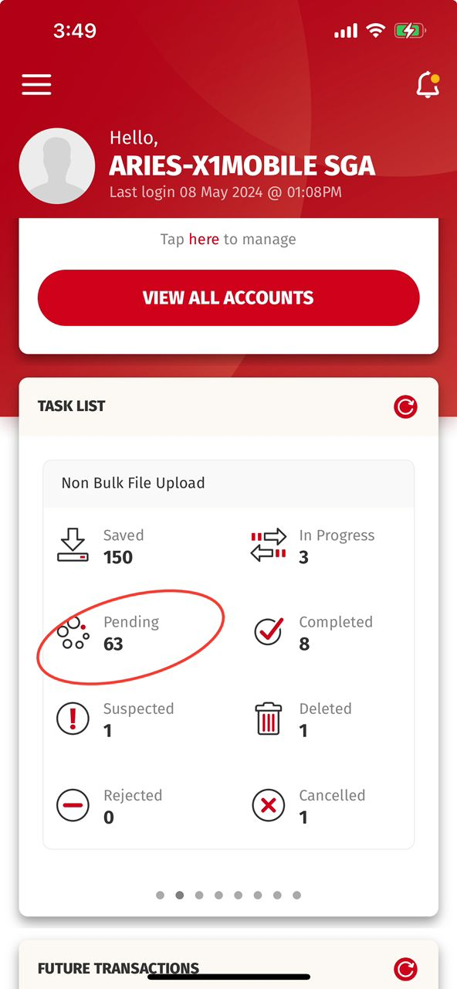
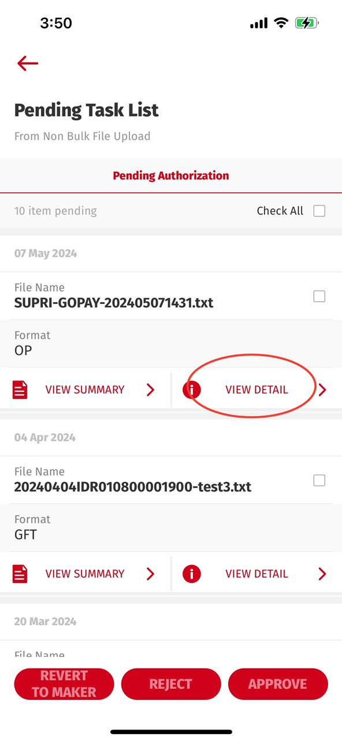
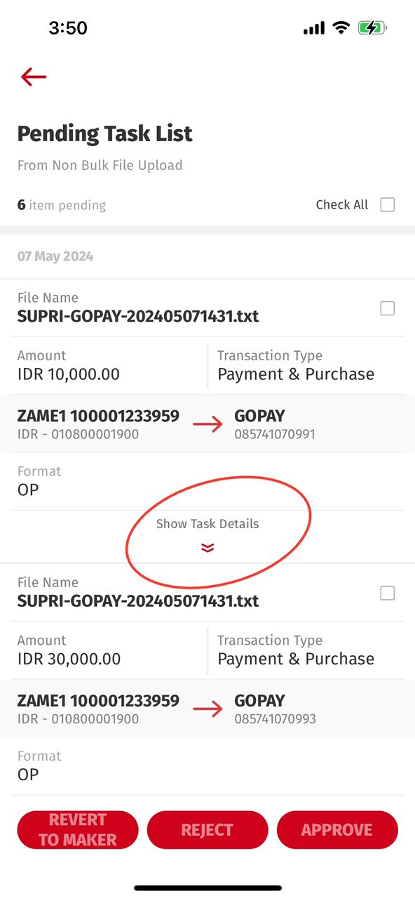
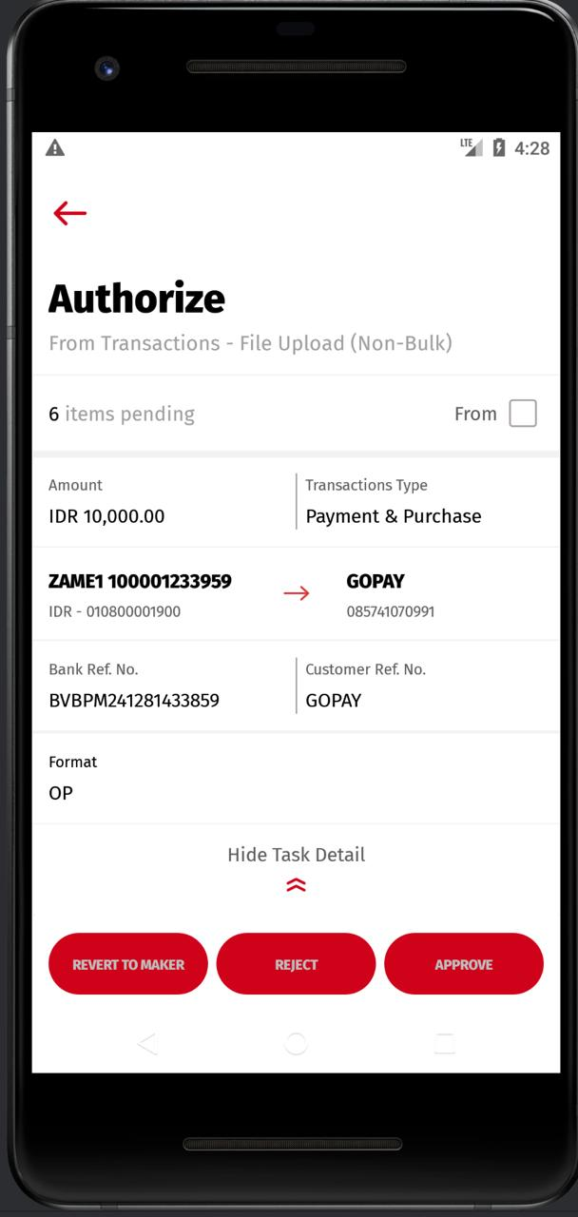
Inherited from Slide #2 – Screen differences between iOS & Android
3. Entry from Dashboard > Task List > Non Bulk File Upload > Pending > VIEW DETAIL
Android: RetrieveTaskTransaction
iOS: retrieveTaskTranx BE: task_list/list_trx
Android: RetrieveAuthorizeTransaction
iOS: retrieveAuthTransaction BE: authorization/list_pending_trx
To verify with iOS & Android > - what is the current mapping on 1st screen? > upload format or Format description?
[Prod] both mapped with upload_description
2. To verify with iOS & Android > - 2nd - Detail screen.
> Android has Format Field (Mapped with upload_format)
> iOS DOES NOT have Format Field.
UAT
Format Field Mapping:-
Need to map with upload_format_desc
iOS:
Android:
Production
Format Field Mapping:-
iOS:
Android:
UAT
Format Field Mapping:-
Need to map with upload_format_desc
iOS:
Android:
Differences for PENDING
View Detail screen: iOS & Android are the same.
Android may need to update the Header & Sub-Header Copywriting
Production - Format Field Mapping:-
iOS: upload_format/ upload_format_desc
Android: upload_format/ upload_format_desc
(Android will do checking on upload _format_desc if BE not returning the key upload_format)

Slide 9
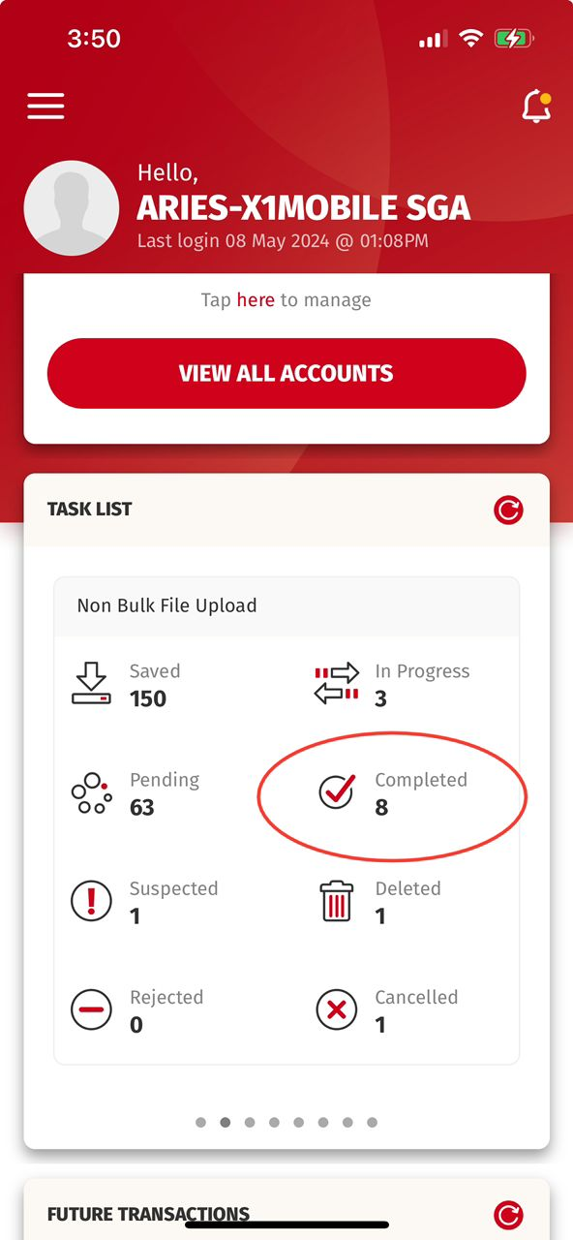
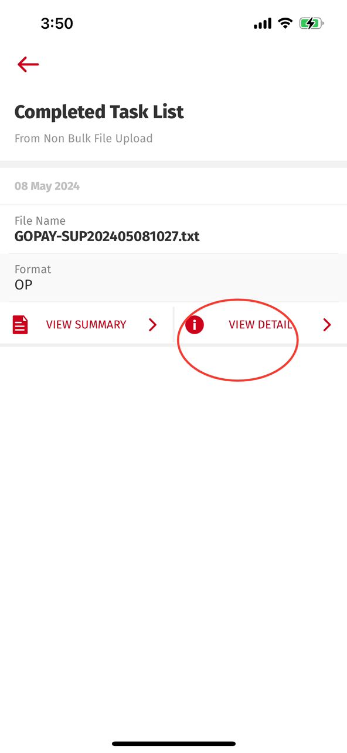
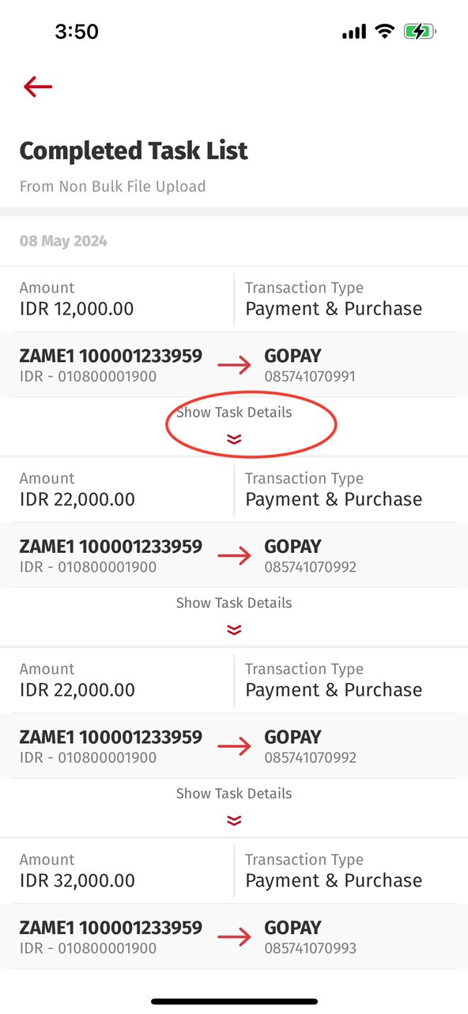
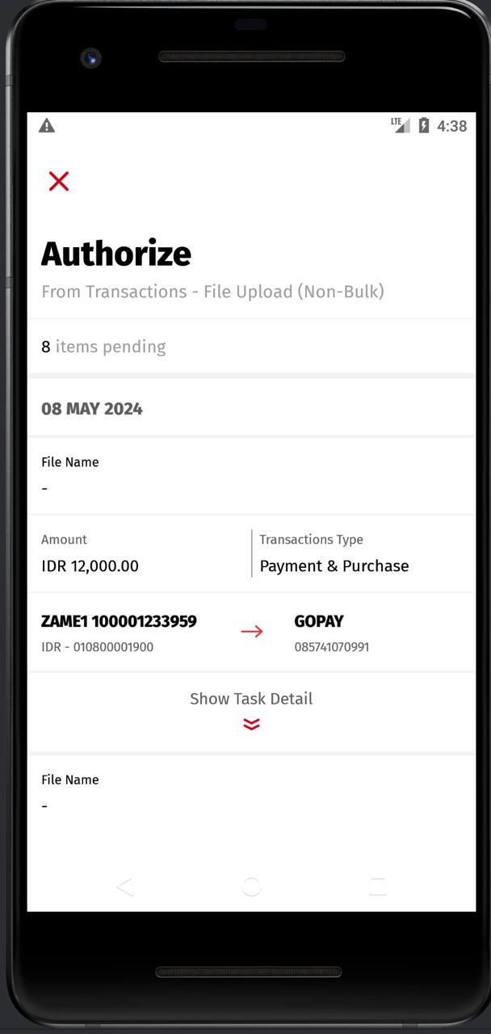
Inherited from Slide #2 – Screen differences between iOS & Android
4. Entry from Dashboard > Task List > Non Bulk File Upload > Completed > VIEW DETAIL
Android: RetrieveTaskTransaction
iOS: retrieveTaskTranx BE: task_list/list_trx
Android: RetrieveTransactionDataList
iOS: retrieveTransactionDataList BE: transaction/data_list
Format Field Mapping:-
Need to map with upload_format_desc
iOS:
Android:

Slide 10
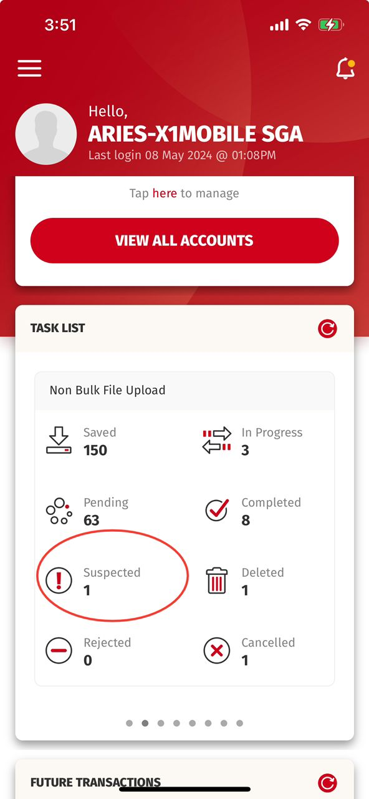
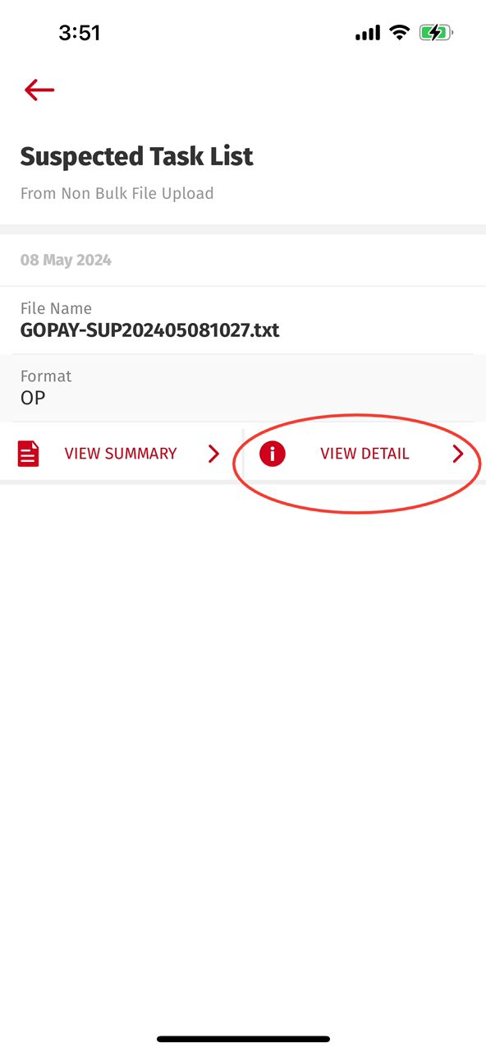
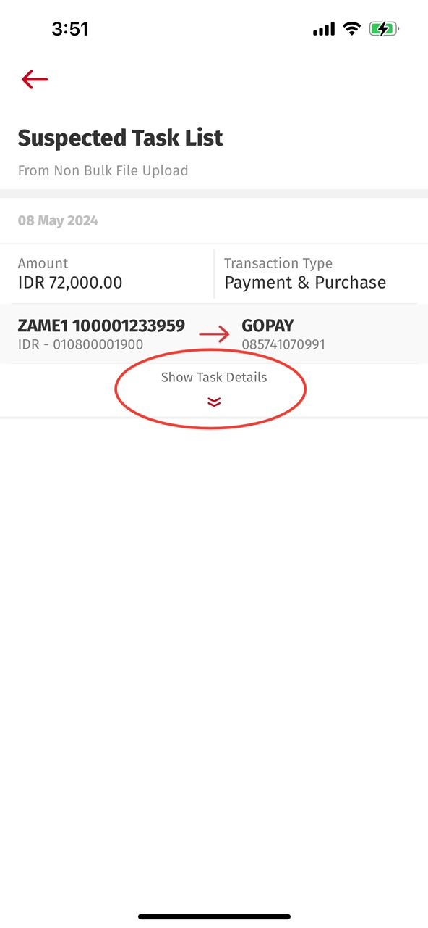
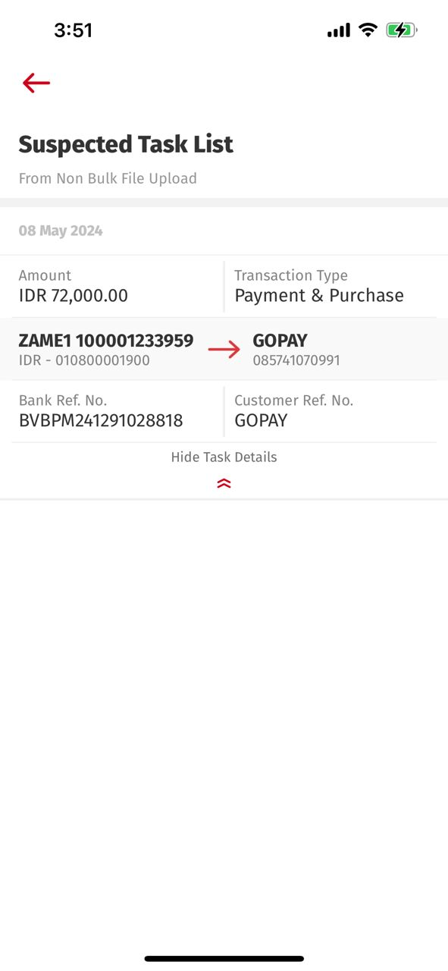
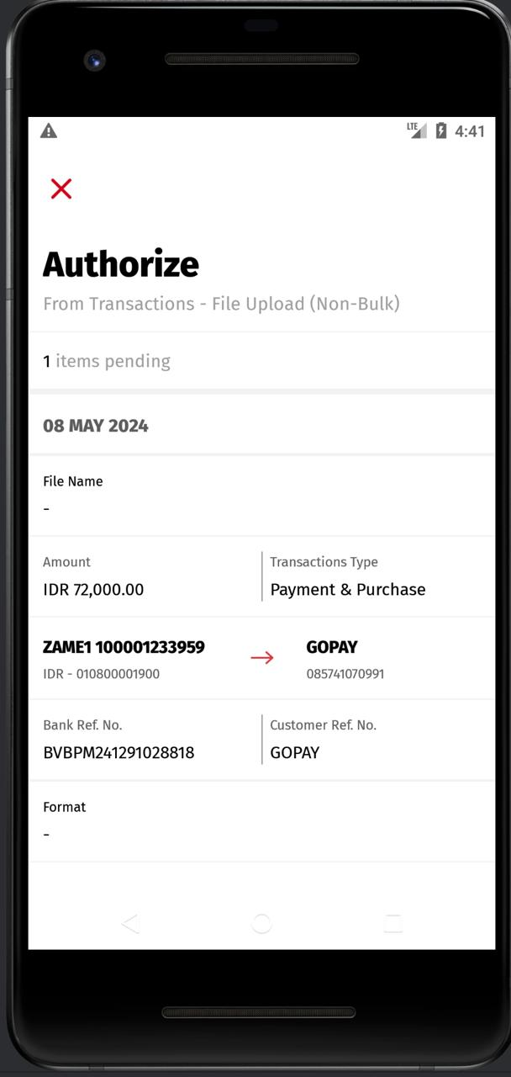
Inherited from Slide #2 – Screen differences between iOS & Android
5. Entry from Dashboard > Task List > Non Bulk File Upload > Suspected > VIEW DETAIL
Android: RetrieveTaskTransaction
iOS: retrieveTaskTranx BE: task_list/list_trx
Android: RetrieveTransactionDataList
iOS: retrieveTransactionDataList BE: transaction/data_list
Format Field Mapping:-
Need to map with upload_format_desc
iOS:
Android:

Slide 11
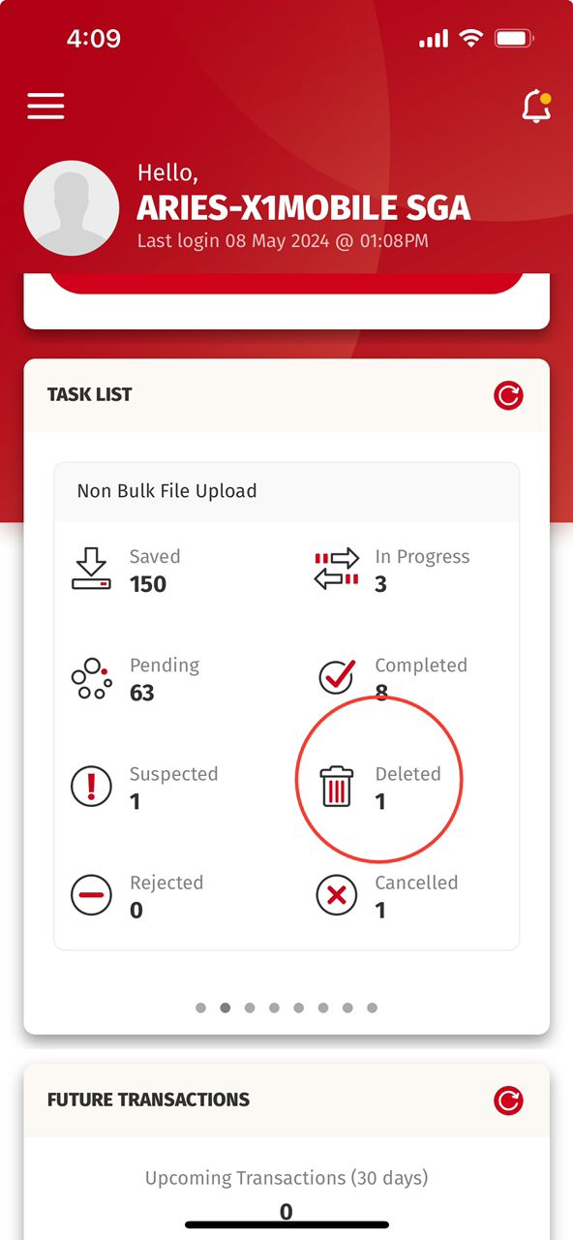
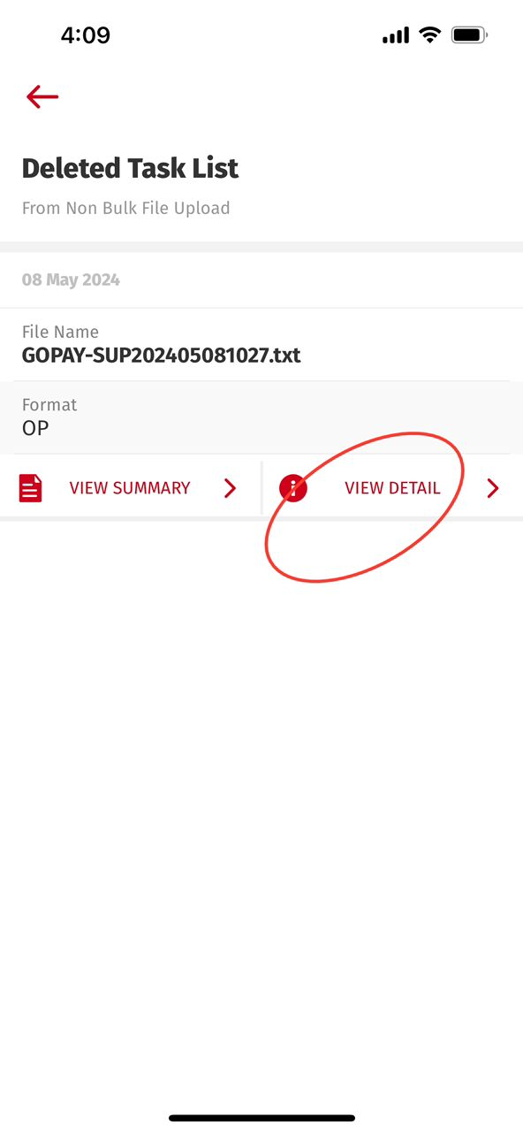
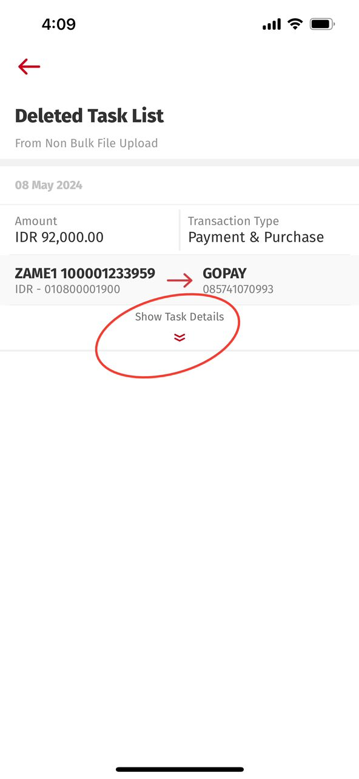
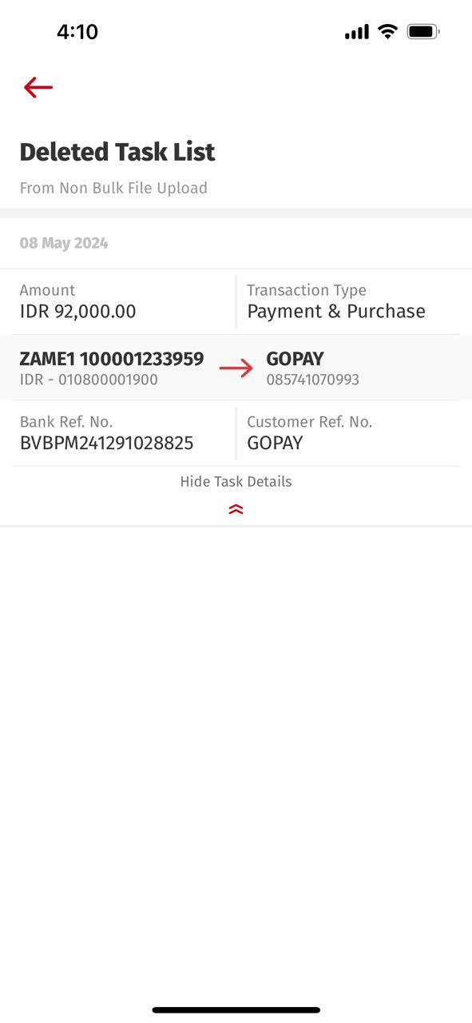
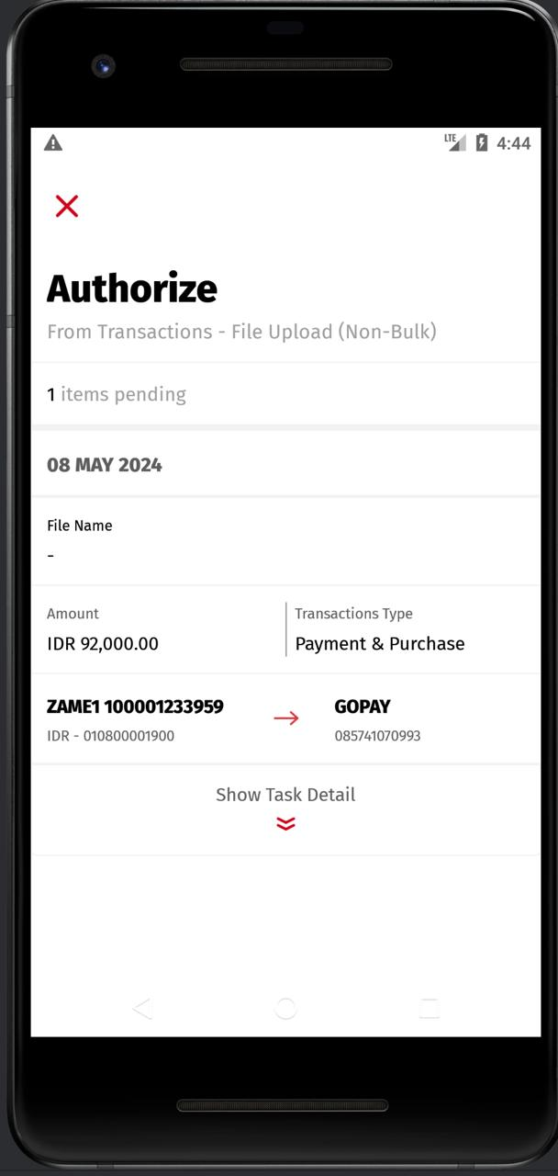
Inherited from Slide #2 – Screen differences between iOS & Android
6. Entry from Dashboard > Task List > Non Bulk File Upload > Deleted > VIEW DETAIL
Android: RetrieveTaskTransaction
iOS: retrieveTaskTranx BE: task_list/list_trx
Android: RetrieveTransactionDataList
iOS: retrieveTransactionDataList BE: transaction/data_list
Format Field Mapping:-
Need to map with upload_format_desc
iOS:
Android:

Slide 12
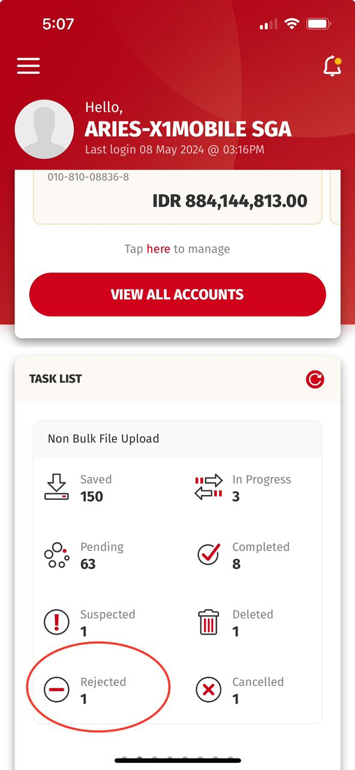
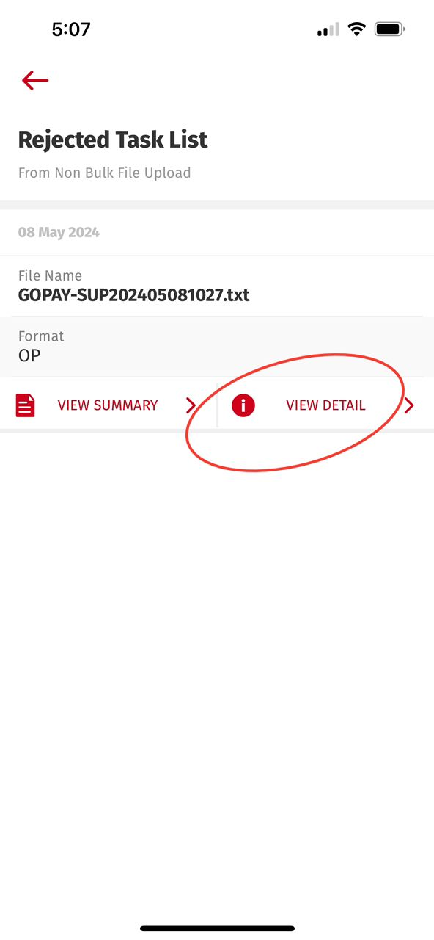
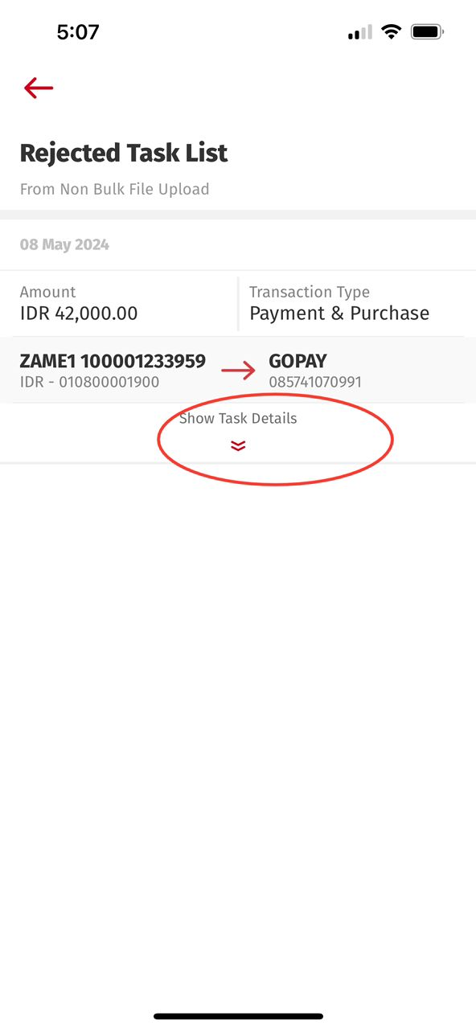
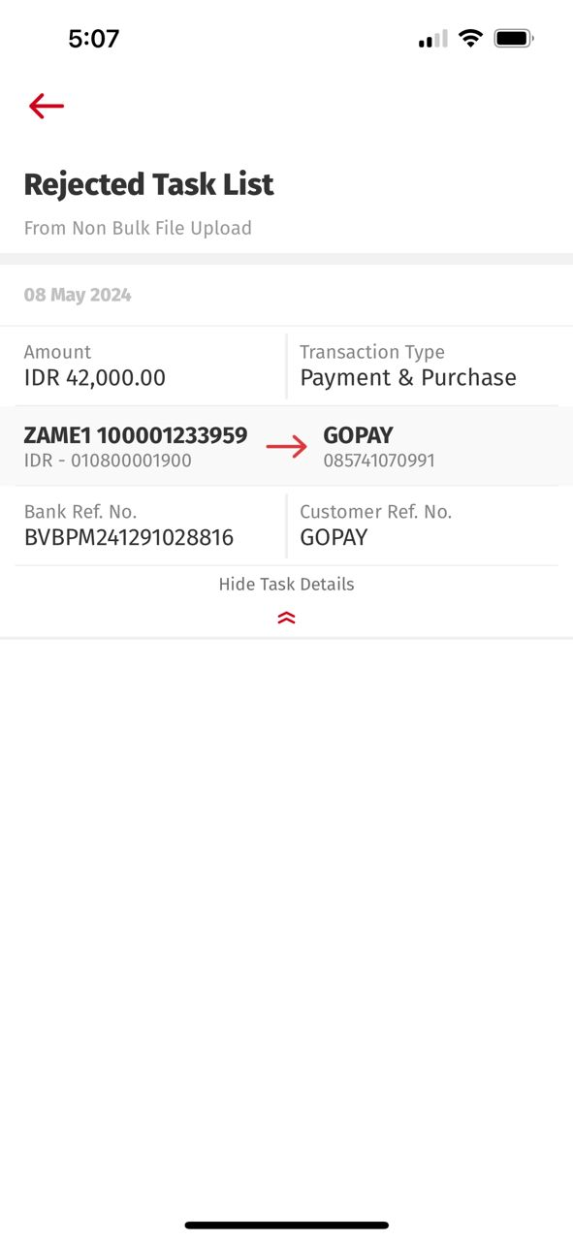
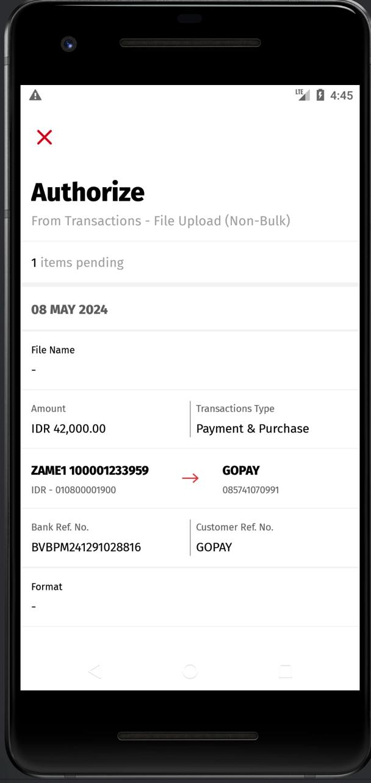
Inherited from Slide #2 – Screen differences between iOS & Android
7. Entry from Dashboard > Task List > Non Bulk File Upload > Rejected > VIEW DETAIL
Android: RetrieveTaskTransaction
iOS: retrieveTaskTranx BE: task_list/list_trx
Android: RetrieveTransactionDataList
iOS: retrieveTransactionDataList BE: transaction/data_list
Format Field Mapping:-
Need to map with upload_format_desc
iOS:
Android:

Slide 13
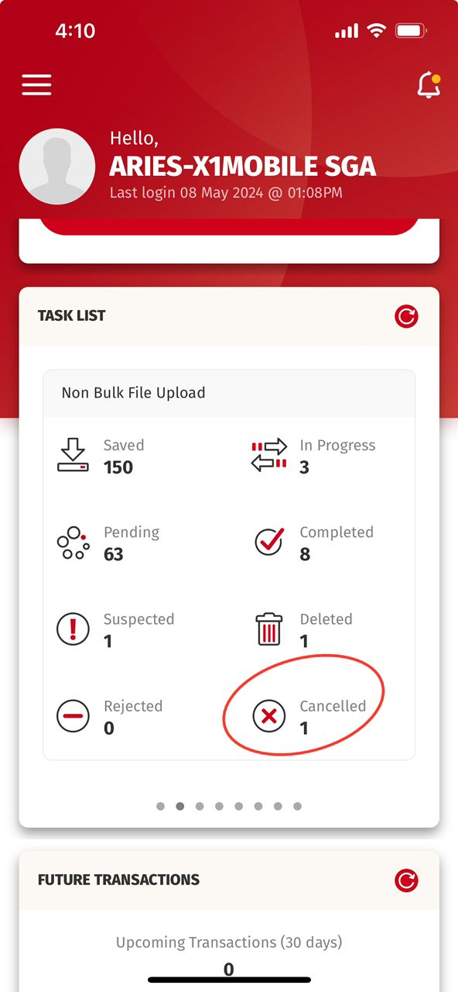
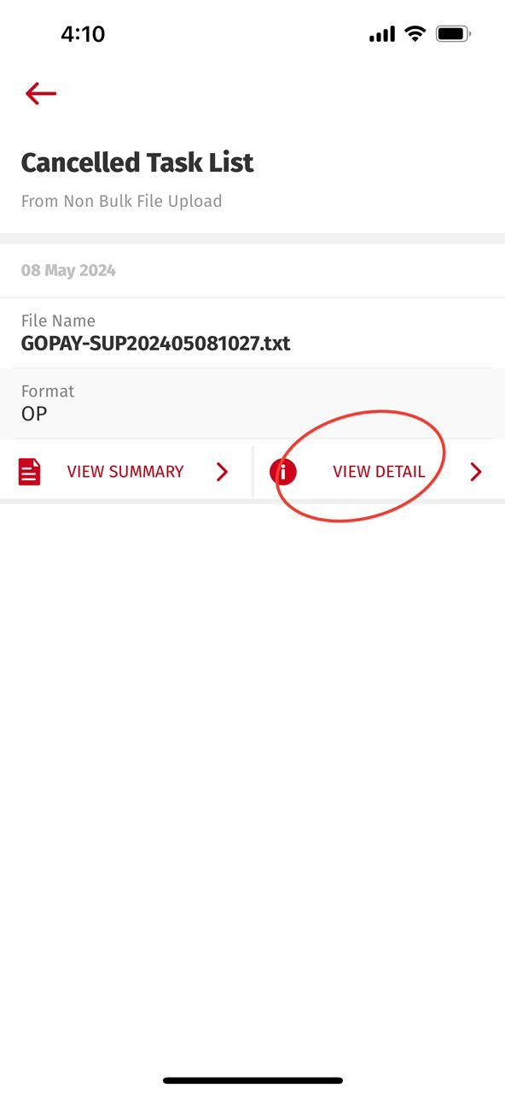
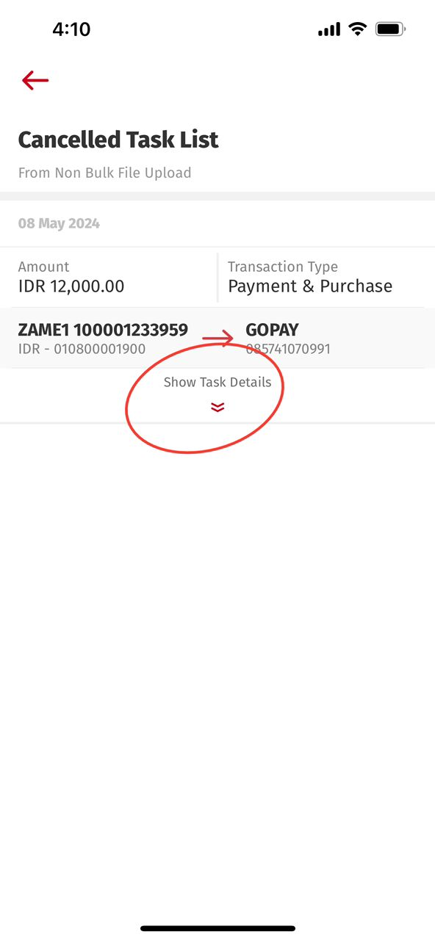
Inherited from Slide #2 – Screen differences between iOS & Android
8. Entry from Dashboard > Task List > Non Bulk File Upload > Cancelled > VIEW DETAIL
Android: RetrieveTaskTransaction
iOS: retrieveTaskTranx BE: task_list/list_trx
Android: RetrieveTransactionDataList
iOS: retrieveTransactionDataList BE: transaction/data_list
Format Field Mapping:-
Need to map with upload_format_desc
iOS:
Android:

Slide 14
Important:-
Question: Entry from Dashboard > Task List > Non Bulk File Upload > << Besides PENDING Icon >> > VIEW DETAIL
It seems like Android needs to adjust below
> Header (Copywriting) > Sub-header (Copywriting) > Items Pending Field (LINE) > remove File Name Field (LINE) > Remove Format Field If we fix for above, what will be the impact? - Functionality - Impact with other MODULE?
We also need to understand how Roles checking would affect the UI layout for Dashboard > Task List > each of the entry of the items such as
1. Saved 2. In Progress 3. Pending 4. Completed 5. Suspected 6. Deleted 7. Rejected 8. Cancelled Remark: need to understand the Role checking if there will impact the UI Layout.

