Slide 1
Retail Internet Banking
Top Up USMS Updated Acknowledgement screen

Slide 2
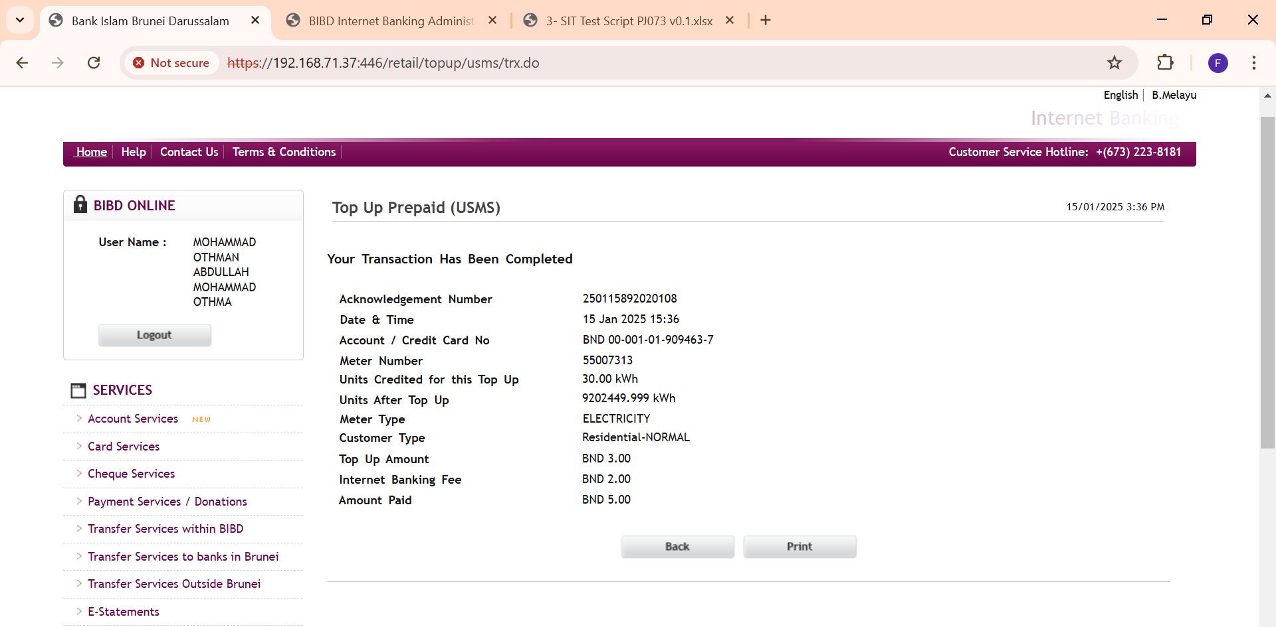
Replaced field name “Current Unit” with
“Units Credited for this Top Up” field
USMS tag: currentUnits
Added “Units After Top Up”
USMS tag: currentUnitsFull
Added “Customer Type” field
USMS tag: customerType

Slide 3
Mobile Internet Banking
Top Up USMS Updated Acknowledgement screen

Slide 4
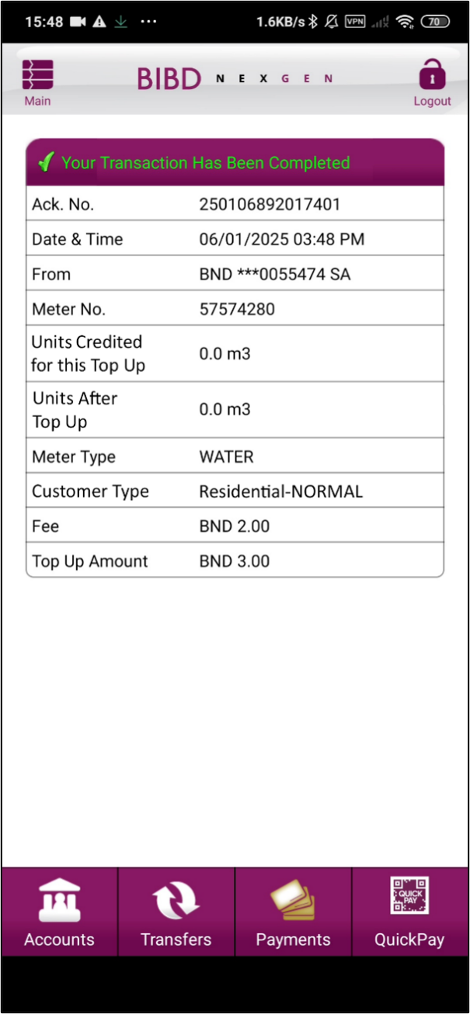
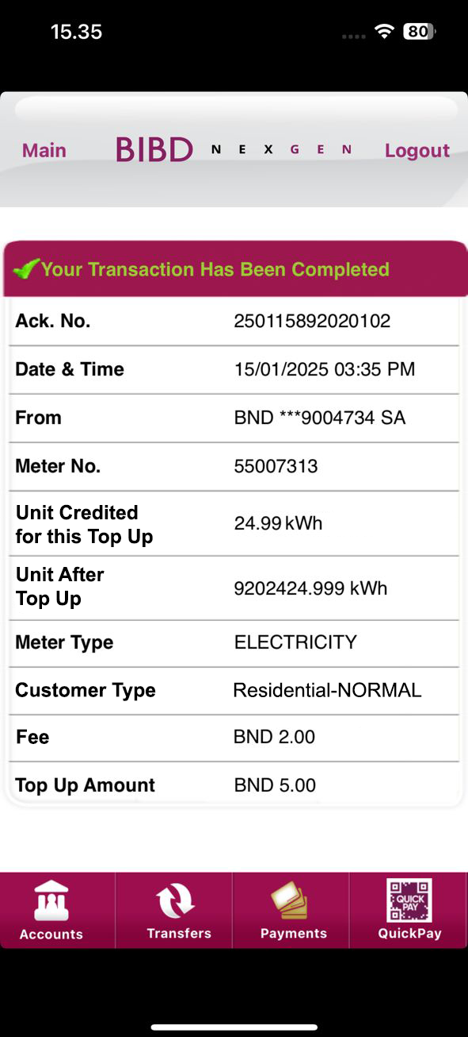
Android
iOS
Replaced field name “Current Unit” with
“Units Credited for this Top Up” field
BE tag:
Added “Units After Top Up”
BE tag:
Added “Customer Type” field
BE tag:

