Slide 1
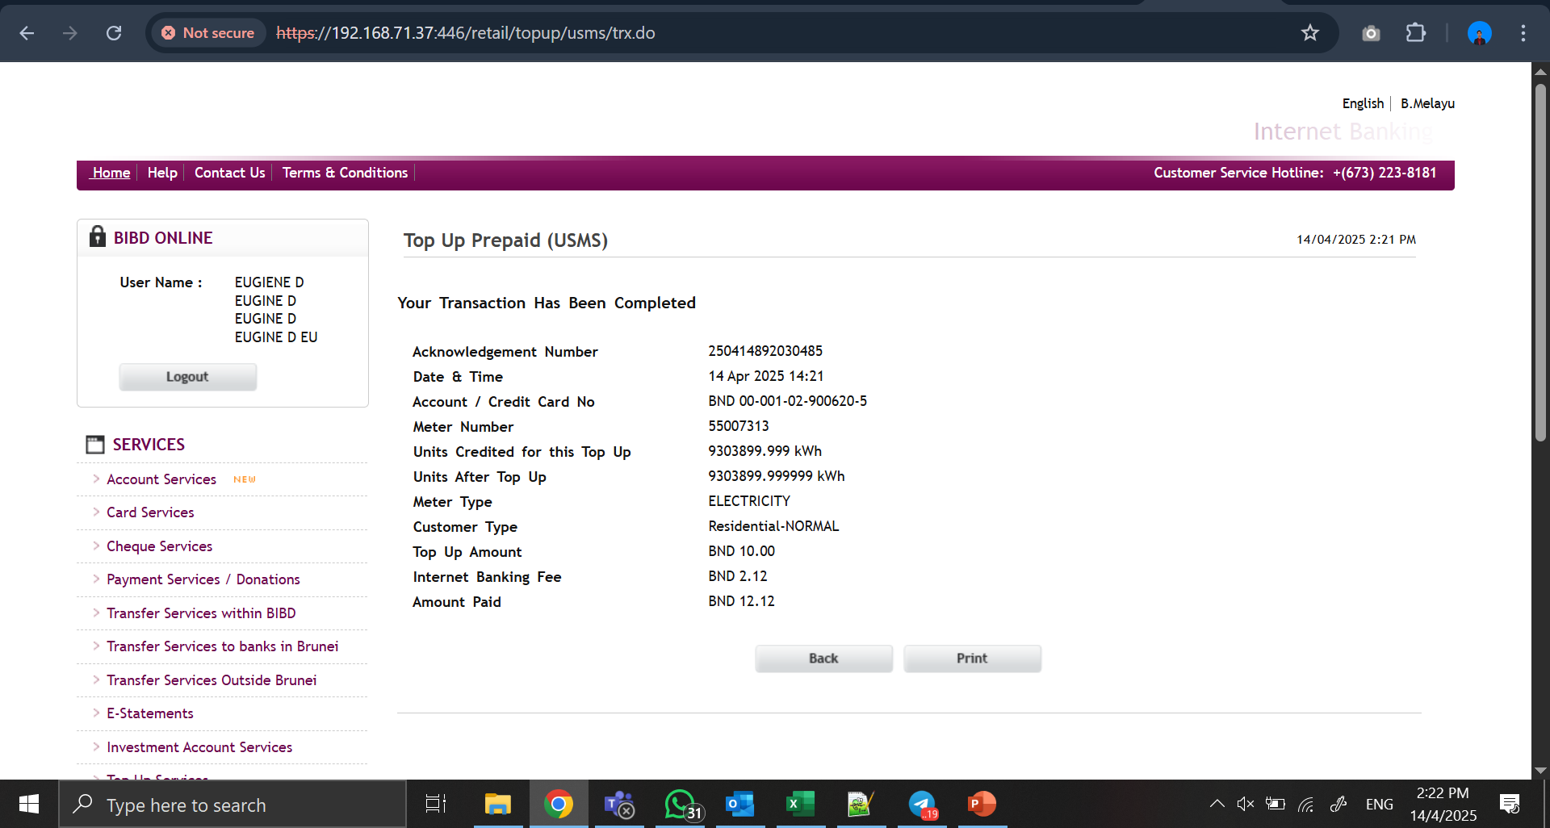

Slide 2
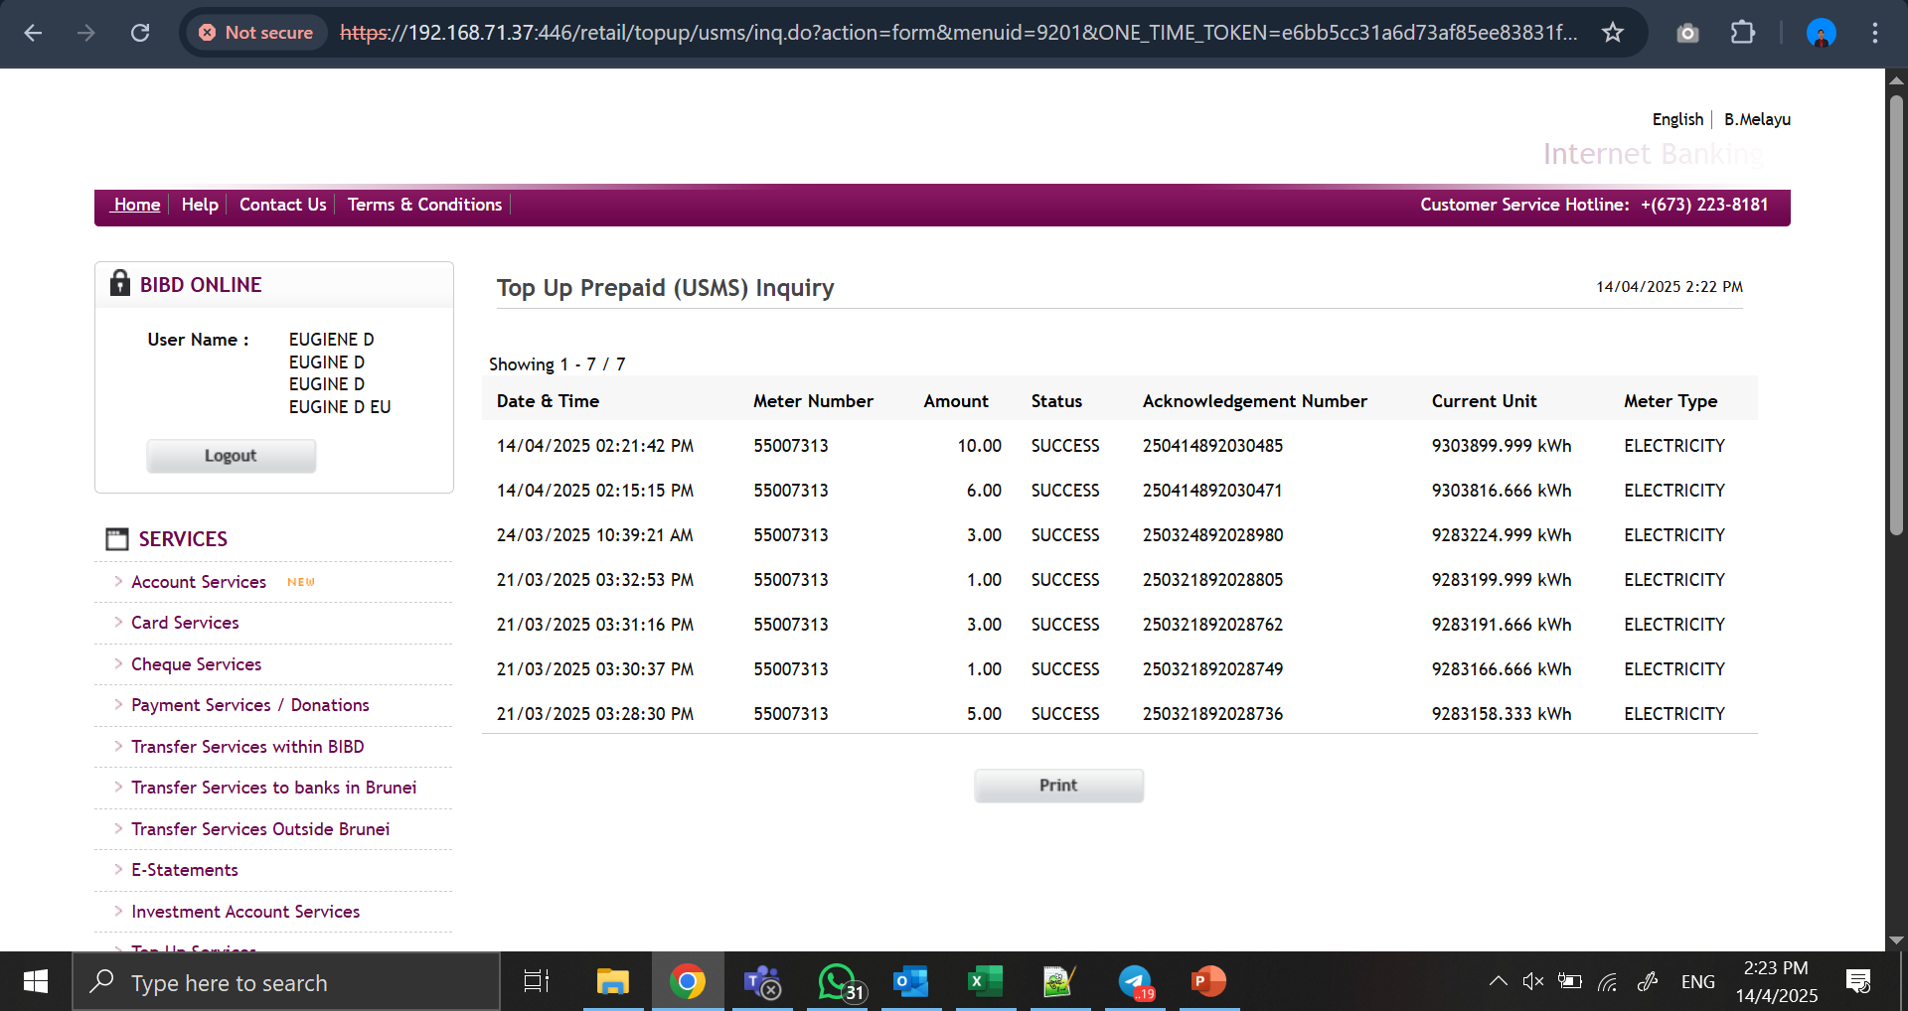

Slide 3
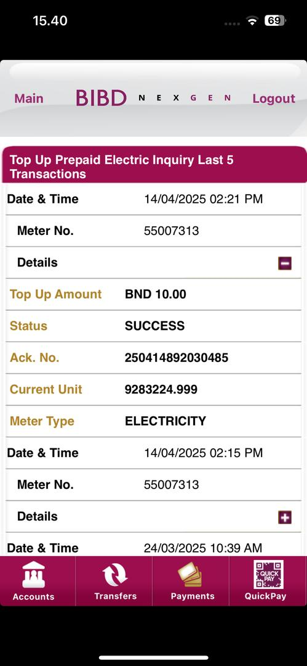
1. Title is should be “Top Up Prepaid USMS Inquiry” and
“Last 5 Transaction” in next line
2.Current Unit display without update
the latest unit

